Slide 1
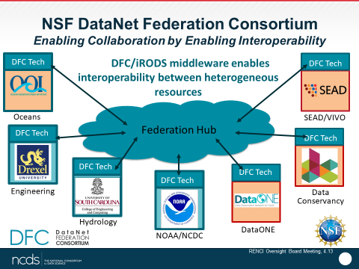
Cyber Training Workshop: High Level Expectations
Arcot (Raja) Rajasekar
Nirav Merchant

Slide 2
Project funded under Training-­‐based Workforce Development for Advanced Cyberinfrastructure (CyberTraining)
NSF 18-­‐516 (replaced NSF 17-­‐507)

Slide 3
Overarching Goals
Overarching Goal:
prepare, nurture and grow scientific research workforce
ensure broad adoption of CI tools, methods, and resources
integrate skills into educational curriculum/instructional material fabric in
advanced cyberinfrastructure (CI) +
computational and data science and engineering (CDS&E)
spanning undergraduate and graduate courses.
Innovative, scalable training and education programs addressing
Emerging needs and Unresolved bottlenecks
Multidisciplinary communities
Undergrads, grad students, instructors, faculty, research CI professionals

Slide 4
Short Term Impacts
Innovative, scalable training/educational activities while challenging PI’s for
preparing a better scientific workforce for advanced CI;
broadening adoption and accessibility of shared computing and data resources by various disciplines, institutions, and groups;
developing or updating curriculum/instructional material to feed into undergraduate and graduate courses;
creating alliances and backbones for collective impact;
providing on-­‐demand, personalized accessibility;
exploring innovative ways of drawing students into computational disciplines (X+Computing and Computing+X);
leveraging and contributing to NSF cyberinfrastructure and research projects (such as XSEDE, NanoHub, LIGO, and NHERI).

Slide 5
Long Term Impacts
Training/Education a vehicle for achieving long term goals while meeting short term objectives
Long term sustainability and scalability: The programs will
Lead to an educational cyberinfrastructure ecosystem enabling “Computational and Data Science for All scientists and engineers”
Re-­‐envisioning the advanced CI ecosystem as integral element of scientific research enterprise
Establish deeper engagement with and impact on various disciplines, institutions, and groups
Result in an ubiquitous and scalable educational cloud infrastructure

Slide 6
Cyber Deluge:
Scientific Data Explosion & Role of Data Science
S
Emergence of Big Data
High Volume and High Velocity
Fast Connectivity Intra/Inter Networks
Commodity Clusters
Peta-scale Storage
Massive Parallelism Paradigms
Hadoop, Spark, Storm
Data-intensive Algorithms
Deep Mining, NoSQL, Map-Reduce
Ease of Publication & Discovery
Open Source Tools and Platforms
Collaborative Science
Multi-disciplinary
Distributed Teams
Analytics
Interaction
Big Data
Discovery
Infrastructure
Cloud/HPC
Computing
(JetStream/Atmosphere)
Discovery
(iCAT,DataVerse)
Elastic Collaboration
(DFC, CyVerse)
Federated Data
(iRODS, DE)
Science Portals

Slide 7

Problems with Cyber Deluge
Necessitate addressing the needs of domain scientists from multiple angles:
Data Access
Metadata Management
Large-scale Data-intensive Analytics and Workflows
Data and Application Discovery
Data Sharing
Data Preservation
Distributed Computing & Storage
Collaboration & Coordination
Train Scientists and Researchers with a holistic perspective

Slide 8
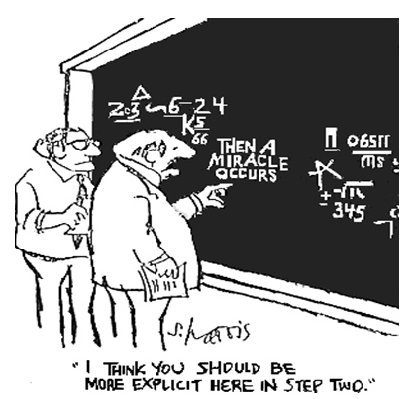
Cyber Training Workshop
Aim of the Workshop:
Help Scientists to do better Science
Learn multiple aspects of data-intensive computing environment
Learn end-to-end data management
Learn to work together with other researchers with complementary expertise
With the ultimate goal to:
Help Reproducible Science
Help Reuse of Data
Help Repurpose Data and Tools beyond original intent

Slide 9

What to Expect
At the End of Two Weeks
Know more about how to deal with large-scale data
Get introduced to high performance computational platforms
How to perform reproducible data-intensive computing
How to preserve & present data across time, distance and domains
How to perform small-scale to large-scale analytics
How to use commodity hardware and open source platforms
How to collaborate and coordinate in a team
Work together in some large-scale collaborative projects
Make new friends

