Slide 1
RNN Encoder-decoder Architecture
William Hu

Slide 2
Sequence to Sequence Problem
Sequence prediction - given a sequence of values, predicting the next value in the sequence or classify this sequence into some types of categories.

Slide 3
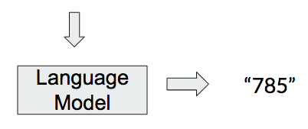
Sequence to Sequence Problem
“My name is CMU deep learning 11- ”

Slide 4

Sequence to Sequence
“Bhiksha en Inde en décembre dernier” =====> “Bhiksha visit India last December”
“My heart is in the work”

Slide 5
Sequence to Sequence Problem
Variable length to variable length
The order of the input sequence is not necessarily the same as the order of the output sequence.
“This course’s workload seems to be very low this semester”
“本学期这门课程的工作量似乎非常低”

Slide 6
Encoder-Decoder Architecture
First introduced in the field of Statistical Machine Translation in 2014 [1].
It has became the state of art language model ever since then.
It can be applied to many fields, we are interested using it as a language model, together with RNN.
Learning languages both semantically and syntactically.

Slide 7
RNN-Encoder-decoder Structure
Encoder
The model will consist of two RNNs - encoder and decoder.
Encoder maps the variable length sequence to fixed length vector representation.
Embeddings
Dncoder
Outputs

Slide 8
RNN-Encoder-decoder Structure
Encoder
Decoder maps the fixed length vector representation back to a variable length target sequence.
Two networks are trained jointly to maximize the joint probability of the target sequence given a source sequence[1].
Embeddings
Decoder
Outputs

Slide 9
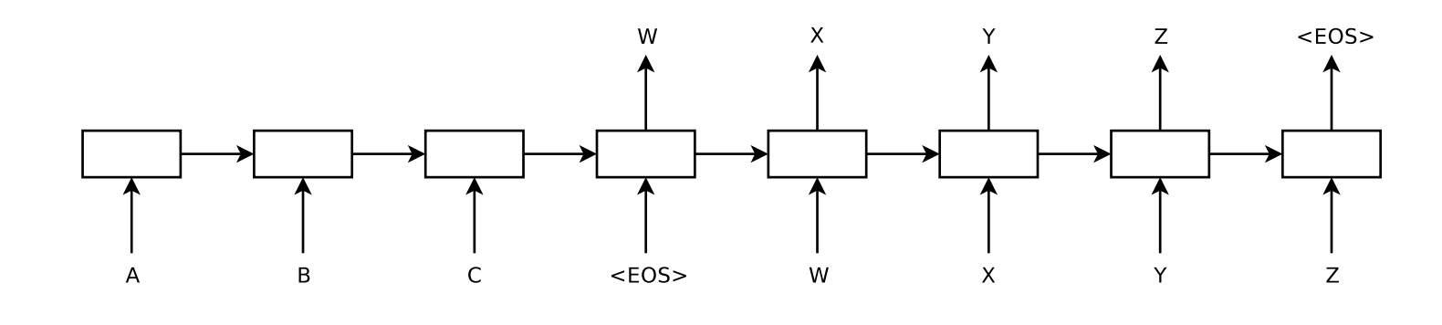
RNN Encoder-decoder Model

Slide 10
RNN Encoder-decoder Model
Input sequence feeds in at each time step.
The embedding is generated for each time step.
The embedding is feeding into decoder to generate target sequence step by step.
p(y1,...,yT | x1,...,xT), conditional probability.

Slide 11
RNN Encoder-decoder Model
Attention’s usage in the encoder-decoder model.
This is a architecture, not a model. Transfomer, Bert Model are all encoder-decoder models without touching RNN.
Transformer as purely linear network to process language.

Slide 12
