Slide 1
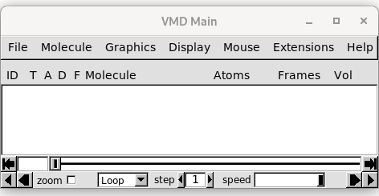
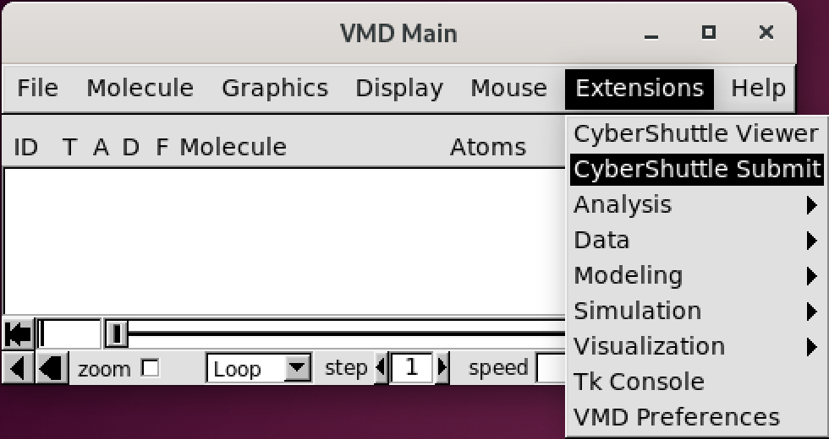
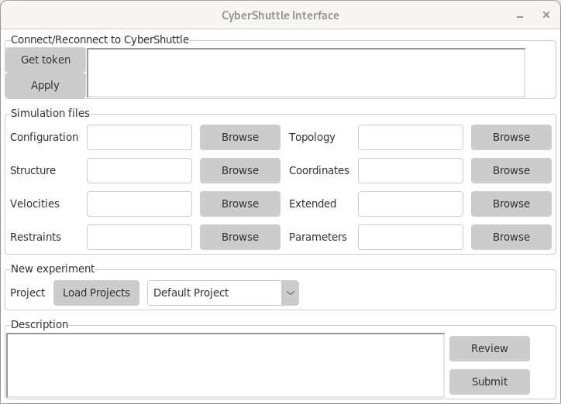
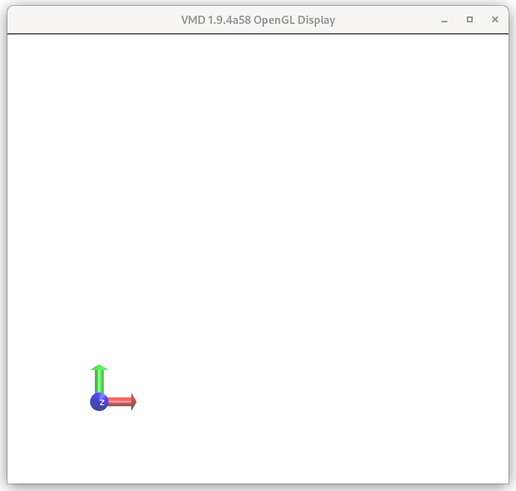
Launch Plugin
1
Get token
2

Slide 2
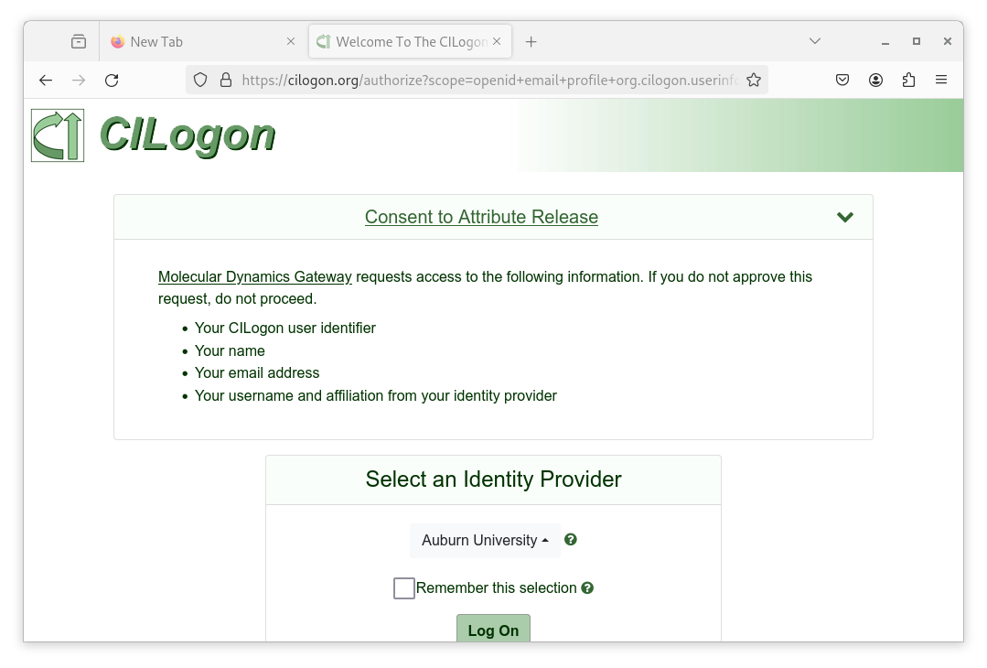
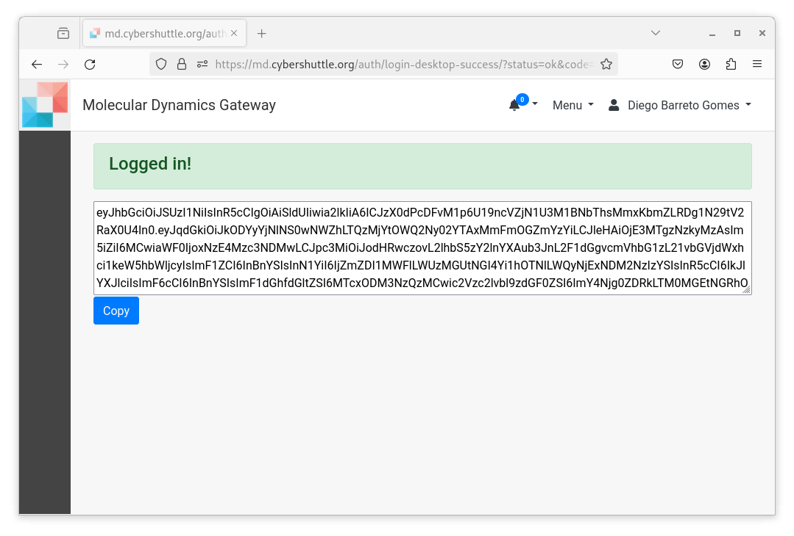
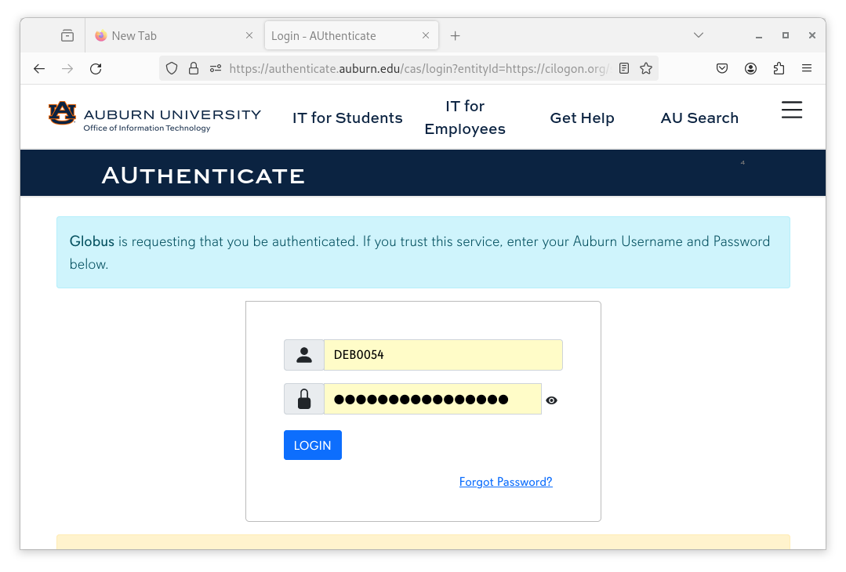
Select ID provider
1
Copy Token
3
Login
2

Slide 3
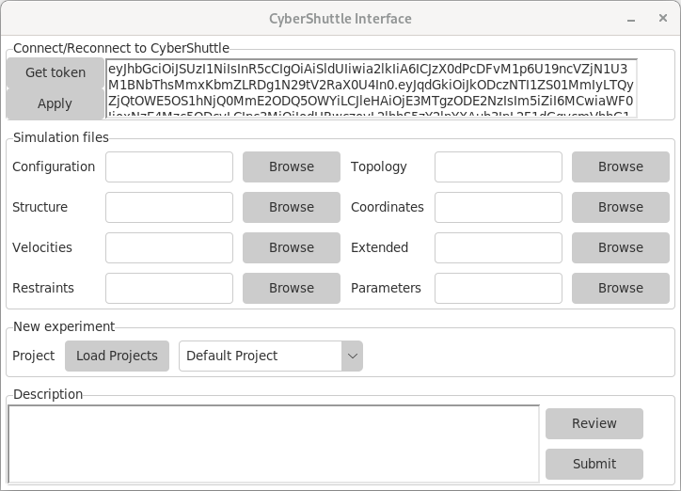
Paste token & Apply
1

Slide 4

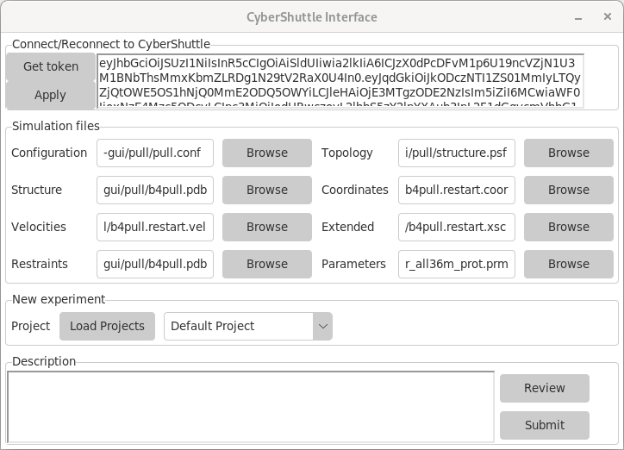
namd.conf file will auto complete in the future
2
Browse for files

Slide 5
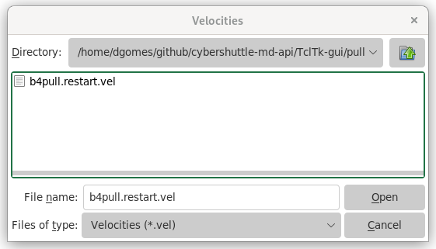
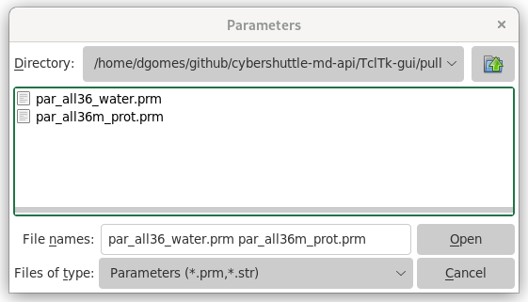

Slide 6
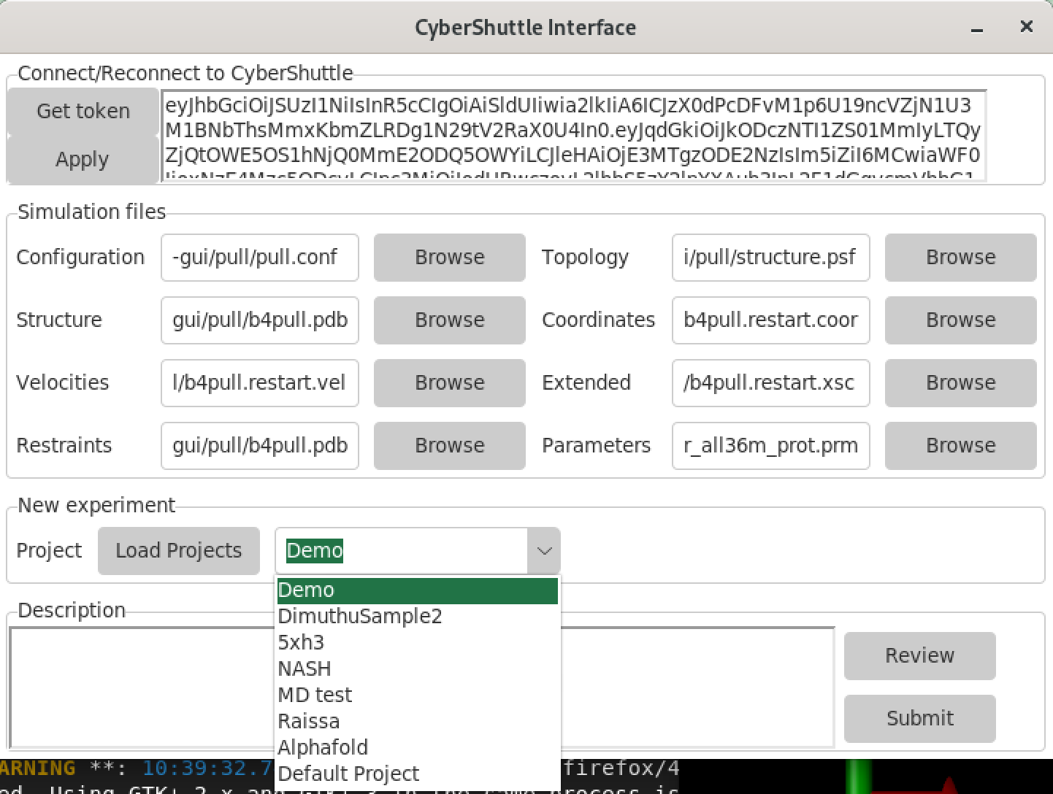
3
Pick a Project
4
Review & Submit

Slide 7
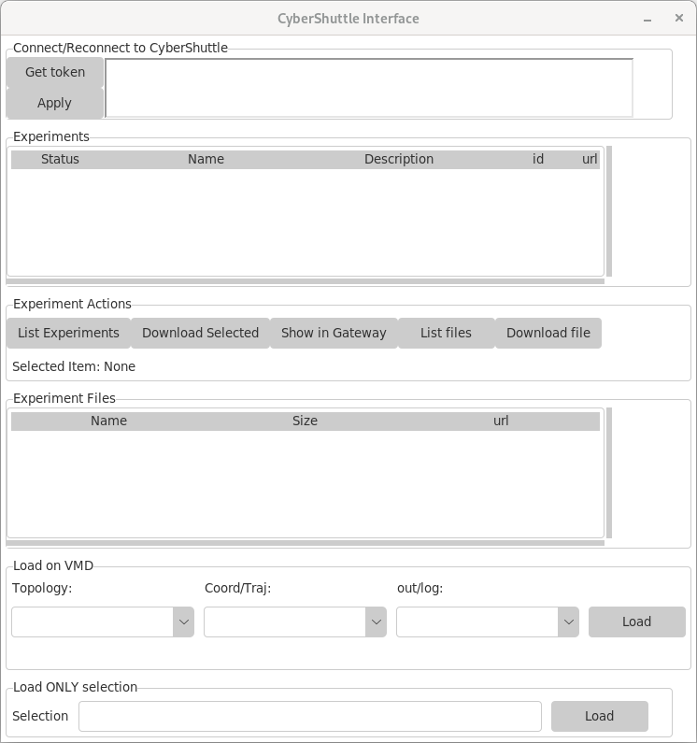

Slide 8
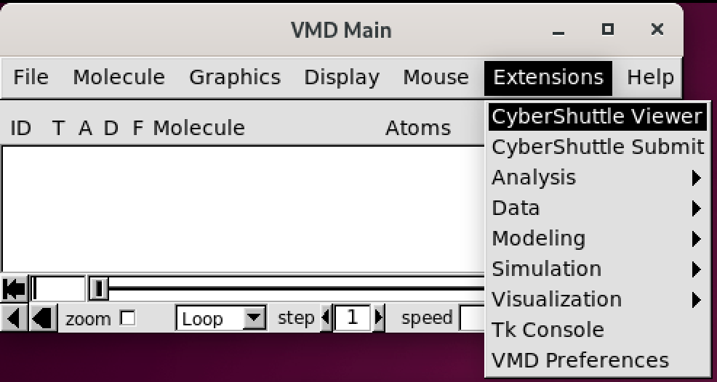
2
1

Slide 9
Select ID provider
1
Copy Token
3
Login
2

Slide 11
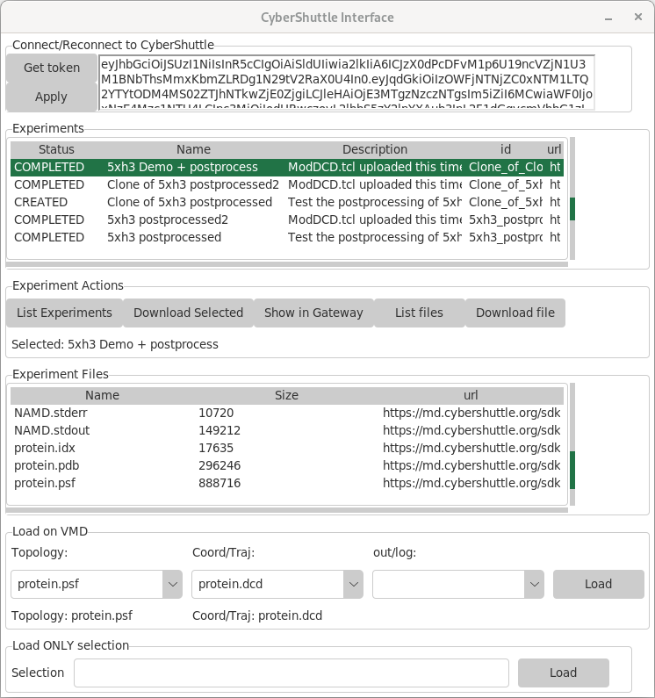
Paste token & Apply
1

Slide 12
2
List experiments

Slide 13
List Files
3

Slide 14
4
Pick a Topology, a Trajectory, and Load

Slide 15
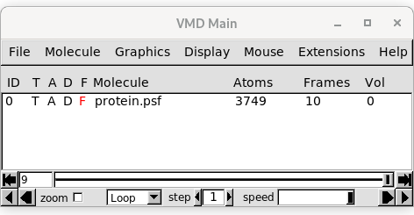
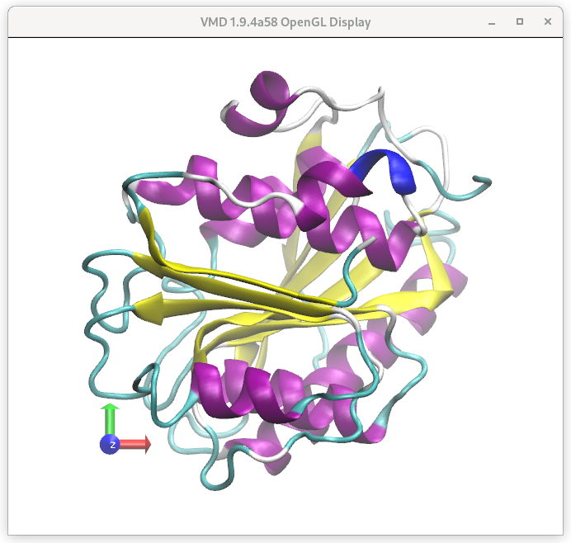
5
VMD will show as “pretty”

Slide 16
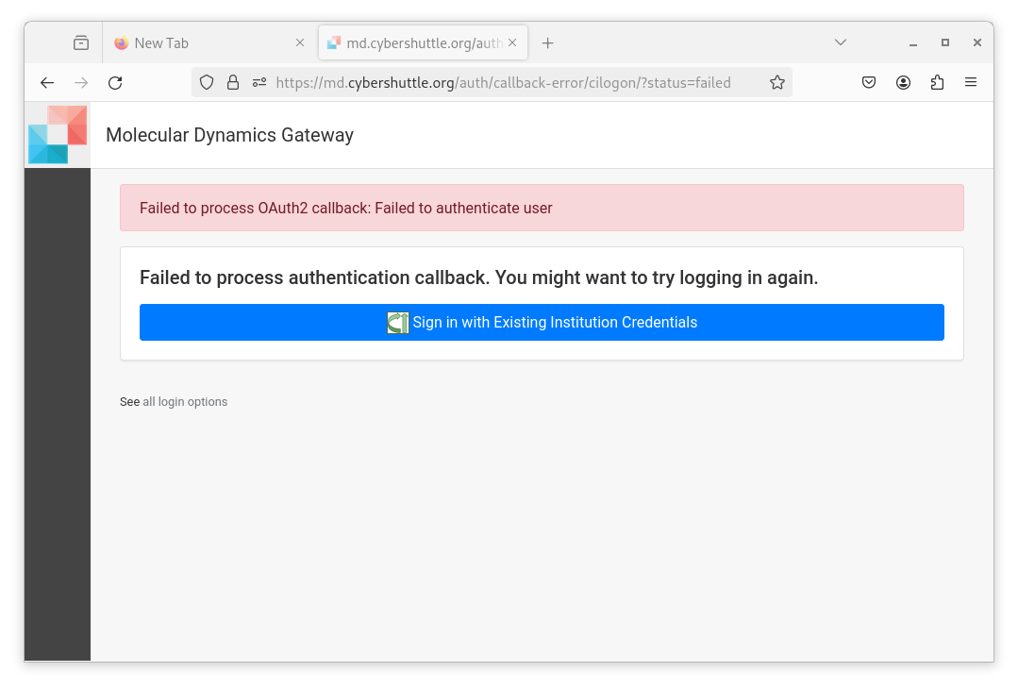
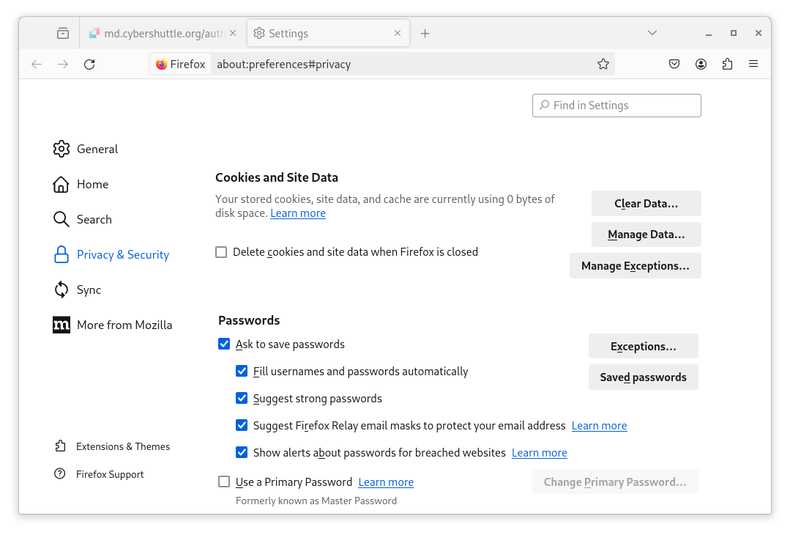
Troubleshooting…
Clear Cache & Cookies

