Slide 1

Dyanmics API
Azure & Power Platform Configuration for daemon apps

Slide 2
Purpose
The purpose of this document is to illustrate what is required to allow a daemon app to access Dynamics API.
Accessing Dynamics API is necessary in order to facilitate automation involved in fetching files/records throughout a 365 tenant based on projects that meet certain criteria.

Slide 3
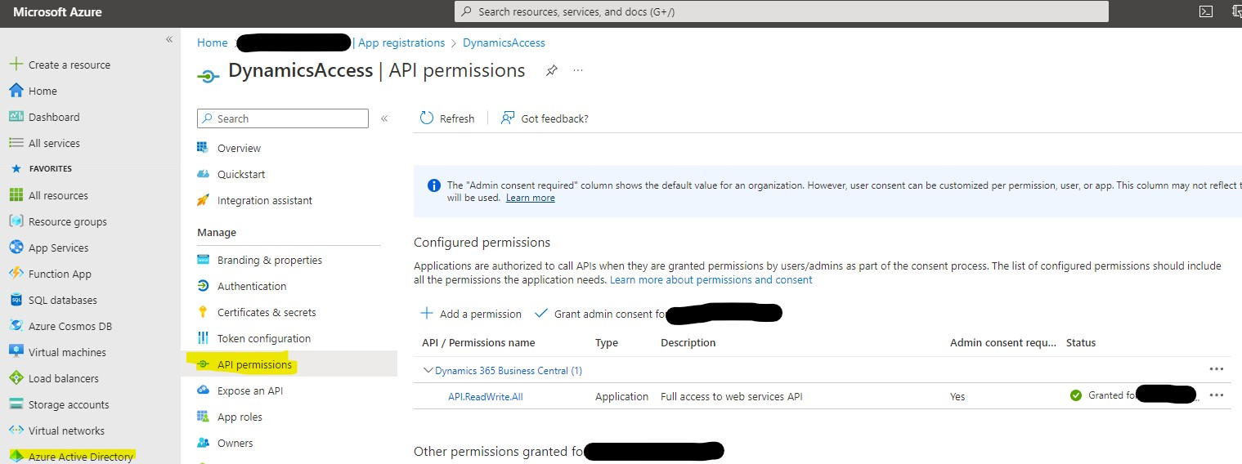
Azure App Registration
In Azure portal, create new app registration via AAD. Access App then app API permission. Add a permission (i.e., API) & grant admin consent for your org for that api/permission:

Slide 4
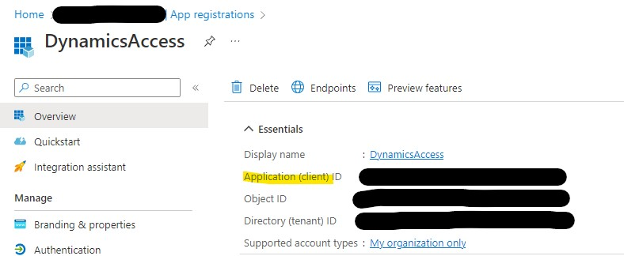
App Attributes
Retreive attributes from the App Overview blade

Slide 5
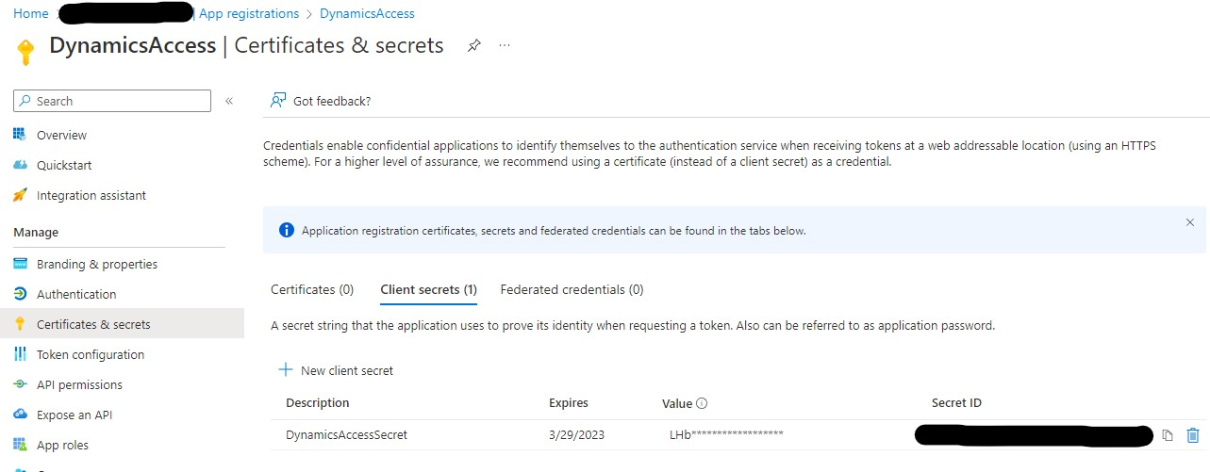
Client Secret
Create new client secret. Document client secret value immediately; it will not be accessible later.

Slide 6
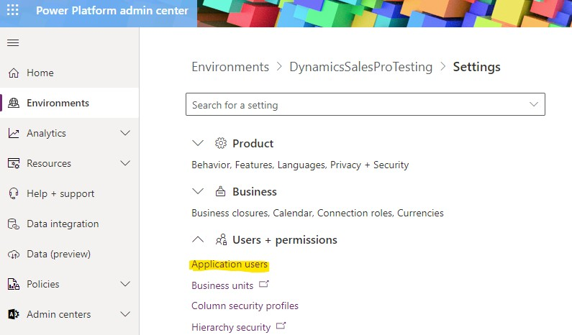
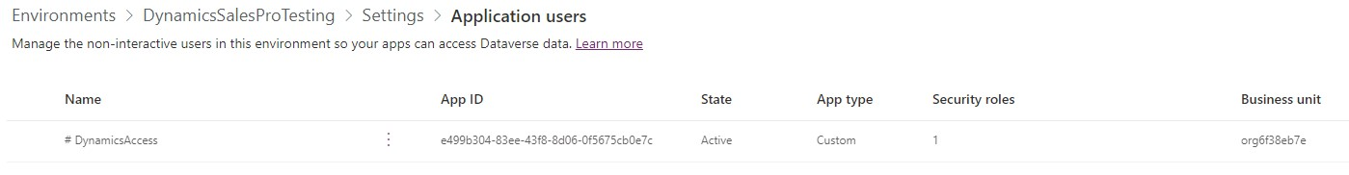
Power Platform App User
Choose appropriate environment & create App User for app created in Azure (will have same name). Choose business unit & security roll (I used system admin; tried others but did not provide access to records).

