Slide 1

GraphAPI (SharePoint)
AZURE CONFIGURATION FOR DAEMON APPS

Slide 2
Purpose
The purpose of this document is to illustrate what is required to allow a daemon app to access SharePoint files via Graph API.
The POC here is to filter files in a SharePoint document library based on part of filename & last date modified.

Slide 3
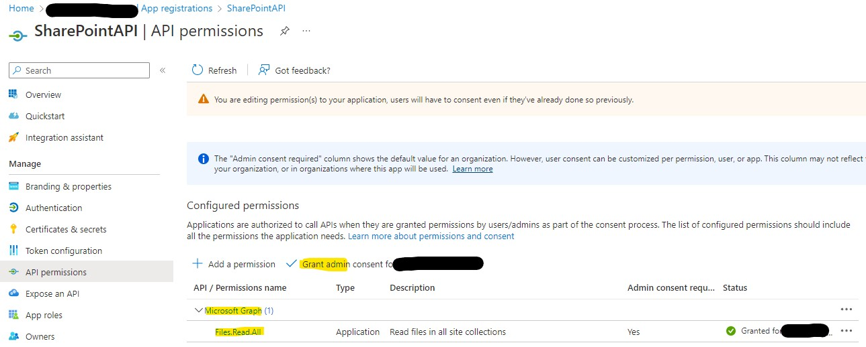
Azure App Registration
In Azure portal, create new app registration via AAD. Access App then app Graph API permission. Add a permission (i.e., API) & grant admin consent for your org for that api/permission:

Slide 4
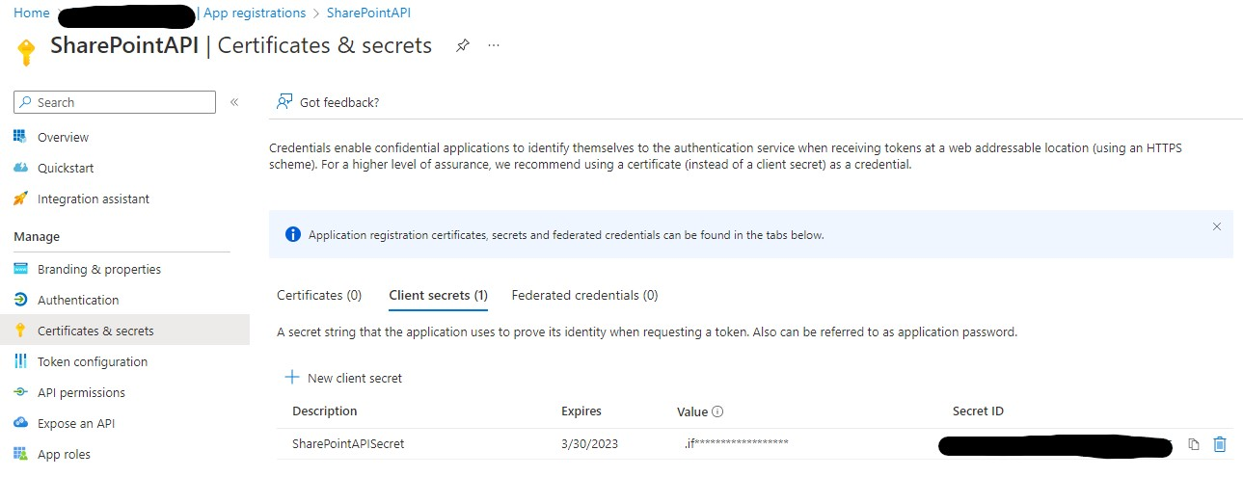
Client Secret
Create new client secret. Document client secret value immediately, it will not be accessible later.

