Slide 1
OPEN SOURCE / PEOPLE + AI
01
Authority
CyberAlchemy
Lab
What may count, and where?
02
Provenance
What produced it?
The open company brain.
03
Lifecycle
A place for people and AI to grow knowledge with its basis intact.
What can change next?
CYBERALCHEMY LAB

Slide 2

ONE ILLUSTRATIVE CAMPAIGN CASE
Which campaign
actually worked?
A recorded 120 leads. B recorded 60. Both spent US$1,200. The answer depends on what “qualified” means.
MEANING / SCOPE / STANDING
Q1 can govern this comparison.
Q1 · accepted for this reporting purpose

Slide 3

CYBERALCHEMY / LAB
03 / 11
Qualified = valid business email + demo request.
ONE CAMPAIGN / Q1 / ACCEPTED FOR THIS REPORTING PURPOSE
CAMPAIGN A UNDER Q1
120 recorded
12 qualified
Counting all 120 as “qualified” would change the criterion. A proposal cannot quietly replace Q1.
OPEN COMPANY BRAIN · LOCAL PRESENTATION
cyberalchemize.com

Slide 4


CYBERALCHEMY / LAB
04 / 11
Three lenses, one campaign report.
ONE CAMPAIGN / Q1 MEANING → R1 REPORT
AUTHORITY
PROVENANCE
LIFECYCLE
Q1 governs reporting, not budget.
Rows + period + method → R1.
R1 is complete; change has a route.
OPEN COMPANY BRAIN · LOCAL PRESENTATION
cyberalchemize.com

Slide 5

CYBERALCHEMY / LAB
05 / 11
Under Q1, B looks stronger.
ONE CAMPAIGN / R1 / ILLUSTRATIVE COMPARISON
BOTH SPENT US$1,200
A 120 recorded → 12 qualified
B 60 recorded → 15 qualified
Per qualified lead: A US$100 · B US$80
R1 retains Q1, the reporting period, selected rows and method. Revenue and budget decisions need more.
OPEN COMPANY BRAIN · LOCAL PRESENTATION
cyberalchemize.com

Slide 6
CYBERALCHEMY / LAB
06 / 11
What if “qualified” misses the target?
ONE CAMPAIGN / CHALLENGE / TARGET-SEGMENT FIT
WHY THE TEAM QUESTIONS Q1
Demo requests may miss target fit.
Q2 / PROPOSED SUCCESSOR
Q1 + a recorded fit assessment.
Q2 is a candidate with no assessed counts. R1 remains 12 vs 15 under Q1.
OPEN COMPANY BRAIN · LOCAL PRESENTATION
cyberalchemize.com

Slide 7
CYBERALCHEMY / LAB
07 / 11
This is how company knowledge grows.
ONE CAMPAIGN / KNOWLEDGE / GROWTH ROUTE
A ROUTE, NOT AUTOMATIC PROMOTION
Observe the gap in Q1
Describe + test Q2
Owner route + gates
Separate later adoption
Q2 remains a candidate. Later assessment would test whether a new criterion helped.
OPEN COMPANY BRAIN · LOCAL PRESENTATION
cyberalchemize.com

Slide 8

CYBERALCHEMY / LAB
08 / 11
The agent can leave. The case stays.
ONE CAMPAIGN / PROJECT STATE / NEXT SESSION
A FRESH SESSION CAN RECOVER
Q1 + R1 basis
Q2 as candidate
Open questions
Standing travels with records, not an agent’s confidence.
OPEN COMPANY BRAIN · LOCAL PRESENTATION
cyberalchemize.com

Slide 9
CYBERALCHEMY / LAB
09 / 11
Your software factory from the future.
ONE CAMPAIGN / CRAFT / Q1 INFORMS A SOFTWARE RULE
Describe requirements, responsibilities and workflows. A typed model and selected profiles guide construction inside the chosen architecture.
ARCHITECTURE
UNDERSTANDING
ASSURANCE
Keep the shape
Keep the why
End routine review
Profiles bound roles and dependencies.
Meaning and workflows survive change.
For sufficiently assured, supported paths.
Human judgment moves to purpose, requirements, exceptions and behavior.
Craft is in development / closed beta. Assurance depends on selected contracts and evidence.
OPEN COMPANY BRAIN · LOCAL PRESENTATION
cyberalchemize.com

Slide 10

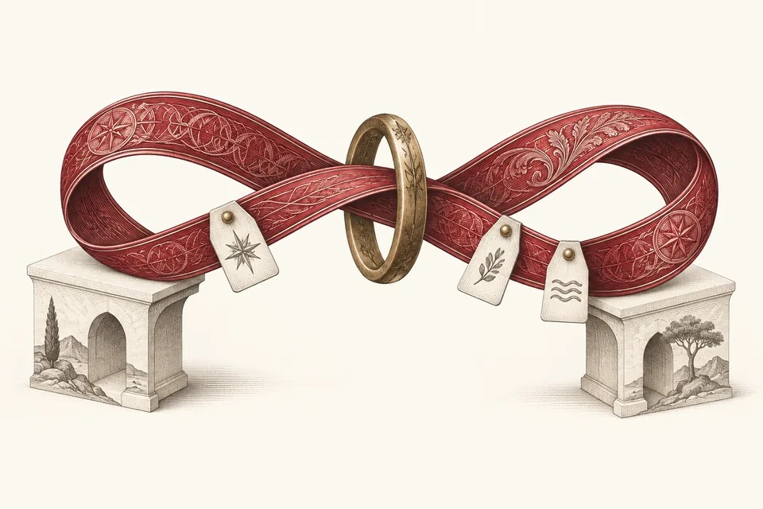
CYBERALCHEMY / LAB
10 / 11
Now carry the method to other work.
Which result holds?
What should we tell the customer?
What did we promise?
OPEN COMPANY BRAIN · LOCAL PRESENTATION
cyberalchemize.com

Slide 11
CYBERALCHEMY LAB / OPEN SOURCE
Let knowledge grow
without losing its roots.
Meaning has a scope. Results keep their basis. Better versions can earn their place.
EXPLORE THE LAB ↗
READ THE GUIDE ↗
INSPECT THE SOURCE ↗
OPEN SOURCE / LAB IN DEVELOPMENT / CRAFT CLOSED BETA

