Slide 1
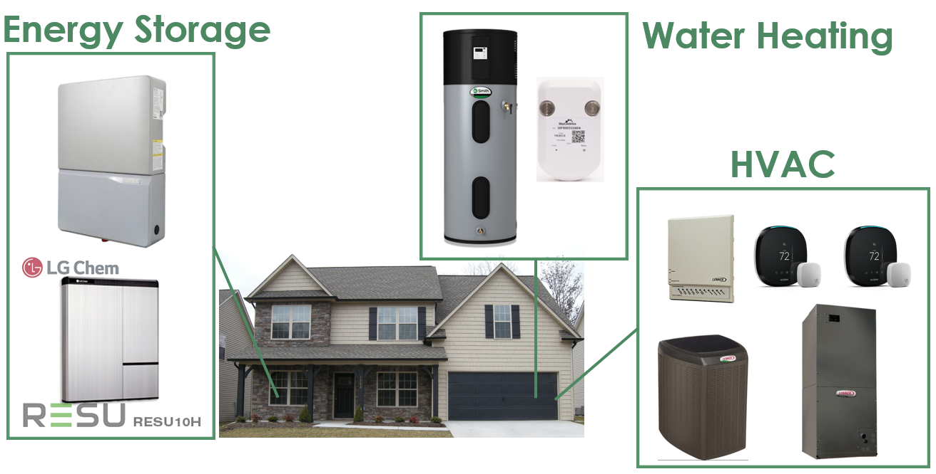
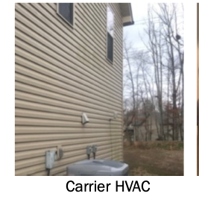
Environmental forecasting
RL Agent (RLA)
Cloud
Temperature
Send input parameters
Price
Learning
from the past
Historical data
Dashboard
Reward
Visualization
Send the reward
Send user preference
Data input (DI)
Send action to thermostat
User preferences
Functionality parts (FP)
Thermostat interface
Send action to HVAC
Environment

