Slide 1
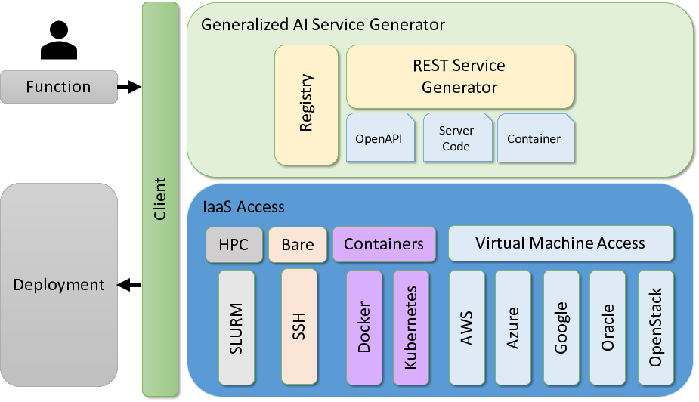

Slide 2
Command line
Service Generator
Notebooks
Interface
Layer
Vender Neutral Access Interface
Cooperation
Service
Competition
Service
Registry
Service
Analytics
Services
Application
Services
Orchestrator
Service
Layer
Security
Vender Neutral Service Interoperability Layer
On Premise
Private Cloud
Public Cloud
Provider
Layer
Service A
Service B
Service C

