Slide 1
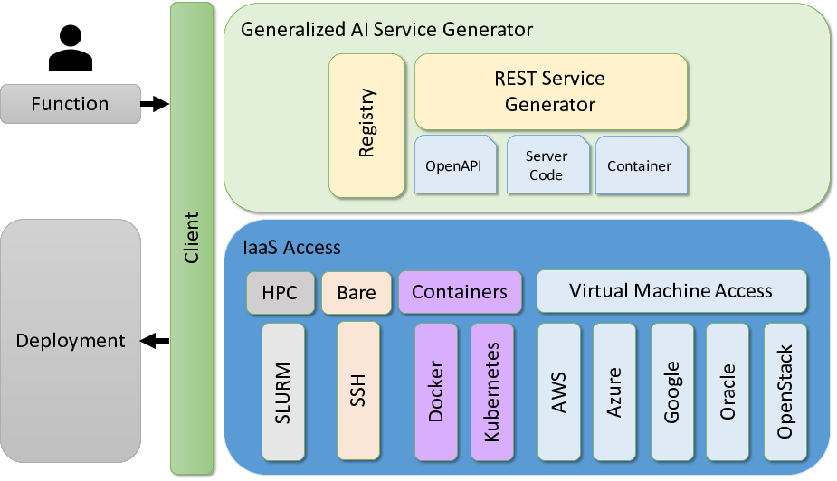

Slide 2
Command line
Service Generator
Notebooks
Interface
Layer
Vender Neutral Access Interface
Cooperation
Service
Competition
Service
Registry
Service
Analytics
Services
Application
Services
Orchestrator
Service
Layer
Security
Vender Neutral Service Interoperability Layer
On Premise
Private Cloud
Public Cloud
Provider
Layer
Service A
Service B
Service C

Slide 3
Model invocation via high level Command line Interfaces
REST Service Generation based on Notebooks
Earthquake Development
Notebooks
Interface
Layer
Vender Neutral Access Interface
Model Cooperation
Service
Model
Competition
Service
Model Registry
Service
Various
Analytics
Services
Earthquake Specific
Services
Orchestrator (Workflow and Coordination)
Service
Layer
Security (Credential Management, AAA)
Vender Neutral Service Interoperability Layer
LCCF (Summit)
University Clusters
Google
Provider
Layer
Batch
Batch and Jupyter
Colab

