Slide 1
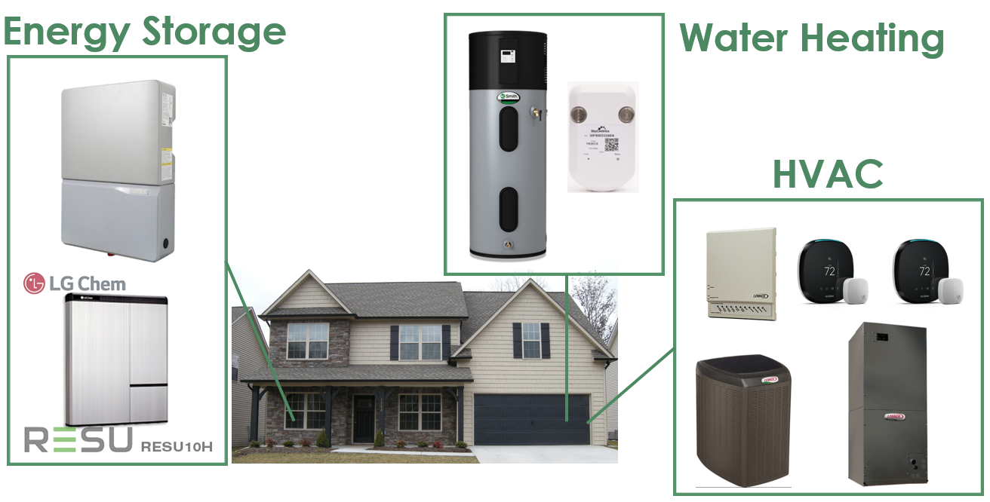
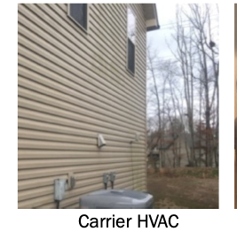
Reward
Environmental forecasting
RL Agent
Cloud
Temperature
Price
Learning
from the past
Dashboard
Historical data
Send user preference
Send recommended action to the HVAC
Visualization
Send learning and environmental parameters
Send action to HVAC
Data input
Functionality parts
Thermostat interface
User input
Environment

