Slide 1
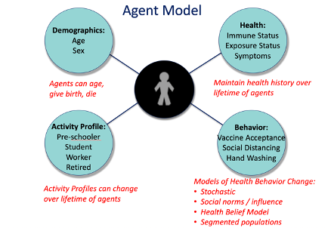
Fig. 1

Slide 2
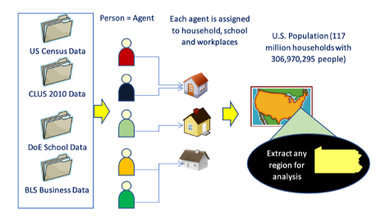
Fig. 2

Slide 3
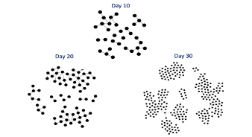
Day 10
Day 20
Day 30
Fig. 3

Slide 4



AICov Framework
AICov Orchestrator
Data API
Micro Simulation of Synthetic Data
Model A
Data API
Model B
Data Wrangler/Extractor
AICov Forecast
Model Selector and Aggregator
Data API
Model C
Data
Scientists
and
Users
AICov
GAN
AICov Interface
…
…
Data
Sources
Data
APIs
Models
Cloudmesh Compute Resource Interfaces
Cloud:
AWS, Azure,
Google, OpenStack,
Kubernetes, …
Datacenter/
Supercomputer:
University,
NSF, DOE,
Cloud
AI Desktop

