Slide 1
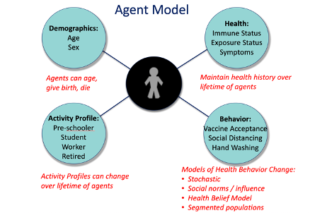

Slide 2
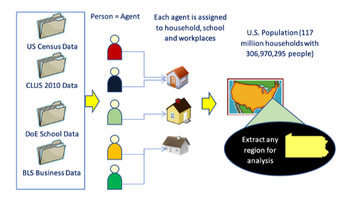

Slide 3
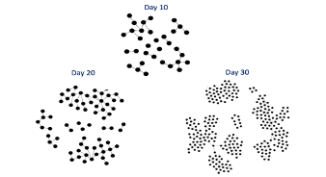
Day 10
Day 20
Day 30

Slide 4



AICov Framework
AICov Orchestrator
Data API
Micro Simulation of Synthetic Data
Model A
Data API
Model B
Data Wrangler/Extractor
AICov Forecast
Model Selector and Aggregator
Data API
Model C
Data
Scientists
and
Users
AICov
GAN
AICov Interface
…
…
Data
Sources
Data
APIs
Models
Cloudmesh Compute Resource Interfaces
Cloud:
AWS, Azure,
Google, OpenStack,
Kubernetes, …
Datacenter/
Supercomputer:
University,
NSF, DOE,
Cloud
AI Desktop

Slide 5
AICov Framework
AICov Orchestrator
Data API
Micro Simulation of Synthetic Data
Model A
Data API
Model B
Data Wrangler/Extractor
Model Selector and Aggregator
Data API
AICov Forecast
Model C
Data
Scientists
and
Users
AICov Interface
…
…
Data
Sources
Data
APIs
Models
Cloudmesh Compute Resource Interfaces
Cloud:
AWS, Azure,
Google, OpenStack,
Kubernetes, …
Datacenter/
Supercomputer:
University,
NSF, DOE,
Cloud
AI Desktop

Slide 6

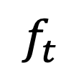
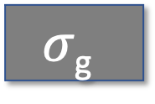

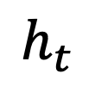
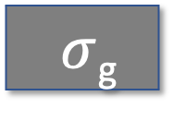
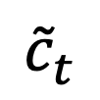
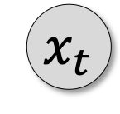
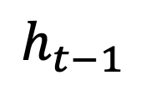
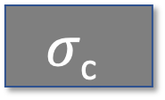
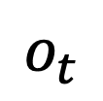
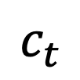
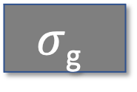
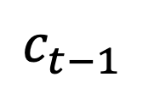

$$h_{t}$$
$$c_{t−1}$$
$$c_{t}$$
x
+
$$σ\text{c}$$
$$f_{t}$$
$$i_{t}$$
x
$$o_{t}$$
x
$${\tilde{c}}_{t}$$
$σ$_{g}
$$σ\text{g}$$
$$σ\text{c}$$
$$σ\text{g}$$
$$h_{t−1}$$
$$h_{t}$$
$$x_{t}$$

