Slide 1
Human in the Loop Virtual Machine Management on Comet
Gregor von Laszewski
laszewski24 @gmail.com
Fugang Wang, Geoffrey C. Fox, Shawn Strande, Christopher Irving, Trevor Cooper, Dmitry Mishin, Michael L. Norman
SDCS & Indiana University
Comet is supported by NSF grant: ACI \#1341698 Gateways to Discovery: Cyberinfrastructure for the Long Tail of Science.

Slide 2
What is Comet
Target the long tail of science
Focuses primarily on small and modest scale computing jobs,
Those that require specialized software environments that are not found on traditional clusters.
Science gateways
Use Virtual Clusters (VCs) by leveraging existing batch queue, e.g. not OpenStack
Near-bare metal performing computing resources
Interactive experience as part of a human-in-the-loop management and usage strategy.

Slide 3
Hardware
2.76 Pflop/s peak; 48,784 CPU cores; 288 NVIDIA GPUs; 247 TB total memory; 634 TB total flash memory
Standard Compute Nodes (1944 total)
Intel Xeon E5-2680v3 2.5 GHz dual socket, 12 cores/socket; 320 GB flash memory; 120 GB/s memory bandwidth
GPU Nodes (72 total)
36 K80 nodes: 2 NVIDIA K80 GPUs per node; dual socket, 12 cores/socket; 128 GB DDR4 DRAM; 120GB/s memory bandwidth; 320 GB flash memory
36 P100 nodes: 4 NVIDIA P100 GPUs; dual socket, 14 cores/socket; 128 GB DDR4 DRAM; 150GB/s memory bandwidth; 400 GB flash memory
Large-memory Nodes (4 total)
1.5 TB total memory; 4 sockets, 16 cores/socket; 2.2 GHz
Interconnect: Hybrid Fat-Tree topology; 56 Gb/s (bidirectional) link bandwidth; 1.03-1.97 µs MPI latency
7.6 PB Lustre-based Parallel File System
Access to Data Oasis
High-performance virtualization

Slide 4
Virtual Clusters on Comet
Focus is on giving user a cluster of virtual machines
Performance is close to bare metal
Utilizes Infiniband
Users decide how many of the allocated virtual machines they like to use
build into accounting and monitoring system of comet

Slide 5
User Support for Virtual Clusters
Project Consultation
Account Management
Virtual Cluster
Support
Project starts with consultation to identify requirements and suitability
Leverages XSEDE accounts and application process, Users tstart with trial account
Users have Virtual Cluster support during their CV activities on Comet
User Support on Comet
User support is targeting multiple areas and are well integrated

Slide 6
Project Consultation
Is the project suitable for VC’s on comet?
Is there enough expertise available <= this has been an issue
Is there enough time to do the project?
Are there alternatives that should be used instead?
Is special support needed?

Slide 7
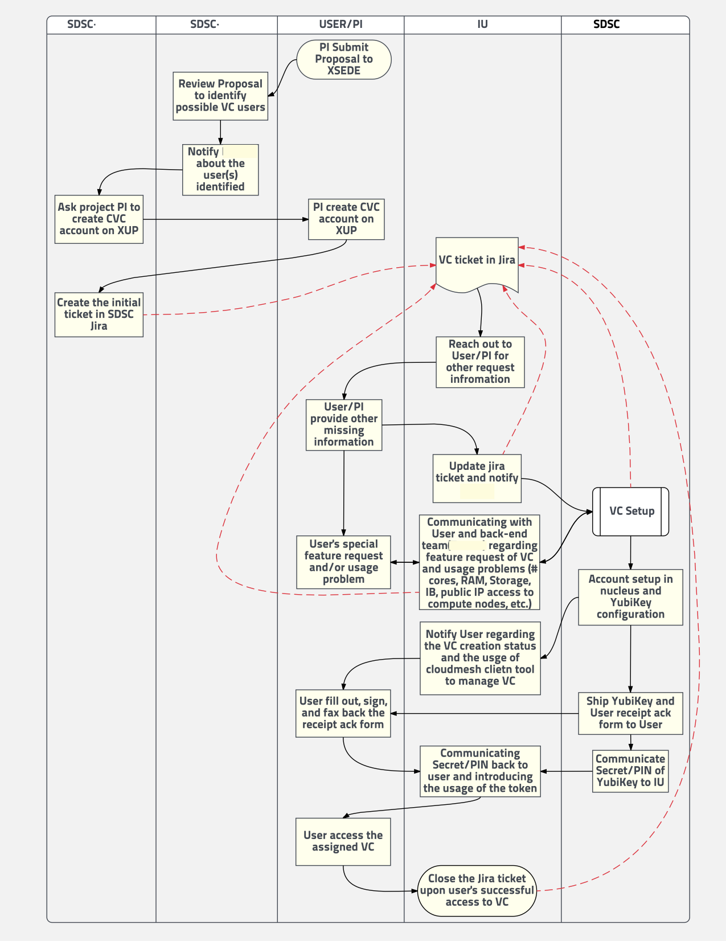
Account Management
Well defined account management project
Proven
Integration with XSEDE
But
using of YubiKeys for access to management node
Integration of user consultation

Slide 8
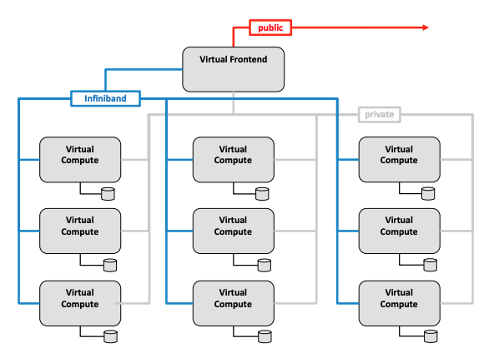
VCs on Comet
User gets a virtual cluster
management through frontend
Users get n cluster nodes (dependent on need).
cluster nodes can be user or not
VCs are all managed by queueing system invisible to the user
Can use all of the clusters backend services and performance

Slide 9
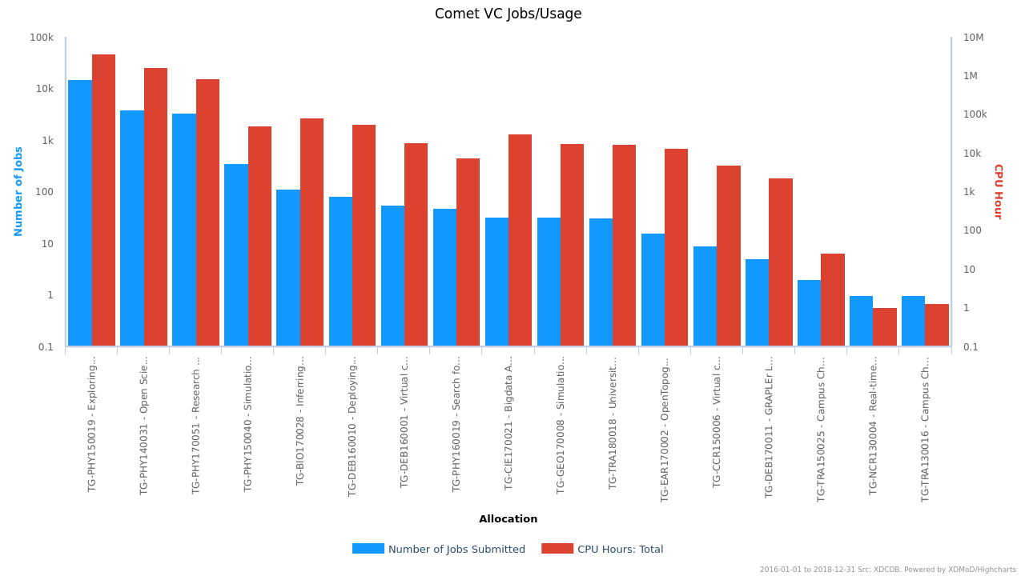
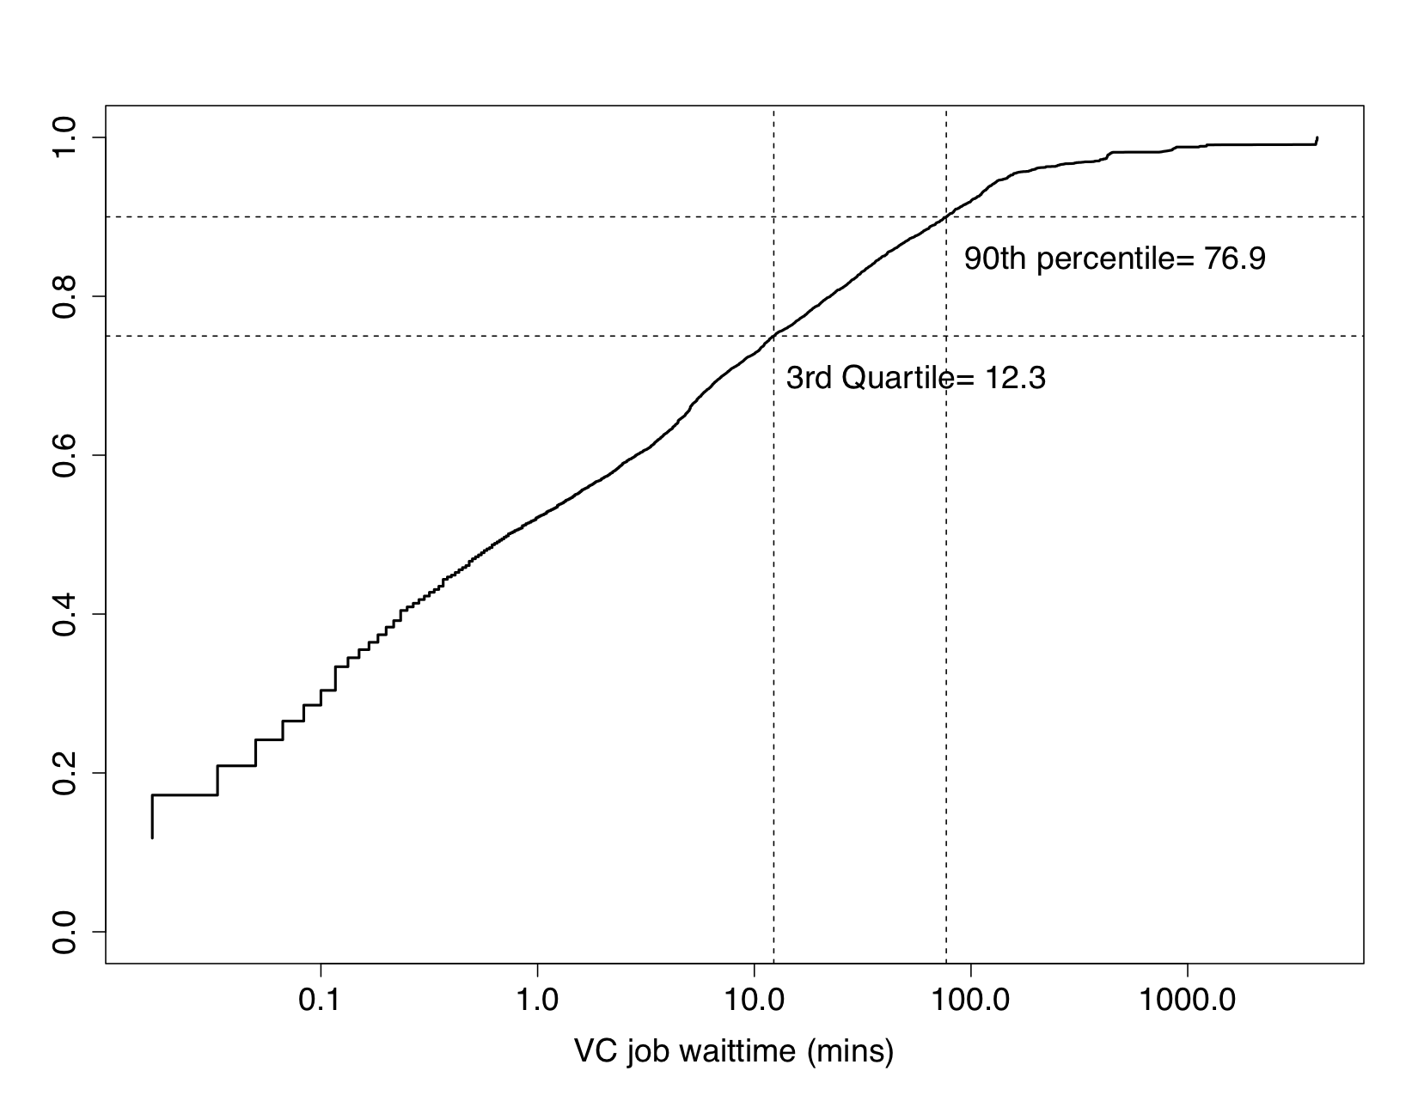
Virtual Cluster Monitoring
XSEDE monitoring
XDMoD integration available
Special Monitoring
relatively low wait time

Slide 10
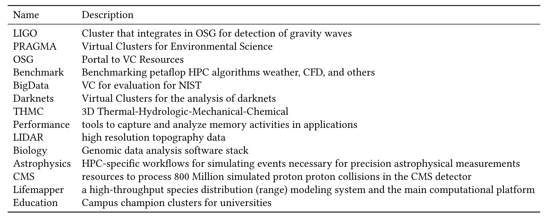
Virtual Cluster Applications

Slide 11
Lessons Learned
Advantages: Software
Superb software, integrates well with existing clusters, including cloudmesh
Good user support, easy to get access and use a VC
Backend does not have have “create my comet cluster elsewhere” (not part of funded project)
Issues: Users
User knowledge to be a system admin managing the cluster is limited
Knowledge, manpower, staff retention at organizations or projects
Issues: Shifting Community Interest
Community wanted to learn OpenStack
Shift from VMs to containers

Slide 12
References
Cloudmesh: http://github.org/cloudmesh
Cloudmesh Comet Plugin: https://cloudmesh.github.io/cloudmesh-comet/
VC user guide:
https://cloudmesh.github.io/cloudmesh-comet/comet.html#comet-userguide
VC CLI reference documentation:
https://cloudmesh.github.io/cloudmesh-comet/command_comet.html#comet-command

