Slide 1
Cloud Metrics for Academic Resource Providers
Gregor von Laszewski, Hyungro Lee
Fugang Wang, Geoffrey C. Fox
Indiana University
Tom Furlani, Robert De Leon
University of Buffalo
laszewski@gmail.com

Slide 2
Acknowledgement
This material based upon work is partially supported in part by the National Science Foundation under Grant No. 1445806, 1445806, and 0910812.

Slide 3
Extensive Expertise in Metrics Work
Benchmarking XSEDE Matlab (IU)
BlueWaters
NCAR
XSEDE
Future
Systems
SaaS
OpenStack, Nimbus, AWS, Azure, Hadoop, ...
Support
SUPREME
(UBMOD)
PaaS
XDMOD
Future
Grid
IaaS
Scientific Impact
Clouds
HPC
Metrics

Slide 4
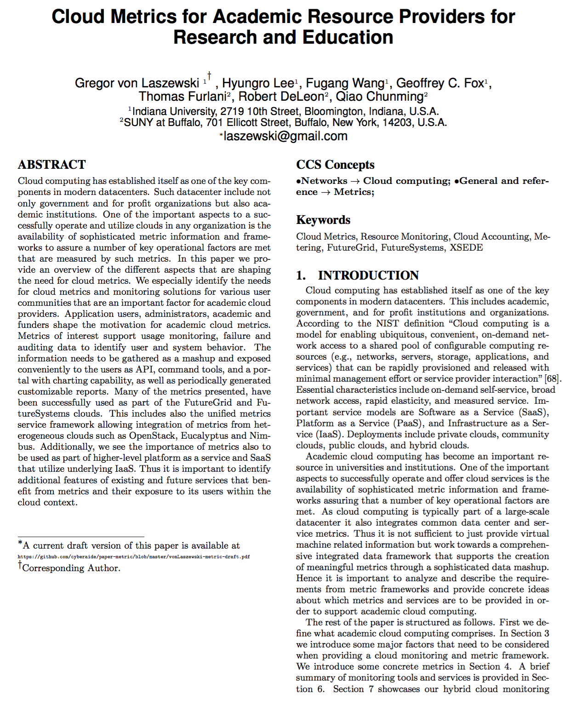
We are writing paper
Current 20 pages draft 2 column ACM proceedings format

Slide 5
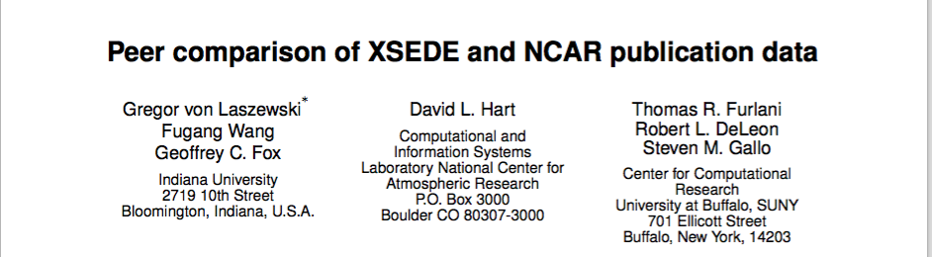
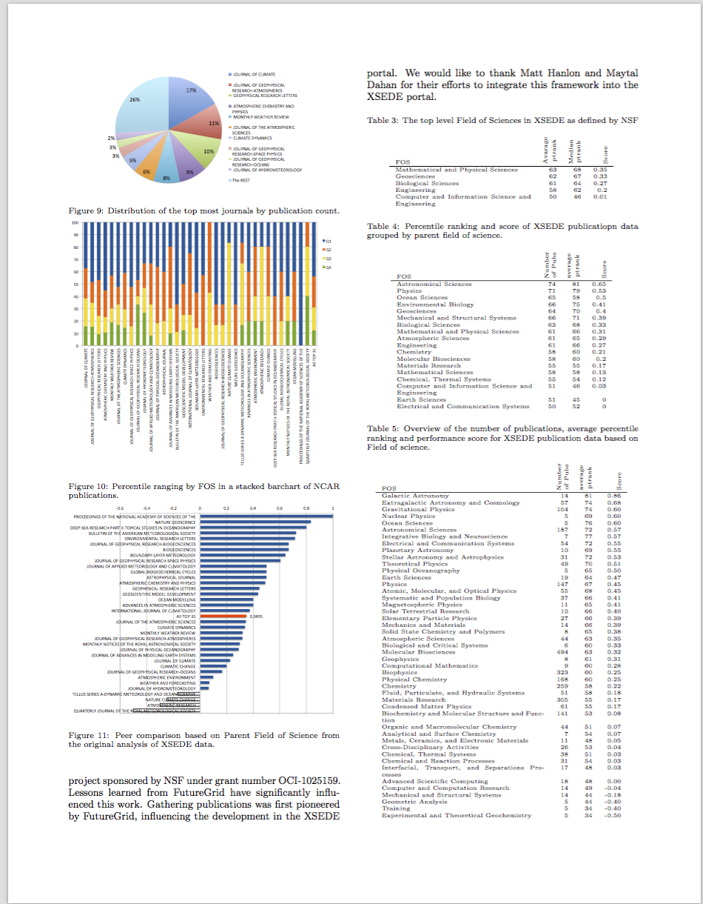
Scientific Impact
Evaluate impact via publications
Obtaining citation data
Metrics
Number of publications; Citation count
H-index; G-index
Relative ranking of citation count within same journal issue
Correlating impact metrics with usage data
Peer Comparison

Slide 6
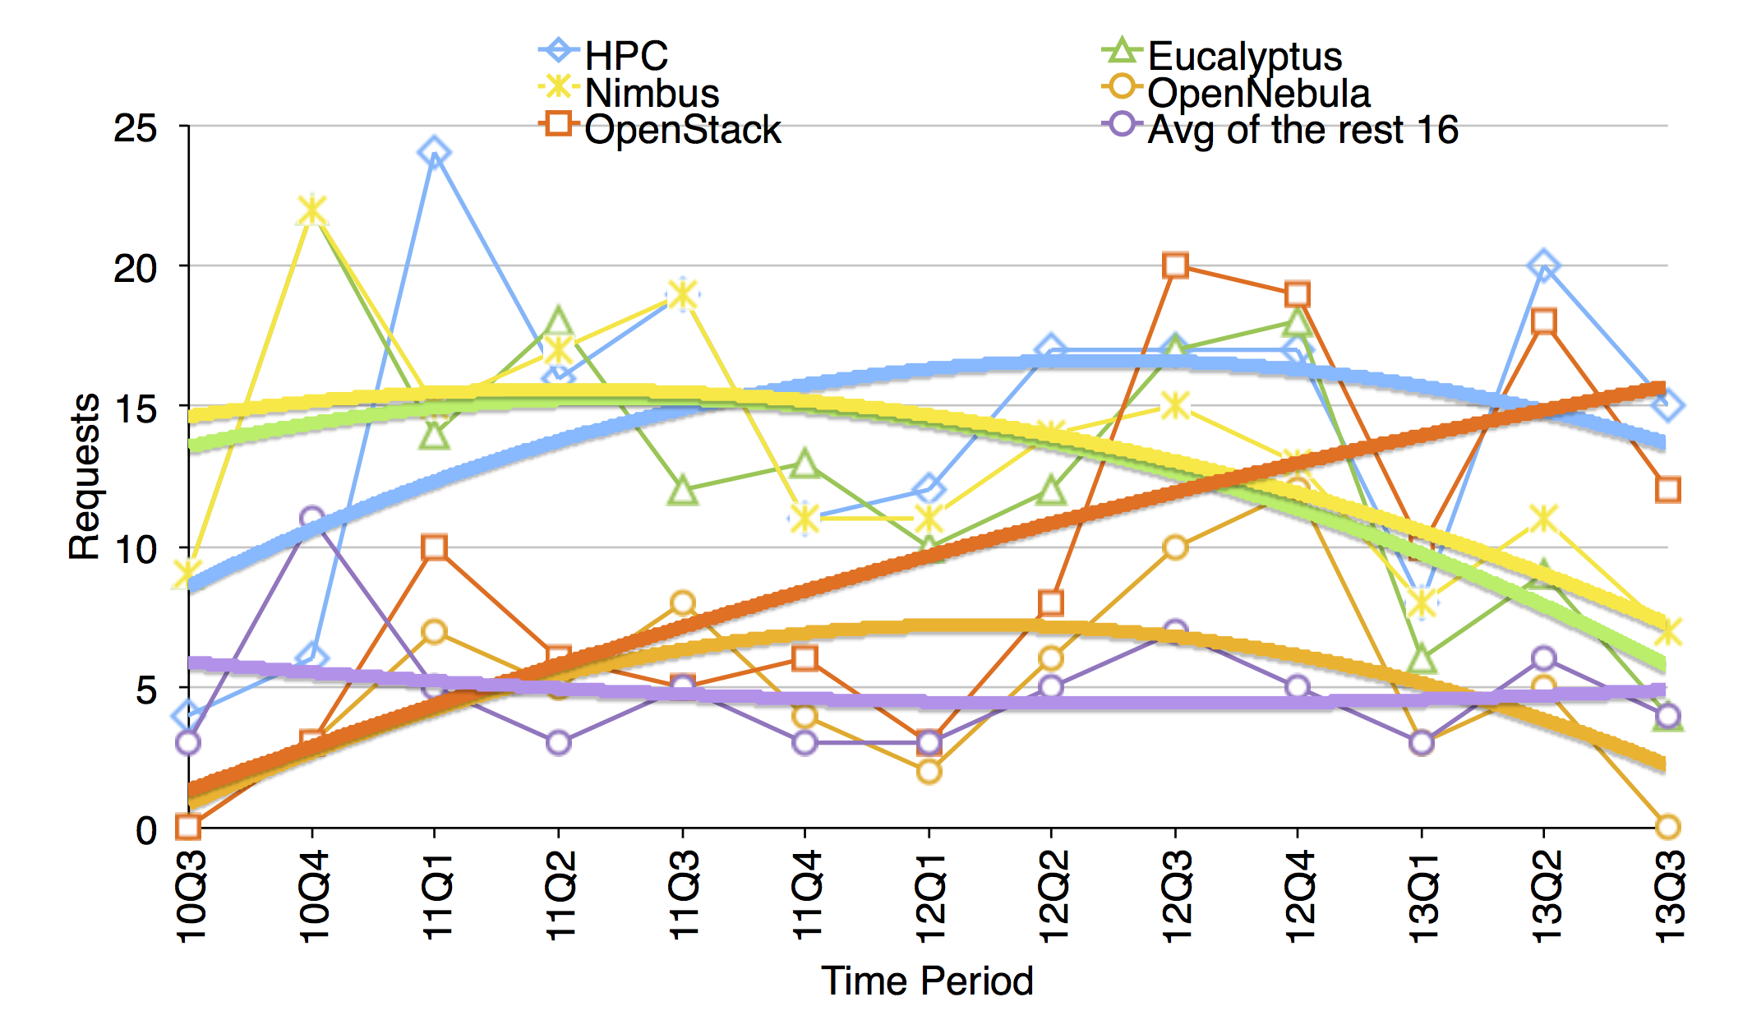
Project Metrics (not included in XRAS)
FG & FS have specific technology request metrics
https://portal.futuresystems.org/projects-statistics

Slide 7
What is Cloud Computing?
NIST
SaaS - Mahout, Spark, HelpDesk, XRAS, ...
PaaS - Hadoop, HPC in the Cloud, Virtual Clusters, Azure, ...
IaaS - OpenStack, Docker, AWS, Eucalyptus, Azure, ...
Note:
a) It is more than IaaS …
b) Different virtualization technologies …
virtual machines, container virtualization

Slide 8
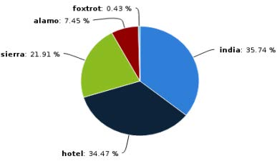
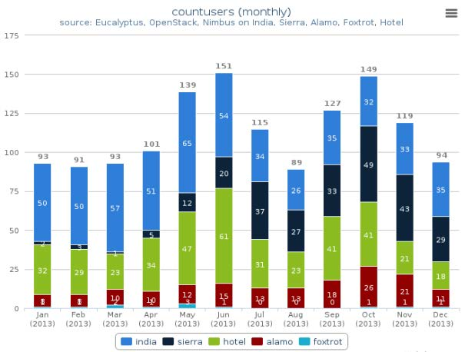
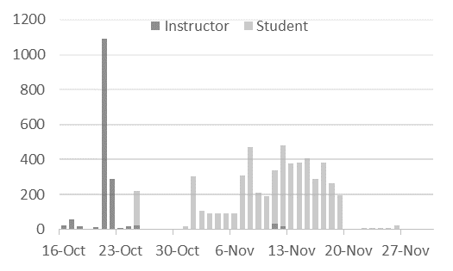
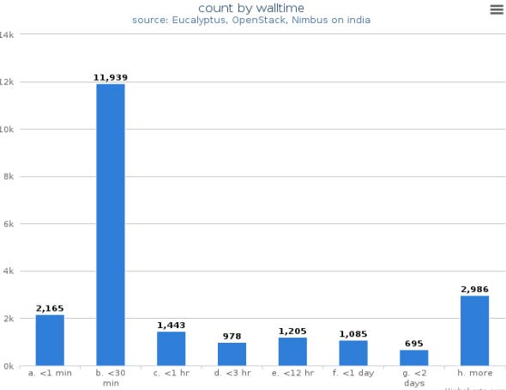
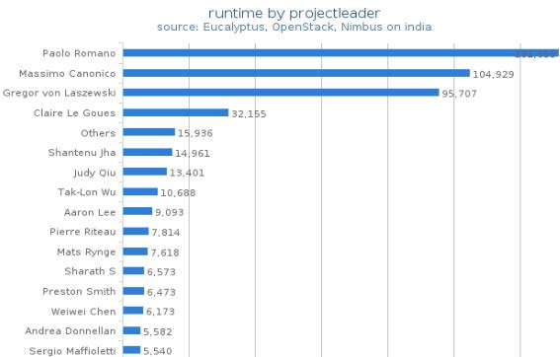
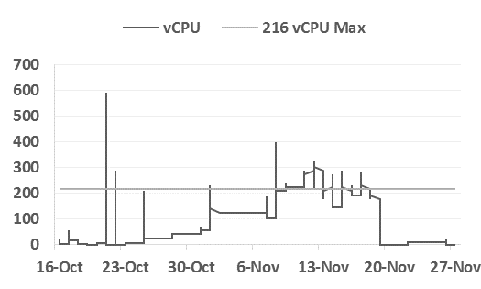
Cloud Metrics (Screenshots FG/FS)
Host Usage
Host Usage
Monthly changes
Instructor vs Student Usage
Runtime Distribution
Project Leader
Resource Utilization

Slide 9
Whe Metrics for Academic Clouds?
Publicly funded resources are expensive
Metrics help
assessing if resources are used according to policies
identifying bottlenecks
providing users information about the system to let them know if the resource can satisfy their demands

Slide 10
Why Metrics (Not just clouds)?
Monitoring
Planning
Billing
Testing
Consuming
Auditing

Slide 11
Where do we need metrics?
Integrated access to metrics is required
It is not sufficient to just provide access to VM metrics
Impact
Metrics -> SaaS
__________
Metrics -> PaaS
______________________
Metrics -> IaaS
Virtual Data Centers -> Metrics
Cloud Frameworks -> Metrics
Data Centers -> Metrics

Slide 12
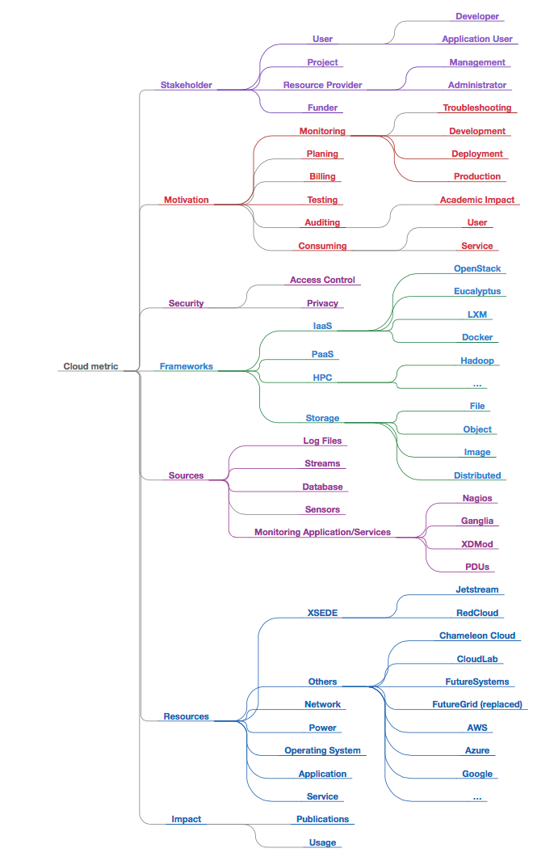
Aspects of Cloud Metrics
Stakeholder
Motivation
Security
Frameworks
Information Sources
Resources
Impact

Slide 13
file://localhost/Users/big/github/cyberaide/paper-metric/beamer.pdf

Slide 14
Error and Alert Metrics
Name | Group | Unit | Purpose | Sample
Error Rate | host, project or term | Percentile | Measure Availability | 2% errors in i57 host, 4% errors in April 2015
Error Count | host, project or term | Count | Identify Issues | 399 User Errors (5xx), 133 errors of Instance type’s disk is too small for requested image (501)
Debug | host, project or term | Count | Troubleshooting | 133 times failed of build instance() function in man ager.py with error code 5xx (disk to small)
Usage Alert | VM, CPU, RAM, or Disk | Count or Size | Notify Limit | 168 of 180 VMs used (93% used)
Trace Resource | VM, CPU, RAM, or Disk | Count or Size | Inform status | 120/168 free/avail disks

Slide 15
HPC vs Cloud metrics
HPC Metrics
Job Metrics
Queue Metrics
Usage Metrics (SU, walltime)
Project Metrics
Application Analysis
Vampir
Log analysis
PAPI
Cloud Metrics
VM Metrics
VM, Reservation Metrics
Usage Metrics (vms, API call, walltime, SU)
Project Metrics (same)
Application Analysis
N/A
Log analysis (also for faults)
VM PAPI
PaaS, SaaS

Slide 16
Questions?

Slide 33
Project management related metrics
P.1 | Number of projects | the cumulative number of projects | measure growth of use, time periods: daily
P.2 | Number of projects by discipline | the cumulative number of projects by discipline | understand the growth of use by field of knowledge. Time periods: daily, monthly, quarterly, yearly
PC3 | Number of projects by organization | the cumulative number of projects by organization | understand the growth of use by institution. Time periods: daily, monthly, qaurterly, yearly
P.4 | Technology in use | the percentage of technologies and software packages in use | improve application-based services with desired technologies
P.5 | Technology desired | the percentage of technologies and software packages preferred to use | measure statistical needs of software packages in the cloud

Slide 34
Project & User Metrics
Project management related metrics
P.1 | Number of projects | the cumulative number of projects | measure growth of use, time periods: daily
P.2 | Number of projects by discipline | the cumulative number of projects by discipline | understand the growth of use by field of knowledge. Time periods: daily, monthly, quarterly, yearly
PC3 | Number of projects by organization | the cumulative number of projects by organization | understand the growth of use by institution. Time periods: daily, monthly, qaurterly, yearly
P.4 | Technology in use | the percentage of technologies and software packages in use | improve application-based services with desired technologies
P.5 | Technology desired | the percentage of technologies and software packages preferred to use | measure statistical needs of software packages in the cloud
User related metrics
U.1 | User count | active users for the cloud | give an indication of how many users use the cloud
U.6 | Users by organization | shows the the infrastructure used by organization | identify the users by organization
U.2 | Users by consumption (VM) | users that use the resources heavily e.g. top 10 users | identify the users by VM usage
U.3 | Users by consumption (Storage) | users that use the resources heavily e.g. top 10 users | identify the users by Storage usage
U.4 | Users by consumption (Network) | users that use the resources heavily e.g. top 10 users | identify the users by Network usage
U.5 | Users by consumption (Image) | shows the most used images | identify popular images
U.6 | Users by consumption (Flavor) | shows the most used flavor | identify popular flavors
U.7 | Users by role | indicates usage by role | a user role defined in an account system with a percentage of the total numbers. e.g. how many class users vs researchers
U.8 | Users by project | distribution of user count by project | assess quotas and limit that may be caused by user count

Slide 35
VM Metrics
Virtual machine metrics.
V.1 | VM Count | counts the launched VM instances on the cloud | assess utilization of the resources
V.2 | VM Count by role | counts the VM by role | asses utilization by role e.g. students vs. research use
V.2 | VM Count by organization | counts the VM by organization | asses utilization by organization
V.3 | VM Creation time | shows when vms have been created | Identification of long running VMs to check for security updates, reminders to terminate unused VMs
V.4 | VM Runtime sum | the total amount of runtime for launched instances | one measurement for utilization of the resource
V.5 | vCPU usage | the number of vCPU cores allocated to instances | vCPU Usage is important for measuring system resource used
V.6 | Memory usage | the size of memories allocated to instances | Memory Usage is important for measuring system resource used
V.7 | VM migration | the time it takes to migrate a VM | moving vms may be needed in case of over utilization of a server
V.8 | VM snapshot | the time it takes to snapshot a VM | moving vms may be needed in case of over utilization of a server
V.9 | VM deletion | the time it takes to delete a VM | users may be interested in how quickly they can delete the vm
V.10 | VM boot | the time it takes to boot a VM | users may be interested in how quickly they can boot
V.11 | VM admin time sum | total time the cloud prepares a system so we can compare it to the actual runtime of the VMs | lead to ratio of preparation vs VM runtime

Slide 36
Image & Flavor Metrics
Image related metrics
I.1 | Image OS | the distribution of the image OS e.g. ubuntu14.04, centOS 7, or Fedora 22 | assist to provide support
I.2 | Image creation date | the creation date of the image | assist to provide security support
I.3 | Image upload date | the time an image was uploaded to the image repository | assist to provide security support
I.4 | Image modification date date | the time an image was last modified in the image repository | assist to provide security support
I.5 | Image usage count | the usage of the image by users | assist in removing unpopular images
I.6 | Image usage wall time | the usage of the image by users | assist in removing unpopular images
I.7 | Image size | the size of the image | assist in sizing the image store and giving indication on how boot times based on download size
I.8 | Image boot time | the boot time of the image | assist in sizing the image store and giving indication on how boot time
I.9 | Image clone count | number of times the image was cloned into a new image | assist in identifying common security risks through image pedigree
I.10 | Image by role | images by role | show favourite images by role (e.g. students)
I.10 | Image by project | images by project | show favourite images by role (e.g. students)
Flavor related metrics.
F.1 | Flavor count | a counts the usage of a specific flavor | help assessing popularity of the flavor
F.2 | Flavor by user | counts the usage of a specific flavor for a user | help assessing popularity of the flavor
F.3 | Flavor by project | counts the usage of a specific flavor for a project | help assessing popularity of the flavor
F.4 | Flavor by image | counts the usage of a specific flavor for an Image | help assessing popularity of the flavor
F.5 | Flavor by wall time | counts the usage of a specific flavor for an Image | help assessing popularity of the flavor
F.6 | Flavor by core | counts the usage of a specific flavor for an Image | help assessing popularity of the flavor
F.7 | Flavor by role | counts the usage of a specific flavor for an Image | help assessing popularity of the flavor

Slide 37
Storage Metrics
Storage related metrics
D.1 | Disk usage (total) | size of Disks allocated | measure total disk usage
D.2 | Disk usage by user | size of Disks allocated | measure disk usage by user
D.3 | Disk usage by project | size of Disks allocated | measure disk usage by project
D.4 | Object usage (total) | size of Object Storage allocated | measure total object storage usage
D.5 | Object usage by user | size of Object Storage allocated | measure object storage usage by user
D.6 | Object usage by project | size of Object Storage allocated | measure object storage usage by project
D.7 | Block usage (total) | size of Block Storage allocated | measure total block storage usage
D.8 | Block usage by user | size of Block Storage allocated | measure block storage usage by user
D.9 | Block usage by project | size of Block Storage allocated | measure block storage usage by project
D.10 | File usage (total) | size of File Storage allocated | measure total file usage
D.11 | File usage by user | size of File Storage allocated | measure file usage by user
D.12 | File usage by project | size of File Storage allocated | measure file usage by project

Slide 38
Server Metrics
Server related metrics
S.1 | Node Distribution | a physical node distribution on the servers | indication of physical system balancing
S.2 | Power Consumption | the amount of energy used in the cloud platform | measure actual cost by Kilo Watt per hour (KWh)
S.3 | Availability | a percentage rate of available resources to accept a new request | provide cloud resources continuously
S.3.1 | Planned Outages | Some resources may be not avalable due to outages | accesses production level readiness of the system
S.3.2 | Unplanned Outages | Some resources may be not avalable due to outages | accesses reliability of the system
S.3.3 | Broken HW | Hardware unavailable due to hardware failure | accesses reliability of the system
S.3.4 | Broken SW | Hardware unavailable due to Software failure | accesses reliability of the system
S.4 | Capacity | an actual limit of a service or physical system in the cloud | let users know if they can still request resources
S.5 | Throughput | the performance of cloud services by measuring completed tasks, i.e. PaaS | measure service performance e.g. PaaS
S.6 | CPU Speed | Indication of cpu speed in a heterongeneous cloud | understand an actual speed of CPUs over different cloud platforms
S.6 | CPU Type | Indication of cpu type in a heterongeneous cloud | understand an actual speed of CPUs over different cloud platforms
S.7 | Memory Speed | the performance of cloud resources by clock speed of a memory | understand an actual speed of memories over different cloud platforms
S.8 | Disk type | the type of disk accessible on the server (SSD, ...) | specific disk type may be needed for certain experiments
S.8 | Disk Speed | the performance of cloud resources by read/write speed of a disk including SSD | understand an actual speed of disks over different disk types

Slide 39
Network & Security Metrics
Network related metrics.
N.1 | Latency | a network and application performance | Measure acceptability and strict latency expectation
N.2 | Network Throughput | the actual amount of data delivered successfully | measure network performance
N.3 | public ips used (total) | number of public IPs used | May indicate resource abuse
N.4 | public ips used (by user) | number of public IPs used | May indicate resource abuse
N.5 | public ips used (by project) | number of public IPs used | May indicate resource abuse
N.3 | private ips used (total) | number of public IPs used | May indicate resource abuse
N.4 | private ips used (by user) | number of public IPs used | May indicate resource abuse
N.5 | private ips used (by project) | number of public IPs used | May indicate resource abuse
Security related metrics.
SEC.1 | User login failure (IaaS) | count of login failures | May indicate security issue or misconfiguration.
SEC.2 | Image creation data | date an image was created | Assessing risks for outdated images.
SEC.3 | False portal users | lots of non users will create portal accounts | Assessing risks for users that intend to abuse the system.
SEC.4 | OS security test failure | run a security test against the image | indicate failuer to update image for known exploits.
SEC.5 | public ips used (total) | number of public IPs used | May indicate security risks
SEC.6 | public ips used (by user) | number of public IPs used | May indicate security risks
SEC.7 | public ips used (by project) | number of public IPs used | May indicate security risks

Slide 40
Service & Location Metrics
Service related metrics.
SV.1 | Help desk outage | the outage time of the help desk. | impacts the user support.
SV.2 | Portal desk outage | the outage time of the portal. | impacts the user support.
SV.3 | AA outage | the outage time of the authentication and authorization service. | impacts the usability.
SV.4 | VM outage | the outage time of the VM management service. | impacts the usability.
SV.5 | Network outage (LAN) | the outage time of the Network service. | impacts the usability.
SV.6 | Network outage (WAN) | the outage time of the Network service. | impacts the usability.
SV.7 | Policy action time | time it takes to execute a specific policy such as reserving a number of servers and freeing them up | assess special user service requests
SV.7.1 | Recovery time | time it takes to recover from a specific failure | assess fault tolerance ability
SV.8 | Deployment | time it takes to deploy the cloud framework | assess operational readiness of the framework
SV.9 | Billing rate/Cost | ability to convert into a service uint. This may be a difficult metric as a variety of service units may have to be considered and some clouds are not about CPU hours offered but about services easily rendered to the users. However through a benchmark we can establish an approximate service unit | make users aware of the cost
Region related metrics.
R.1 | Location | a geographical location of a user. | Location is important for resource availability to different regions.

Slide 41
We will select 10 slides from this

Slide 42
Public Clouds
Access to resources
$ (demand paid by $ brings supply)
Kind of access
individual, small group
hosted service
production services
Academic users do use public clouds
Azure, HP, AWS, Rackspace
(discounted, spot pricing)

Slide 43
Academic Cloud Computing (no $)
Access to resources
based on merit (demand may exceed supply)
based on affiliation
based on funding of the resource by group
based on organization (IT vs school)
Kind of allocations
Project based
individual, medium, large groups
Portal/Gateway based
many users
access to specialized science services
Integration of public commercial clouds

Slide 44
Which Academic Clouds Exist?
FutureGrid
FutureSystems
Chameleon Cloud
CloudLab
Jetstream
RedCloud
....

Slide 45
Example: Types of Resources influencing metrics
MRI, Instruments with cloud usage
Networks, Internal and external networks (Internet2)
Storage, where to keep the data
Power
Operating system, project specific small specialized footprint vs. generalized science OS
Appliances, customized for project/class
Services, require uptime to serve for longer period
=> Multitude of information sources and metrics

Slide 46
Examples: Why Metrics?
Long term planning for resource
demand vs supply (do we need more resources, can resources be used otherwise)
Current status of resource
is system operating normal and can I use now
Reporting
Automate quarterly reporting to show how the system is used
Auditing
Help detailed auditing of the system for security reasons.

Slide 47
=> Timing of Metrics
Period
Metric applied over period of time
Real time
Metrics applied now
Time to Live
Collected data for Metrics may expire and need to be recalculated or is no longer of importance

Slide 48
Cloud Metrics
Collect resource usage and performance data in the cloud platforms including failure information (errors)
Support multiple cloud platforms: OpenStack, Eucalyptus, Nimbus
Integrated view of usage data across multiple clouds
Dynamic and static reports in PDF, CSV, or web pages
Metric classification according to user roles such as system administrator, project leader, or general user
Audit of user behavior by system log analysis

Slide 49
Previous & Current Work
FutureGrid
Aqua
Scientific Impact

Slide 50
Discussion
IaaS cloud
SUs/CPU Hours (HPC) -> VM Core Hours (Cloud)
Job status/errors -> Request success/error rate and distribution
Memory and Storage (RAMs; block device; object store)
Other resources: Public IPs; Network resources
Data Mashup: IaaS and data center information (e.g. power, network)
What about PaaS and SaaS?
The operation model?
portal/gateway in front end, VMs in back end?
What measures are available and being collected?

Slide 51
Discussion - cont’d
Information about target systems within TAS/XMS?
Jetstream - (atmosphere front end + openstack; providing list of preconfigured images (with applications within) for users to launch)
atmosphere - http://www.iplantcollaborative.org/ci/atmosphere
“Statistical reporting for total CPU hours, memory usages, total instances and applications launched by users. Also statistical methods for each instances/applications (listing favorite application, etc.)”
Notes:
Jetstream refs:
http://www.jetstream-cloud.org/
http://news.iu.edu/releases/iu/2014/11/jetstream-nsf-grant.shtml
https://kb.iu.edu/d/bfde
“Jetstream will be a user-friendly cloud environment designed to give researchers and students access to computing and data analysis resources on demand — from their tablets, laptops or desktop computers. People will interact with the system through a menu of “virtual machines” designed to support research in many disciplines including biology, atmospheric science, earth science, economics, network science, observational astronomy and social sciences. Jetstream will also allow creators of new research software to make those tools easily available to potential users, speeding their adoption.”
“Jetstream is like an ‘easy button’ giving researchers simple access to supercomputing tools and data sets. They can work from hand-held devices or even old PCs and have bundles of the most useful software tools for their research available via Jetstream.”
Jetstream will support two especially important biology platforms: iPlant and Galaxy. Jetstream will be particularly focused on researchers working in the "long tail" of science with born digital data. Jetstream will also support deployment of user-friendly Science Gateways.
Jetstream is scheduled to be available for production use in January 2016.
“Yep, it’s really a cloud. Software layers:
–Atmosphere interface
–KVM
–OpenStack
–CentOS Linux (probably)
”

Slide 52
Conclusion
Integrated metrics
Mashup of data for metrics
Academic Cloud
Public Cloud
IaaS, PaaS, SaaS
Network, storage, power
Access Restrictions
Role, Project, …
Some data is typically not available to users (power, mashup)
Scientific Impact

