Slide 1



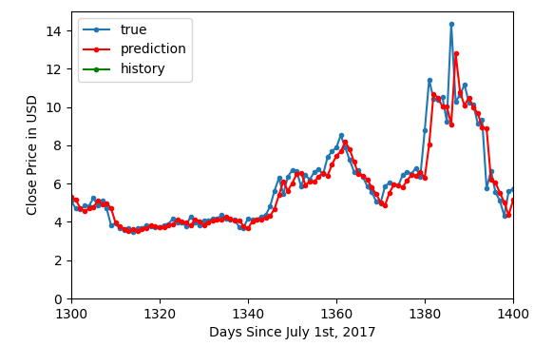
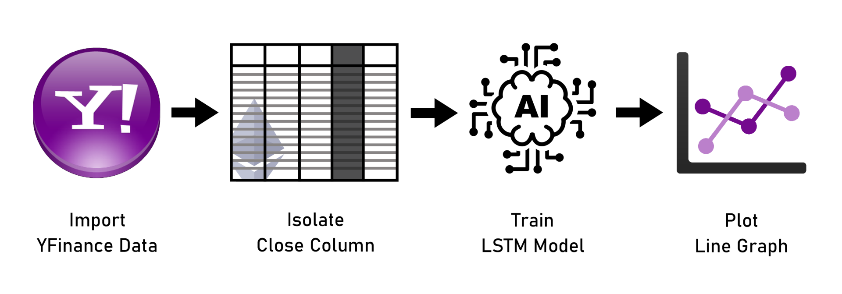
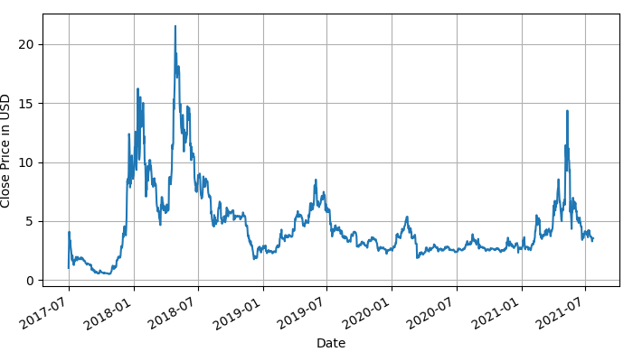
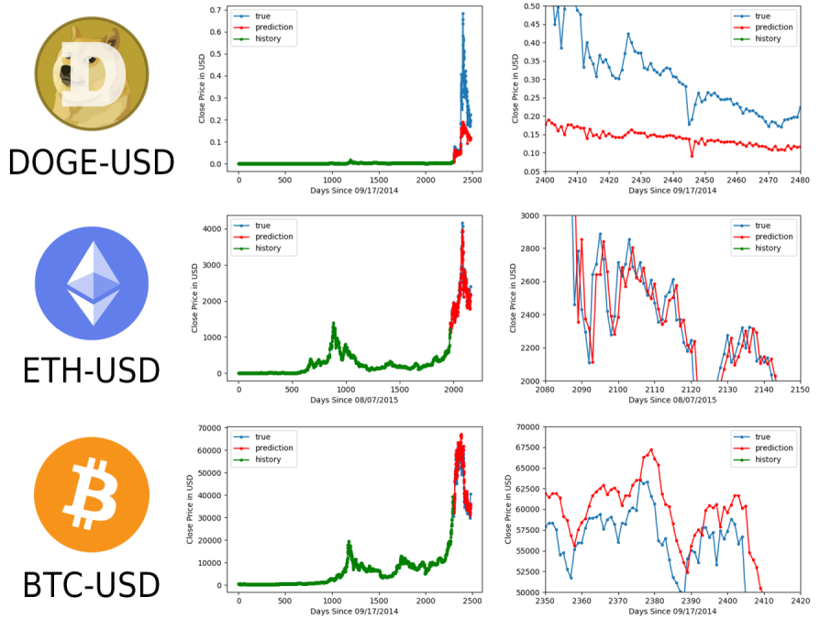
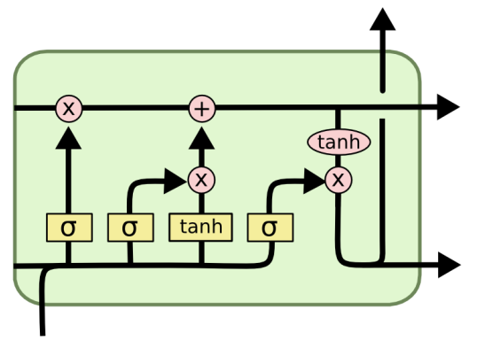
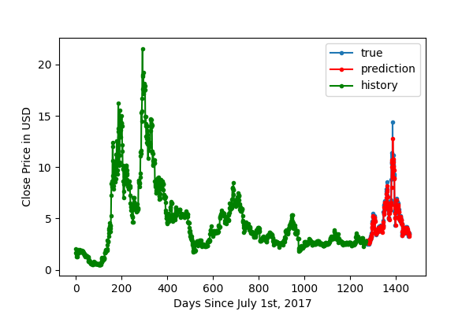

Time Series Analysis of Blockchain-Based Cryptocurrency Price Changes
Jacques Fleischer¹, Carlos Theran, Ph.D.², Yohn Jairo Parra Bautista, Ph.D.², and Gregor von Laszewski, Ph.D.³
¹Miami Dade College, Kendall Campus, Miami, FL ²Florida Agricultural and Mechanical University, Tallahassee, FL ³Indiana University, Bloomington, IN
INTRODUCTION
METHODS
Zoomed-In EOS-USD Prediction Model
REFERENCES
Blockchain is an open, distributed ledger that records transactions of cryptocurrency. This new blockchain technology is becoming an increasingly popular alternative to mainstream transactions through traditional banks¹. These transactions utilize cryptocurrency, an attractive blockchain-based investment of today's age, particularly in Bitcoin. However, the U.S. Securities and Exchange Commission warns that high-risk accompanies these investments².
Prediction Program Architecture
¹Iansiti, M., & Lakhani, K. R. (2018, February). The Truth About Blockchain. Harvard Business Review. https://hbr.org/2017/01/the-truth-about-blockchain
²Schock, L. (n.d.). Thinking About Buying the Latest New Cryptocurrency or Token?. https://www.investor.gov/additional-resources/spotlight/directors-take/thinking-about-buying-latest-new-cryptocurrency-or
³Fleischer, J. (2021, July 26). yfinance-lstm.ipynb Jupyter Notebook. GitHub. https://github.com/cybertraining-dsc/su21-reu-361/blob/main/project/code/yfinance-lstm.ipynb
⁴Yahoo Finance. (n.d.). EOS USD (EOS-USD). https://finance.yahoo.com/quote/EOS-USD/history?p=EOS-USD
⁵Hochreiter, S., & Schmidhuber, J. (1997). Long Short-Term Memory. Neural Computation, 9(8), 1735-1780. https://www.bioinf.jku.at/publications/older/2604.pdf
⁶Olah, C. (2015, August 27). Understanding LSTM Networks. https://colah.github.io/posts/2015-08-Understanding-LSTMs/
⁷Green, J. S. (2018, July 19). Understanding cryptocurrency market fluctuations. The Daily Telegraph. https://www.telegraph.co.uk/business/business-reporter/cryptocurrency-market-fluctuations/
⁸Shroff, R. (2020, February 14). When Blockchain Meets Artificial Intelligence. Medium. https://medium.com/swlh/when-blockchain-meets-artificial-intelligence-e448968d0482
⁹Loukas, S. (2020, July 10). Time-Series Forecasting: Predicting Stock Prices Using An LSTM Model. Towards Data Science. https://towardsdatascience.com/lstm-time-series-forecasting-predicting-stock-prices-using-an-lstm-model-6223e9644a2f
¹⁰Viraf. (2020, June 29). How (NOT) To Predict Stock Prices With LSTMs. Towards Data Science. https://towardsdatascience.com/how-not-to-predict-stock-prices-with-lstms-a51f564ccbca
¹¹Zomer, D. (2020, June 17). Using machine learning to predict future bitcoin prices. Towards Data Science. https://towardsdatascience.com/using-machine-learning-to-predict-future-bitcoin-prices-6637e7bfa58f
EOS-USD Cryptocurrency Price Data
Figure 3: The process of producing LSTM timeseries based on cryptocurrency price.
This project’s code was inspired by Serafeim Loukas⁹ and Viraf’s¹⁰ programs, which we modified to predict cryptocurrency instead of stocks. This project used LSTM to predict the price because its structure allows for the learning of features through different time-steps, remembering patterns in data. This neural network can also selectively choose which data points to use and which to disregard for the model¹¹. For example, this experiment's code isolated only the close values since we intended to predict closing price.
Firstly, the program received input such as “EOS-USD” or “BTC-USD” to know which cryptocurrency to predict. A complete list of acceptable inputs is under the Symbol column at https://finance.yahoo.com/cryptocurrencies but theoretically, the program could analyze traditional stocks as well.
Then, the program downloaded the historical data for the corresponding coin through yfinance. This Python module retrieved the cryptocurrency’s historical data from Yahoo Finance. The data underwent normalization for optimization of the model. Next, the Close data (the price that the currency has at the end of the day) were split into two sets— a training set and a test set— to assess the model’s accuracy through a training model. The training model was run through a layer of LSTM, a dropout layer to prevent overfitting, and a dense layer to give the model a memory capacity. The program ran the model through 50 epochs, which are phases of LSTM training to build the prediction’s accuracy.
Figure 5: A zoomed-in version of Figure 4, whose x and y axes were scaled for readability.
Other Cryptocurrencies’ Prediction Models
Figure 1: Line graph of volatile EOS-USD price from 1 July 2017 to 22 July 2021. Generated using yfinance-lstm Jupyter notebook³, utilizing price data from Yahoo Finance⁴.
Cryptocurrency’s price is extremely volatile, proving difficult for investors. To understand its price behavior, we used long short-term memory (LSTM), a neural network (form of AI) which ingests information and processes data using a “gradient-based learning algorithm”⁵. The data helps the algorithm learn patterns in time-series: line graphs of regularly occurring data points. We employed LSTM neural networks to analyze cryptocurrency price data so that the model can attempt to predict the latest 200 days of their future price.
Figure 6: EOS, Dogecoin, Ethereum, and Bitcoin prediction models.
LSTM Layer Data Processing
DISCUSSION
RESULTS
The predicted models proved to be quite accurate. For example, the prediction for EOS-USD had a mean squared error of 0.485 USD, only off by half a dollar. At first glance, the results look promising as the predictions have minimal deviation from the true values. However, upon closer look, the values lag by one day, which is a sign that they are only viewing the previous day and mimicking those values. Furthermore, the model cannot go several days or years into the future because there is no data to run on, such as opening price or volume.
EOS-USD Prediction Model
ACKNOWLEDGMENTS
The original research summarized in the following was supported, in part, by National Science Foundation Subaward FAMU C-5083 (Florida Georgia Louis Stokes Alliance for Minority Participation). Any opinions, findings, and conclusions or recommendations expressed in this material are those of the authors and do not necessarily reflect the views of the funding agency.
Thank you to Dr. Gregor von Laszewski, Dr. Yohn Jairo Parra Bautista, and Dr. Carlos Theran for their invaluable guidance. Furthermore, thank you to Florida A&M University for graciously funding this scientific excursion and Miami Dade College School of Science for this research opportunity.
Figure 2: Visual depiction of one layer of long short-term memory⁶.
PURPOSE
CONCLUSIONS
We used Artificial Intelligence (AI) to predict the prices' behavior and counteract cryptocurrency’s severe volatility, which can scare away possible investors⁷. For example, an up-and-coming innovation is the automatic trading of “digital investment assets” by AI, which will hugely outperform trading conducted by humans⁸. This innovation would not be possible without the construction of a program that can pinpoint an ideal time to buy and sell; this project sought to serve as a foundation for such.
Prediction can be a boon for insights into investments with potentially great returns. These findings can contribute to a positive cycle of attracting investors to a coin, which results in a price increase, which repeats.
The experiment is confounded by the nature of stock prices: they follow random walk theory, which means that the nature in which they move follows a random walk: the changes in price do not necessarily happen as a result of previous changes. Thus, this nature of stocks contradicts the very architecture of this experiment because long short-term memory assumes that the values have an effect on one another.
For future research, a program can scrape tweets from influencers' Twitter pages so that a model can guess whether public discussion of a cryptocurrency is favorable or unfavorable (and whether the price will increase as a result).
Figure 4: EOS-USD price overlayed with the latest 200 days predicted by LSTM. Generated using yfinance-lstm Jupyter notebook³. The blue line is the actual price that the cryptocurrency had that day whereas the red is the predicted price.
Notes:
For assistance with this research poster template visit: https://www.posterpresentations.com/helpdesk.html

