Slide 1
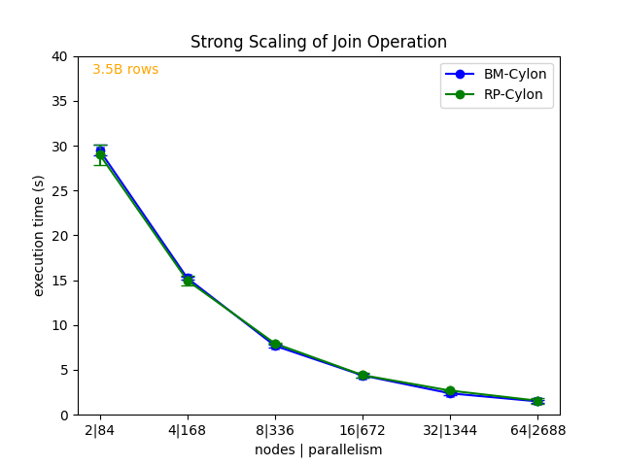
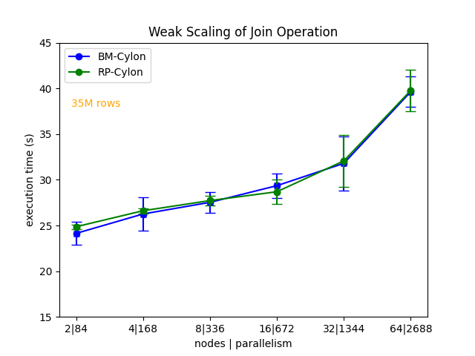
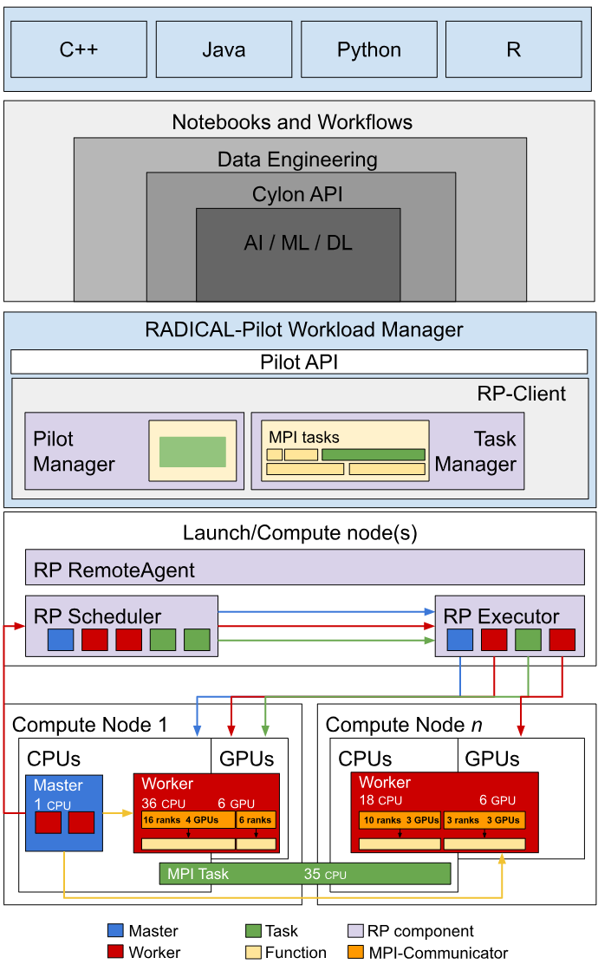
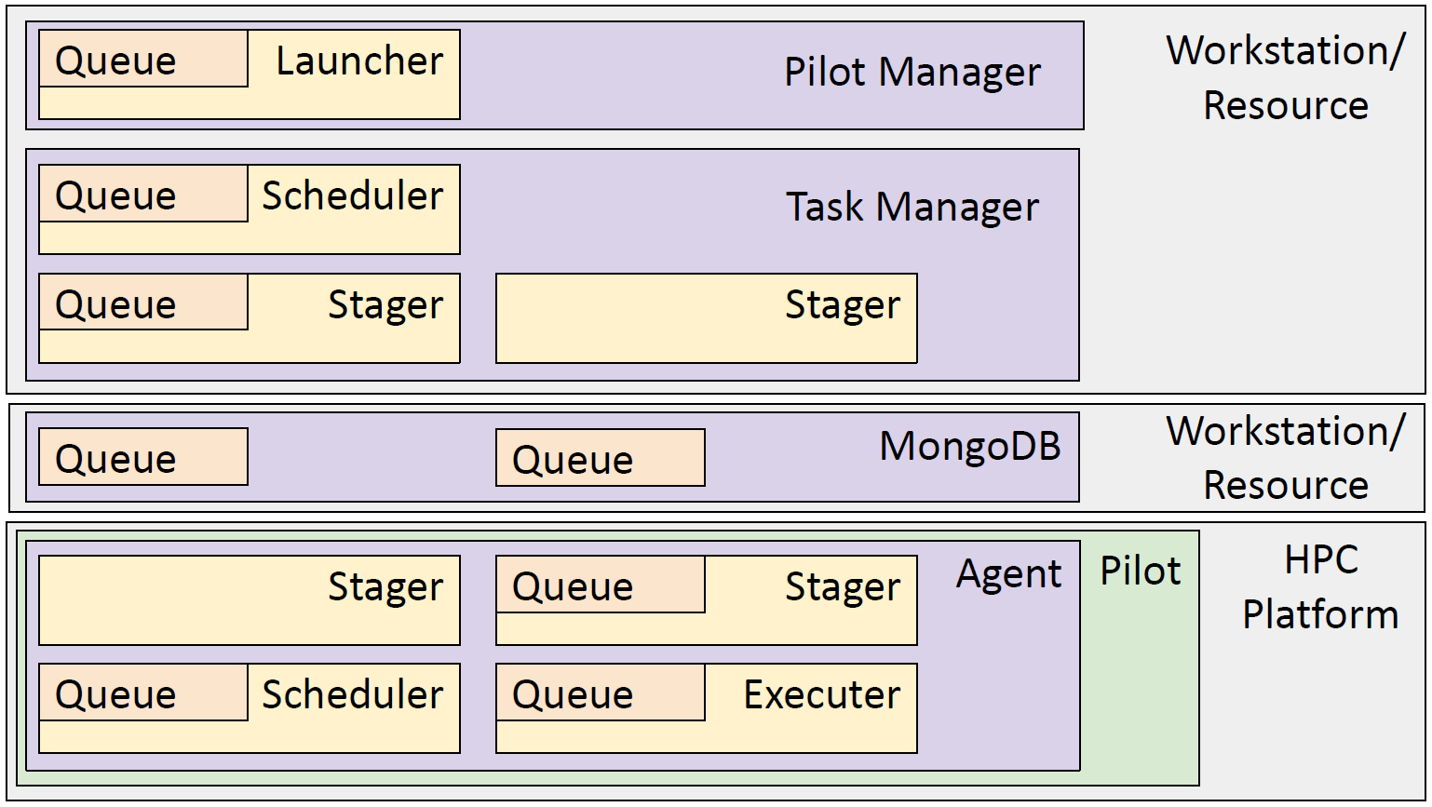
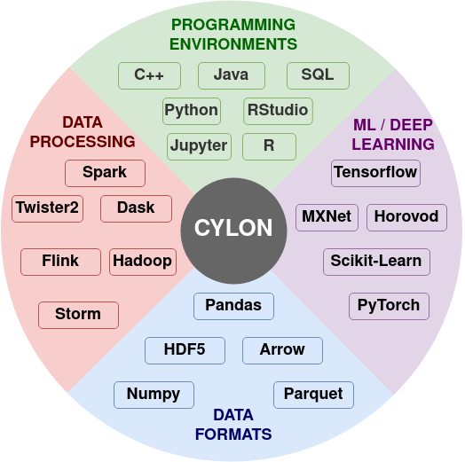
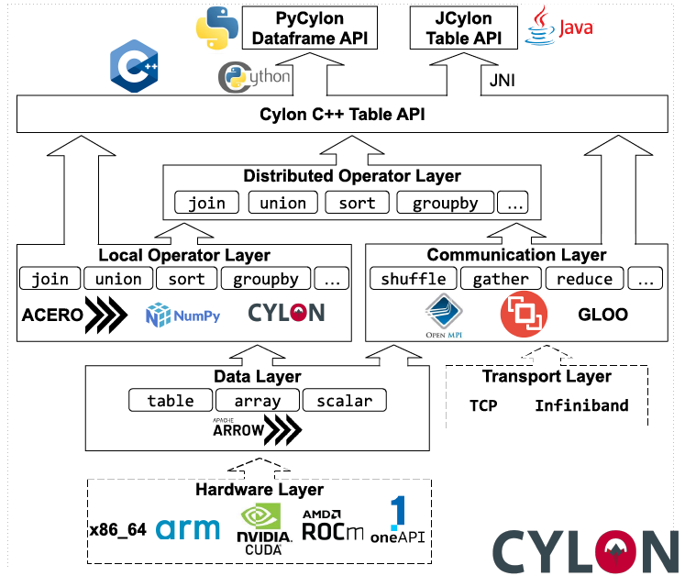
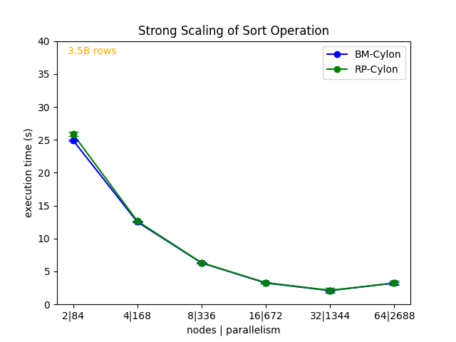
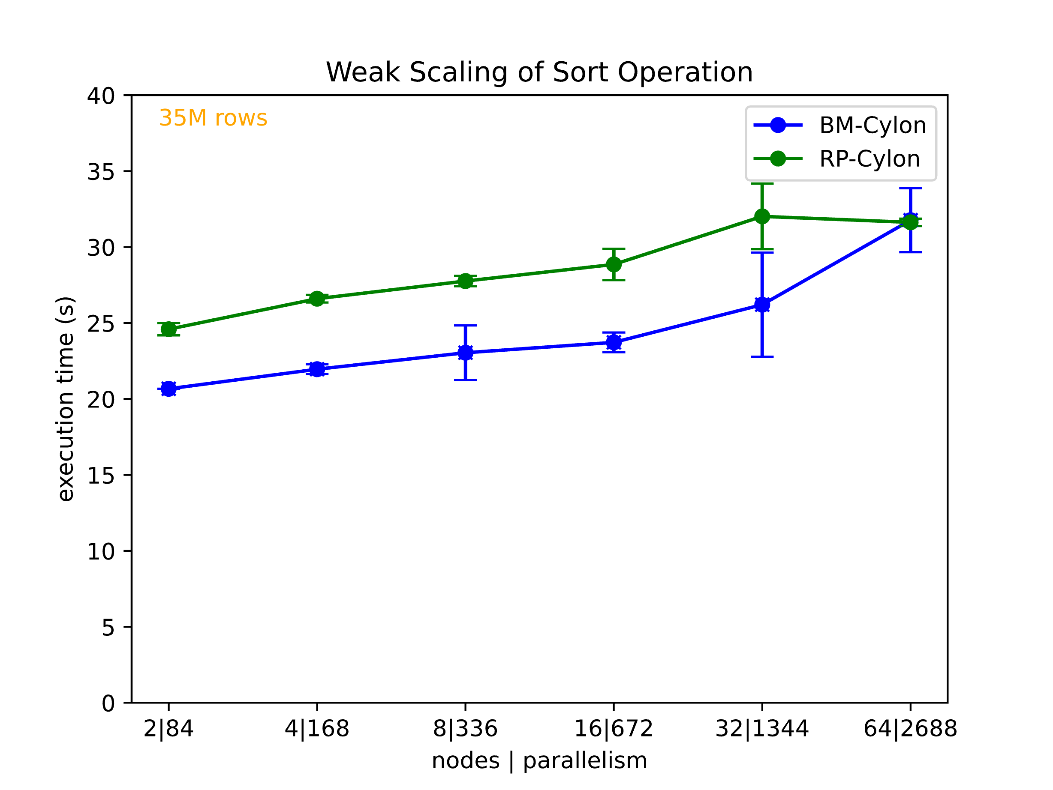
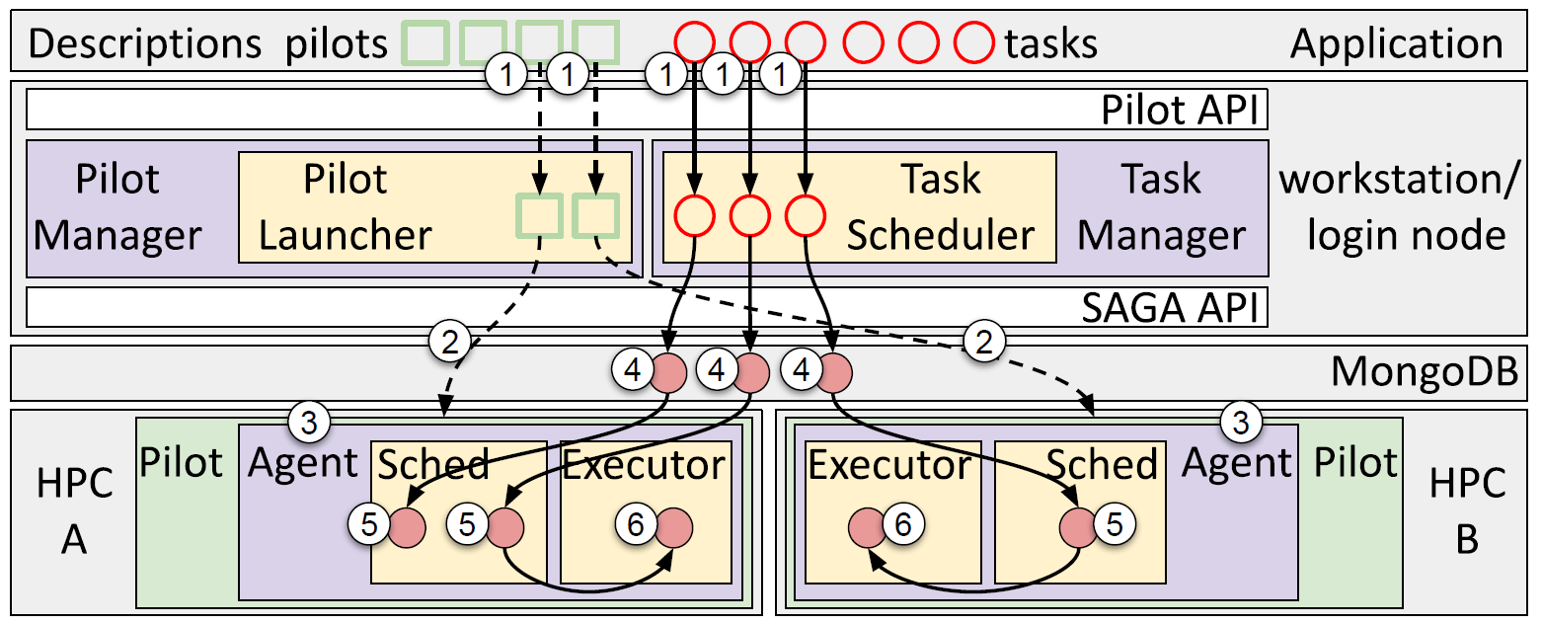


Heterogeneous Data Pipelines for Scientific Computing
NSF 2200409 (Virginia)
NSF 1829704 (Indiana)
Highlights
Leverage Cylon very good performance
> 4x over Pandas serially
> 150x over Pandas parallelly, >50x gains over Dask/Ray DF
> 4x gains over Spark RDDs, Cover ~30% Pandas Dataframe API
Radical Cylon has overlapping performance graph with baremetal cylon on
UVA Rivanna and ORNL Summit in strong and weak scaling test.
Multiple operations (join, sort, …) when performed in different pipeline reduces 20% of execution time.
Hands-off processed data to PyTorch DP DL with zero-copy
Significant technology development: Hybrid HPC, Communication interface;
Benchmarking ; Experiment management; Online and PDF material publication; Training material selection and
production
Data engineering requires high performance data processing frameworks integrating with with ML/DL environment and other frameworks
Cylon provides a common core with layered architecture for distributed SPMD operations leveraging HPC high-performance communication and data processing.
Through the new Radical-Cylon integration we enable now also a task based heterogeneous execution.
Radical-Cylon coordinates now multiple SPMD operations integrating them as functions in the heterogeneous pipelines allowing execution performed based on pre-scheduled resource allocations by the HPC resource manager.
Geoffrey C. Fox, Gregor von Laszewski Arup Sarker Mills Staylor, Niranda Perera
vxj6mb@virginia.edu, gregor@virginia.edu, djy8hg@virginia.edu, qad5gv@virginia.edu
BIOCOMPLEXITY INSTITUTE

