Slide 1
XSEDE TAS
Scientific Impact XSEDE 14, Atlanta, GA, July 16, 2014
Fugang Wang
Gregor von Laszewski
Geoffrey C. Fox
Thomas R. Furlani
Robert L. DeLeon
Steven M. Gallo

Slide 2
Problem
XSEDE provides large scale resources to users to advance science.
Is there some way to provide an indication about the impact of providing such facilities like XSEDE?
How is the impact of scientific research of individual user, project, or field of study, and what if being related to the granted allocation in XD?
When evaluating a proposal request, what is the criteria to judge whether the proposal is potentially leading to good research and broader impact, and how to get metrics to back up this?
Notes:
The three problems mentioned here: XD impact in general (how to justify the funding XD received?); individual impact within XD (how to compare individuals based on XD relevant impact); general achievement/reputation for prospective XD PIs/users

Slide 3
Background and Related Efforts
Measure an individual’s scientific achievement/impact
Number of publications; metrics like h-index, g-index
The same metrics but based only on recent pubs
Measure a project’s impact in general
nanohub’s citation statistics
Google Scholar
IU Scholarometer
Publish or Perish
Altmetrics
Notes:
What metrics are being used by others to measure researchers; funded projects, etc.
Nanohub:
A ‘citation’ is a published work that cites/refers nanohub site or its related content
Secondary citation is the citation of the above defined ‘citation’
Statistical distributions of the ‘citation’ related data based on different criteria (author’s organization; topic area – research, education, and so on; continent; cited/referred tools/content; cited year; publication type)
Overall secondary citation and h-index computed

Slide 4
Approach
Using the publication and citation data to derive measures for scientific output impact.
Publication and/or citation data are available via subscribed resources (such as ISI Web of Knowledge) or open access like Google Scholar, Microsoft Academic Search, however they usually don't provide unlimited access.
Another approach is to gather the data from users directly.
We will also need users’ input to identify if a publication is XSEDE related (via the XSEDE portal bibliography management feature)
Notes:
Automatic approach – to get the ‘in general’ metrics indicating individual researcher’s achievement.
User provided data – a) via XD portal, XD related publications to compute XD related metrics. The data is very limited since the biblio upload is an optional but not required, and users typically don’t feel motivated to do that. While getting more such data, the XD related metrics would be increasing significantly.
User provided data – b) Based on Google scholar profile id to retrieve the publication list has been done in the proof of concept work. So if the users are providing such information via the XD portal or via POPS as part of the allocation request process, we can try this approach to automatically get user vetted publications list.
Citation data via Google Scholar seems working fine, although quite slowly. In the future this process might be kept running to find citation for new publications; or updating the old data if all completed.

Slide 5
Data Acquiring
Publication data:
Automatic approach:
Mining the NSF award data available from NSF;
Utilizing services from Google Scholar, Microsoft Academic Search, etc.;
Mashup data from different sources;
Requiring user input
XSEDE portal has provided a means for users to upload their publication data.
Users provide their public profile id in a 3rd party online bibliography management system like Google Scholar, and we then do the automatic retrieval;
Citation data:
Are not provided by users directly. Instead obtain data from Google Scholar and ISI.

Slide 6
Metrics
Intuitive Metrics: Number of publications, Number of citations
H-index
Derived based on productivity (quantity of papers published) and impact (based on citation)
h as the max number of papers with citation number higher or equal to h
H-index(m) to compare veteran researchers with junior researchers
G-index
Similar to h-index but it uses average citations so you got rewarded if you have a paper with very high citations
Other Metrics – i10-index (number of publications with at least 10 citations)
Does a researcher keep up with the good research he/she usually does more recently – Metrics from only recent publications

Slide 7
System Design
Pluggable data sources via mining databases and/or accessing 3rd party service APIs
Mashup database providing common interface to collaborating systems like XDMOD
Service layer and web presentation
Notes:
The 3 highlighted points of the architecture view.

Slide 8
Data Acquired – Publication Data
Over 140k publications or over 20k XSEDE users
Not user vetted; Not XSEDE specific
1k user vetted/tagged publication entries
XSEDE related publications, as of July 2014
Notes:
Projects ~ 30 publications per project
Per user by projects is about 10 publications per user
Remember all y is log scale

Slide 9
Data Acquired – citation data
Citation data from ISI for all publications
Citation data from Google Scholar for 33,861 publications
These cover 1462 users (active users from 2012)

Slide 10
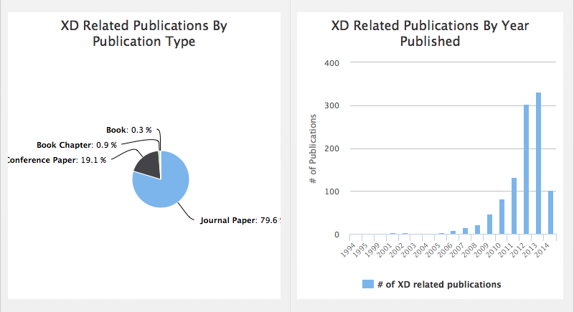
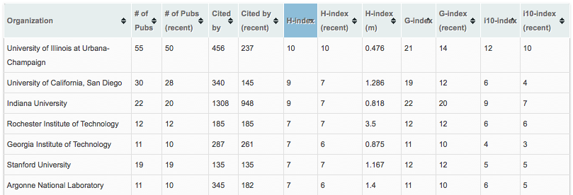
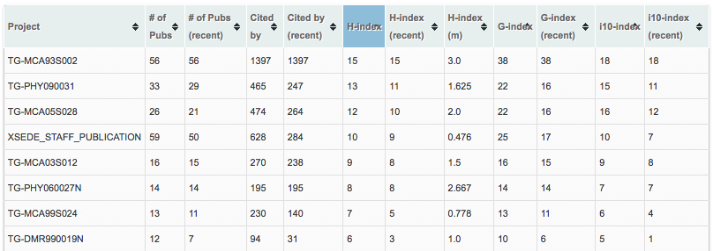
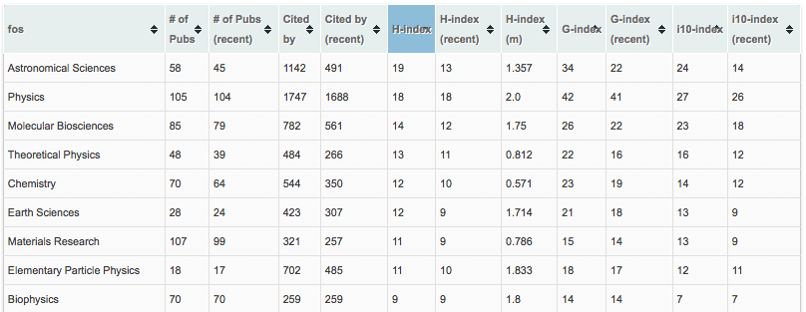
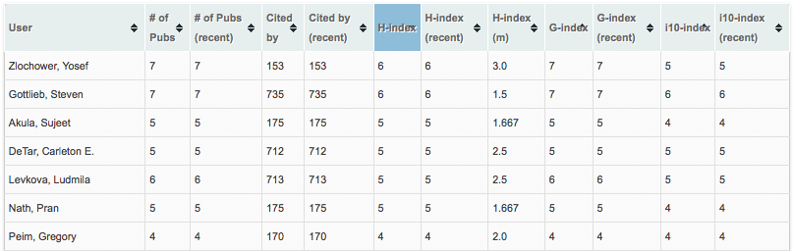
Direct Impact Metrics Derived from XSEDE related publications only
XD users: 1075
Organizations: 247
XSEDE projects: 381
Number of publications: 1061
Total citations received from these publications: 12925
(As of July 1, 2014)

Slide 11
Impact Metrics vs Allocations
Weak correlation on individual project level (r ~ 0.3), if we compare for all projects (>6k), or based on project types.
No figure shown, see paper
On FOS level stronger correlation (r ~ 0.7) (132 FOS)
Figures shown to the right
Notes:
Whole data base not just xsede related

Slide 12
H-index of FOS vs Allocations
Effect of size of FOS is shown
De-trended plotting
See interactive version http://tas.futuregrid.org

Slide 13
Projects Impact Metrics vs Allocations (grouped by FOS)
100
50
10
A Data point shows the correlation (r) of project level impact metrics vs the allocations for a FOS.
Data point (dot/circle) size proportional to the size (number of projects) of the FOS.
In the next image we summarize these images (next slide)
Notes:
Tricky to explain.
try to see if we can identify a correlation of the FOS with the number of projects in that size
positive correlation of project level impact metrics vs allocation. The higher the allocation the higher impact

Slide 14
Projects Impact Metrics vs Allocations (by FOS) – cont’d
Number of publications vs allocations on project level, within each FOS.
Boxplots show the distribution of the correlation coefficient (r), grouped based on size of FOS.
Notes:
We can not yet conclude definitely,
The middle 1st quartile, 3 quartile box (50%) are narrower and median is increasing
Box whisker diagram
Shows higher positive correlation when we categorize the projects based on field of science.
This concludes that comparing just based on number or h-index between FOS is not a good criteria for comparision of quality.
Correlation is coming from the size, but also how much goes to field of science.
Some field of science require more allocations than others to produce the same impact

Slide 15
Impact per Allocation vs Allocations (by projects)
Based only on user vetted publications which are tagged to be associated with XSEDE projects/allocations
~300 Projects involved
What do we learn?
Smaller projects are more efficient?
But remember the FOS difference!
Other metrics to be taken into account
A preliminary ROI indicator?
Investment: Allocation
Return: impact metrics
H/G-index, #Pubs, #Cite,
Notes:
If a project recies double the allocation we can not expect that the impact doubles …
Decreased trend when we put more resources in.
Controversial: should we just support smaller project as we than get more publications ;-)
Too few data points to make a valid statement, however we are statistically already quite significant, but WE MUST HAVE MORE DATA AND DO A LONG TERM STUDY!!!

Slide 16
Summary & Discussion
A framework and workflow allowing scientific impact data retrieval, metrics generation and analysis for XSEDE.
Bibliometrics based measures
Easily adoptable and reusable for other similar HPC facilities
Impact metrics for XSEDE entities based on XSEDE related publications
Correlation analysis of impact metrics (based on all general publications obtained) vs the allocations for projects and FOS.
On individual project level no correlation observed.
Stronger correlations observed at FOS level analysis.
When categorizing the projects based on type, FOS, higher correlation observed.
No causal effect is implied.
Impact measure per allocation unit

Slide 17
Ongoing Activities and Future Plans
Boosting the amount of user vetted and tagged publications.
Our collected data are exposed to XSEDE portal to facilitate the publication discovery feature.
Extracting publication data from past XSEDE quarterly report.
Retrieving from 3rd party user vetted repositories (Mendeley, Research Gate, Orcid, Google Scholar, etc.)
Views for users/PIs and XSEDE management teams (resource allocation committee e.g.).
Plain metrics for entities;
Relative standing of an entity within its category (based on allocation type; FOS; etc.)
tas.futuregrid.org
Access will be available from XDMoD.

