Slide 1
Introduction

Slide 2
Instructions for use
EDIT IN GOOGLE SLIDES
Click on the button under the presentation preview that says "Use as Google Slides Theme".
You will get a copy of this document on your Google Drive and will be able to edit, add or delete slides.
You have to be signed in to your Google account.
EDIT IN POWERPOINT®
Click on the button under the presentation preview that says "Download as PowerPoint template". You will get a .pptx file that you can edit in PowerPoint.
Remember to download and install the fonts used in this presentation (you’ll find the links to the font files needed in the Presentation design slide)
More info on how to use this template at www.slidescarnival.com/help-use-presentation-template
This template is free to use under Creative Commons Attribution license. You can keep the Credits slide or mention SlidesCarnival and other resources used in a slide footer.

Slide 3
Linux
1
An introduction

Slide 4
What is linux ?
Kernel
Distributions
Deployment (Servers, desktop, virtual machines)
File structure
Linux shell
Windows subsystem for linux (WSL)

Slide 5
The kernel
Interface program between the hardware and the user processes (drivers).
In charge of managing the resources of the machine.
Security and system calls.

Slide 6
The shell
The shell is a command line interface between the user and the OS

Slide 7
The shell
Navigation commands:
pwd
ls, cd
mkdir
Basic file management:
touch
mv, cp, rm
nano, cat, more/less

Slide 8
Computer architectures
2

Slide 9
The CPU

Slide 10
Flynn’s taxonomy
SISD
SIMD
MIMD
SMP
NUMA

Slide 11
Processes and threads
3
Example using C++ threads library, and measuring execution times

Slide 12
What is a process?

Slide 13
What is a thread?

Slide 14
Multi-task computing
4
Concurrent, parallel and distributed computing

Slide 15
Concurrent computing
Process lifetime overlapping (pipelines)

Slide 16
Parallel computing
Threads, OpenMP

Slide 17
Distributed computing
MPI and others

Slide 18
Our process is easy
first
second
last

Slide 19
Thanks!
Any questions ?
You can find me at
@username
user@mail.me

Slide 20
Let’s review some concepts
Yellow
Is the color of gold, butter and ripe lemons. In the spectrum of visible light, yellow is found between green and orange.
Blue
Is the colour of the clear sky and the deep sea. It is located between violet and green on the optical spectrum.
Red
Is the color of blood, and because of this it has historically been associated with sacrifice, danger and courage.
Yellow
Is the color of gold, butter and ripe lemons. In the spectrum of visible light, yellow is found between green and orange.
Blue
Is the colour of the clear sky and the deep sea. It is located between violet and green on the optical spectrum.
Red
Is the color of blood, and because of this it has historically been associated with sacrifice, danger and courage.

Slide 21
4000
3000
2000
1000
0
You can insert graphs from Excel or Google Sheets

Slide 22
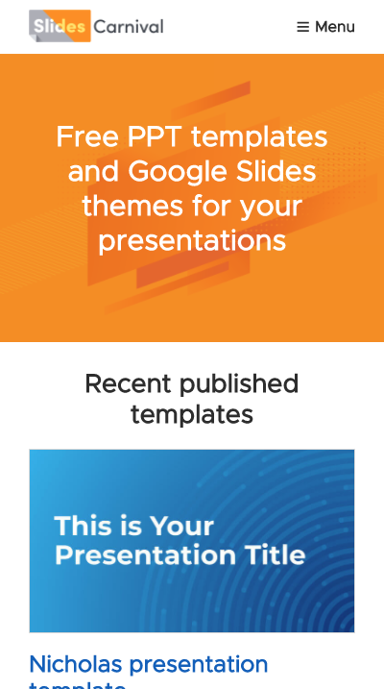
Mobile project
Show and explain your web, app or software projects using these gadget templates.

Slide 23
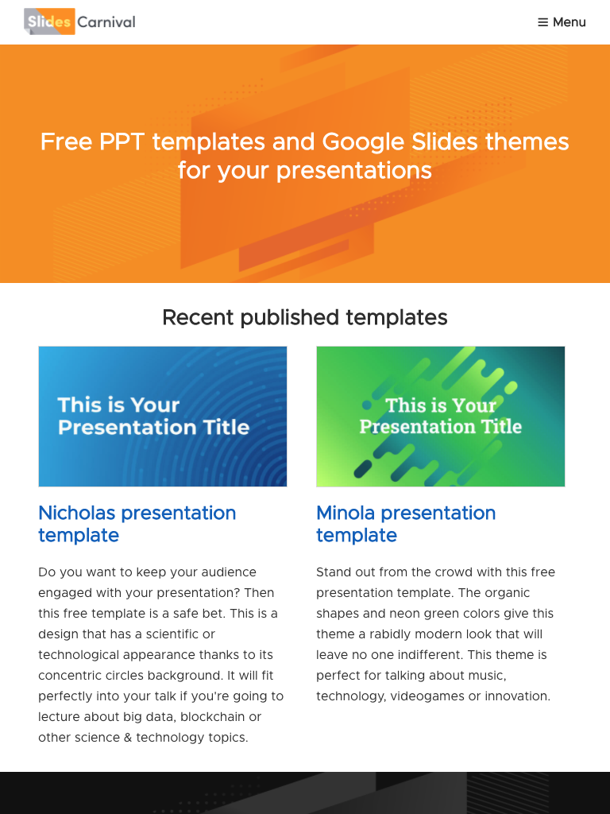
Tablet project
Show and explain your web, app or software projects using these gadget templates.

Slide 24
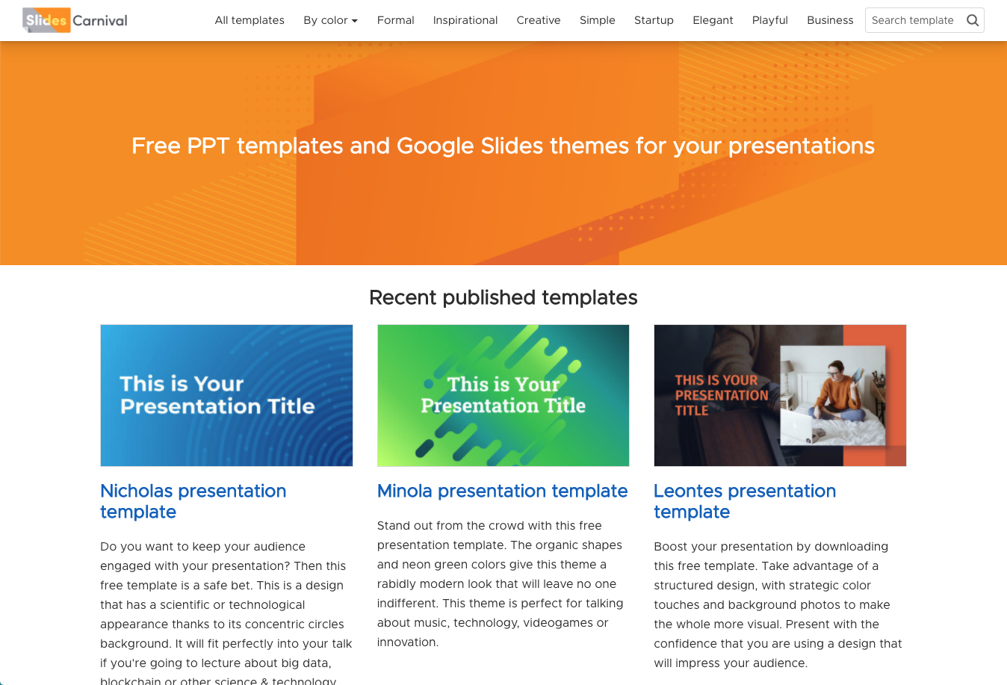
Desktop project
Show and explain your web, app or software projects using these gadget templates.

Slide 25

Free templates for all your presentation needs
For PowerPoint and Google Slides
100% free for personal or commercial use
Ready to use, professional and customizable
Blow your audience away with attractive visuals

