Slide 1
For TechKnow
Faaiz Quyoom • 12th S1

Slide 2
About me
Interested in and willing to learn more about Technology
Self-learnt how to code back in 8th grade
Experienced in Python across multiple APIs
Skilled at data analysis and presentation
Have knowledge about Python libraries like Pygame and Urllib
Have made physics-perfect environments in Pygame
Created a bot capable of mass scraping websites and presenting the information

Slide 3
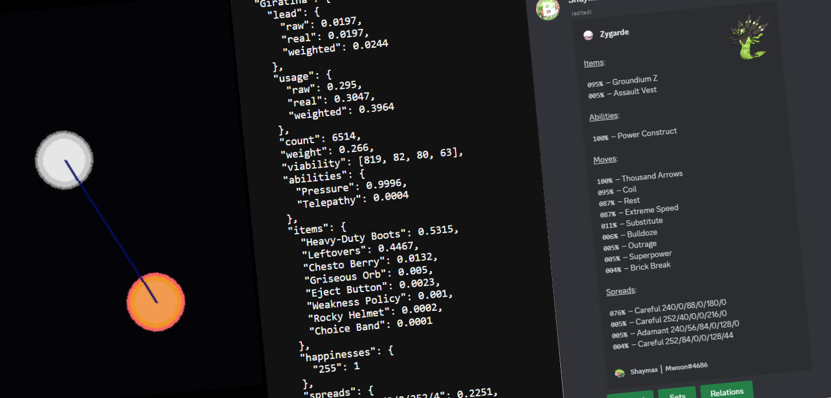
I enjoy making useful programs and improving my knowledge on subjects im interested in
For TechKnow I will -

Slide 4


















Thank You

