Slide 1
Introduction to .NET
Content :
Introduction to .NET Technology
Introduction to Web Based Applications
Introduction to ASP.NET

Slide 2
Introduction to .NET Technology

Slide 3
What is .NET ?
Microsoft.NET is a Framework
Microsoft .NET is a Framework which provides a common platform to Execute or, Run the applications developed in various programming languages.
Microsoft announced the .NET initiative in July 2000.
The main intention was to bridge the gap in interoperability between services of various programming languages.

Slide 4
.NET Framework Objectives
The .NET Framework is designed to fulfill the following objectives:
Provide object-oriented programming environment
Provide environment for developing various types of applications, such as Windows-based applications and Web-based applications
To ensure that code based on the .NET Framework can integrate with any other code
Notes:
Faculty Notes:

Slide 5
.NET Framework
VB
C++
C#
JScript
…
Visual Studio 2008
Common Language Specification
ASP.NET
Windows Forms
ADO.NET
Base Class Library
(CLR) Common Language Runtime
Operating System
Notes:
Faculty Notes:
Figure above illustrates the Microsoft .NET Framework. All .NET languages are built on a Common Language Specification. While designed specifically to support the .NET versions of Visual Basic, C++, C# and JScript, .NET also supports other languages that can be modified to this specification. These include Perl, Python, COBOL, Eiffel, Pascal, Fortran, SmallTalk, Java, RPG, Ada, APL, J# and others.
The .NET Framework is designed to unify programming models to enable cross-language integration.
The Microsoft Active Server Page (ASP) technology has been enhanced as ASP.NET and is designed to allow the easy development of Web services and Web forms see figure above. The development of Windows forms has also been improved with .NET, and ADO.NET provides full support for data and XML. Visual Studio 2005 supports and integrates all of these development environments, automating many development tasks that previously required manual integration.
Each of the languages in the figure is supported by Visual Studio 2005, which is an enhanced IDE. The other languages discussed earlier can also be added to Visual Studio 2005. The strategy behind Visual Studio 2005 is to enable applications to be developed within Windows for later execution in a .NET environment on any platform.

Slide 6
The .NET Framework consists of:
The Common Language Specification (CLS)
It contains guidelines, that language should follow so that they can communicate with other .NET languages. It is also responsible for Type matching.
The Framework Base Class Libraries (BCL) A consistent, object-oriented library of prepackaged functionality and Applications.
The Common Language Runtime (CLR) A language-neutral development & execution environment that provides common runtime for application execution .
Notes:
Faculty Notes:
Just read out the slide the sub point are explained in next slide

Slide 7
Common Language Specification
CLS performs the following functions:
Establishes a framework that helps enable cross-language integration, type safety, and high performance code execution
Provides an object-oriented model that supports the complete implementation of many programming languages
Defines rules that languages must follow, which helps ensure that objects written in different languages can interact with each other

Slide 8
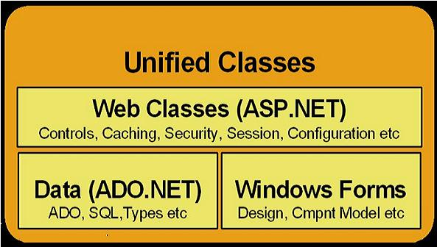
.NET Framework Base Class Library
The Class Library is a comprehensive, object-oriented collection of reusable types
These class library can be used to develop applications that include:
Traditional command-line applications
Graphical user interface (GUI) applications
Applications based on the latest innovations provided by ASP.NET
Web Forms
XML Web services

Slide 9
Common Language Runtime (CLR)
CLR ensures:
A common runtime environment for all .NET languages
Uses Common Type System (strict-type & code-verification)
Memory allocation and garbage collection
Intermediate Language (IL) to native code compiler. Which Compiles MSIL code into native executable code
Security and interoperability of the code with other languages
Over 36 languages supported today
C#, VB, Jscript, Visual C++ from Microsoft
Perl, Python, Smalltalk, Cobol, Haskell, Mercury, Eiffel, Oberon, Oz, Pascal, APL, CAML, Scheme, etc.

Slide 10
Execution in CLR
Source code
VB
C#
C++
Compiler
Compiler
Compiler
Managed
code
Assembly
IL Code
Assembly
IL Code
Assembly
IL Code
Common Language Runtime
JIT Compiler
Native Code
Operating System Services
Notes:
Faculty Notes:
We already know that an assembly does NOT contain native binary code, but instead MSIL code. Obviously before the MSIL code can be executed it must be converted into native binary instructions. Converted? Does this mean interpreted? NO! The MSIL code is compiled and not thrown away. This means that the next time the code is requested it is already in the form of machine instructions and thus this mechanism in the log run is far more efficient than an interpreter for example.
The compilation is carried out by a JIT (Just In Time) compiler. Does the compiler compile all of the code in one go? The answer to this question is NO. If this approach was taken there would be a long delay during the applications initialization, and realistically not all the code within the module will be required in one go. Instead, when the code is loaded a ‘stub’ is connected to each method. When a method is called via the stub the compiler generates the binary native code. This mechanism goes a long way to describing why the compiler is called a ‘JIT’ compiler.
Compiled code is only saved in the same process (run) of an application. And even then it's not guaranteed. We do what's called "code-pitching" which means we through away cold (or little used) JITed code if memory pressure requires it. We do persisted JITed code in the install time scenario.
The benefit to this system is obviously portability. A couple of things to think about -
Let’s imagine you’ve built a managed component for the Intel Pentium III platform. It works fine. Later in the year Intel released a super new chip. When Microsoft released a new version of the JIT, it’s possible that this brand spanking new version of the JIT will have learned a few new tricks e.g. to make use of the new improved instruction set of the new Intel chip or new CPU registers!
And finally, Microsoft plans to offer a tool called PREJIT. This tool will compile your assemblies into native code and save the resultant binary executable code to disk. When the assemblies are next loaded the binary code is already available thus improving startup time and execution speeds.

Slide 11
Visual Studio 2008 IDE
Microsoft has introduced Visual Studio.NET, which is a tool (also called Integrated Development Environment) for developing .NET applications by using programming languages such as VB, C#, VC++ and VJ#. etc.

Slide 12
C# (C Sharp)
Microsoft C# (pronounced C Sharp) developed by Microsoft Corporation, USA
New programming language that runs on the .NET Framework
C# is simple, modern, type safe, and object oriented
C# code is compiled as managed code
Combines the best features of Visual Basic, C++ and Java
Notes:
Faculty Notes:
C# code is compiled as managed code, which means it benefits from the services of the common language runtime. These services include language interoperability, garbage collection, enhanced security, and improved versioning support.

Slide 13
C# Features
Simple
Modern
Object-Oriented
Type-safe
Versionable
Compatible
Secure
Notes:
Faculty Notes:
Simple – It simplifies the use of operators such as -> :: and pointers. It treats integers and boolean data types as two different types.
Modern – because it supports:
Automatic garbage collection
Rich model for Error handling
Decimal Data type for Financial applications
Robust Security model
Object –Oriented:
Supports all the tenets of an object-oriented system
Encapsulation
Inheritance
Polymorphism
Type-Safe:
Dynamically allocated objects and arrays are initialized to zero
Access to arrays are range bound and warned if it goes out of bounds
C# enforces overflow checking in arithmetic operations
Reference parameters that are passed are type-safe
Versionable:
New versions of software's work with existing applications this is known as versioning
Compatible:
Enforces .NET common language specifications and there fore allows inter-operation with other .NET languages

Slide 14
Introduction to Web Based Applications

Slide 15
Introducing Web Applications
Web Page
Static web page
This type of web page consists of HTML code typed directly into text or a web page editor
It is saved as an .htm or .html file
Static
Dynamic
The content (text, images, hyperlinks, and so on) and appearance of a static web page is always the same.
These web pages do not utilize any database or any other technology that dynamically builds up pages or content at runtime based on their visitors input.
Notes:
http://www.visualbuilder.com/aspnet/tutorial/pageorder/2/

Slide 16

How Are Static Web Pages Served ?
WEB SERVER
3. Web Server locates .html file
Author writes
HTML
4. HTML stream( from the .html page) returned to the browser
2. Client requests the web page
5. Browser processes
HTML and displays
page
CLIENT
Notes:
1. Author writes HTML.
2. The Web browser sends a request for a particular Web page of a Web site to the Web server hosting that site. 3. The Web server searches for the page in directory containing Web pages for the Web site.
4. On finding the requested page, the Web server collects the HTML of the Web page. 5. The Web server sends the HTML to the requesting browser which then parses it to develop the visual presentation of the page.

Slide 17
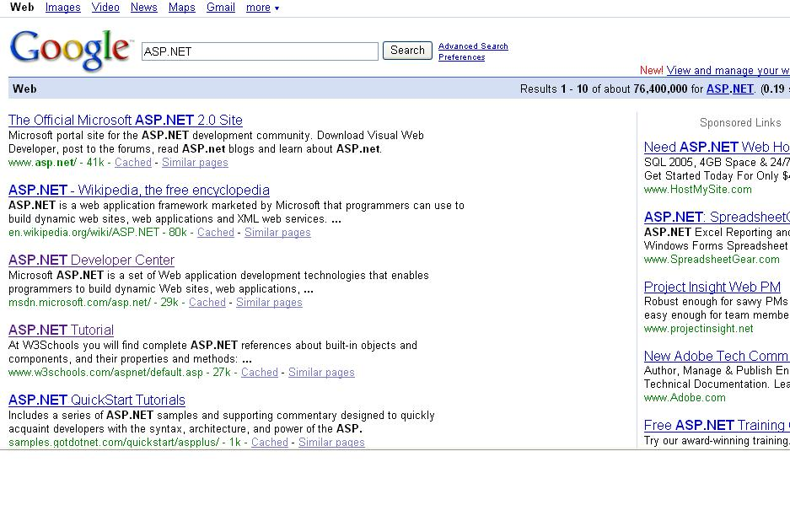
Dynamic web page
Dynamic Web sites provide its visitors to modify the content of the web page based on their input.
They utilize databases and other mechanisms that enable to
identify their visitors
present them with customized greeting messages
restructure the content according to user input etc..
Examples:
Online shopping stores,
search engines
email
chat, community portals etc.

Slide 18
Dynamic web page
Dynamic Web sites make use of “server-side technology”.
Server-side technologies add an extra layer to the static web page that enables the Web Server to generate HTML on the fly.
The web server will first
interpret the server-side code present in web pages,
generate the appropriate HTML and then
send the response to the web browser.
Notes:
Web servers are software that manage Web pages and make them available to client browsers – via a local
network or over the Internet. In the case of the Internet, the Web server and browser are usually on two
different machines, possibly many miles apart. However, in a local situation you can set up a machine
that runs the Web server software, and then use a browser on the same machine to look at its Web pages.

Slide 19
How Are Dynamic Web Pages Served?
Web Server collects the contents (code + HTML) of the web page and parses the contents to produce HTML.
WEB SERVER
2. The Web Server searches for the requested page
4. The HTML stream is sent back to the requesting browser
1. The Web browser sends a request
5. Browser processes
HTML and displays
page
CLIENT
Notes:
1. The Web browser sends a request for a particular Web page of a Web site to the Web server hosting that site.
2. The Web server searches for the page in directory containing Web pages for the Web site.
3. On finding the requested page, the Web server collects the content (code + HTML) of the Web page.
4. The Web server then parses the content to produce HTML.
5. The HTML stream is sent back to the requesting browser which then parses it to develop the visual presentation of the page.

Slide 20

Introduction to ASP.NET

Slide 21
Introduction to ASP.NET
ASP.NET is part of the Microsoft .NET framework
ASP.NET is an effective and flexible technology for creating interactive and dynamic web pages.
It is a convergence of two major Microsoft technologies:
Active Server Pages (ASP)
Active Server Pages is Microsoft’s server side scripting technology for building dynamic web pages.
.NET Framework
The .NET Framework is a suite of technologies designed by Microsoft where program development takes place.
Notes:
Faculty Notes
ASP.NET applications can be written in any .NET compatible language like Visual Basic .NET, C#, and JScript .NET.

Slide 22
Introduction to ASP.NET
It is built on .NET Common Language Runtime
ASP.NET :
Provides better user authentication
Has better language support.
Has a large set of new controls (web controls)
Uses compiled code, which increases the performance of the applications
It is programmable using any of the .NET languages (VB.NET, C#, VJ# etc).
The ASP.NET pages are saved with the .aspx extension.

Slide 23
Working of an ASP.NET Application
To execute an ASP.NET file, the following steps are followed:
A web browser sends a request for an ASP.NET file to the web server by using a URL.
The web server receives the request and retrieves the appropriate ASP.NET file from the disk or memory.
The web server forwards the file to the ASP.NET script engine for processing.
ASP.NET
Script
Engine
WEB SERVER
CLIENT

Slide 24
Working of an ASP.NET Application
4. The ASP.NET script engine reads the file from top to bottom and executes it.
5. The processed ASP.NET file is generated as an HTML document and the ASP.NET script engine sends the HTML page to the Web server.
6. The Web server then sends the HTML code to the client which interprets the output and displays it.
ASP.NET
Script
Engine
WEB SERVER
CLIENT

Slide 25
Advantages of ASP.NET
Easy Programming Model
Flexible Language Options
Compiled Execution
Rich Output Caching
Web-Farm Session State
Enhanced Reliability
Master Pages
Themes
Improved Security
Web Services
Improved Performance and Scalability
Notes:
Faculty Notes
Review the points on the slide, and provide the following elaboration to each point:
Easy Programming Model: HTML-like style of declarative programming of Server controls lets you build great pages with very less code than with classic ASP. All Web browsers support ASP.NET page -- including Netscape, Opera, AOL, and Internet Explorer
Flexible Language Options: More than 25 .NET languages are supported by ASP.NET. This gives flexibility in choice of language
Rich Class Framework: Over 4500 classes and more that encapsulate rich functionality like XML, data access, file uploading, regular expressions, image generation, performance monitoring and logging, transactions, message queuing, SMTP mail are available in .NET Framework
Compiled Execution: ASP.NET application is up to date due to dynamic compilation, and this compiled execution makes the application fast
Rich Output Caching: Rendering of controls to XHTML is improved by output caching. Database caching enables the application to be notified when the underlying database changes, eliminating unnecessary queries
Web-Farm Session State: In a Web farm, ASP.NET session state lets you share session data and user-specific state values across all machines. A Web Farm comprises of multiple Web servers situated on different machines having the same Web Application running on them. It is used for scaling up to increasing number of users and provide satisfactory response times.
Enhanced Reliability:
Master Pages - Using Master Pages, ASP.NET makes it easy to create and apply a common look-and-feel to your Web site. It ensures that the application is always available to users by automatically detecting and recovering from errors like deadlocks and memory leaks.
Themes: Using Themes, Web pages can be given a consistent appearance with the built-in support.
XHTML ComplianceUsing ASP.NET, XHTML-compliant pages can be easily created.
Improved Security ASP.NET helps you protect your data and users.
Built-in Protection ASP.NET has built-in protection from many common forms of hacker attacks, including cross-site scripting and more.
XML Web Services: ASP.NET makes exposing and calling XML Web Services simple. XML Web services allow applications to share data and communicate with other application over the Internet, irrespective of the type of operating system or programming language.
Improved Performance and Scalability: ASP.NET lets you use serve more users with the same hardware.

Slide 26
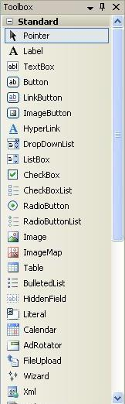
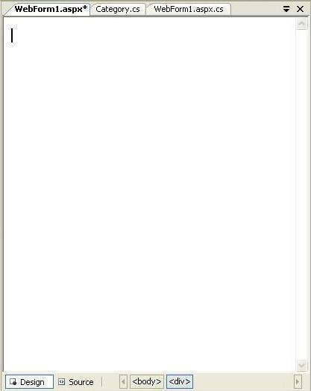
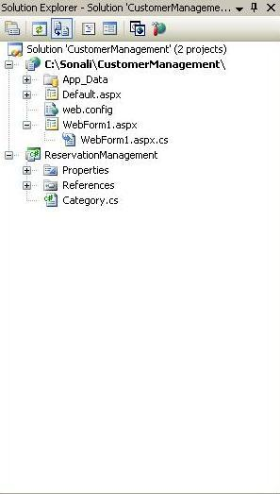
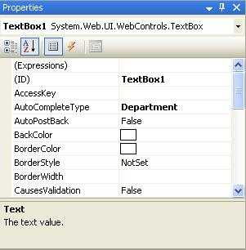
Visual Studio 2008 IDE
Title Bar
Menu Bar
Tool Box
Document window
Solution Explorer
Properties Window
Status Bar
Notes:
Faculty Notes:
Run this slide

Slide 27
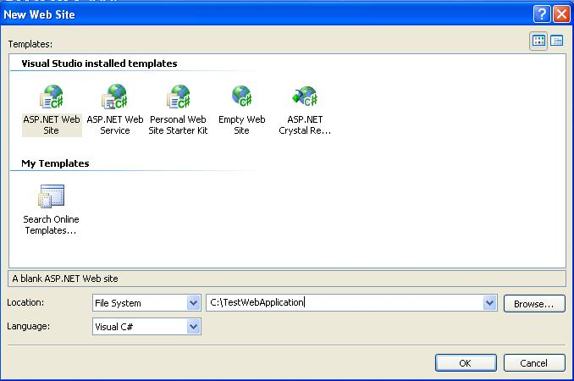
Creating a New Web Application
To start a new Web Application in VS 2008, Click the Create Web Site button on the Start page or Select File > New > Web Site
The New Web Site allows you to choose:
Templates
Language for creating an
application
Location where the application
will be created
Notes:
Faculty Notes:
This slide demonstrates how to create a new Web Application in VS 2008.
You can also create other projects such as a Windows Application, Class Library, Console Application etc;
by selecting File > New > Project and then selecting the required project.

Slide 28
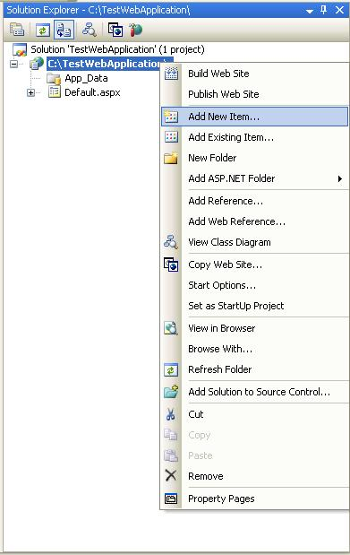
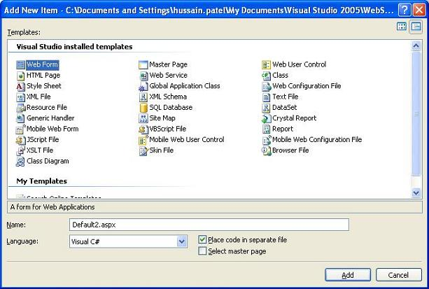
Creating a New Application (Continued)
After you create a new Web Application, Default.aspx page is added to this Website. To Rename this page, Select the page from the Website node in the Solution Explorer > Right Click > Rename.
Files can be added to the Project, using Solution Explorer:
Right click on the project node, in the Solution Explorer, and select the option Add New Item.
The Add New Item window will popup.
Select the type of file (item) to be added and click on Add.
Notes:
Faculty Notes:
Read the content in the slide (Self-explanatory)

Slide 29
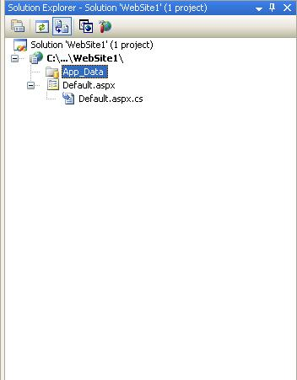
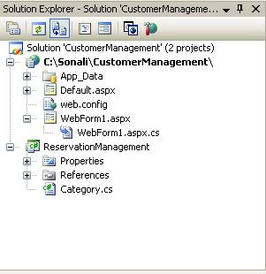
Solution Explorer
Presents a tree view structure of files present in the project.
By default a New Website will contain:
An App_Data folder
A Default.aspx page (including Default.aspx.cs)
To view Solution Explorer:
Select View > Solution Explorer
OR
Press buttons Ctrl+W,S
Notes:
Faculty Notes
Read the content in the slide (Self-explanatory)
Note: You can add multiple projects in a single Solution Explorer.

Slide 30

Solution Explorer (Continued)
The Toolbar at the top of Solution Explorer enables various tasks.
Code
Refresh
Copy Website
Properties
View Designer
Nest Related Files
ASP.NET Configuration
Notes:
Faculty Notes
Explain the following tasks:
Properties – Displays the properties window for the selected file
Refresh - Refreshes the Solution Explorer
Nest Related Files - Undoes the nesting found in ASP.NET files developed by using code-behind files
Code - Displays the code behind file/s
View Designer - Displays the document window
Copy Website – Enable you to copy your application from one point to another (on the same server or on a different server) by opening a new dialog in the document window
ASP.NET Configuration – Displays the ASP.NET configuration page within the document window

Slide 31
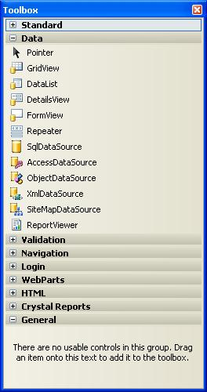
Toolbox
To add controls in the Design Window use Toolbox.
There are various tool tabs available in the Toolbox.
The controls in the IDE are presented in a hierarchical manner (e.g., Standard Tab, Data Tab, Validation, Navigation, WebParts etc.).
Depending on the type of project (application) the toolbox tabs will vary.
To view the tool box:
Select menu View > Toolbox
OR
Press buttons Ctrl+Alt+X or Ctrl+W, X
You can also view the controls as icons by right-clicking on the toolbox you want to change and deselecting the List View.
Notes:
Faculty Notes
Read the content in the slide (Self-explanatory)
Use ToolBox to add controls in the Design Window.
Just drag and drop the required controls in the design window and the control gets added to your application.

Slide 32
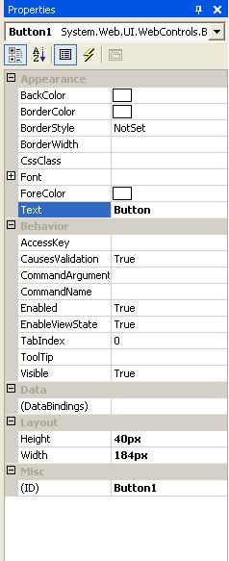
Properties Window
To view or change the properties and events of a selected control during design use the Properties Window
To configure a control:
Click once to select it
Press F4 or Select menu View > Properties window
Modify the appropriate properties in the window
There are various options provided for viewing the properties of the selected control, such as:
Categorized view
Alphabetical view
Properties view (default)
Events View
Property pages
Notes:
Faculty Notes:
Properties shown in grey are read-only
The default view for the Selected control properties view is displayed. Use:
Categorized View (to view the properties by category)
Alphabetical View (to view the properties in alphabetical order)
Events View (to view the events associated with the control)
Property Pages (to view the property page of an option)

Slide 33
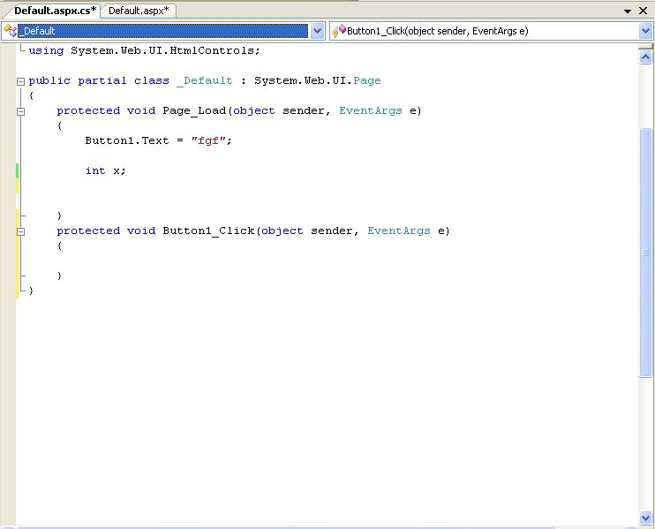
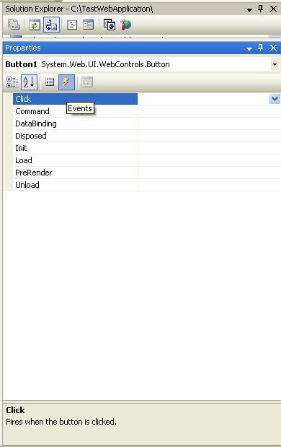
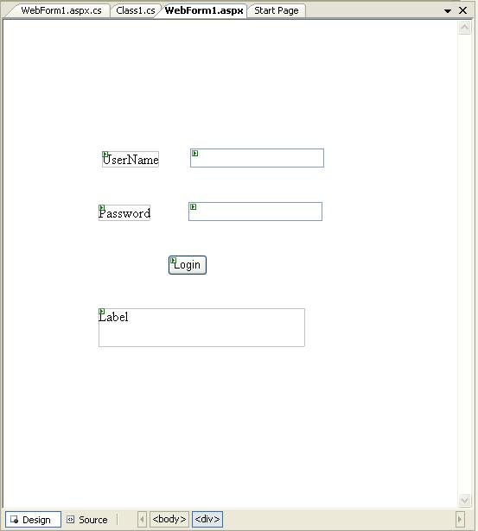
Adding an Event
Events can be added to the code in one of three ways:
Double clicking a control in design view
Typing the code manually
Selecting the Events Icon and double clicking the required event from the Properties Window
Event Handler For Button
Notes:
Faculty Notes:
Type it in manually
You must specify the appropriate parameters and the handles clause
Double-click on a control in the design view
For example, double-click on the page, it will create a Page.Load event handler. Double-click on a button or input control, it will create the required click or change event handler.
Choose the event from the drop-down list:
Once you double-click the control, the events get added to the drop-down list on the top of the code view.
You can choose the required event from this list.

Slide 34
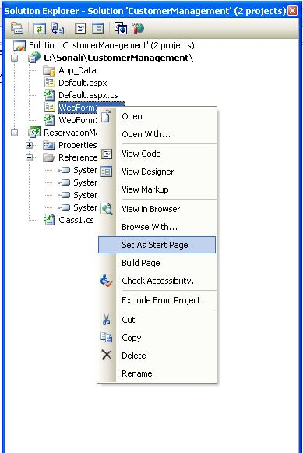
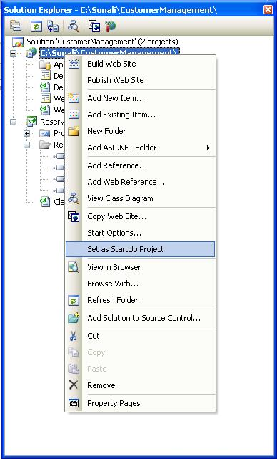
Project Settings
Project Settings can be adjusted using various options in the Project Properties menu or by using the Solution Explorer window.
These settings change based on the type of application developed.
Setting Startup Page:
Right Click on the form you want set as the startup page in the Solution Explorer.
Select option Set As Start Page.
Startup Project (In case of multiple projects):
Right Click on Project to set as startup project in the Solution Explorer.
Select Option Set As StartUp Project.

Slide 35
Resources
Visual Studio 2008 Website
http://msdn.microsoft.com/vstudio/

Slide 36
Questions and Comments
???
Notes:
Faculty Notes:
Ask participants if they have any questions about the content covered in this presentation.

