Slide 1
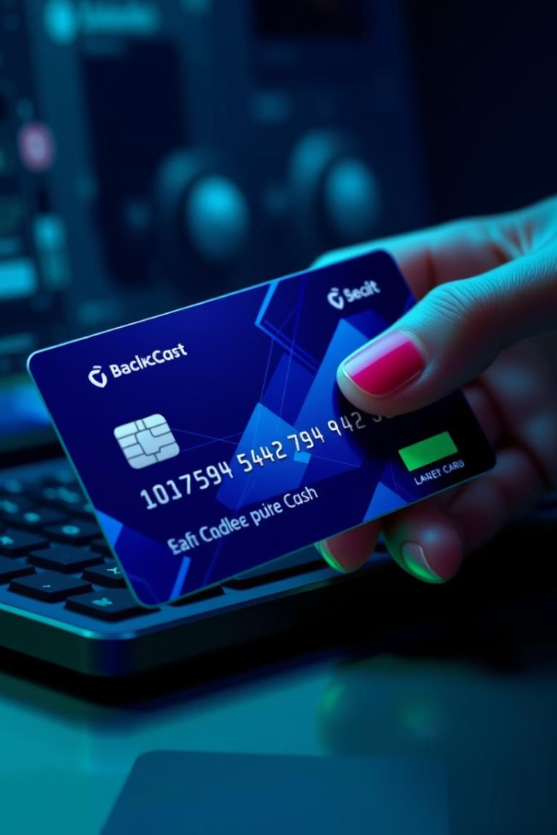
What is Carding? A Growing Threat in Pakistan
This presentation will delve into the increasing threat of carding in Pakistan, a fraudulent activity that exploits stolen credit and debit card data. As digital payments surge across the nation, understanding how these crimes occur, how to protect yourself, and the real-world impact becomes crucial for every digital user. We will cover the methods used by fraudsters, recent cases, and actionable steps to safeguard your financial information.
Mansoor Bukhari

Slide 2




The Rise of Carding in Pakistan
Carding: Illicit Use of Stolen Data
Pakistan's Digital Payment Boom
Carding refers to the unauthorized use of stolen credit or debit card information, often for online purchases or cash withdrawals. It's a significant component of cybercrime globally.
With rapid growth in digital payments, Pakistan has become a larger target for carding. The convenience of online transactions also introduces new vulnerabilities for consumers.
E-commerce Fuels Activity
Millions Lost to Fraud
The surge in e-commerce platforms has provided a fertile ground for carding activities, as fraudsters leverage online shopping to convert stolen data into tangible goods or cash.
In 2023 alone, an estimated $50 million was lost to card fraud in Pakistan, highlighting the severe financial impact on individuals and the economy.

Slide 3
How Card Data is Stolen
Phishing
Skimming
Deceptive emails or fake websites trick users into revealing sensitive card details, often disguised as legitimate communications from banks or popular services.
Illicit devices attached to ATMs or Point-of-Sale (POS) terminals capture card information as it's swiped or inserted, often without the cardholder's knowledge.
Malware
Data Breaches
Harmful software like keyloggers and spyware can be installed on a victim's device to covertly harvest card data, passwords, and other personal information.
Hackers frequently target company databases that store customer payment information, leading to large-scale data breaches that expose millions of card details.
Dumpster Diving
Less common but still a threat, fraudsters physically retrieve discarded card statements or receipts from trash bins to obtain sensitive account numbers.

Slide 4





Validating Stolen Cards
Small Purchases
Carders test the validity of stolen cards by making small, inconspicuous online purchases, typically ranging from $1-2, to avoid raising immediate suspicion.
Automated Checkers
Sophisticated automated tools, known as "checkers," are used to quickly verify card usability and balance by simulating transactions on various payment gateways.
Trial Subscriptions
Exploiting free trial subscriptions for streaming services or software is another common method to confirm a card's active status and bypass larger transaction alerts.
BIN Databases
Fraudsters utilize BIN (Bank Identification Number) databases to verify card types, issuing banks, and other details, helping them target specific card vulnerabilities.

Slide 5

Fraudulent Use of Cards
Unauthorized Online Purchases
Stolen cards are frequently used to buy high-value electronics, designer clothes, and other easily resalable items from e-commerce sites.
Creating Fake Accounts
Carders set up fake accounts for various online services, including streaming platforms, VPNs, and gaming sites, often for personal use or to sell access.
Buying Prepaid/Virtual Currency
Stolen funds are converted into prepaid gift cards or virtual currencies, which are harder to trace and can be quickly liquidated or used for further illicit transactions.
Funding Illicit Activities
In more organized criminal networks, carding proceeds are used to fund a range of other illegal activities, from drug trafficking to cyber extortion, expanding their criminal enterprise.

Slide 6




Cashing Out Stolen Goods
Reselling on Marketplaces
Fraudsters resell goods purchased with stolen cards on popular online marketplaces like OLX or Daraz, often at a discounted price for a quick sale.
Converting Gift Cards
Prepaid gift cards obtained fraudulently are converted into cash through online exchangers or by selling them to unsuspecting individuals for a reduced value.
ATM Withdrawals
Using cloned cards, carders attempt high-risk ATM withdrawals. This method is often riskier due to surveillance and increased security measures at financial institutions.
Money Mules
Complex schemes involve recruiting "money mules" to transfer illicit funds through bank accounts, adding layers to obscure the money's origins and making it harder for authorities to trace.

Slide 7








How Carders Hide Tracks
VPNs & Proxies
Encrypted Messaging
Using Virtual Private Networks (VPNs) and proxy servers allows carders to mask their true IP addresses and locations, making it difficult to trace their online activities.
Communication within carding networks often takes place on encrypted messaging apps like Telegram or Signal, ensuring conversations remain private and untraceable.
Cryptocurrency
Burner Phones
Utilizing cryptocurrencies for transactions provides a layer of anonymity, as these digital assets are decentralized and harder to track than traditional fiat currencies.
Carders frequently use disposable "burner phones" with fake or unregistered SIM cards to avoid leaving a digital trail tied to their real identity.

Slide 8

Real Cases in Pakistan
2024
Multan Gang Arrested
An 18-member gang was apprehended in Multan for online fraud, defrauding victims of over $200,000, showcasing the scale of local carding operations.
2019
FIA Bust
The Federal Investigation Agency (FIA) busted an international credit card scam, which notably implicated several bank employees, highlighting insider threats.
2023
Rawalpindi Scam
Arrests were made in Rawalpindi involving a scam where fraudsters impersonated bank officials to trick unsuspecting individuals, particularly the elderly, into divulging card details.
7K+
Fraud Complaints
FIA data from 2022 indicates over 7,000 card fraud complaints were filed, underscoring the pervasive nature of this crime across Pakistan.

Slide 9





Why Pakistanis Are Vulnerable
Limited Awareness
Many Pakistanis lack awareness of sophisticated carding tactics, making them susceptible to phishing, malware, and social engineering scams.
Weak Cybersecurity
Poor cybersecurity practices, such as reusing passwords across multiple platforms, create easy entry points for fraudsters.
2FA Non-Adoption
The lack of widespread adoption of two-factor authentication (2FA) leaves accounts vulnerable even if passwords are stolen.
Online Reliance
Increasing reliance on online transactions for daily activities expands the attack surface, creating more opportunities for carding.
Education Gap
A significant education gap exists, with 85% of Pakistani adults lacking formal cybersecurity education, hindering their ability to identify and protect themselves from threats.

Slide 10
How to Protect Yourself
Action
Description
Strong Passwords & 2FA
Use complex, unique passwords and enable two-factor authentication on all accounts to add an extra layer of security.
Suspicious Emails/Links
Be vigilant about unsolicited emails or links; never click on them if they seem suspicious or request personal information.
Monitor Bank Statements
Regularly review your bank and card statements for any unauthorized transactions and report discrepancies immediately.
Report Fraud Immediately
If you suspect card fraud, contact your bank and the FIA Cyber Crime Reporting Center at 1991 without delay.
Anti-Malware Software
Install and regularly update reputable anti-malware and antivirus software on all your devices to protect against malicious attacks.
Secure Websites
Only conduct online transactions on secure websites (look for "https://" in the URL and a padlock icon in your browser).
Educate Family
Share knowledge about carding risks with family members, especially the elderly and children, to help them stay safe online.

