Slide 1
Flask VirusTotal Integration
Upload Files and Check Hashes with VirusTotal API
Syed Mansoor ul Hassan Bukhari

Slide 2
Agenda
Installation and setup
Application structure
Flask integration setup
Analyze through file
Analyze through hash
summary
Suggestion and improvement

Slide 3
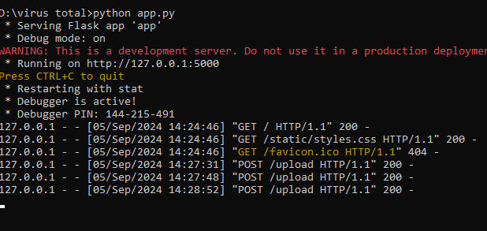
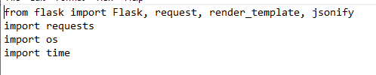
Installation and setup
Install Required Libraries
Run app through command prompt

Slide 4
Application Structure
app.py
templates/index.html
static/style.css
vt-api.txt

Slide 5
Flask Application Setup
Flask web application to upload files and check hashes with Virus Total
Integrated with Virus Total API
Handles file uploads and API responses

Slide 6
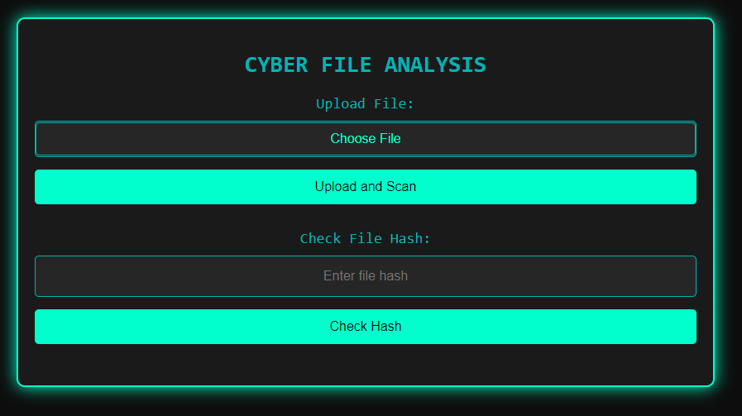
Frontend

Slide 7
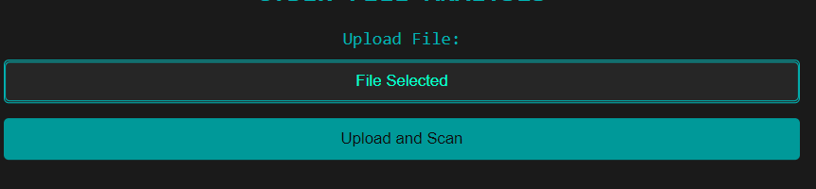
Uploading Files to VirusTotal
Users can upload files via the /upload route
Files are scanned by Virus Total
Results returned to the user in JSON format
Polls the Virus Total API for scan results

Slide 8
VirusTotal API Results
Retrieves analysis results via Virus Total API
Displays file info such as SHA256, MD5, and size
Shows detection stats for malicious, suspicious, and harmless files
Generates a summary of antivirus detections

Slide 9
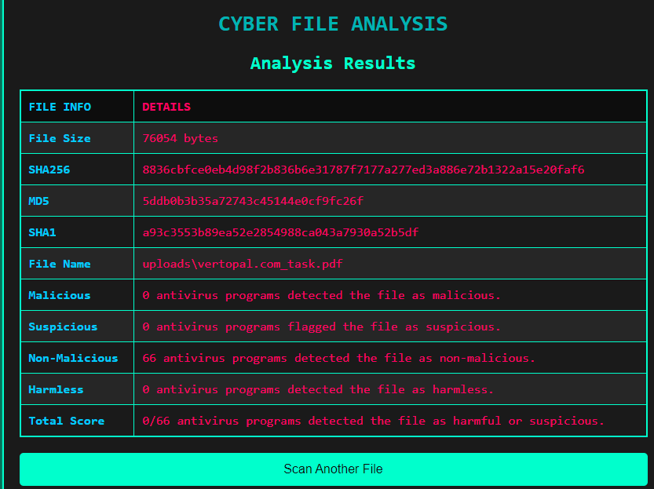
Scanner Result

Slide 10
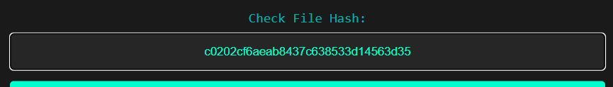
Checking File Hashes
Users can check file hashes via the /hash route
Retrieves information for the hash from Virus Total
Displays the analysis results in a tabular format
Provides a summary of antivirus detections

Slide 11
Summary
Flask application integrated with Virus Total API
Supports file uploads and hash lookups
Polls Virus Total API for scan results
Displays detailed analysis reports with antivirus detection statistics
Easy to extend for additional security features and APIs

Slide 12
Suggestions and Improvements
Enhance user interface for better usability
Implement real-time updates for file scan results
Add logging and error handling for better debugging
Integrate additional threat intelligence APIs
Improve performance by optimizing API calls and reducing wait times
Add user authentication for security and access control

