Slide 1


Cyber Success Restoring

Slide 2
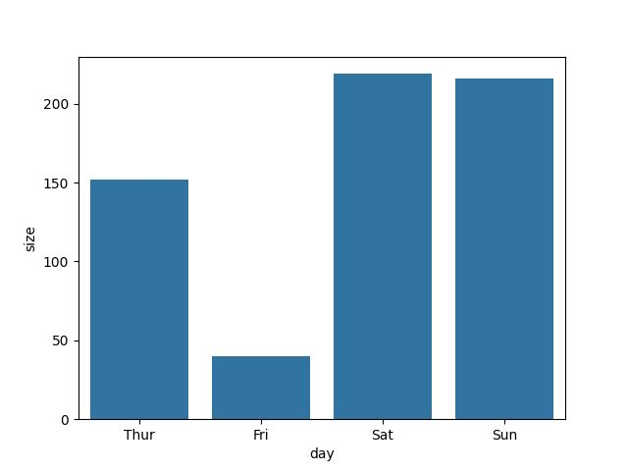
Days wise people
In this ob we understand
Most of people come in sat and less of people come in fri sug : on sat food will prepare early and diner will prepare early

Slide 3
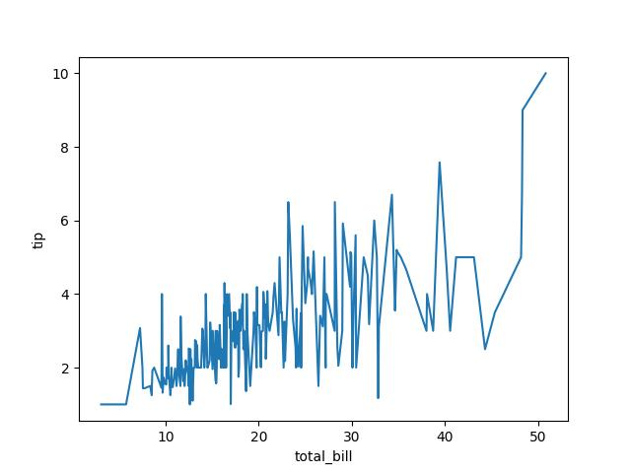

Slide 4
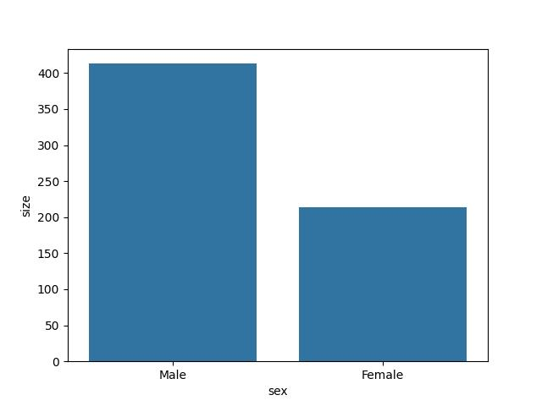

Slide 5
Conculation

Slide 6
Thank you

