Slide 1
Powertrain Design Group Meeting #1
Final Report of “Automotive Powertrain System”

Slide 2
Outline
Why Electric vehicle??
EV concept and technologies (BEV, HEV, FCEV etc.)
Learn EV Mechanical Composition
Vehicle modeling and simulation tools
Parallel Hybrid Vehicle Design
  performance criterion
  road load characteristics
  electric motor and ICE design
Energy Management System
Know about batteries and battery modelling
Electric vehicle simulation
HEV simulation

Slide 3
Why Electric Vehicles?
Increasing automobiles
Declining oil reserves
Increasing greenhouse emissions
Global warming, CARB regulations
Solution: improve the existing power system efficiency, alternate fuels, new materials or alternate power systems like electric vehicles
First solution may not solve the problem in long run. So, look for the other three.

Slide 4
Electric Vehicle concept
EV is a road vehicle based on modern electric propulsion consisting of electric machines, power electronic converters, electric energy sources and storage devices, and electronic controllers;
EV is a broad concept, including BEV, HEV, FCEV, etc;
Regenerative breaking is possible in EVs;
EV is not only just a car but a new system for our society’s clean and efficient road transportation;
EV is an intelligent system which can be integrated with modern transportation networks;
EV design involves the integration of art and engineering;
More advancements are to be done to make them affordable;

Slide 5
EV Mechanical compostion
Three major components and interconnections
propulsion system
wheels
energy source
auxiliary power
Electric Propulsion system: generates the necessary power to the wheels. Includes transmission and energy management system
Energy source: consists of energy sources like fossil fuel, battery or fuel cells. Generates or accepts energy
Auxiliary power system : supplies power to auxiliaries like a.c., fan, lightning system etc.

Slide 6
Comparison of BEV, HEV, and FCEV
Types of EVs
BEV
HEV
FCEV
Propulsion
Electric motor drives
Electric motor drives
ICE
Electric motor drives
Energy system
Battery
ultracapacitor
Battery
Ultracapacitor
ICE generating unit
Fuel cells
Energy source and infrastructure
Electric grid charging facilities
Gasoline stations
Electric grid charging facilities (optional for plug-in hybrid)
Hydrogen
Methanol or gasoline
ethanol
Characteristics
Zero emission
Independence on fossil oil
Commercially available
Low emission
Higher fuel economy
Commercially available
Zero emission Independence on fossil oil
High energy efficiency
Under development (future trend)
Major issues
Limitations of battery
Short range (100-200km)
Charging facilities
Dependence on Fossil fuel
complex
High fuel cell cost
Lack of infrastructure

Slide 7
Vehicle modeling/Simulation tools
Need vehicle modeling because of following reasons
Many configurations/energy management/control strategies
Analytical solution difficult
Prototyping and testing is expensive & time consuming
Simulations tools
SIMPLEV : fuel economy, emissions and several other variables;
MARVEL : optimize size of ICE & battery…cannot predict fuel economy, max. speed acceleration…;
V-Elph : in-depth analysis on plant configurations, sizing, energy management, and optimization of important component parameters;
ADVISOR: forward/backward approach/ menu interface, different configurations, fuel economy, consumption, emissions, performance;
Others: PSAT, CarSim, OSU-HEVSim, Hybrid Vehicle Evaluation code (HVEC);

Slide 8





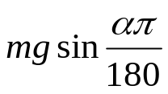
Parallel Hybrid Vehicle Design
hierarchical design starting at the system level ending at component level;
define the performance criterion to be met
acceleration from 0 to 100 km/h (rated vehicle speed) in 16 seconds
gradeability of 5 deg at 100 km/h and maximum of 25 deg at 60 km/h
speed of 160 km/h (ICE only) and 140 km/h (motor only)
single gear ratio and ideal loss-free gears is taken for simplicity;
Road load: A resistive force in the direction opposite to the movement of the vehicle
parameters and constants
Where
is the road load
0 – 27.78 m/s (0 – 100 km/h) in 16 s;
vehicle mass (m) 1767 kg;
rolling resistance coefficient (Cf ) 0.015;
aerodynamic drag coefficient (Cd) 0.35;
wheel radius 0.2794 m (11 in);
zero head-wind conditions;
is the rolling resistance = Cf mg
is the aerodynamic drag = 0.5ρCdAv2sgn(v)
is the road grade =

Slide 9
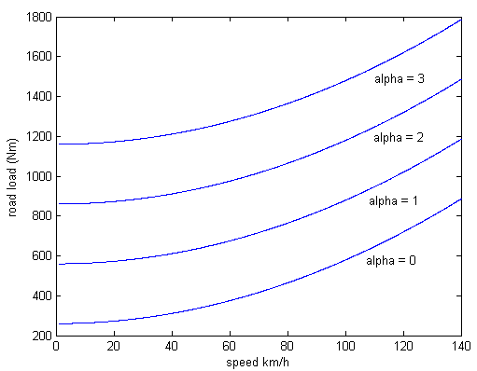


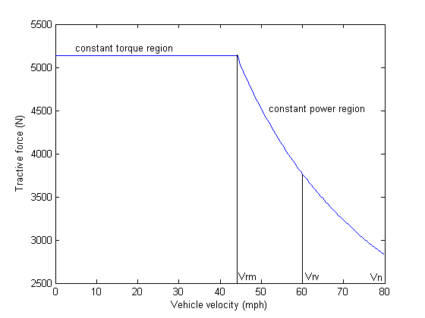
Road load dependence on the vehicle speed
for various road grade angles is shown on the
right
Tractive force is the actual force needed to
drive the vehicle at a velocity v.
is the acceleration force needed to
accelerate the vehicle
Electric Motor design: Motor is designed to meet the acceleration and road load
requirements during initial acceleration
Motor operates in three regions
constant torque region
constant power region
natural mode
Vrm – rated motor speed Vrv – rated veh. speed Vn- max. veh. speed
Characteristics of a motor

Slide 10
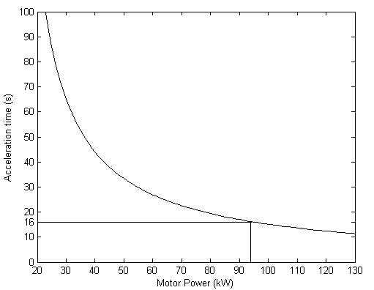
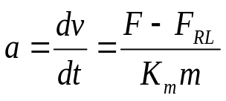
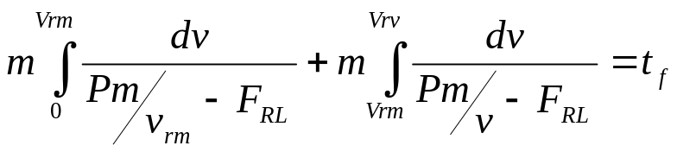
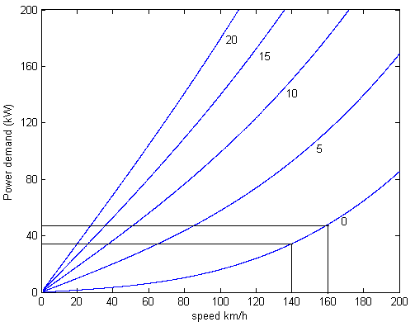
Differential equation governing the system is:
F - available force
Km - mass factor
Splitting the equation in to two constant torque
and constant power region, we get
From the figures, electric motor is to be sized at 95 kW to
meet the 16 sec. acceleration performance and max.
velocity requirement (140 km/h)

Slide 11
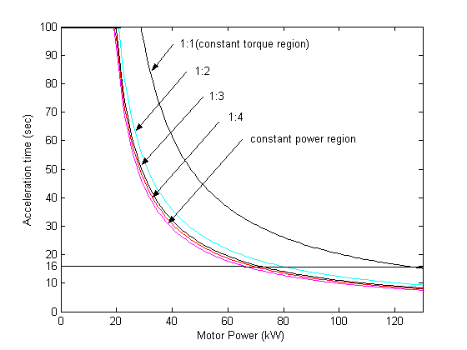

The power requirement decreases
as the constant power ratio increases
Increasing the ratio above 1:4, gives
diminishing results.
Effect of extending the constant power ratio
on the power requirement

Slide 12
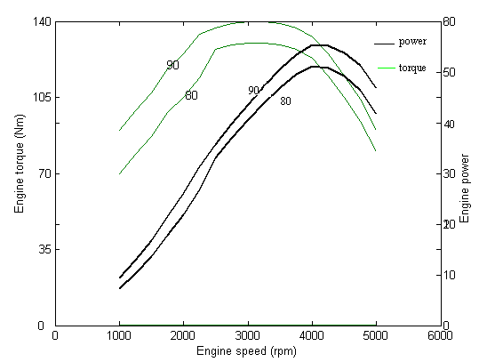
...... Internal Combustion Engine design
ICE torque-speed characteristics
generated using a 2-D lookup table approach in Simulink
ICE design: The ICE is designed to provide the average load power during the drive cycle.
To meet the maximum velocity requirement of 160 km/h, the ICE is to rated at approx. 45 kW. An additional 10 kW for hotel loads, a 55 kW ICE is to be needed.

Slide 13
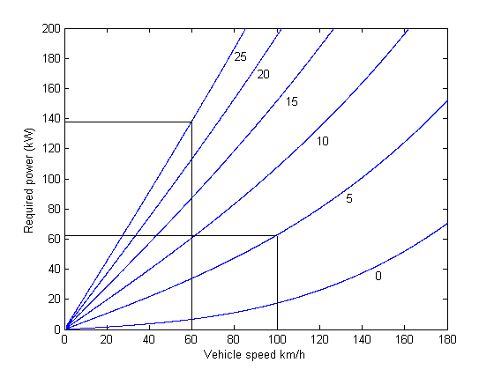
...... Gradeability requirements
From the figure in the right hand side, it is
seen that the vehicle requires approx. 62 kW
to climb a grade of 5 degrees at 100 km/h
and approx. 140 kW to climb a grade of
25 degrees at 60 km/h.
The maximum available power in the vehicle is the sum of available power from the motor and ICE which is equal to 150 kW. The available power is clearly greater than the two power requirements of gradeability.

Slide 14
Energy Management System
Electrical loads in an EV/HEV like cranking system, communications equipment, hotel
loads like electronic loads, a.c. etc and control systems like drive train control, chassis
control must be managed effectively in order to get better efficiency;
EMS is basically a control algorithm which determines how the power is produced in a
powertrain and distributed as a function of vehicle parameters;
The main functions of EMS would be
optimize energy flow for better efficiency;
predict available energy and driving range;
propose a suitable battery charging algorithm;
use regenerative breaking to charge the batteries;
suggest more efficient driving behavior;
report any malfunctions and corrects them;

Slide 15
Comparison of various HEV control strategies
Control strategy | Description | Advantages | Disadvantages
Electrically peaking hybrid concept | electric motor provides acc’n and dec’n power ICE provides average load power in drive cycle | IC at high speeds reduces emissions and optimizes fuel economy performance comparable to conventional vehicles | The power provided by the batteries is significant, requiring more batteries thus more weight
Thermostat or ‘on/off’ strategy | Propulsion depends on SOC High SOC- motor Low SOC-ICE | Increases fuel economy of a series hybrid vehicle | Produces deep cycles in the battery damaging the battery
Power-follower series hybrid control strategy | The ICE power varies directly with the tractive motor power, but it is higher by a SOC dependent factor to allow for losses in the gen./batt. | Better fuel economy ICE immediately follows tractive power requirements, giving better performance | No emissions benefit over ICEVs, and is chosen only for its fuel economy characteristics
Fuzzy logic control | ICE operated in limited fuel use strategy or efficiency strategy Motor operated at low speeds | SOC in limits Tolerant to imprecise measurements and component variability | High fuel consumption because ICE is operated in high torque region

Slide 16
Battery
Terminology
Capacity is the amount of charge the battery can supply. SI unit is Amphour
Specific energy is a measure of electrical energy stored for every kilogram of battery mass.
SI unit is Wh/kg
Energy density is the amount of electrical energy stored per cubic meter of battery volume.
SI unit is Wh/m3
Specific power is the amount of power obtained per kilogram of battery. SI unit is W/kg.
Energy efficiency is the ratio of electrical energy supplied to the amount of energy required
to return it to the state before discharge. Energy efficiency of a battery is in the range of
55 – 75 %.
State of Charge (SOC) is a key parameter, indicates the residual capacity of a battery.
Typically, the SOC is maintained between 20% and 95%.
Depth of Discharge (DOD) is the percentage of battery capacity to which the battery is
discharged.

Slide 17
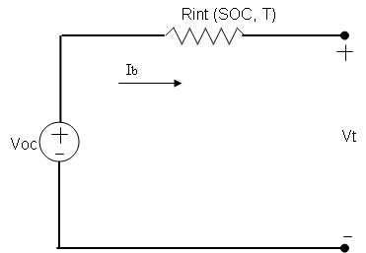
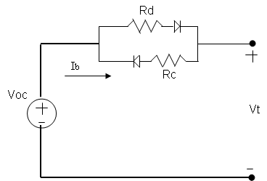
Battery modeling
commonly used model
consists of an ideal battery with open-circuit voltage
Voc, a constant equivalent circuit Rint and battery
terminal voltage Vt.
Vt=Voc-IRint
not a dynamic model
internal resistance is different for charging and
discharging cycles.
resistance Rc comes in to play when battery is
charging and Rd when discharging
disadvantage of not being dynamic

Slide 18
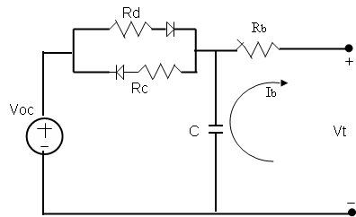
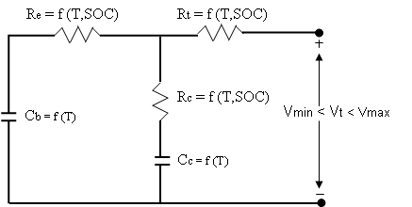
...... Battery modeling continued
adding a capacitor across the voltage source
gives it the dynamic behavior
RC model
resistances are modeled as a function of temp-
erature and battery SOC
Cb is large enough to hold the capacity of the
battery and Cc is small to reflect the dynamic
changes in the battery
maintains the battery output voltage within
the high and low voltage limits

Slide 19
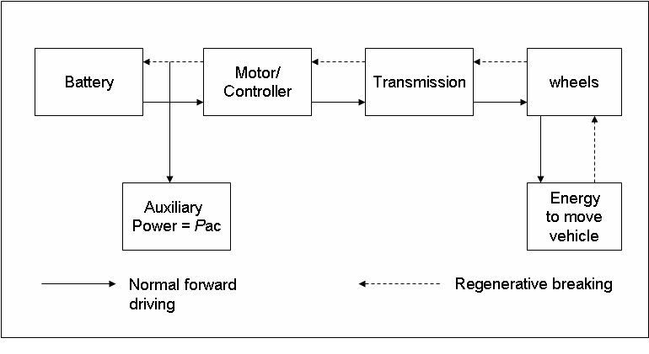
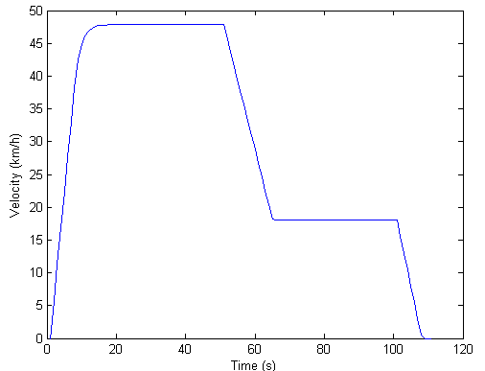
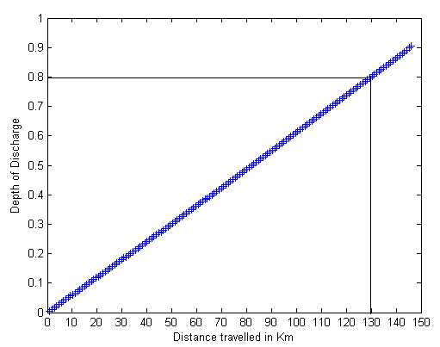
Battery Electric vehicle simulation
Block level BEV and energy flows are shown
ECE-47 cycle is used for simulation
The algorithm is to find the battery power by
calculating the power at the input and output
of each block using the efficiencies.
The battery power is then used to find the
battery current and then DOD.
check whether the battery is discharged
otherwise do one more cycle.

Slide 20
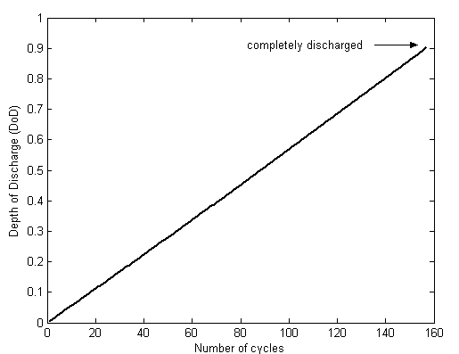
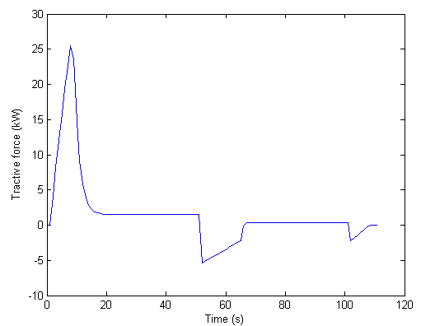
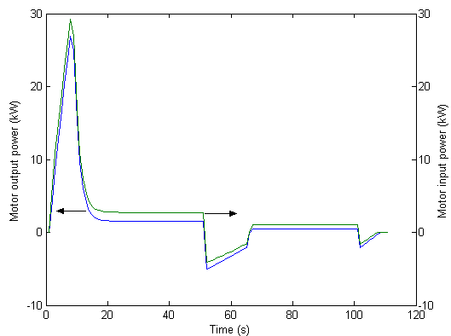
...... BEV simulation continued

Slide 21
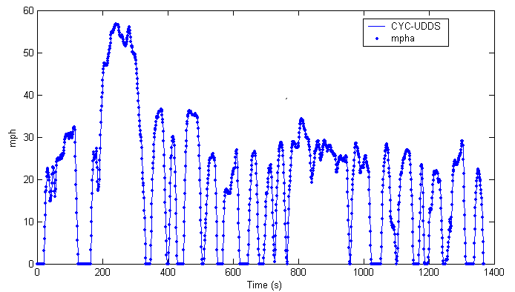
Hybrid Electric Vehicle simulation
HONDA Insight is simulated in ADVISOR
The following performance criterion is set
0 – 60 mph in 12 seconds
40– 60 mph in 6 seconds
0 – 85 mph in 24 seconds
maximum speed limit was set at 120 mph.
6 % grade at 55 mph constraint was set for the gradeability test.
A 50 kW ICE , 10 kW electric motor , a 20kW NiMH energy storage system, a 5 gear manual transmission is selected and the ‘insight’ power control strategy is selected. The combined mass the vehicle was set to be 962 kg and the drive cycle ‘CYC_UDDS’ is chosen.
Simulation results are shown below:
0 – 60 mph in 11.5 seconds
40 – 60 mph in 5.3 seconds
0 – 85 mph in 23.5 seconds
Maximum speed is 120 mph
6% gradeability at 55 mph is achieved.

Slide 22
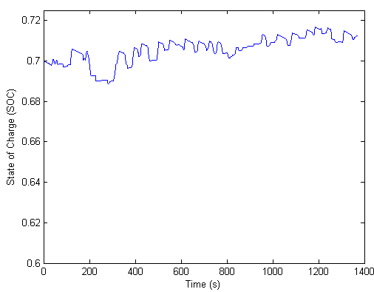
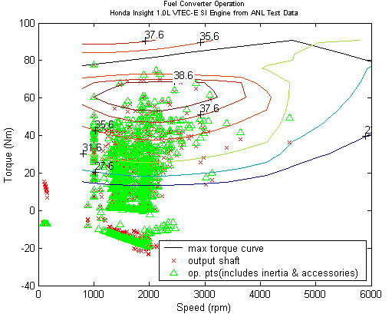
...... HEV simulation continued

Slide 23
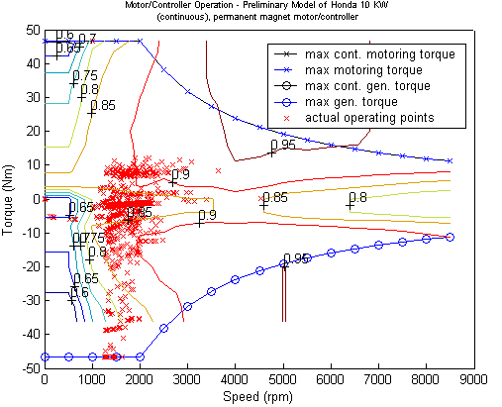
...... HEV simulation continued

Slide 24
References
[1] Chan C. C. and Chau K. T., “Modern Electric Vehicle Technology,” Oxford Uni. Press, 2001.
[2] Riezenman M. J., “Electric Vehicles,” IEEE Spectrum, Nov. 1992
[3] Chan C.C., “The state of the Art of Electric and Hybrid vehicles,” Proc. of the IEEE, vol. 90, no. 2, Feb. 2002.
[4] I. Husain, “Electric and hybrid vehicles: Design Fundamentals,” CRC Press, New York, 2003.
[5] K. M. Stevens, “ A versatile computer model for the design of the design and analysis of electric and hybrid drive trains,” Master’s thesis, Texas A&M Univ., 1996.
[6] K. B. Wipke, M. R. Cuddy, and S. D. Burch, “ADVISOR 2.1: A User-Friendly Advanced Powertrain Simulation Using a Combined Backward/Forward Approach,” NREL/JA-540-26839, Sep. 1999.
[7] N. Schouten, M. Salman, and N. Kheir, “Fuzzy logic control for parallel hybrid vehicles,” IEEE Trans. Contr. Syst. Technol., vol. 10, pp. 460-468, May 2002.
[8] ADVISOR 2002 Documentation
[9] J. Larminie and J. Lowry, “Electric vehicle technology explained,” John Wiley & Sons, Ltd., England, 2003.
[10] K. L. Butler, M. Ehsani, and P. Kamath, “A Matlab-Based Modeling and Simulation Package for Electric and Hybrid Electric Vehicle Design,” IEEE Trans. on Veh. Tech., vol. 48, no. 6, pp. 1770-1778, Nov. 1999.

