Slide 1
Data Wrangling: Risk assessments of potential failure of aging dams
Jinwoo Park, Zhiyu Li, Anand Padmanabhan
Department of Geography and Geographic Information Science
CyberGIS Center for Advanced Digital and Spatial Studies
CyberInfrastructure and Geospatial Information Laboratory
University of Illinois at Urbana-Champaign
Mar 14, 2022

Slide 2
Background
I-GUIDE (collaboration with Drs. Lall and Kalyanam)
Numerous dams in the US are in a risky situation.
Understand the hydro dynamics in the case of dam failure
Project communities at risk, critical infrastructure, and economic and ecological impacts of dam failure.

Slide 3
Datasets
National inventory of dams
HIFLD (Jinwoo)
Airports and Heliports; Colleges & Universities; Communication Facilities; Correctional Facilities; Electrical Substations; Emergency Medical; Fire Stations; Hospitals; Power Plants; Natural Gas Storage; Petroleum Bulk Stations; Police Stations; Railway Lines; Schools; Wastewater Plants
National Levee Databases (Zhiyu)
National Flood Hazard Layers (Rajesh, Purdue)

Slide 4
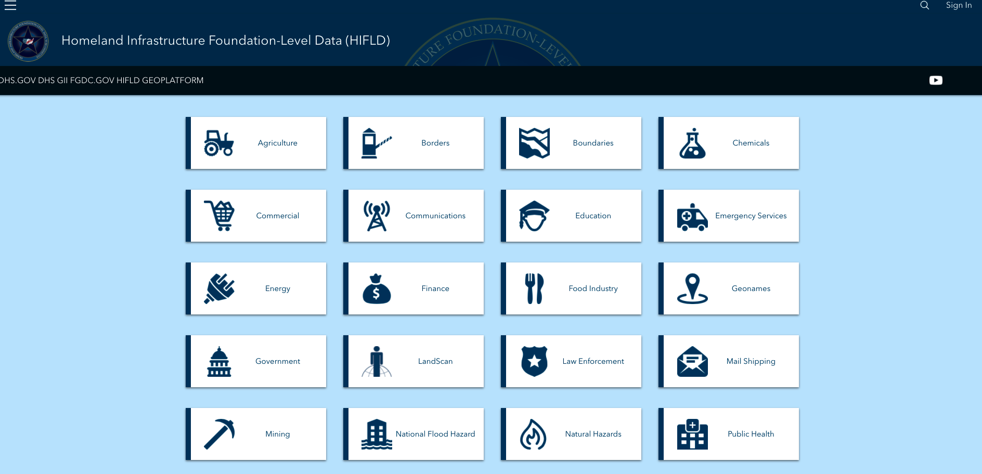
Homeland Infrastructure Foundation-Level Data (HIFLD)

Slide 5
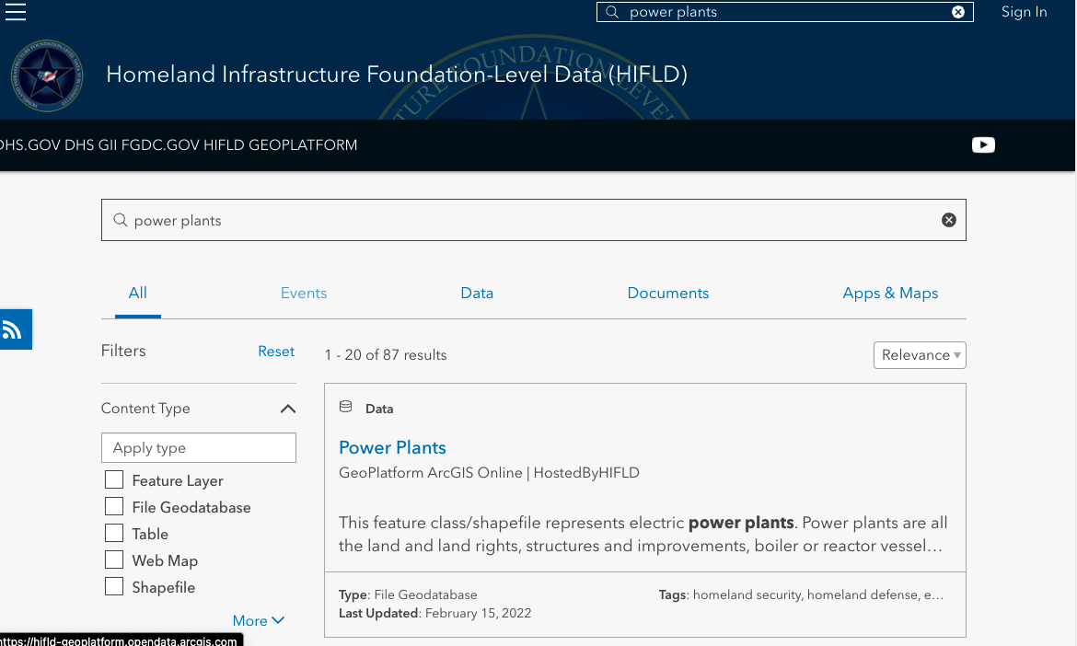
Example: Power plants

Slide 6
Example: Power plants
Provides data in various formats (e.g., file gdb, shapefile, csv, etc.)
Provides online service via ArcGIS API.
NO METADATA IS AVAILABLE.

Slide 7
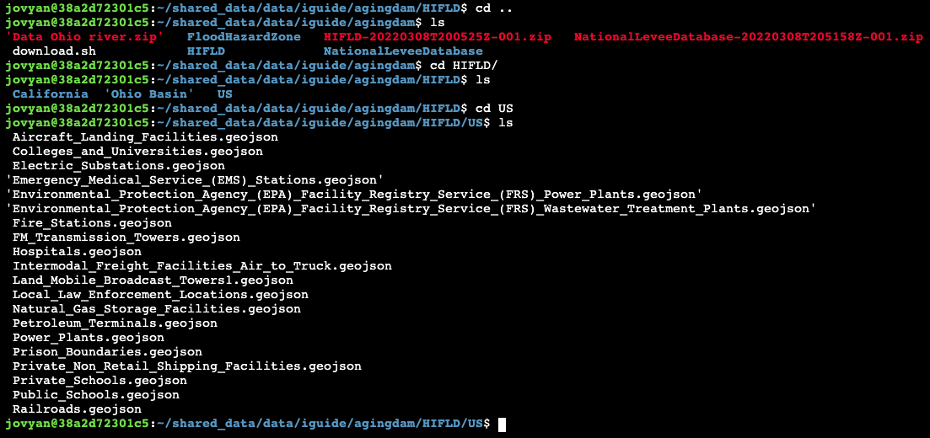
Data repo on Keeling
/data/cigi/cybergis-jupyter/production_data/notebook_shared_data/data/iguide/agingdam

Slide 8
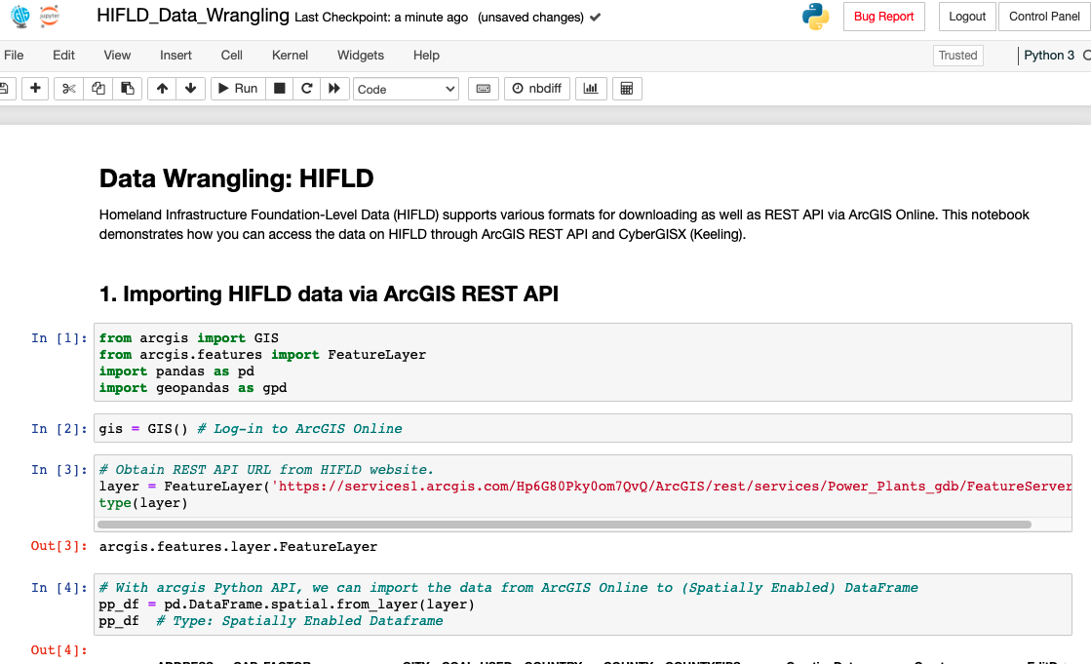
Demonstration

Slide 9
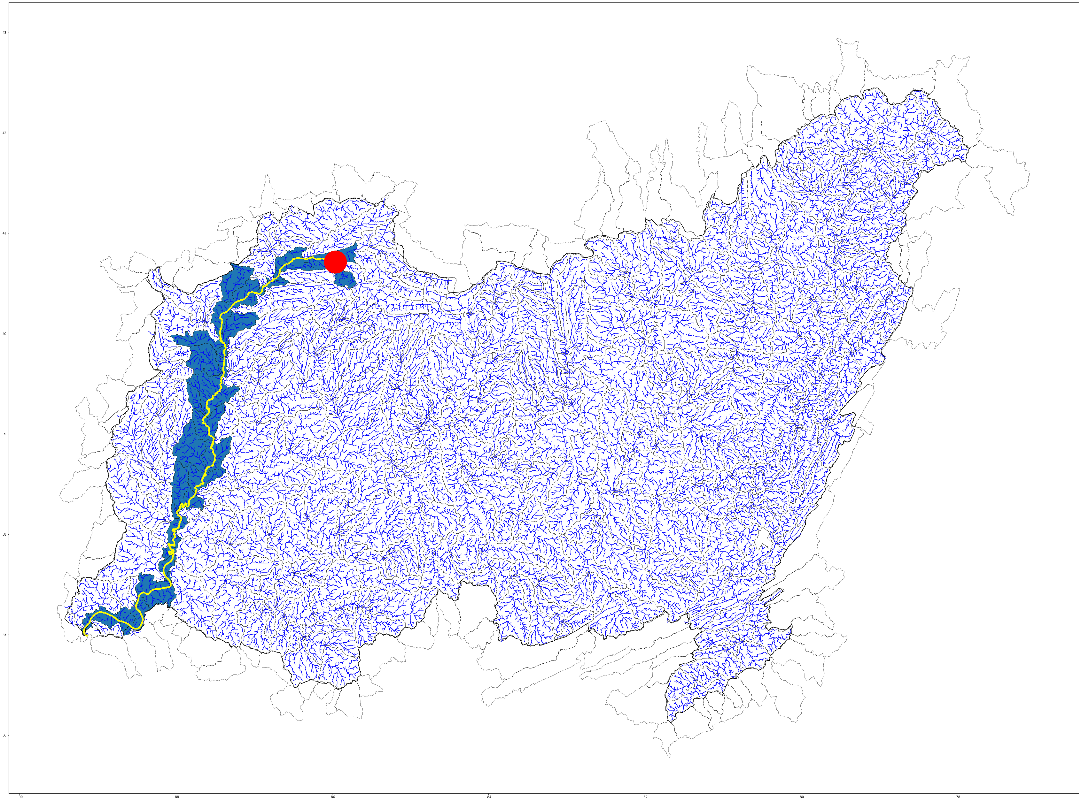
Risk assessment example

Slide 10
Thanks for your attention. Q & A
jparkgeo@illinois.edu

