Slide 1
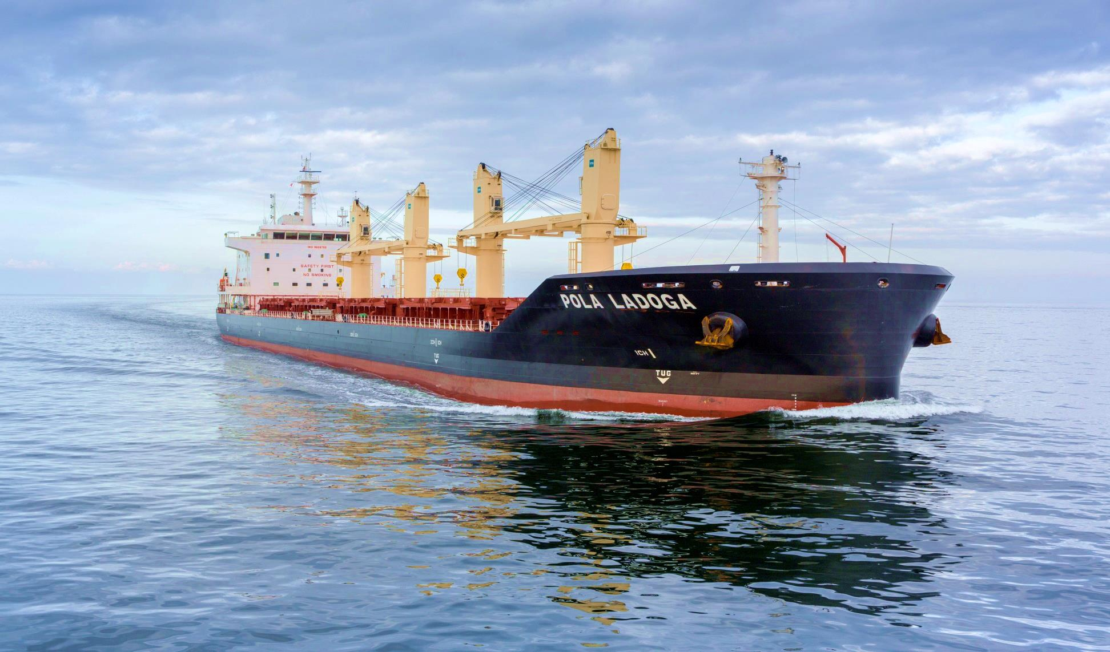
Pola Maritime Ltd.

Slide 2
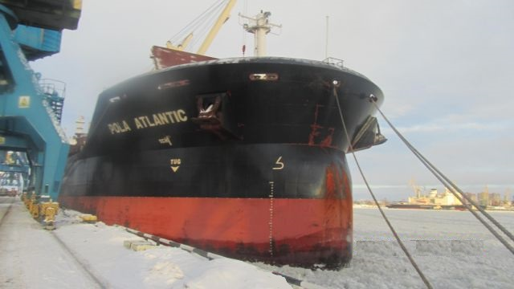
Pola Maritime - Introduction
Water is our Element
Pola maritime limited, established in 2006, is an entity for highly experienced shareholder interests in the dry bulk shipping industry. These shareholders own multiple vessels across the inner navigation shipping, tanker and deep-sea fishing sectors.
A long story short
650.000 dwt capacity and average fleet age of 3.2 years by end of 2016
At any given time the fleet consists of about 30-35 ships (owned/chartered-in short & long period). As from January 2014 we added six Seahorses 375 eco type and by the end of 2016 Pola will have a mix of 25 owned and long term time chartered-in ships ECO handy size fleet and 12 panamax.
Our clients count with flexibility, fast response and reliability to their needs.
With a young fleet and a highly motivated multicultural staff, Pola firmly believes in their bright and successful future.

Slide 3
Pola Maritime - Panamax
EXPANDING INTO PANAMAX
During the previous year Pola has expanded towards the Panamax market. Developing 3rd party trading for key clients on spot and COA basis.
Focus on Minerals, Mainly Coal origin from USA, North Atlantic, South Africa, Indonesia and Australia
Pola’s experienced Panamax department is looking to take advantage of the volatility and the favorable market opportunities going forward.
Pola will be looking to develop close relationships and joint ventures with key and close clients.

Slide 4
Pola Maritime – 37500 – Qingshan Shipyard
Press Release
Nr 007/2014
Pola Maritime takes delivery of their 6th Eco 37500 dwt Sea Horse
*** M/v POLA PALEKH ***
September 30th, 2014
Pola Maritime have taken delivery of the last vessel built at Qingshan Shipyard on 15th September 2014.
The Vice President of the CSC-Sinotrans Group, Mr. Liu, has attended the ceremony together with local authorities, DNV-GL and Bankers representatives.
Pola is now under negotiation with the shipyard to build another series of Handysize units for delivery in 2018-2019.
With this last acquisition Pola have now about 30 units trading in the Atlantic and Pacific Area where they concentrate their activity.

Slide 5
Pola Maritime – Owned fleet
N. | VESSEL | BUILT | SUMMER DWT | DRAFT (m) | ICE CLASS | FLAG
1 | POLA AUGUSTA | 2008 | 32,271 mt | 10.02 | ICE PASS. | Malta
2 | POLA ATLANTIC | 2010 | 33,466 mt | 09.85 | ICE PASS. | Malta
3 | POLA PACIFIC | 2011 | 33,413 mt | 09.85 | ICE PASS. | Malta
4 | POLA INDIAN | 2014 | 37,667 mt | 10.65 | 1C | Malta
5 | POLA LADOGA | 2014 | 37,667 mt | 10.65 | 1C | Malta
6 | POLA ONEGA | 2014 | 37,667 mt | 10.65 | 1C | Malta
7 | POLA UGLICH | 2014 | 37,667 mt | 10.65 | 1C | Malta
8 | POLA MUROM | 2014 | 37,667 mt | 10.65 | 1C | Malta
9 | POLA PALEKH | 2014 | 37,667 mt | 10.65 | 1C | Malta
10 | POLA ILARIA | 2010 | 37,495 mt | 10.42 | 1C | Malta
11 | POLA ANISIA | 2006 | 46,412 mt | 11.81 | - | Malta

Slide 6
Pola Maritime – Long period - Time Charter-in fleet
N. | VESSEL | BUILT | SUMMER DWT | DRAFT (m) | ICE CLASS | FLAG
Emerald 37k dwt
1 | NORDTIGRIS | 2015 | 38,000 mt | 10.50 | no | Malta
Seahorse 35k dwt
2 | HANZE GDANSK | 2013 | 34,735 mt | 10.10 | 1C | The Netherlands
3 | HANZE GÖTEBORG | 2013 | 34,735 mt | 10.10 | 1C | The Netherlands
4 | HANZE GENDT | 2012 | 34,751 mt | 10.10 | 1C | The Netherlands
5 | HANZE GENUA | 2015 | 34,662 mt | 10.10 | 1C | The Netherlands
Green Dolphin 38.5k dwt
6 | INTERLINK ABILITY | 2015 | 38,680 mt | 10.50 | 1C | Marshall Islands
7 | INTERLINK SAGACITY | 2015 | 38,743 mt | 10.50 | 1C | Marshall Islands
8 | INTERLINK ACITVITY | 2015 | 38,710 mt | 10.50 | 1C | Marshall Islands
Total dwt capacity 664,559 mt

Slide 7
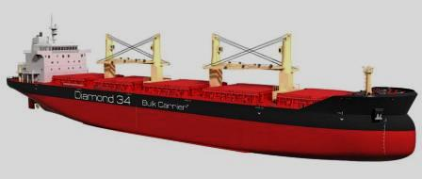
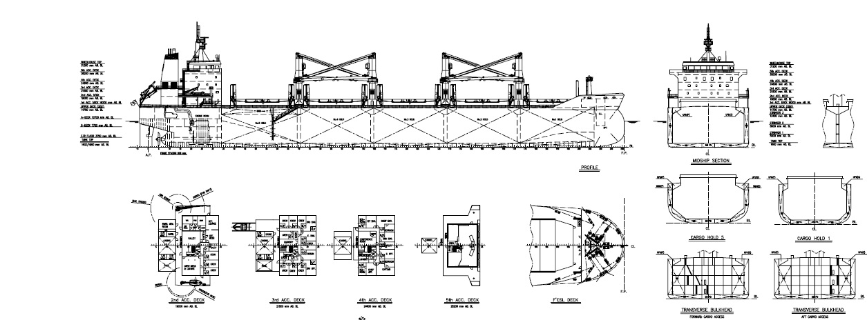
Pola Maritime
Diamond 34k dwt

Slide 8
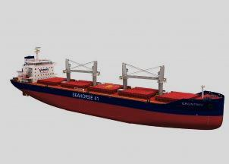
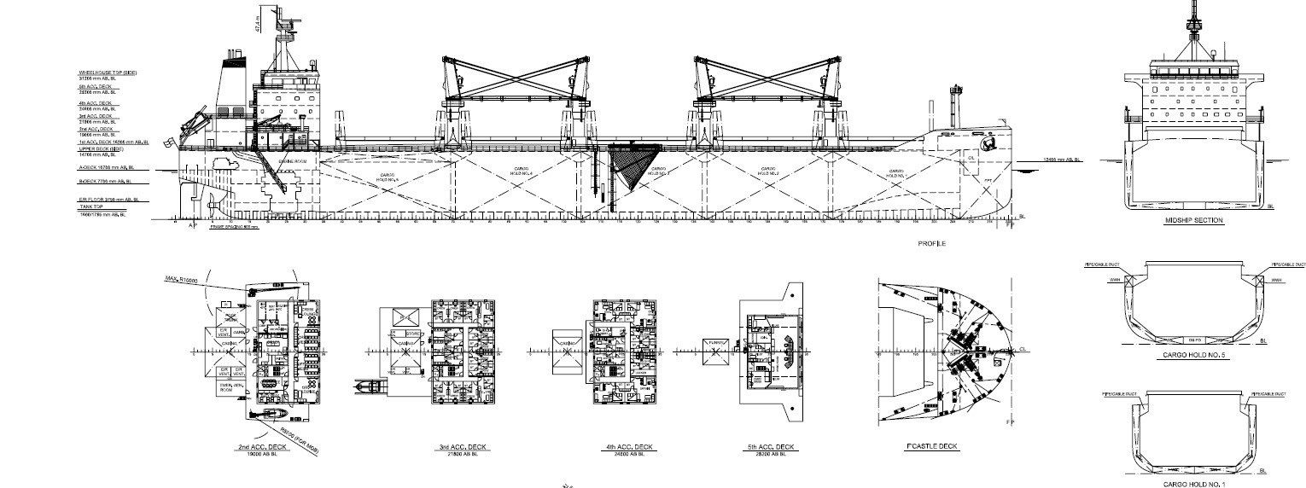
Pola Maritime
Seahorse 375 – Qingshan Shipyard

Slide 9
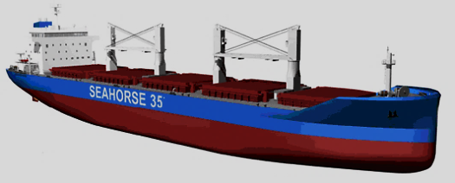
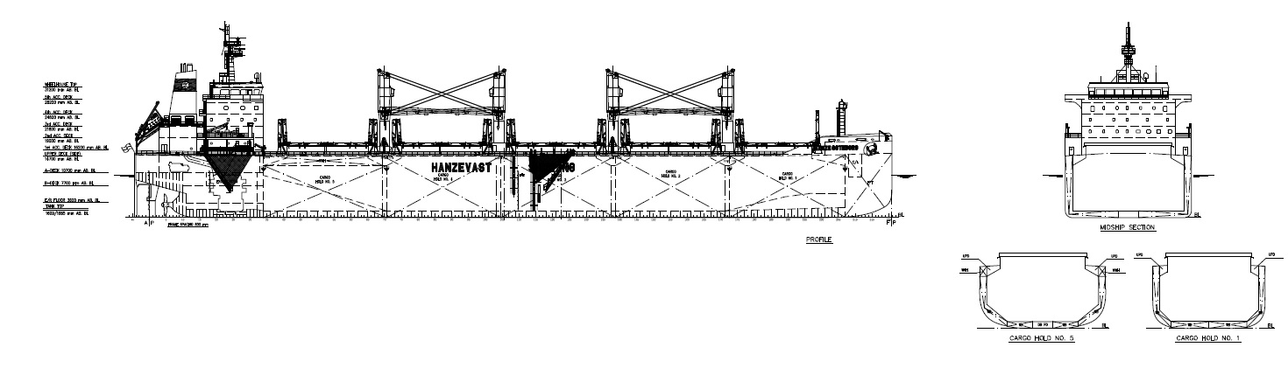
Pola Maritime
Seahorse 35K dwt

Slide 10
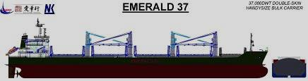
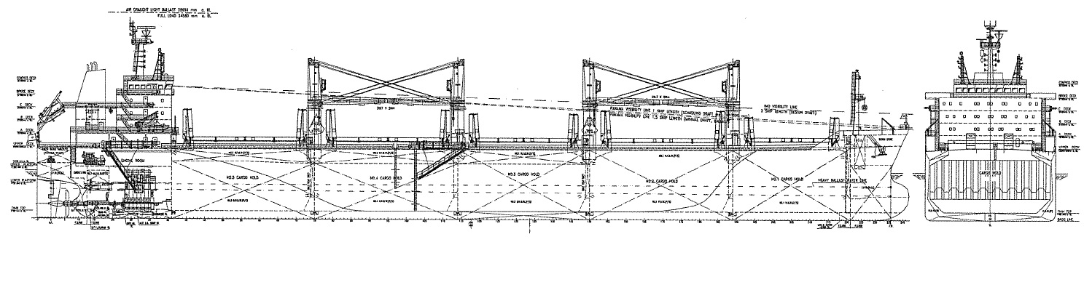
Pola Maritime
Emerald 37K dwt

Slide 11
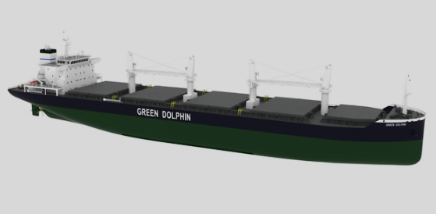
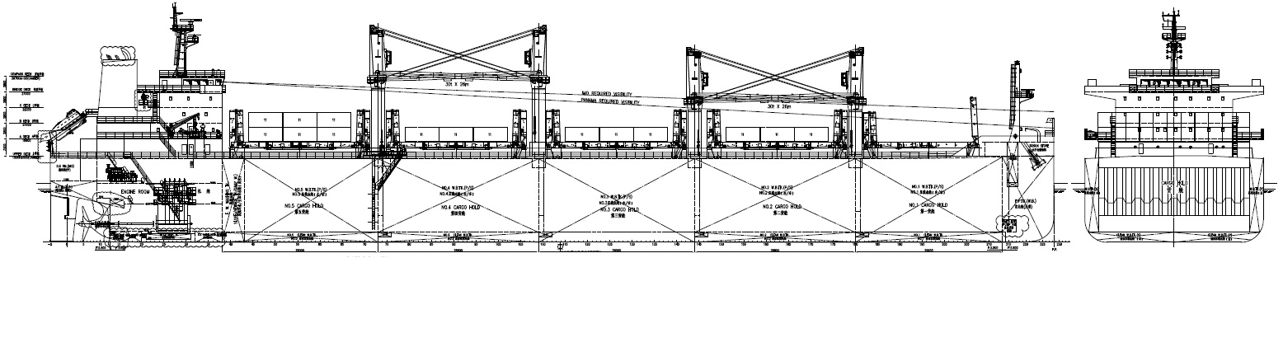
Pola Maritime
Green Dolphin 385

Slide 12
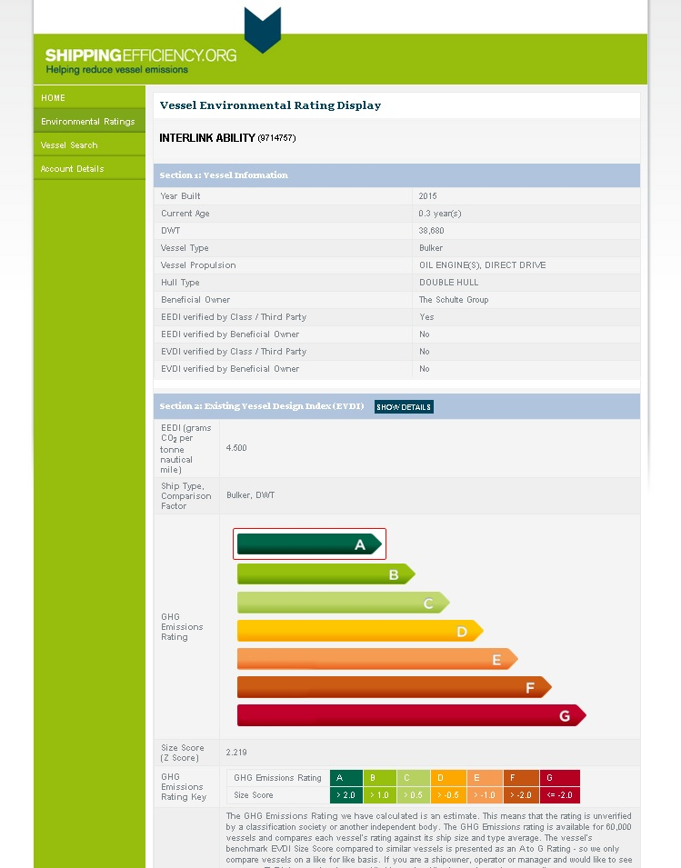
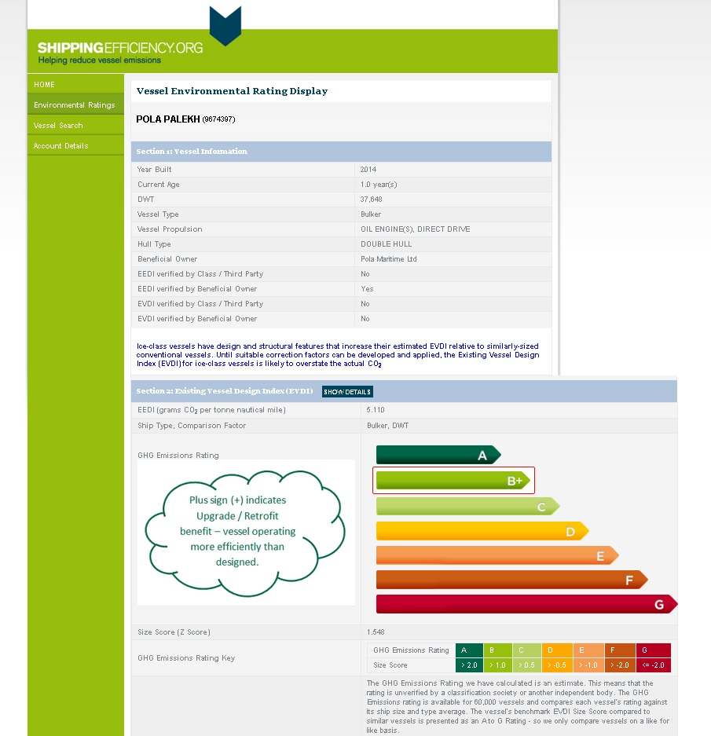
Pola Maritime
ShippingEfficiency.org

Slide 13
Pola Maritime – Phase 1
Selected the Team working in the H.Q.
Established Pola’s name in the Atlantic dry cargo market
Grow the Fleet up to 20/30 ships between Owned & TC
**completed**
Pola Maritime – Phase 2
Open an office in Argentina / Brazil
Develop Contract with Latin America traders
Split the fleet between Atlantic and Pacific basin.
**completed**
Pola Maritime – Phase 3
Open an office in Far East
Establish Pola’s name in the Pacific dry cargo market
Develop COA or spot shipment for Atlantic direction
**in progress**

Slide 14
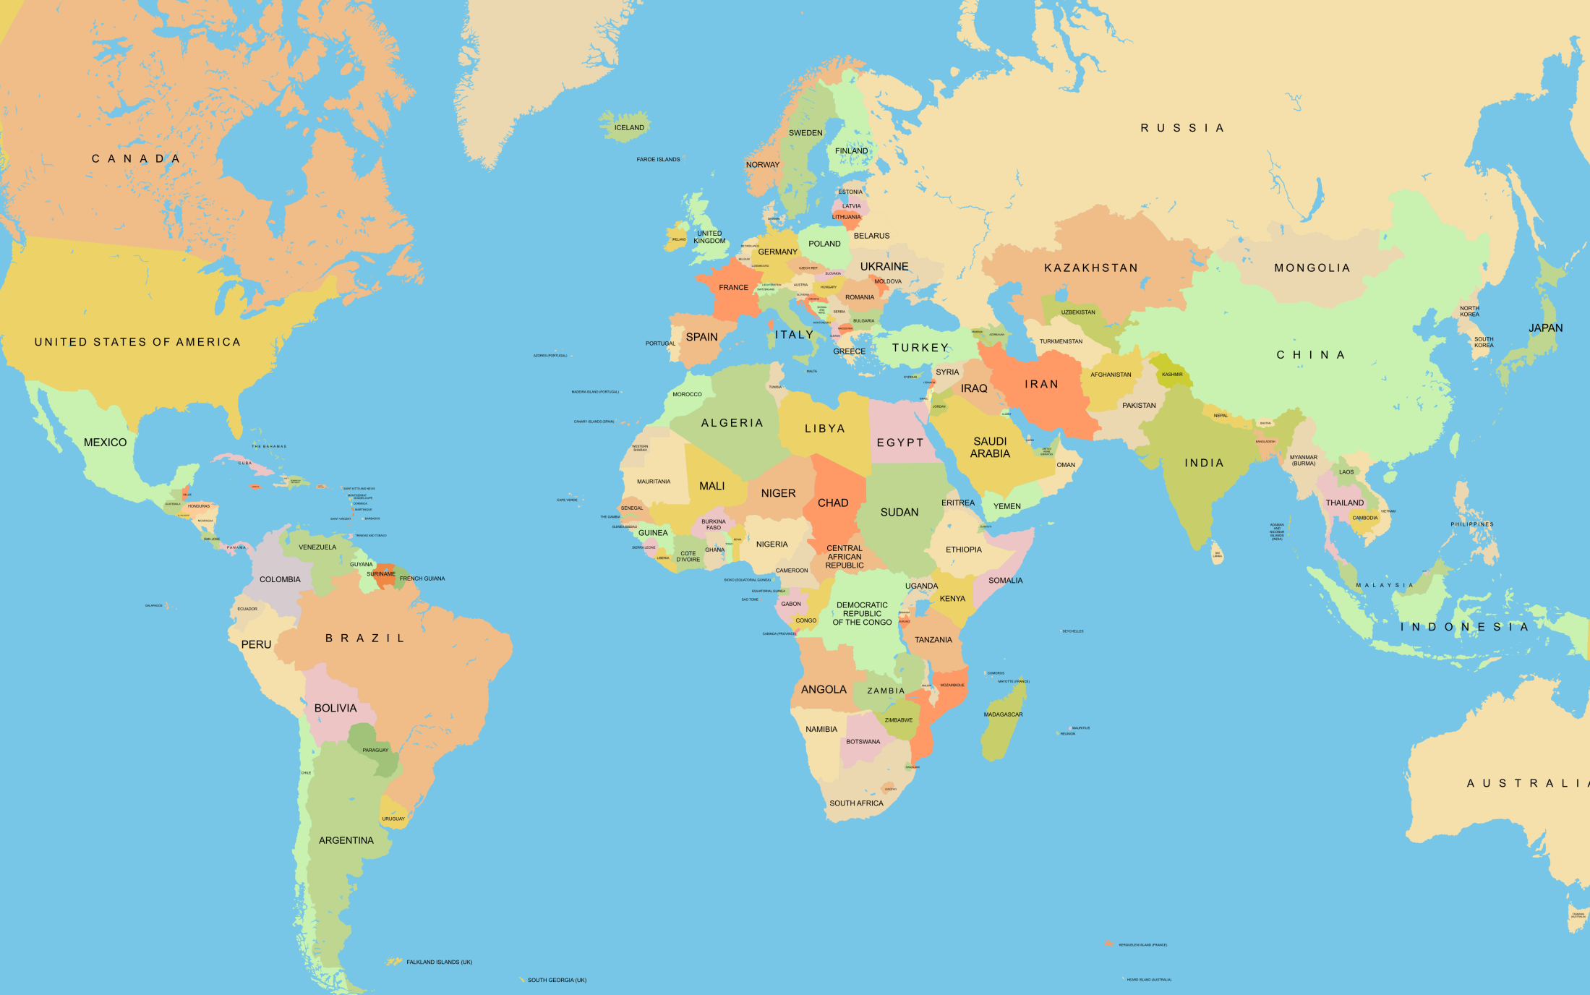
Pola Maritime - Offices
Fase 1
Fase 3
H.Q.
Fase 2
Fase 2

Slide 15
Pola Maritime - Statistics

Slide 16
Pola Maritime - Statistics
Commodity | 2012 | % | 2013 | % | 2014 | % | 2015 | %
GRAIN | 356,772 | 22% | 587,173 | 35% | 1,076,114 | 37% | 1,967,730 | 33%
STEEL | 719,279 | 44% | 477,028 | 28% | 934,898 | 33% | 820,287 | 14%
FERTS | 275,939 | 17% | 286,052 | 17% | 425,555 | 15% | 1,783,910 | 31%
OTHERS | 284,305 | 17% | 334,395 | 20% | 414,709 | 15% | 1,253,665 | 22%
Total | 1,636,295 |  | 1,684,648 |  | 2,851,276 |  | 5,825,592

Slide 17
Pola Maritime - Clients
1 | Adani Group | 20 | Koch Fertilizers
2 | Bunge | 21 | Vitol
3 | Rio Tinto | 22 | Nidera Brasil
4 | Cargill | 23 | Nitron
5 | BPC | 24 | Yara
6 | Uralkali | 25 | Norsul
7 | Uralchem | 26 | Raffles
8 | Intergrain | 27 | Marcegaglia
9 | Transgrain | 28 | FLAME SA
10 | SSE | 29 | Energy
11 | Rusal | 30 | Dreymoor
12 | Mekatrade | 31 | Alimentos & F.
13 | Ameropa | 32 | Fitco
14 | Sucden | 33 | Ansac
15 | OCP | 34 | Solvadis
16 | Noble | 35 | Riera Roura
17 | Glencore | 36 | Flame
18 | Edfman | 37 | Holcim
19 | Bulk Trading SA | 38 | L. Dreyfus

Slide 18
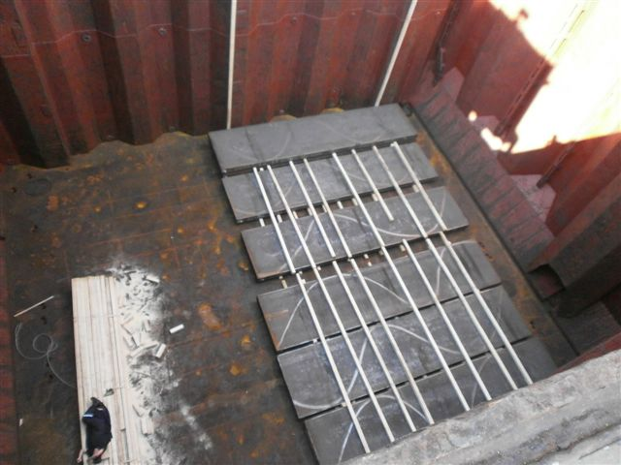
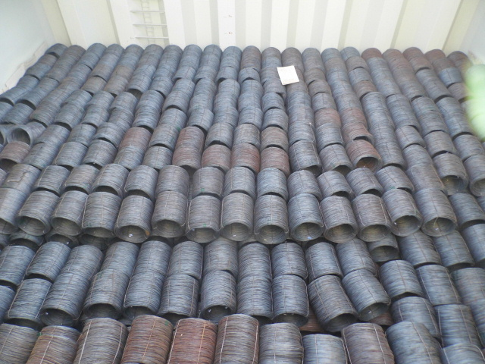
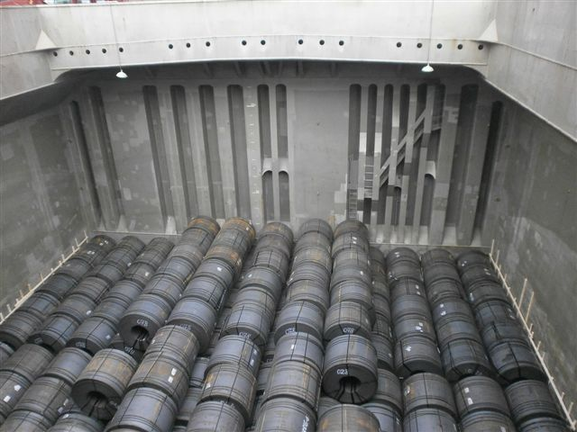
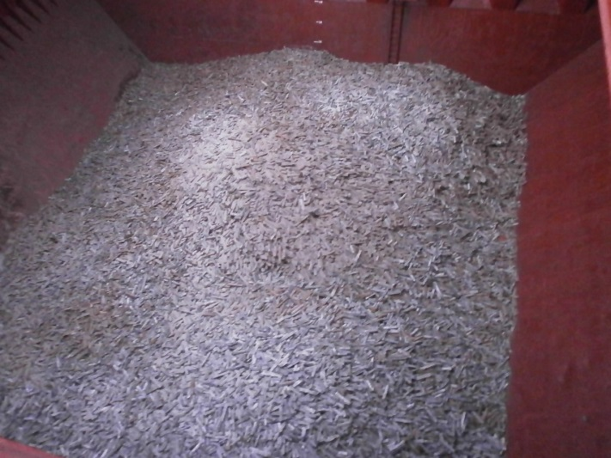
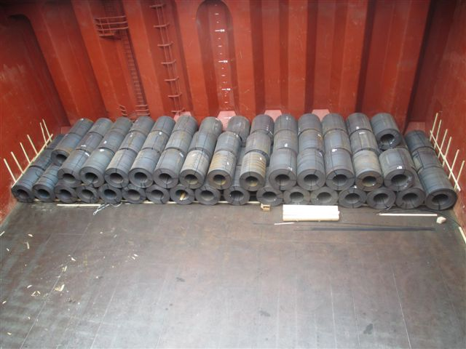
Pola Maritime – Cargo operations

Slide 19
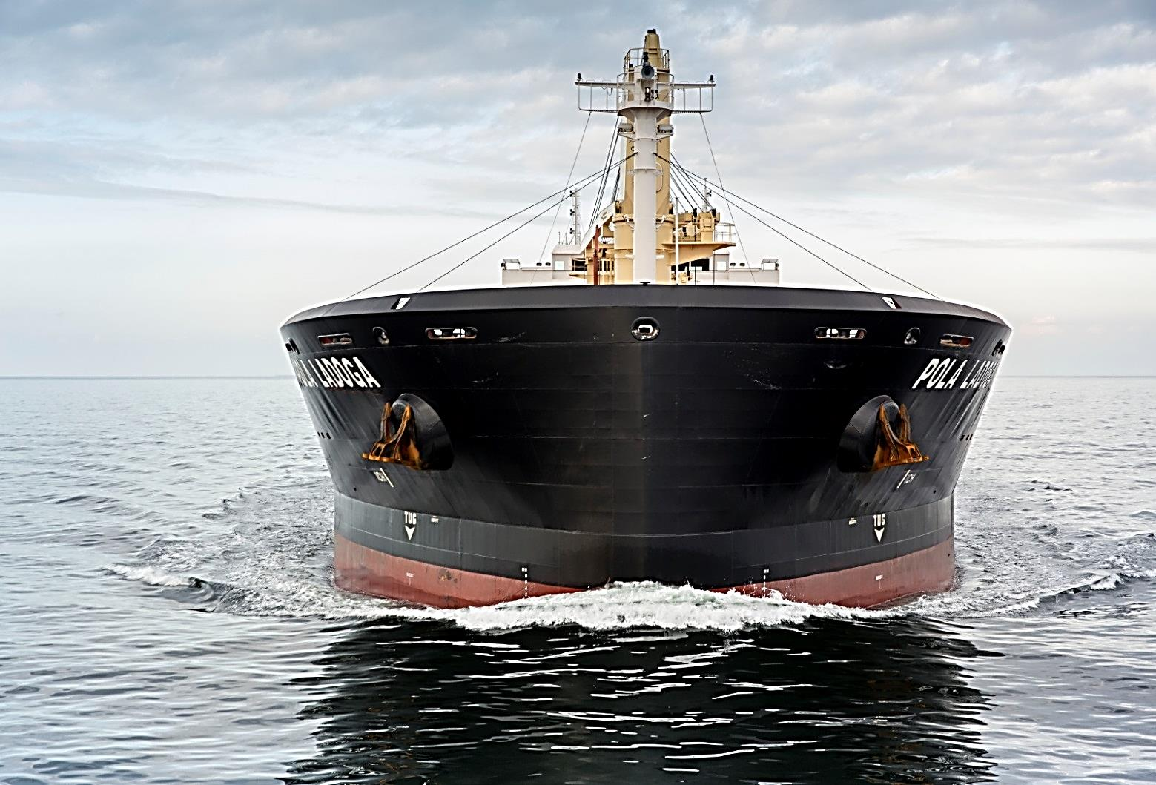
For inquiry please contact:
Pola Maris NV
On behalf of Pola Maritime Ltd
London Tower
Noorderplaats 9
2000 Antwerp - Belgium
ph : +32 3727 1510
fax : +32 3727 1519
email : chartering@polamaris.be

