Slide 1
Understanding Networking

Slide 2
HELLO!
I am Jose K James...
01
06
2021
S2 CSEA
34

Slide 3
Goals of Class
Basic understanding of common modern networking technology and terminology
Understanding of networking
Physical Layer
Wireless networks
Internet
Security
Career

Slide 4
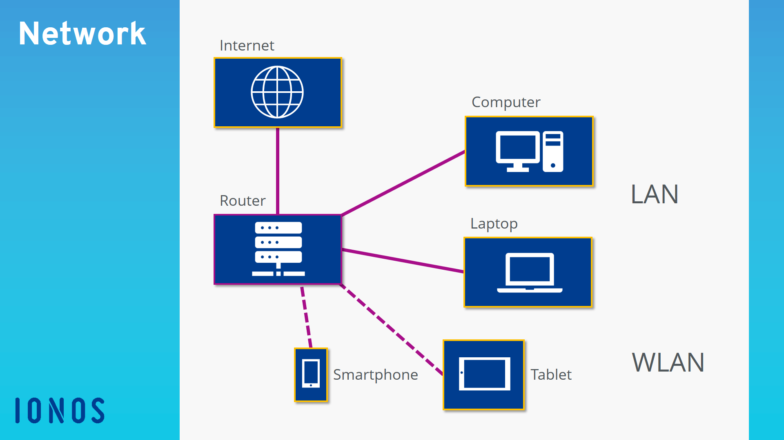
What is a “Network”?
Definition: Network
A network is a group of two or more computers or other electronic devices that are interconnected for the purpose of exchanging data and sharing resources.

Slide 5
Advantages of a Network
Shared use of data
Shared use of resources
Central control of programs and data
Central storage and backup of data
Shared processing power and storage capacity
Easy management of authorizations and responsibilities

Slide 6
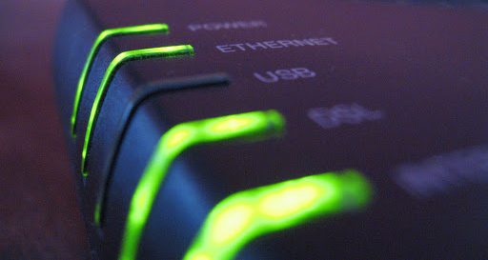
Types of Networking

Slide 7
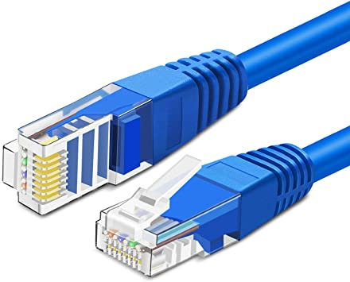
Physical Layer
Pretty much just Cat 5 (or Cat 5e or Cat6) twisted pair copper wire
Other: Fiber (multi-mode or single-mode) coaxial copper (thick- and thin-net), Cable Modem, plain phone (DSL), microwaves (wireless ethernet), etc.

Slide 8
Wireless networks
Computer networks that are not connected by cables are called wireless networks. They generally use radio waves for communication between the network nodes
Mobile phone networks
Wi-Fi
Satellite communication networks

Slide 9

Internet
The Internet is the biggest world-wide communication network of computers.
The Internet has millions of smaller domestic, academic, business, and government networks, which together carry many different kinds of information.
It is used by billions of people all over the world.
Notes:
The short form of internet is the 'net'. ...

Slide 10
7.676 B
5.112 B
4.388 B
Jan
2019
That’s our population
And a lot of mobile users
Total Internet Users

Slide 11
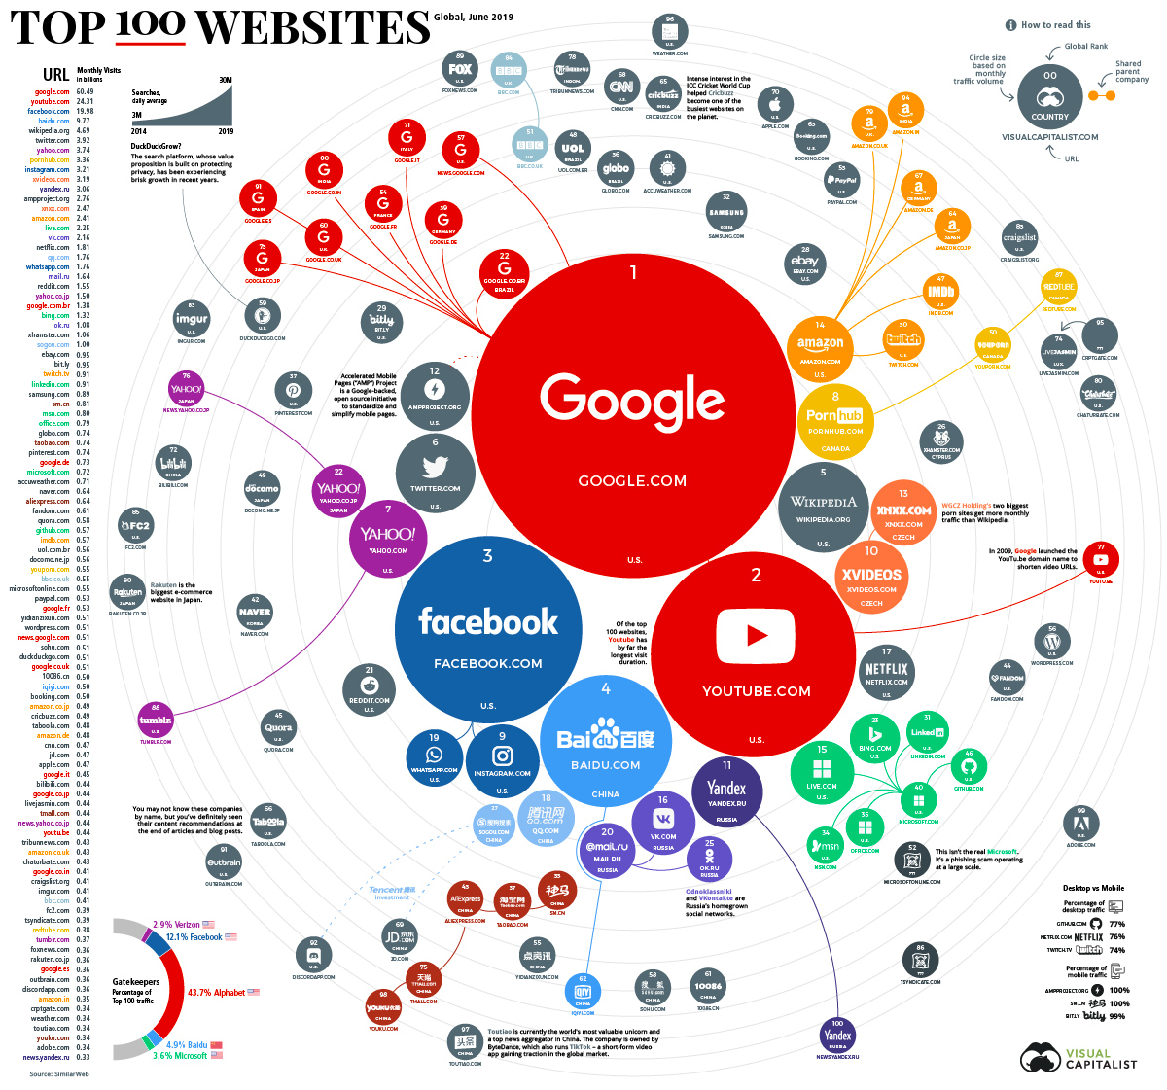
Global Network . Traffic !

Slide 12

Security
Firewalls
Anti-virus and anti-malware software
Access control
VPN
Wireless security

Slide 13

Career
Network Analyst
Cisco Certification
CCNA
CCNP
CCIE
Wireshark WCNA Certification
Some of the top networking companies across the world are listed here.
IBM
Cisco Systems
Intel
3Com

Slide 14
Resources
Networking Web Page: http://www.stanford.edu/services/network/
‘The Bits and Bytes of Computer Networking’ By Google
Digital guide –IONOS
WWW

Slide 15
THANKS!
Any questions?
You can find me at
josekjames5@gmail.com

