Slide 1
PED
Welcome
Batch Members:
M Aishwarya (588)
K V R Krishna Sastry (563)
P Madhuri (5B1)
K P Prathyusha (576)
Project Guide:
G Karunakar

Slide 2

Abstract
PED is an offline Personal English Dictionary, where a user can customize his/her own dictionary. PED has a facility to insert, update and delete a particular word.

Slide 3
Existing System
Dictionary services are mostly provided over internet, i.e., a user with an electronic device which can access the internet can search for a word and find its details
Limitations of Existing System
Every Individual has their own electronic gadgets with high cost and good features, which are over dependent on the internet. If the user moved to any remote areas, he/she cannot access the services provided over the internet, which means no internet results no solution. And also takes more effort to get a response data from the server. At some times a user may not get satisfied with the response provided by some site “A”, then he/she should search that word in another site B/C/… After a long time if the user forgets the meaning of that word he/she should start from “A” again. These are the limitations of existing system

Slide 4
Proposed System
PED will be an offline Dictionary service for Desktop and Android users. It will be useful anywhere and anytime so that it even satisfies travelers too. PED do not need to wait for server response over internet, as the device itself has the response in its respective storage. If the user is not satisfied with the response given by the PED, then the user can customize that response as he/she wants. So for the next time PED satisfies that particular user for sure.

Slide 5
Advantages of Proposed System
→ Word search with suggestions and auto fill.
→ Can add new words.
→ Can update the existing words details.
→ Deletion of unwanted words is also possible.
→ Bulk insertion of ‘n’ number of words is even possible.
→ Uses an embedded database.
→ Comes with predefined words based on the Oxford which are collected through web scrapping.

Slide 6
Software Requirements Specification
Operating System: Windows7 or above
IDEs: Android Studio & Eclipse
Programming Environments: Java 8.0+& Python 3.0+
Editors: Visual Studio Code or any alternative
External Java Libraries: JDBC, JFoenix, JavaFX, ControlsFX & MarryTTS
APIs: requests, Beautiful Soup 4, nbsp MaterialFilePicker, SqliteAssetHelper & pl.droidsonroids.gif
Browser: Google Chrome or any alternative
Other software: Photo Shop CS6 & Scene builder 8.0
Hardware Requirements Specification
Network Interface Card: To access Internet over Ethernet or Wi-Fi
RAM: 4GB or above
Storage: 250GB or above
Input Devices: Basic Mouse & Basic Keyboard
Output Devices: Monitor & Speaker

Slide 7
Modules
Find
Add
Update
Load
Delete
About

Slide 8
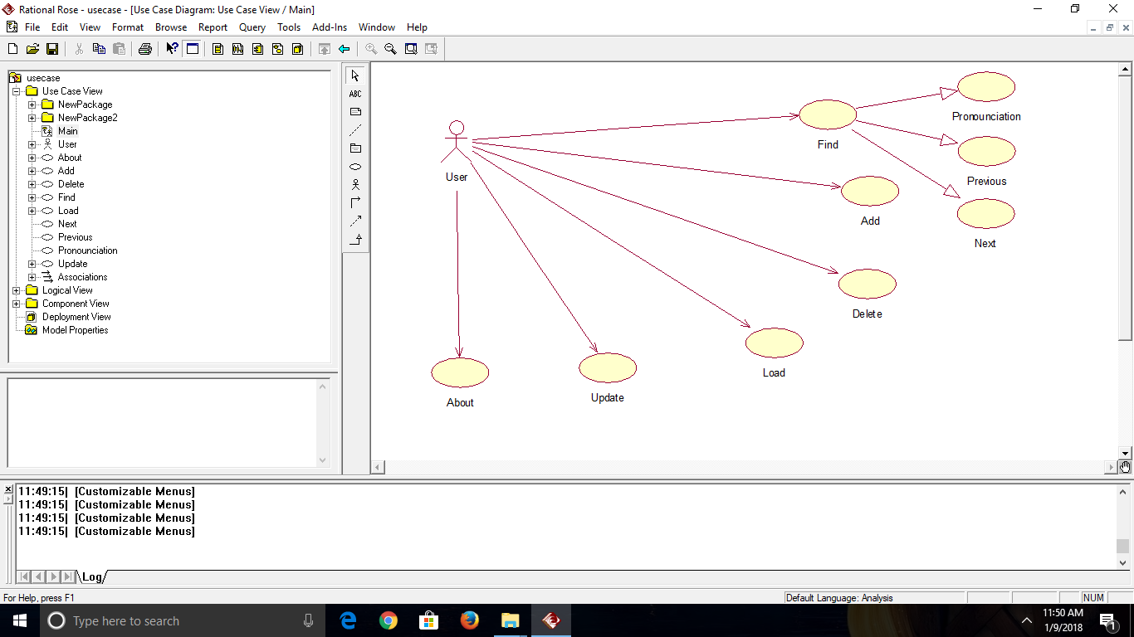
DESIGN
Figure 1
USE CASE DIAGRAM

Slide 9
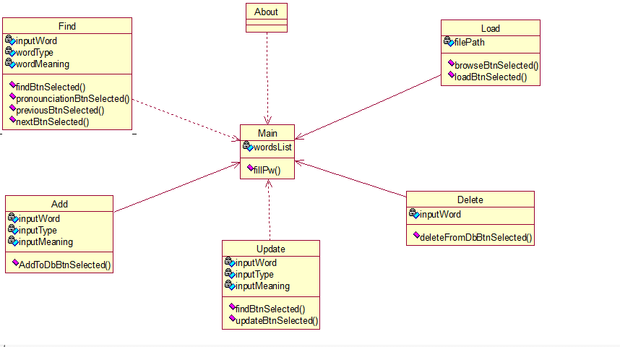
Figure 2
CLASS DIAGRAM

Slide 10
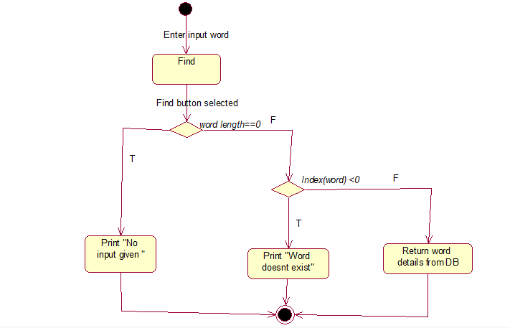
Figure 3
ACTIVITY DIAGRAM -FIND

Slide 11
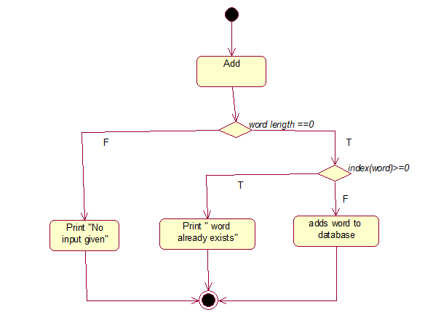
Figure 4
ACTIVITY DIAGRAM - ADD

Slide 12
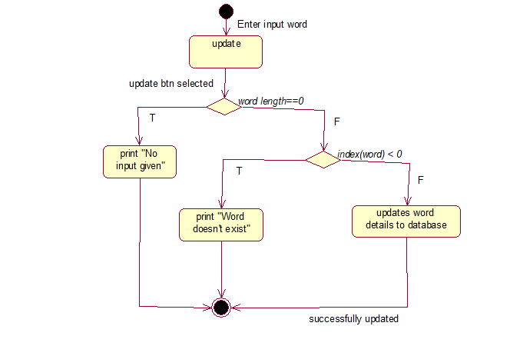
Figure 5
ACTIVITY DIAGRAM - UPDATE

Slide 13
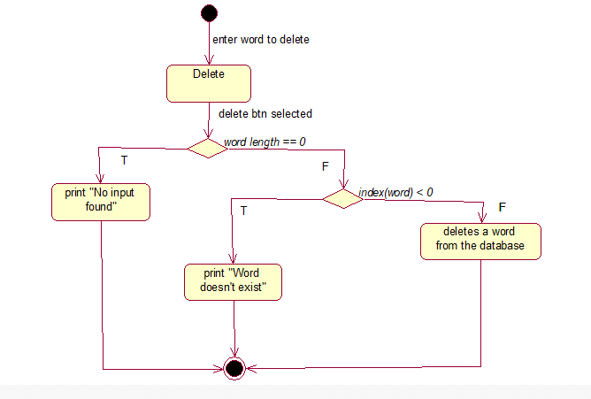
Figure 6
ACTIVITY DIAGRAM - DELETE

Slide 14
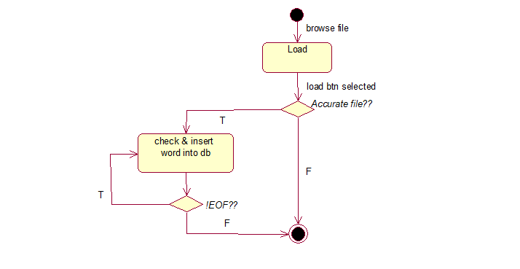
Figure 7
ACTIVITY DIAGRAM - LOAD

Slide 15
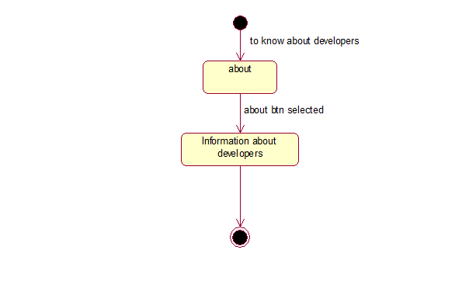
Figure 8
ACTIVITY DIAGRAM - ABOUT

Slide 16
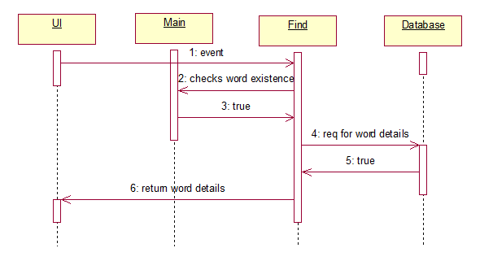
Figure 9
SEQUENCE DIAGRAM - FIND

Slide 17
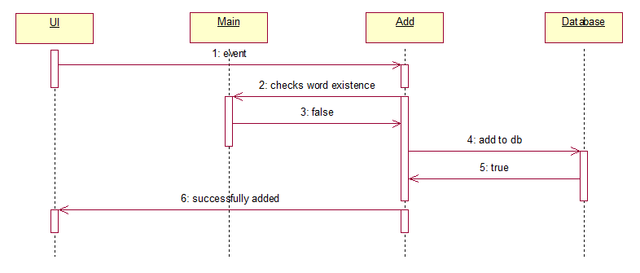
Figure 10
SEQUENCE DIAGRAM - ADD

Slide 18
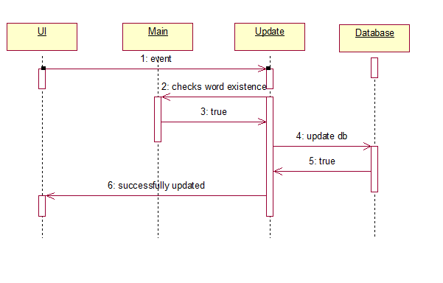
Figure 11
SEQUENCE DIAGRAM - UPDATE

Slide 19
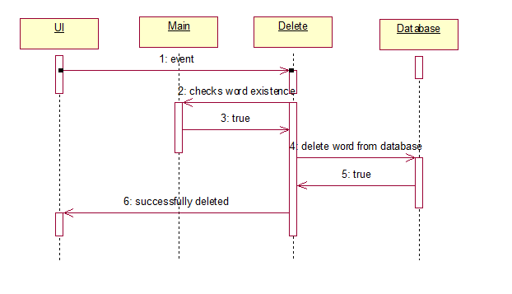
Figure 12
SEQUENCE DIAGRAM - DELETE

Slide 20
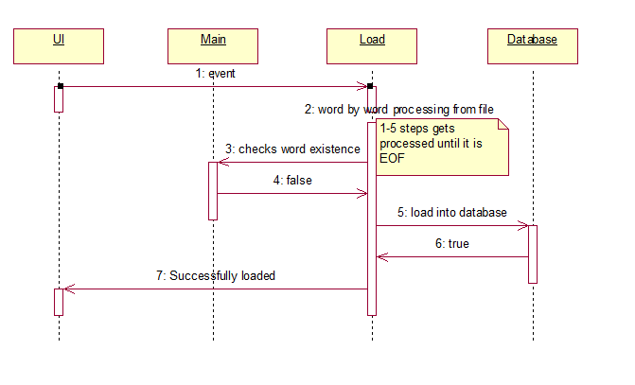
Figure 13
SEQUENCE DIAGRAM - LOAD

Slide 21
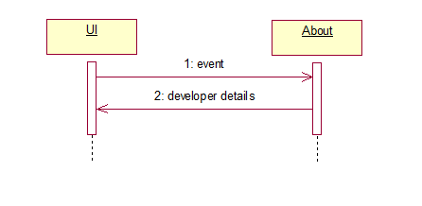
Figure 14
SEQUENCE DIAGRAM - ABOUT

Slide 22
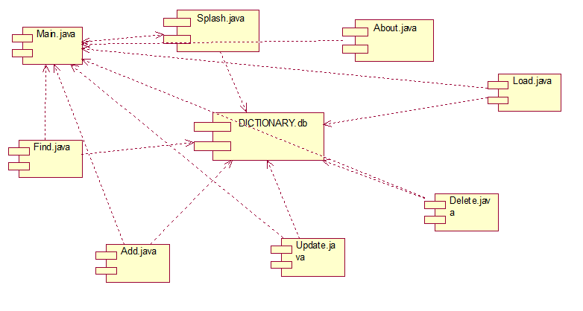
Figure 15
COMPONENT DIAGRAM

Slide 23
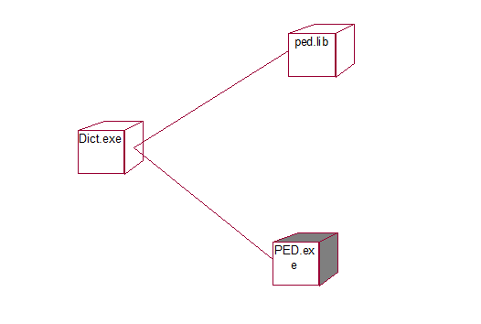
Figure 16
DEPLOYMENT DIAGRAM

Slide 24
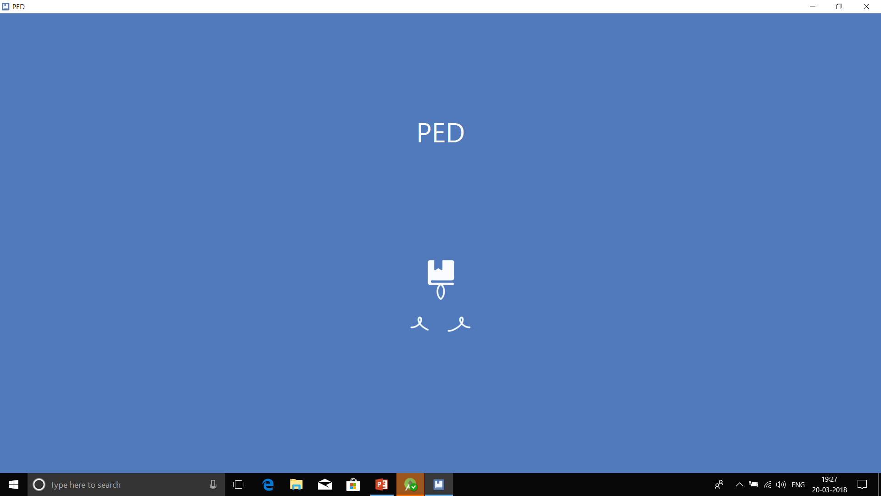

Slide 25
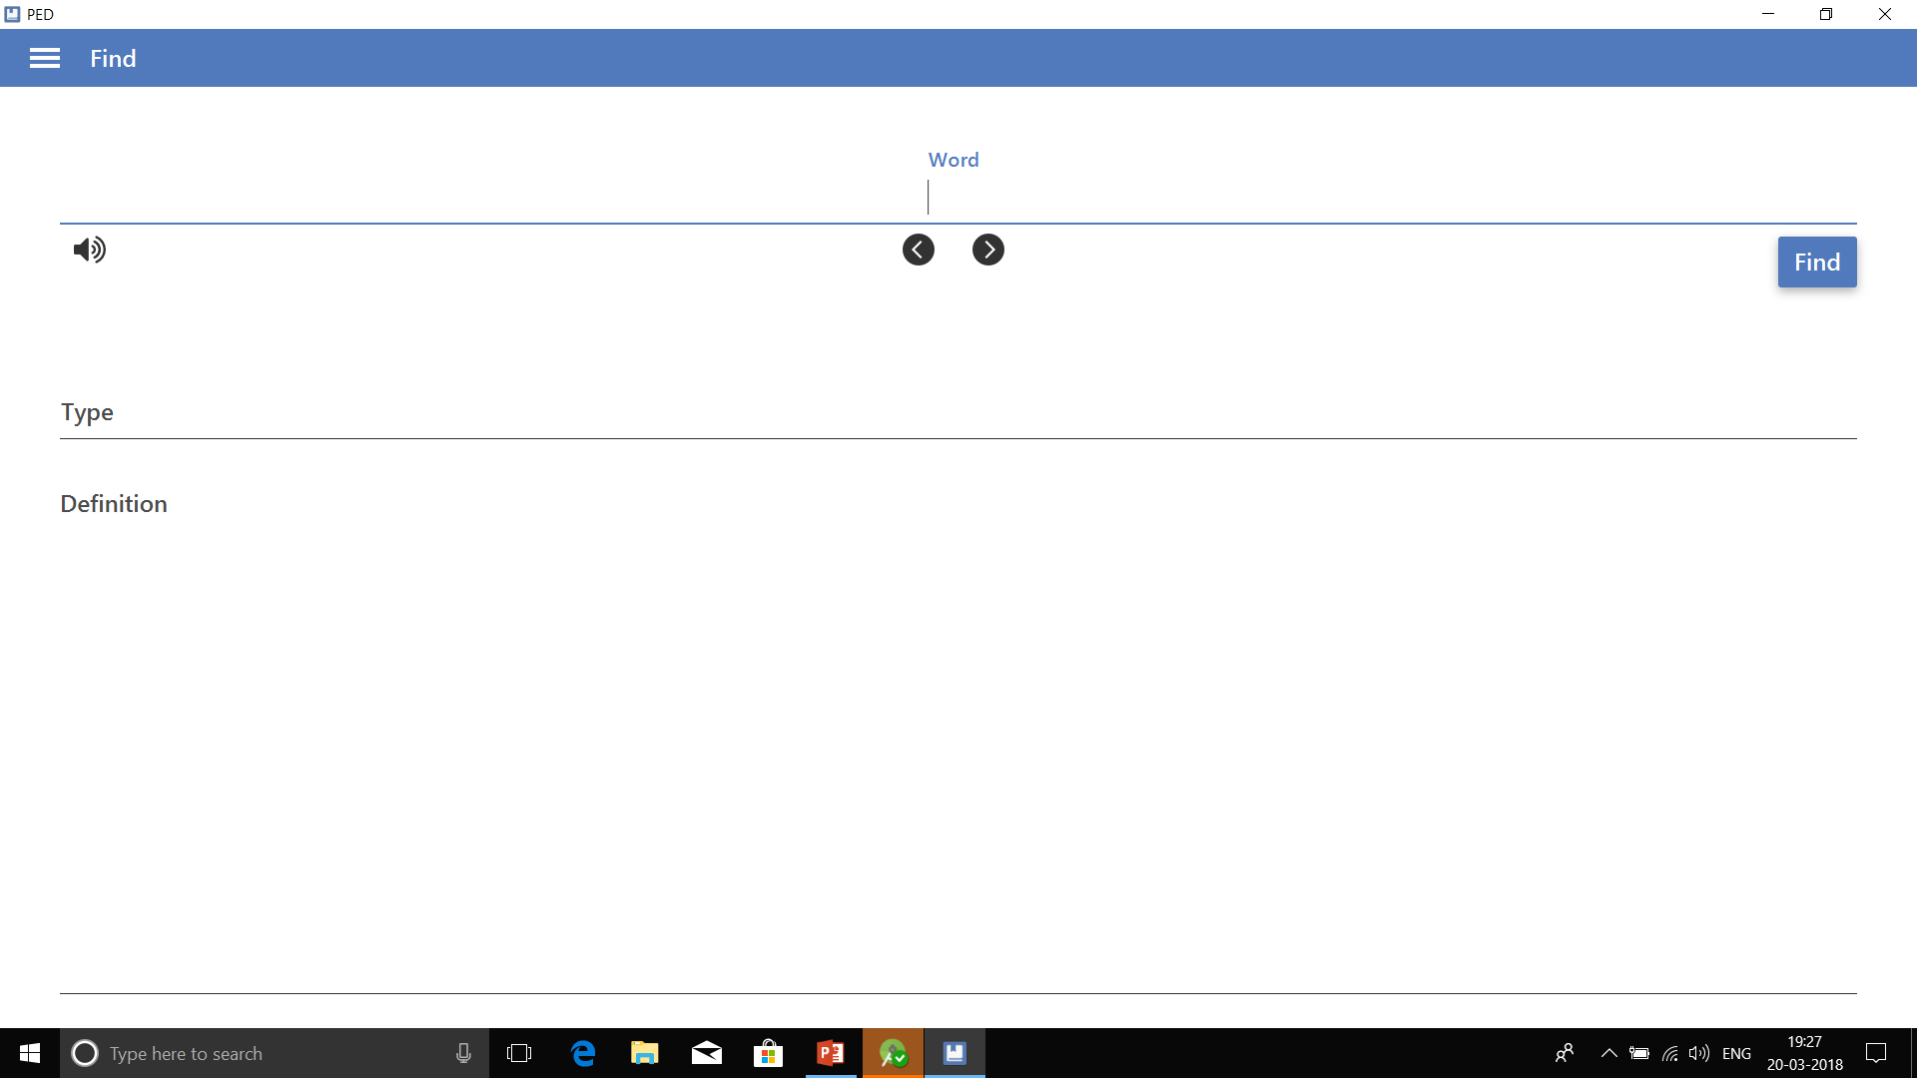

Slide 26
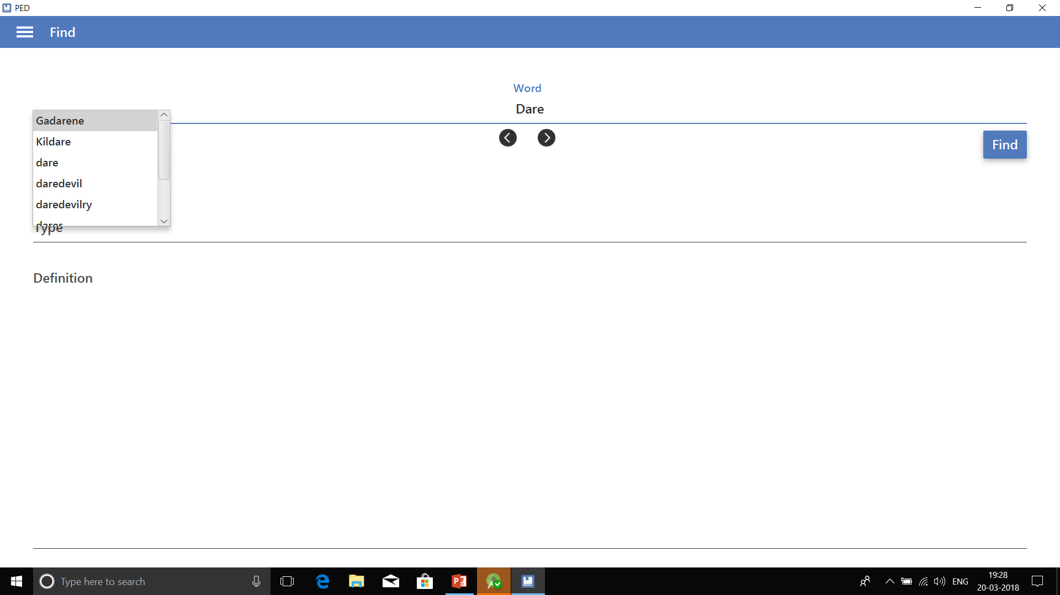

Slide 27
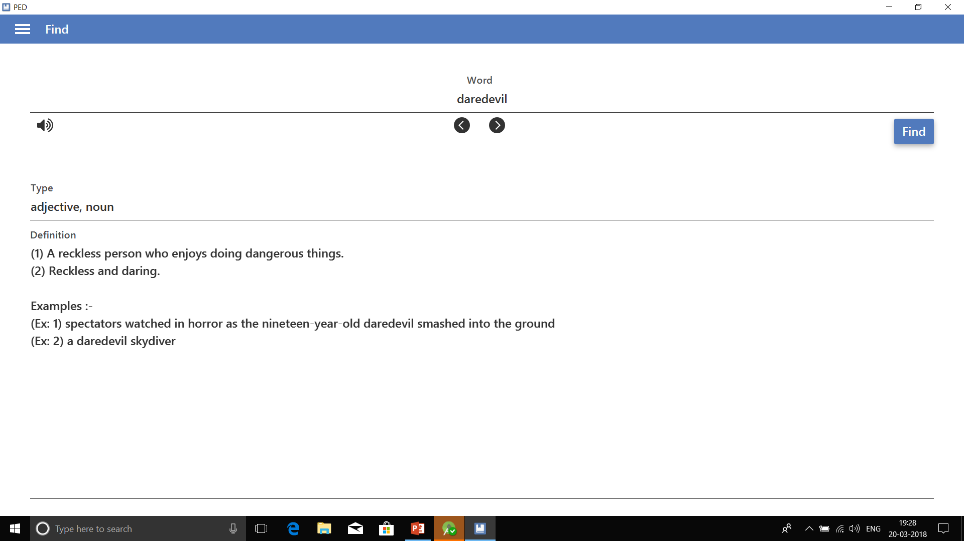

Slide 28
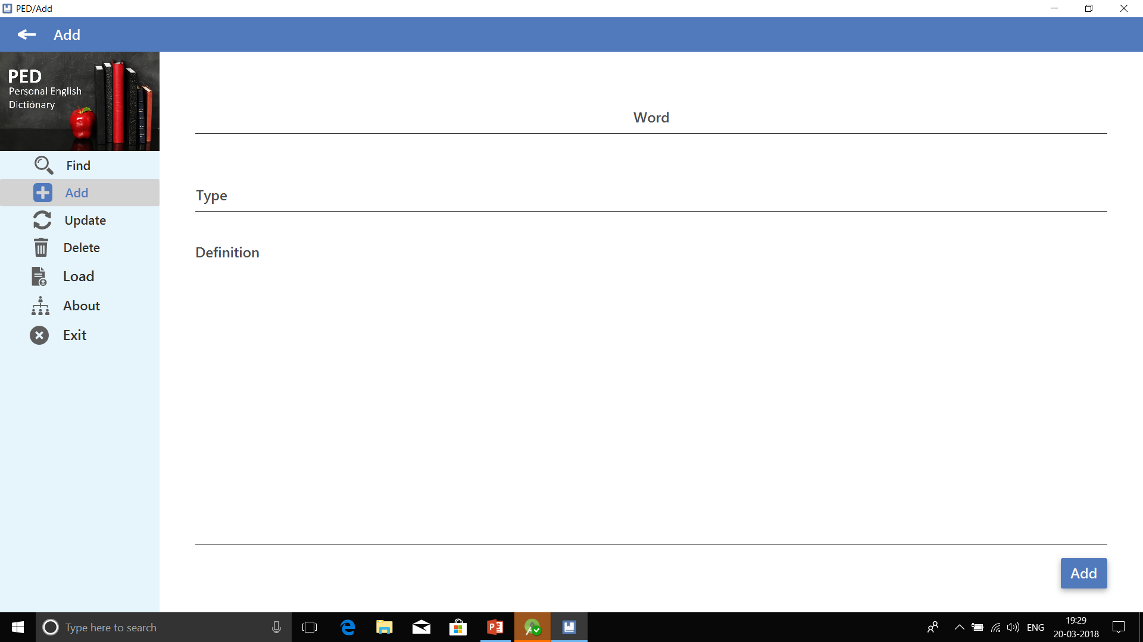

Slide 29
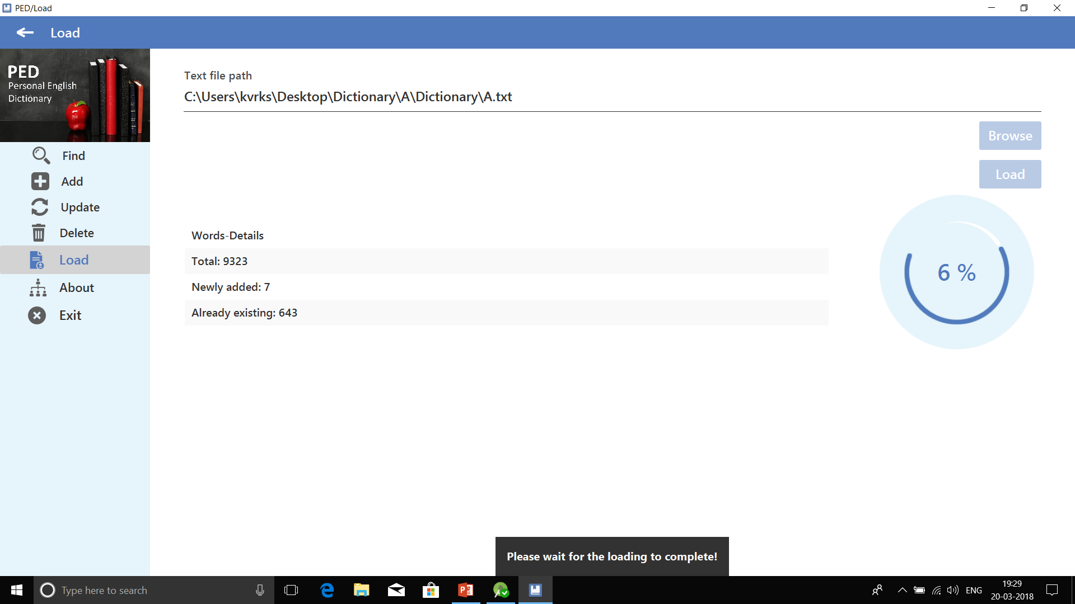

Slide 30
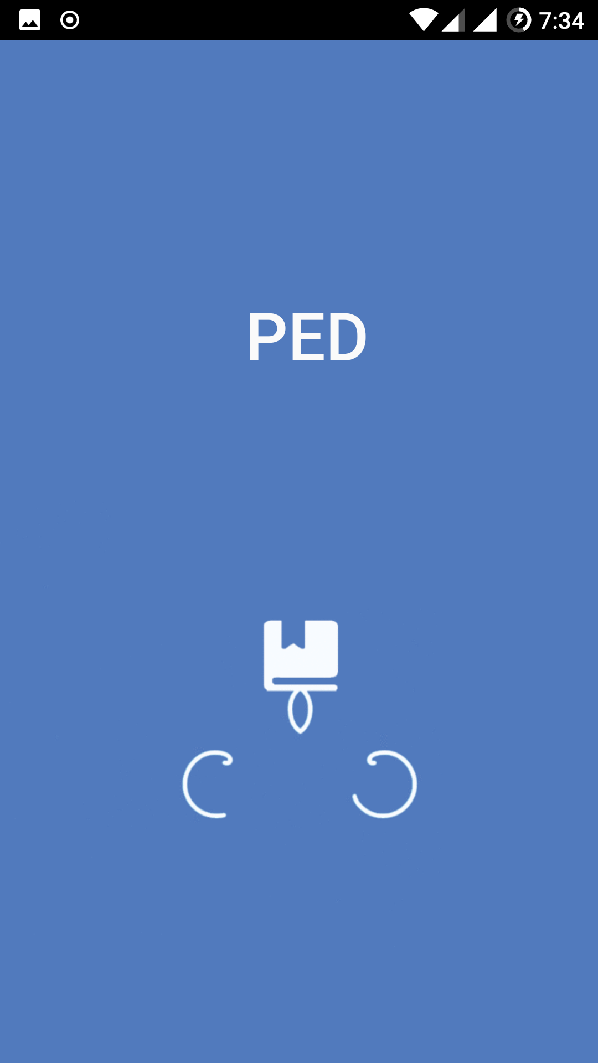

Slide 31
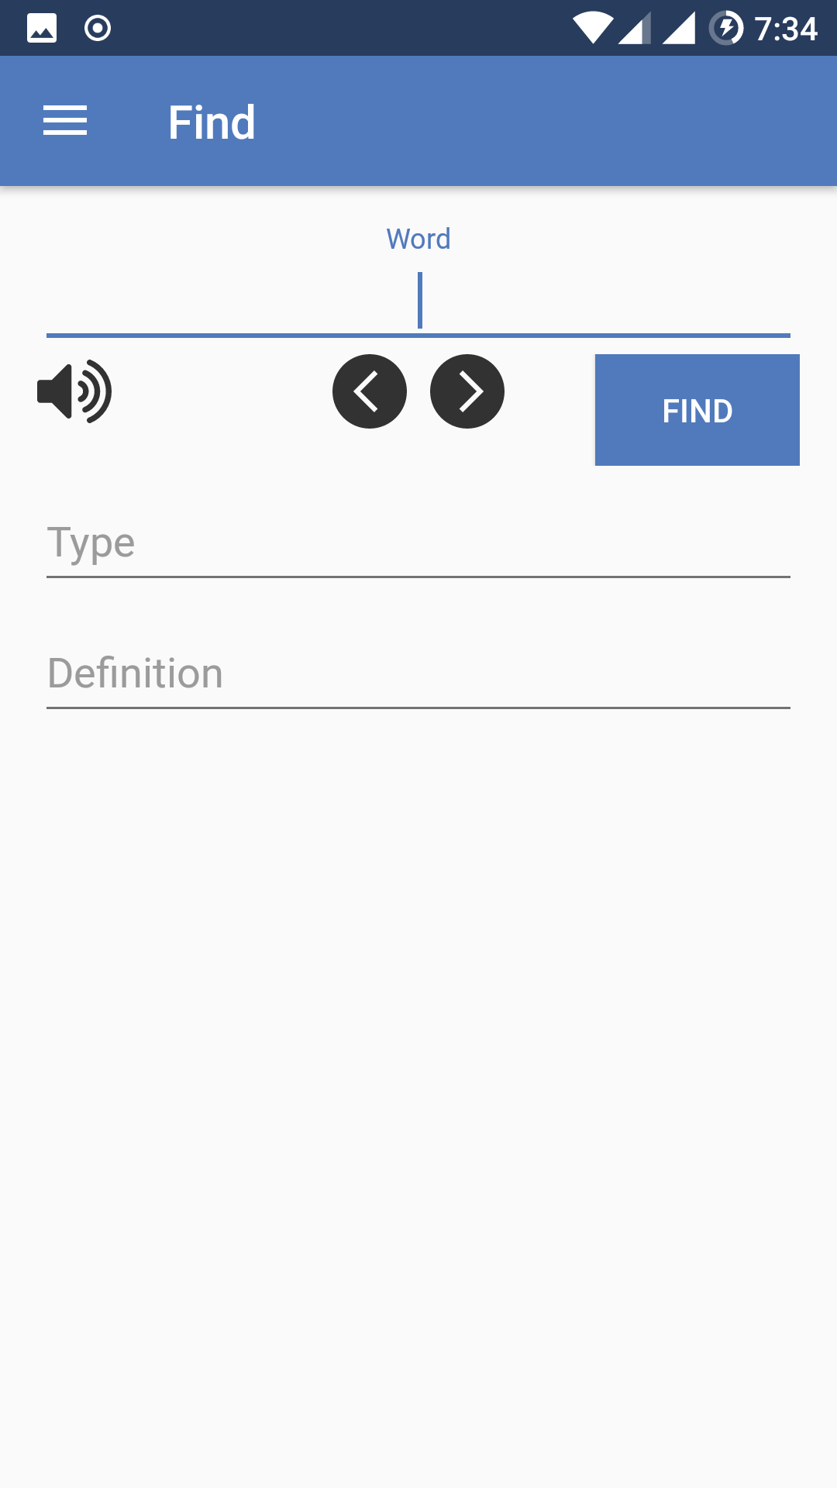

Slide 32
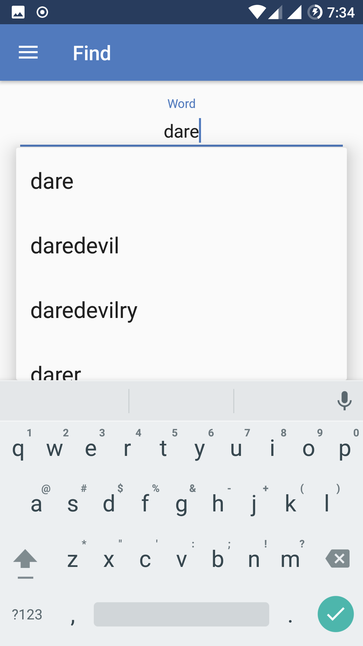

Slide 33
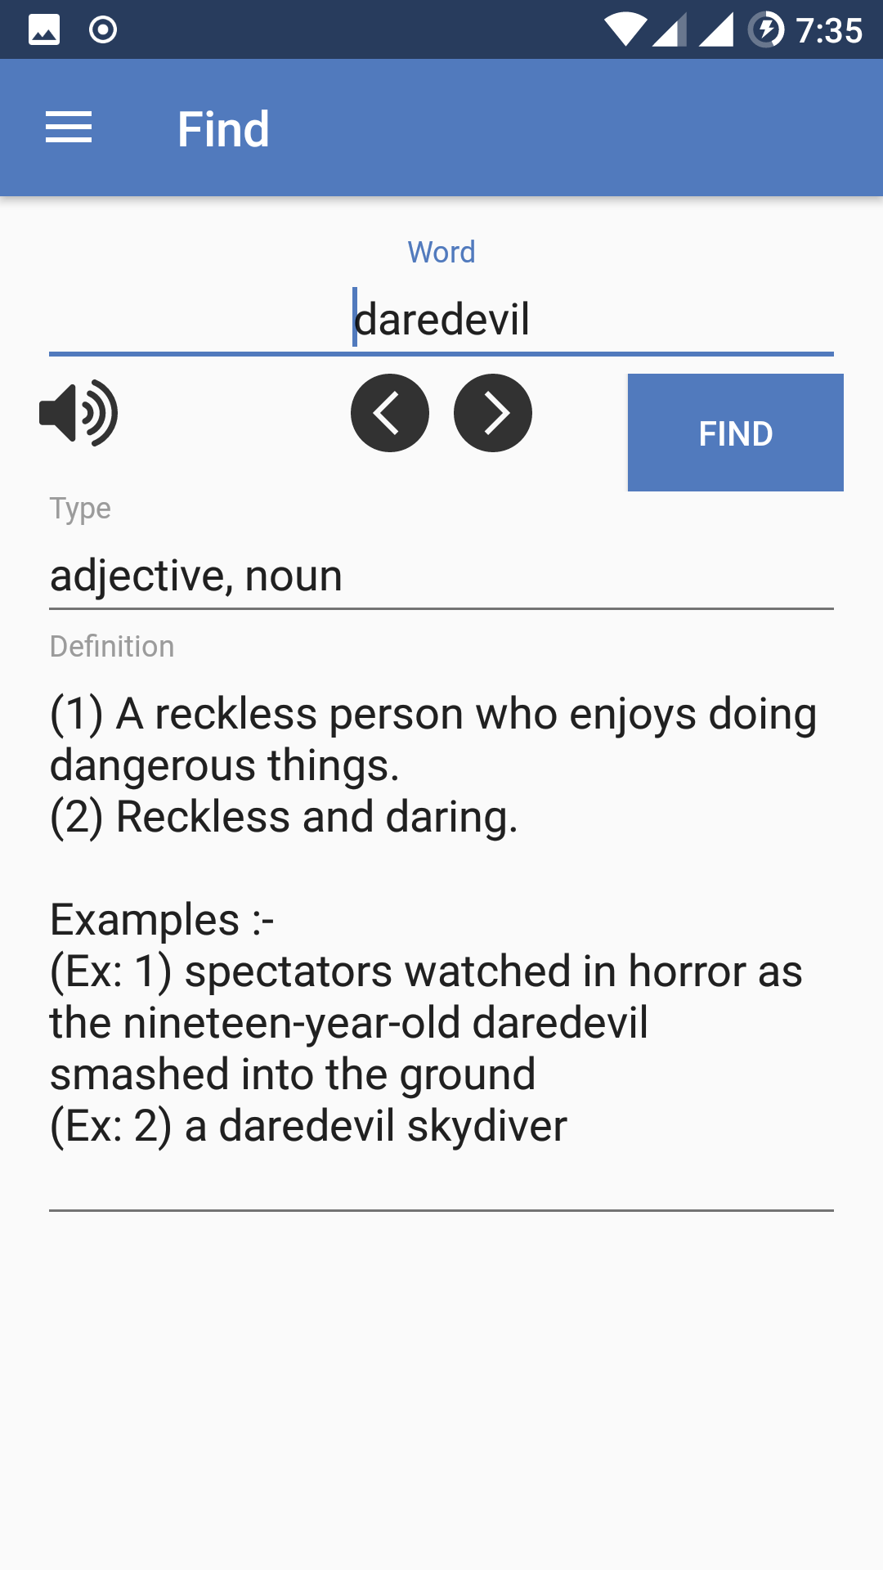

Slide 34
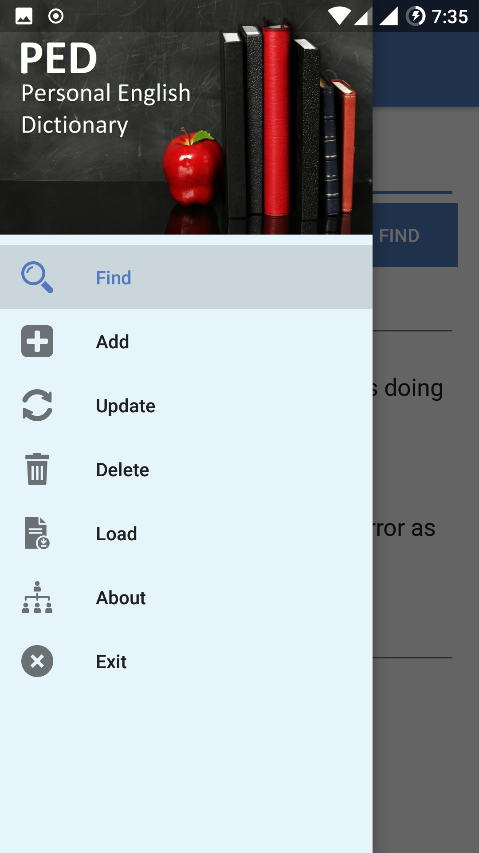

Slide 35
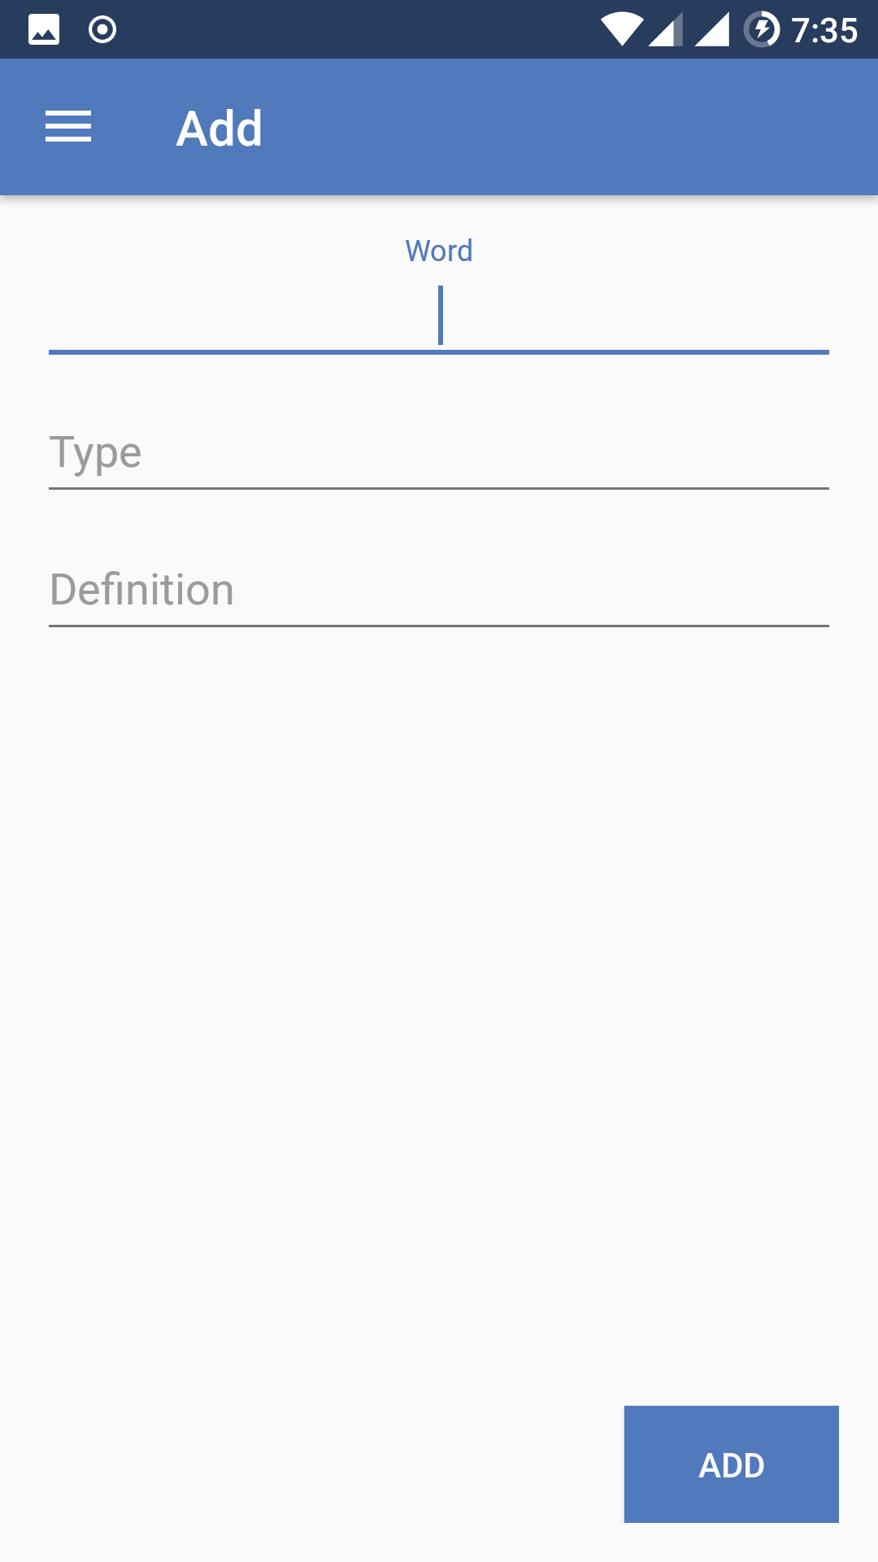

Slide 36
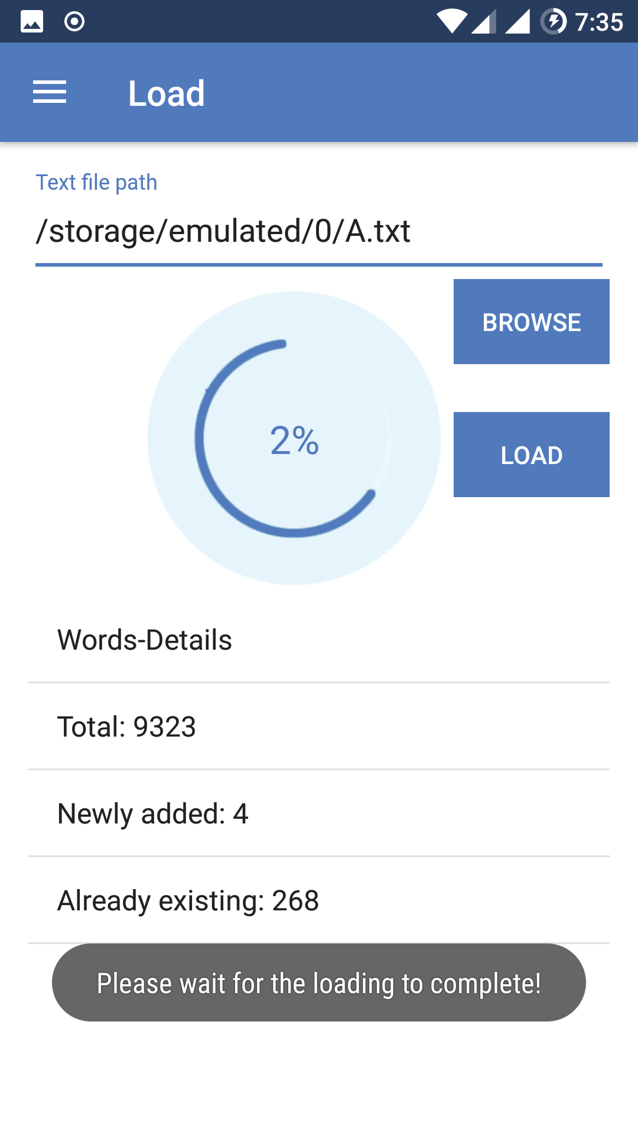

Slide 37
THANK YOU
For your support
-Yours PED Team

