Slide 1
Cryptography using Python
Minor Project

Slide 2
What is Cryptography ?
Cryptography is the science of using mathematics to encrypt and decrypt the data.
There are two types of cryptography : 1. Symmetric Key & 2. Asymmetric key
Symmetric Key Cryptography uses only one key for encryption and decryption.
Asymmetric uses two key, one for encryption and second one for decryption.
Data Confidentiality, Data Integrity, Authentication and Nom-repudiation are the core principles of modern-day cryptography.

Slide 3
About Project :
Intention : Implementing a simple cryptography technique to encrypt the files.
OS : Parrot os (Security edition)
Text Editor/Compiler : nano & pluma
Language : Python Programming Language
Algorithm : AES (128 bit key) using PKCS7 padding
Packages/Module : 1. os
2. Cryptography.Fernet
Methods : generate_key() , encrypt(), decrypt() etc.

Slide 4
AES :
AES stands for “Advanced Encryption Standard”.
AES is a Symmetric Key Algorithm.
Symmetric Key Algorithm uses only one key to encryption and decryption.
AES is a Block Cipher and the key size can be 128/192/256 bits.
The number of encryption process rounds is depends on size of key.
Each round comprises of 4 steps : SubBytes , ShiftRows , MixColumns , Add RoundKey.

Slide 5
About Code:
The encryption code is divide into four parts ;
Beginning
Gathering Files
Encryption Key
Files Encryption

Slide 6
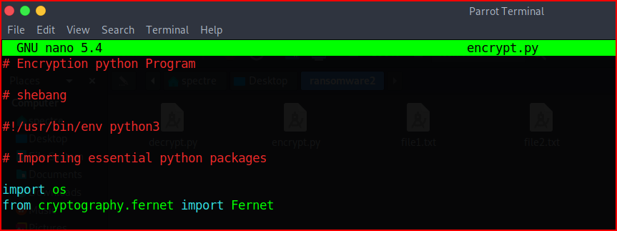
Beginning :
Adding the shebang line in code.
Importing the python in-built packages.

Slide 7
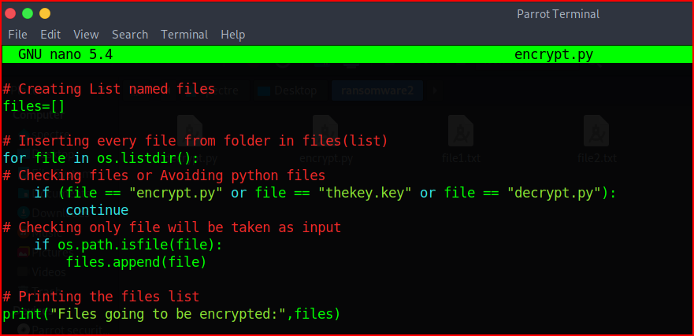
Gathering Files :
Creating a list named “files”.
Implementing a for-loop for inserting the files in list excepting python files.
Putting condition(if:) for inserting only file type in a list.

Slide 8
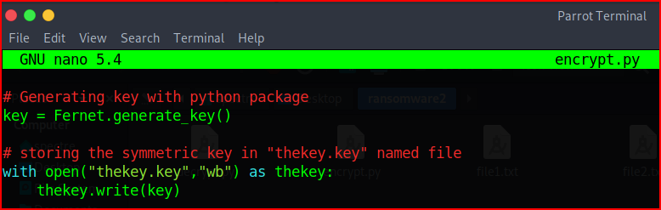
Encryption Key :
For generating a encryption key we use python’s package method.
We store the key in “thekey.key” file.

Slide 9
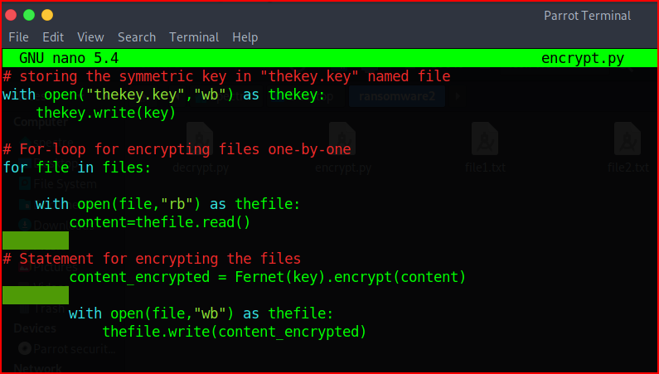
Files Encryption :
Implementing a for-loop for files to open them in reading mode one-by-one.
Using python’s “Fernet” Module, encrypt these files one-by-one.

Slide 10
Code Execution

Slide 11
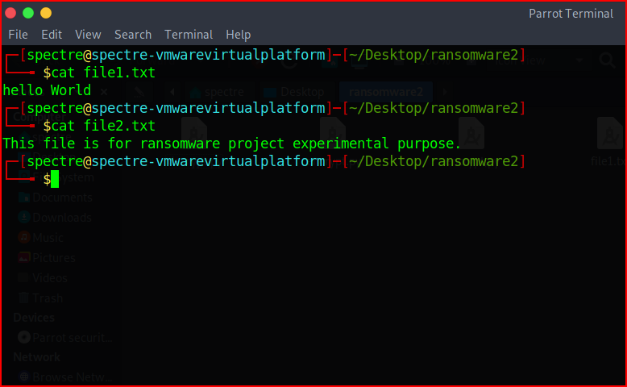
We have two files named file1.txt & file2.txt, they both are in decrypted form.

Slide 12
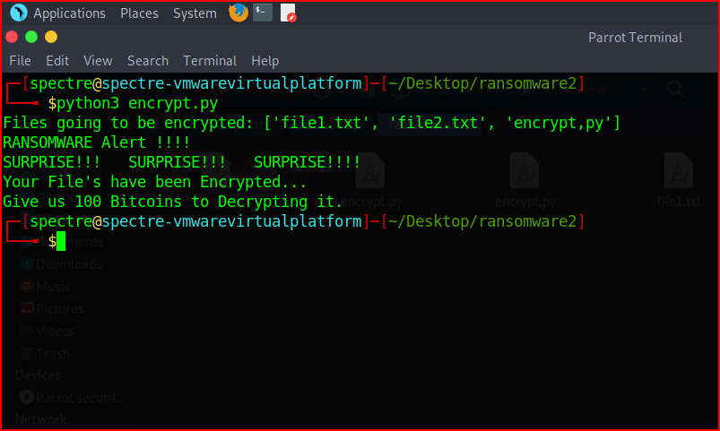
Here, we execute the encryption program & we encrypted those two files with .txt extension.

Slide 13
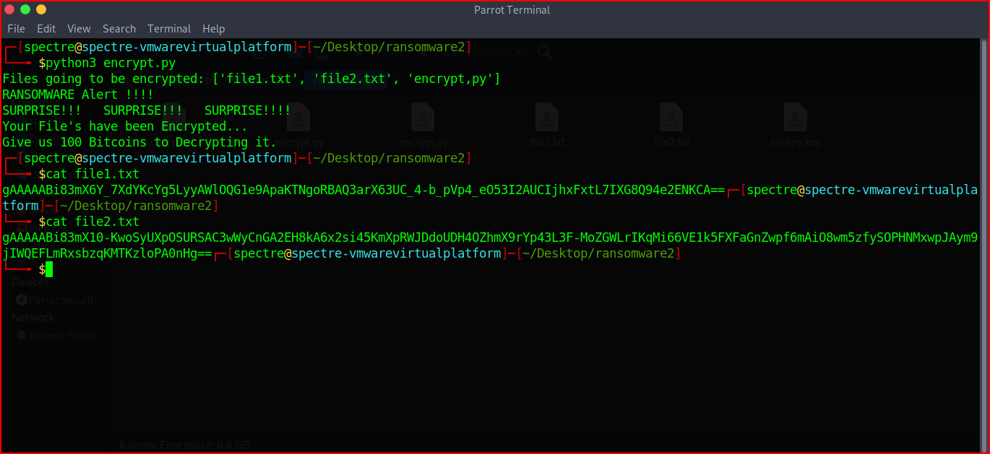
Here, we can see that both files are encrypted & the contents of files are in cipher text form.

Slide 14
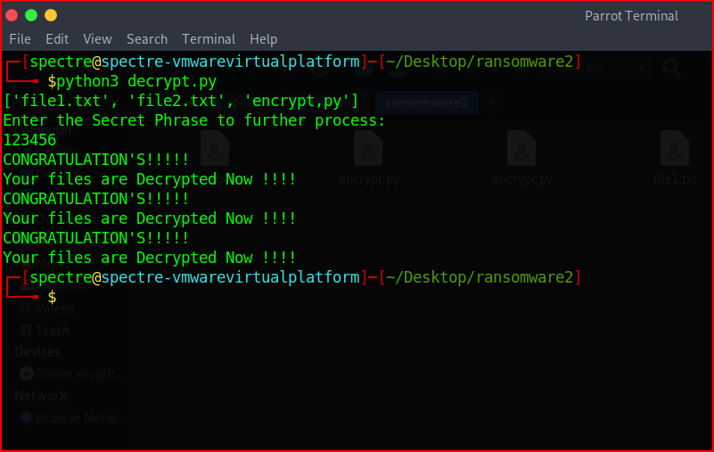
Now, we are going to decrypt the files by our “decrypt.py” program.

Slide 15
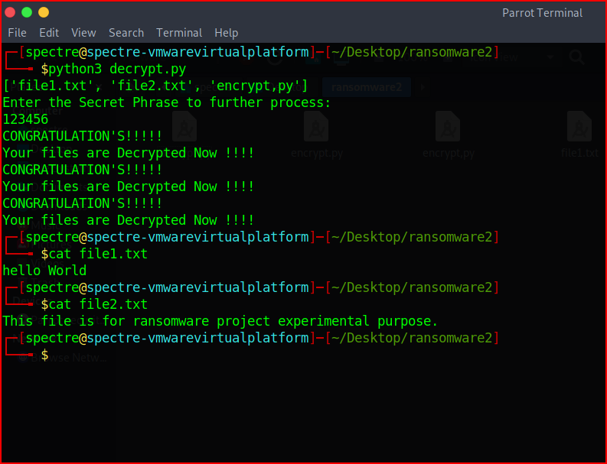
As we can see both files are now decrypted and content is in plain text.

Slide 16
Reference :
Networkchuck (YouTube channel)
Session name – i created a malware with python(it’s SCARY easy!!)
Session Link - https://youtu.be/UtMMjXOlRQc

Slide 17
Thank You !
Ketan Mote
Cyber Security Student at Indira College of Commerce and Science, Pune.
LinkedIn - Ketan Mote
GitHub - ketan96github
Mail-id - moteketan9@gmail.com

