Slide 1
Kchat Application
Kchat Chatting application using one server and as many clients as you need.
Student name : Mahmoud Khalil
Student id : 120160351

Slide 2
Kchat Overview
What is Kchat ?
Kchat is a free and open source python software and protocol used to make a simple chat between clients using one server.
Which port did you choose for Kchat ?
I used port 1234 just because it’s simple to remember.

Slide 3
Kchat Workflow
How does Kchat work ?
First there must be a server in a specified ip that runs Kchat “Server.py” file (which open the port 1234 and wait for clients)
Clients must connect to the server ip on 1234 port
Clients must use #conn and #user commands for authorization
Clients can send / receive messages from / to the server

Slide 4
Kchat Transport Protocol
Which transport protocol do Kchat uses and why ?
Kchat uses the Transmission Control Protocol (TCP)
TCP provides reliability, ordering and error-checking
Kchat messages have to be correct and reliable

Slide 5
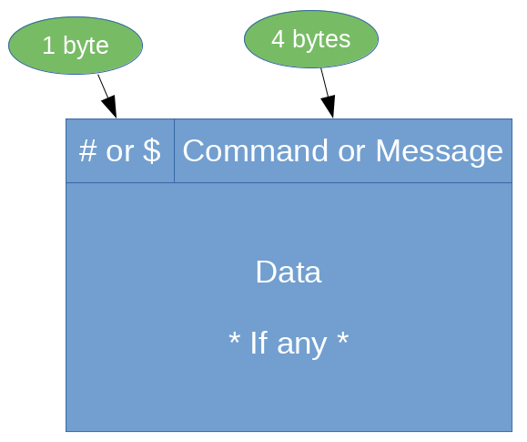
Kchat Header
Commands can’t be mixed with messages.
Command headers can uses data section some times.
No checksum value because TCP contains a checksum.

Slide 6
Kchat Commands
The Kchat uses the symbol “#” before any command.
This is the list of commands which is available now :-
  #conn : used in the first time to ensure from the connection.
  #user : used to change the username of a client.
  #help : used to show the manual help page for the kchat.
  #exit : used to close the connection and exit.
  #ulst : used to request users names who connected to same server.
  (#ulst is not implemented yet )

Slide 7
Kchat Messages
The Kchat uses the symbol “$” before any chatting message.
If a client make “$Hello” message then it will be sent for all clients.
To specify a message client have to do it like this “$username$Hello”.

Slide 8
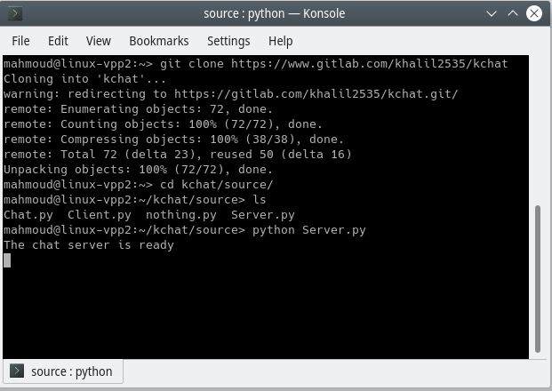
Kchat Server
Kchat doesn’t support GUI for servers.
Make the git command and run the “Server.py” file using python.
The server is running on default configurations.

Slide 9
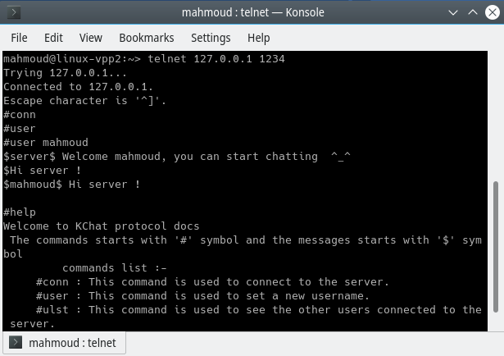
Kchat Client (Console)
Using “telnet” command.
# for commands and $ for messages.
Simple and work fine.
Can get interrupted while writing a message.

Slide 10
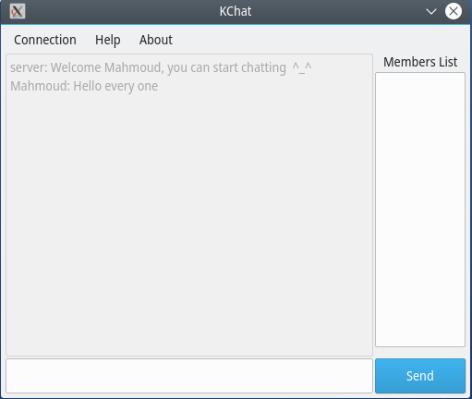
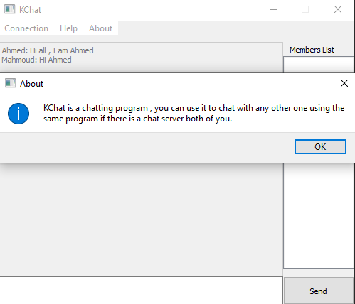
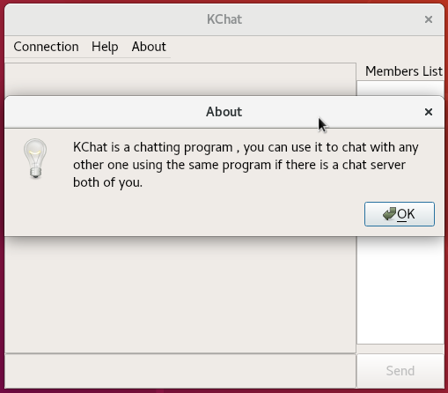



Kchat Client (GUI)
Running fine on Multiple platform.
On KDE
On Windows
On Gnome

Slide 11
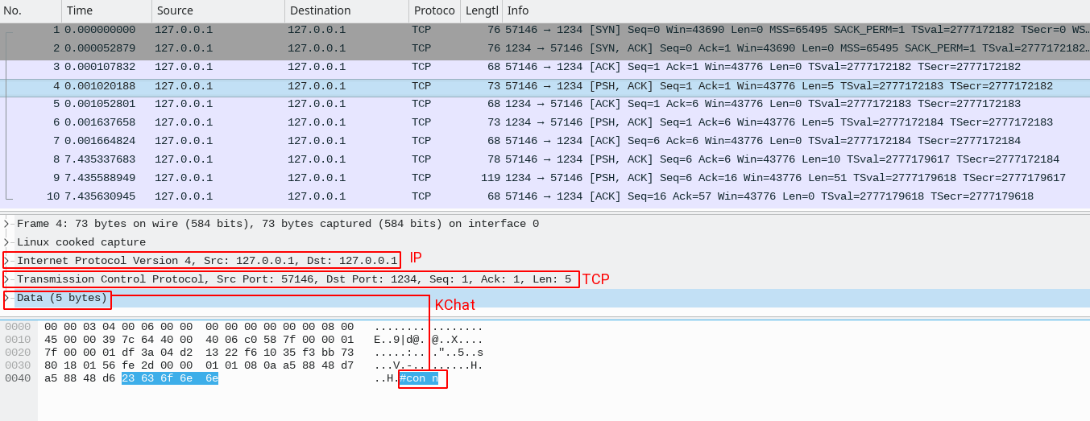
Kchat Packets
Sample of sniffed packets using Wire shark.

Slide 12
Running Kchat
* Practical Part *
* open Kchat server on host.
* open 2 clients one using command lines and other GUI.
* open another client on virtual windows using GUI.

Slide 13
Kchat Needs Help !
Kchat protocol/application is under development yet .
To help Kchat :-
  Use it!, It’s the simplest way to help software.
  Contribute for it, If you are programmer.
  Translate it, To other languages if you can.
  Submit feedbacks / errors / feature requests.

Slide 14
End of Presentation
Thank You

