Slide 1

PROTOTYPE (pun intended)
MUHAMMAD ALI KHAN
CYS232035

Slide 2
Typing SPEED Game with Python (Tkinter GUI)
This is a GUI-based typing game that measures typing speed and accuracy. Key features include a timer, WPM counter, score tracker, and leaderboard.

Slide 3
Tools and Technologies
Developed using Python with the Tkinter library for GUI. Used built-in modules like random, time and webbrowser.

Slide 4
Game Idea and Workflow
User enters their name and chooses a timer. They type a random paragraph, and the game calculates WPM and score.

Slide 5
Code Structure Overview
Code is modular with separate functions for UI, logic, and scoring. Main components include:
start_game()
ask_for_username()
game_state

Slide 6
GUI Design with Tkinter
Used Tkinter widgets like Label, Text, Button, and Radiobutton. Elements are arranged using pack() and window is centered using center_window().

Slide 7
Game Mechanics
Countdown is managed using after() method for smooth timing. Live feedback highlights correct and incorrect words using colour logic.

Slide 8
Leaderboard and WPM
WPM is calculated based on correct words and time. Top 5 scores are stored and displayed in a sorted leaderboard.

Slide 9
End Game and Replay
When time ends, input is disabled and final results are shown. Users can replay the game with a single click.

Slide 10
SUMMARY OF PYTHON CONCEPTS USED
Data Structures: Dictionaries, Lists
Control Flow: If/else, Loops
Time Handling: time module
Functions: For code modularity
Tkinter: For GUI components (Buttons, Labels, etc.)
Events: For user interactions like keyboard presses

Slide 11
Conclusion
Learned about GUI handling, state management, and real-time updates in Python. Future ideas: persistent leaderboard and login.

Slide 12
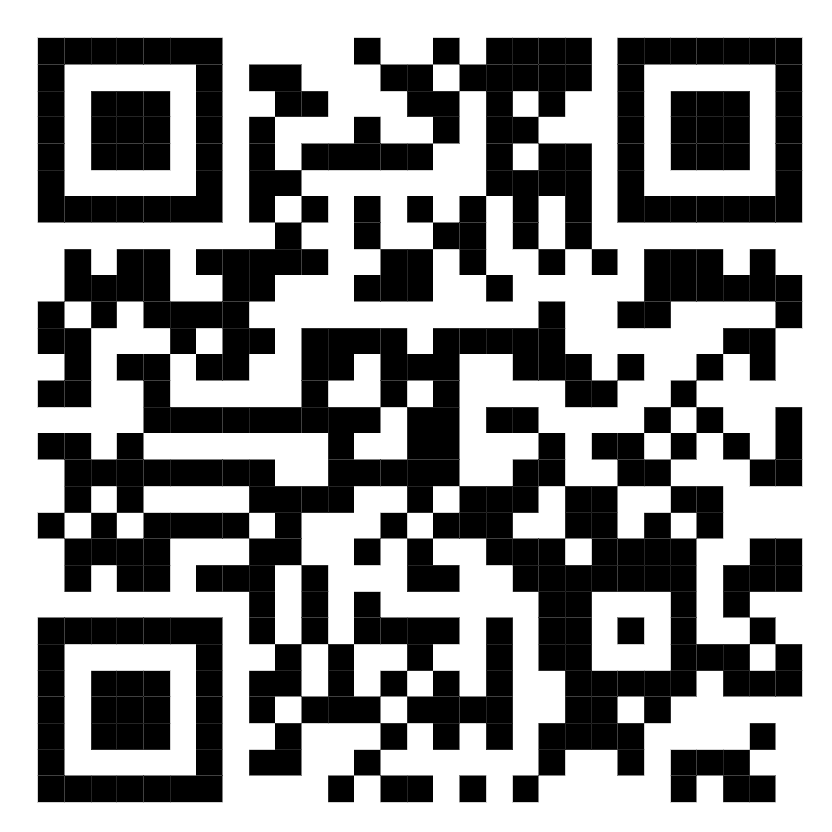
SCAN TO GET THE SOURCE CODE

