Slide 1
Leveraging Deep Learning for Advanced Threat Detection & Traffic Analysis
Convolutional Neural Networks for Network Monitoring
Presenter: Younas, Umar, Shamina | Date: Oct 15, 2025
01

Slide 2
Agenda
Evolving Network Threats
CNN Fundamentals
CNNs in Action
Conclusion & Q&A
1
2
3
4
5
6
7
8
ML & Neural Networks
Data Transformation
Advantages & Challenges
Thank You
02

Slide 3
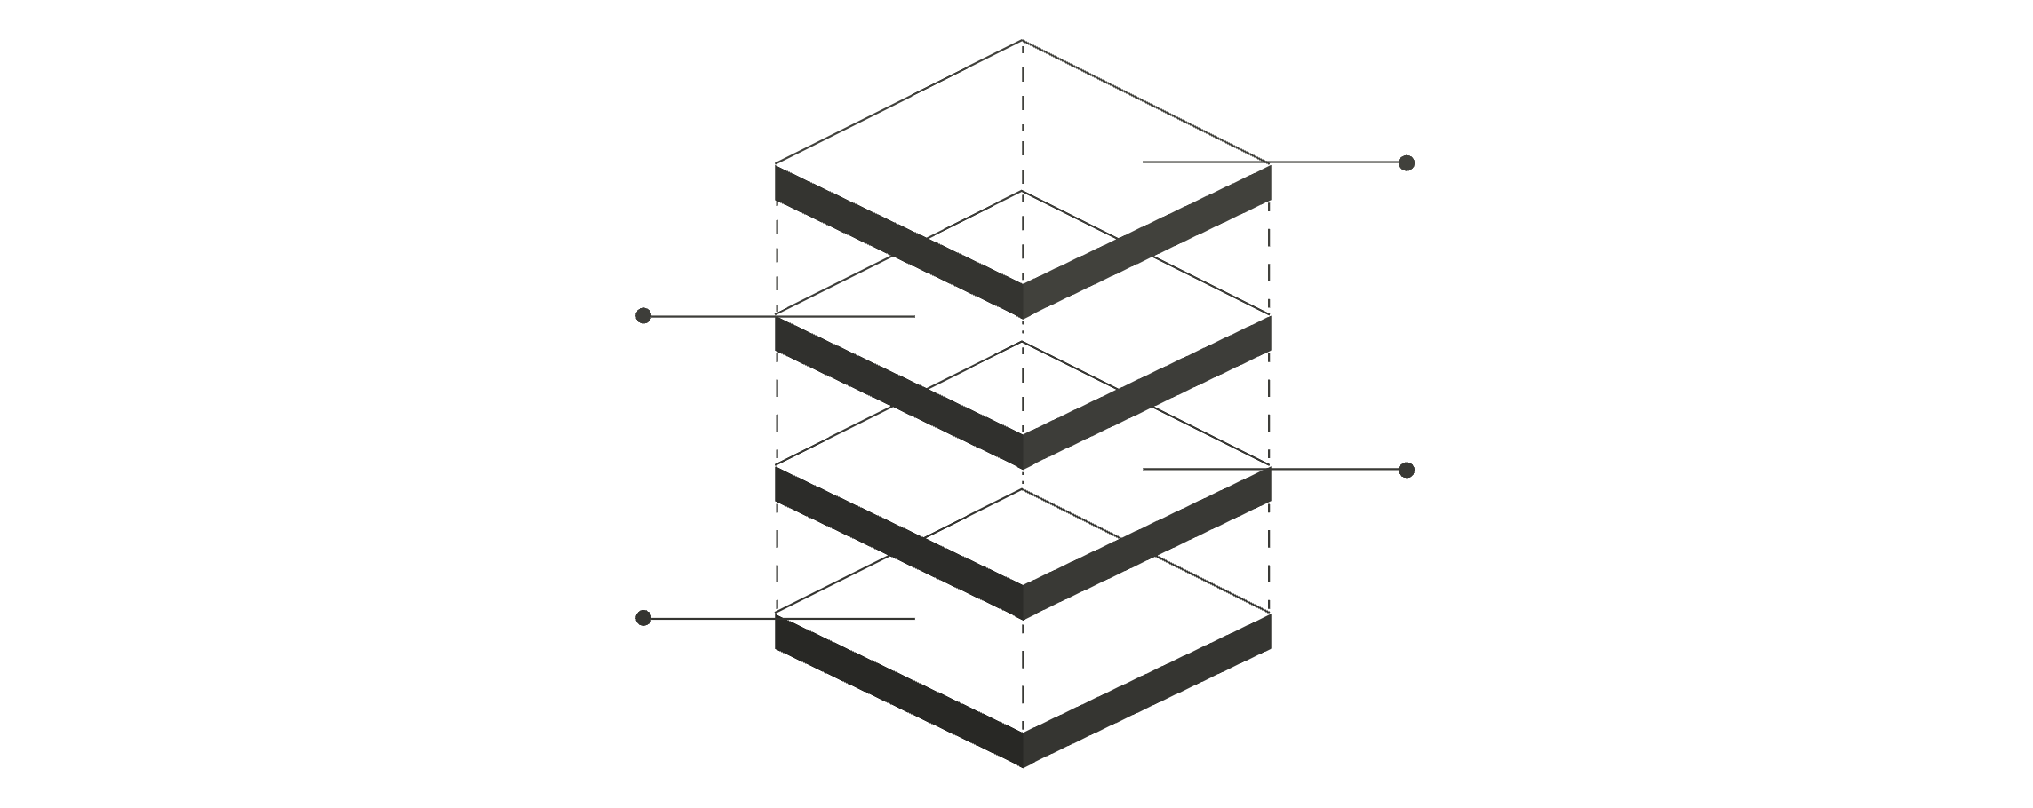
The Evolving Landscape of Network Threats
Traditional NMS Limitations
1
2
3
Rule-Based Detection
Alert Fatigue
Encrypted Traffic
Relies on known patterns and pre-defined thresholds, making it ineffective against novel attacks (zero-day) and polymorphic malware.
Static thresholds often lead to too many false positives, overwhelming security teams.
Traditional Deep Packet Inspection (DPI) struggles with encrypted traffic, creating a "dark space" for threats.
The Need for Intelligence
We require adaptive security systems that learn and proactively identify anomalies before they become full-blown incidents. Network traffic generates vast amounts of data, which is perfect for Machine Learning.
Encrypted Traffic
Obscured payloads evade rules
Zero-Day Attack
Novel threat not recognized
Known Attack Signatures
Detection Engine
Database of identified threats
Firewall performing signature checks
03

Slide 4
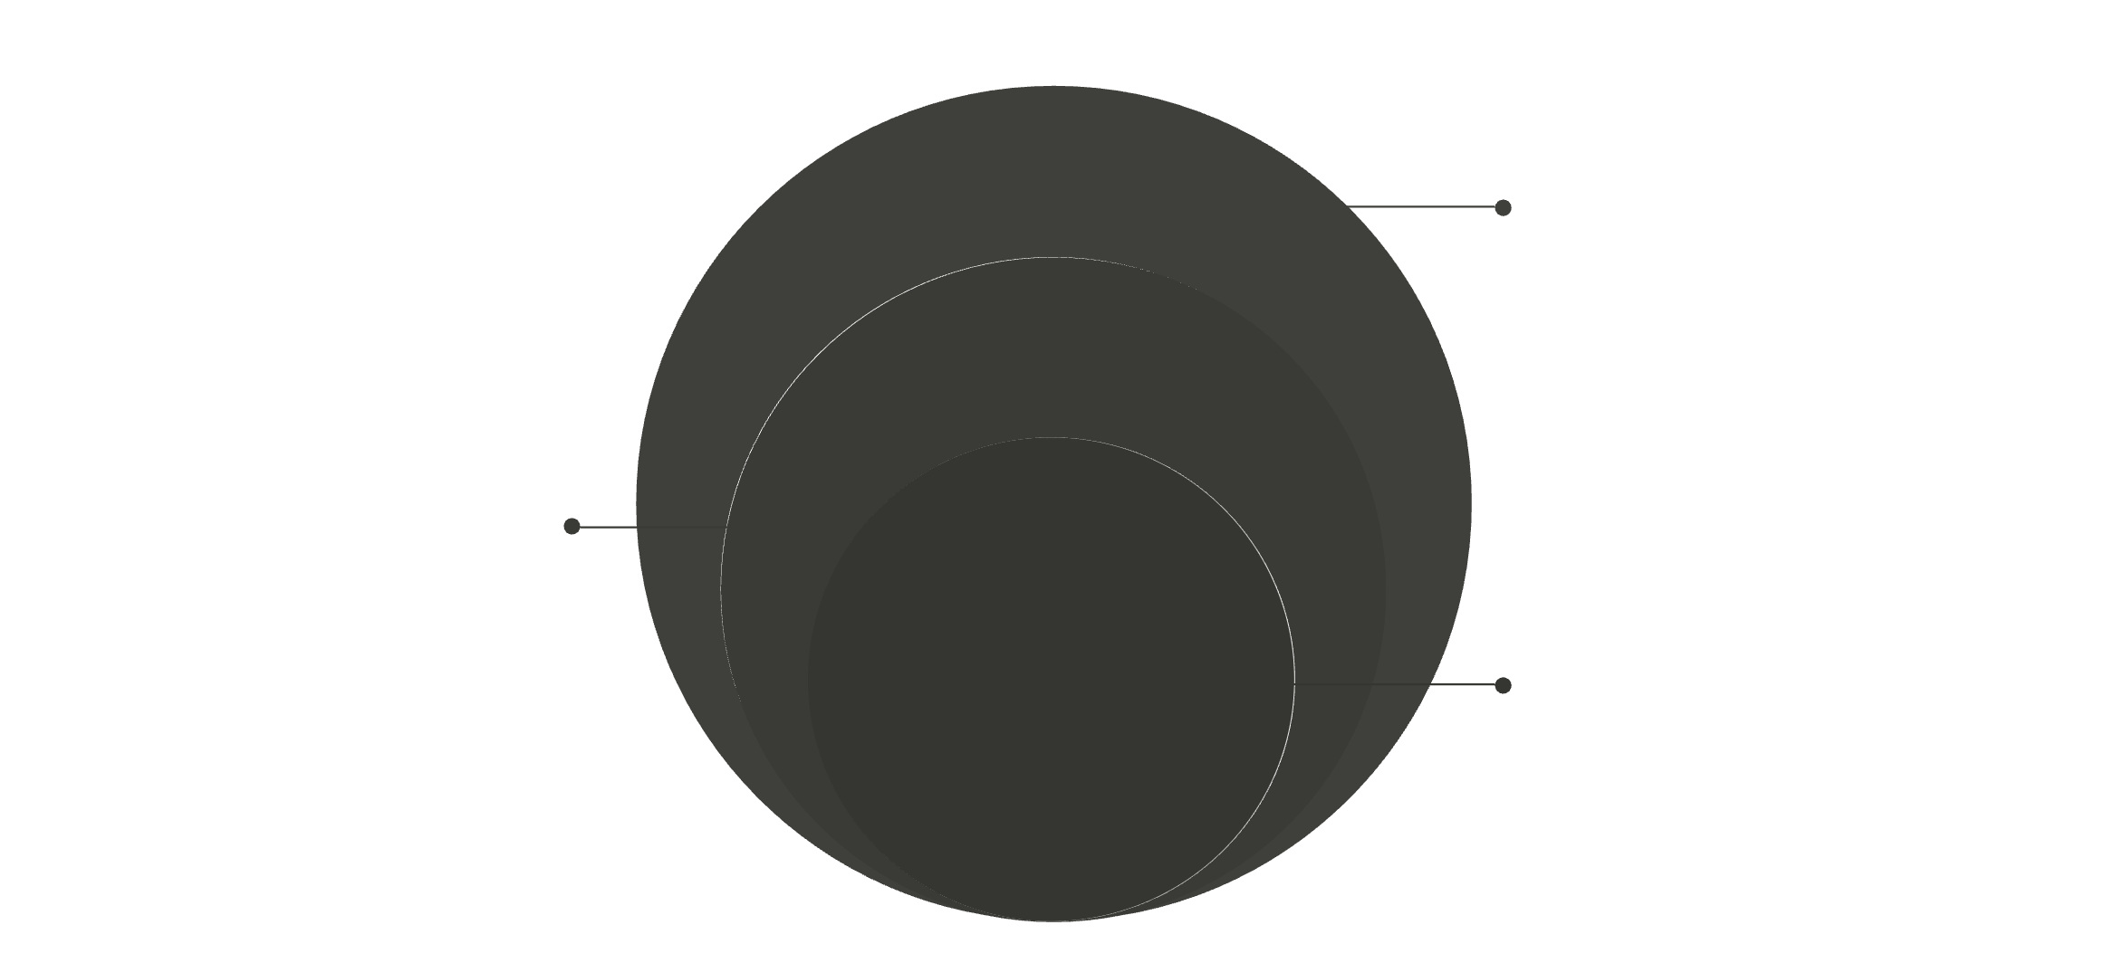
Introduction to Machine Learning & Neural Networks
1
2
What is Machine Learning (ML)?
Basic Neural Networks (NN)
Algorithms that learn patterns from data to make predictions or decisions without explicit programming.
Loosely based on the human brain, NNs are composed of interconnected "neurons" organized in layers.
Supervised Learning: Learns from labeled data (e.g., "attack" vs. "normal").
Input Layer: Receives raw data.
Unsupervised Learning: Finds hidden patterns in unlabeled data (e.g., clustering traffic types).
Hidden Layers: Perform computations and learn complex features.
Output Layer: Produces the final prediction.
Output LayerProduces predictions or class scores
Hidden LayerApplies weighted sums and activations
Input LayerReceives features from the dataset
Deep Learning: Going Deeper
Deep Learning uses Neural Networks with many hidden layers. This power allows the system to learn hierarchical representations of data—simple features in early layers, complex abstractions in deeper layers. This is possible today due to large datasets, powerful GPUs, and improved algorithms.
04

Slide 5



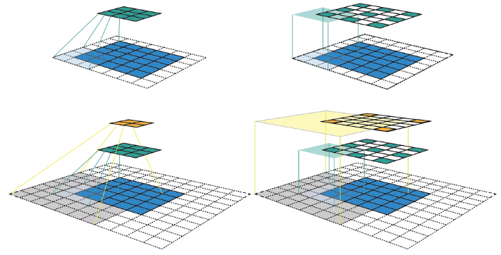
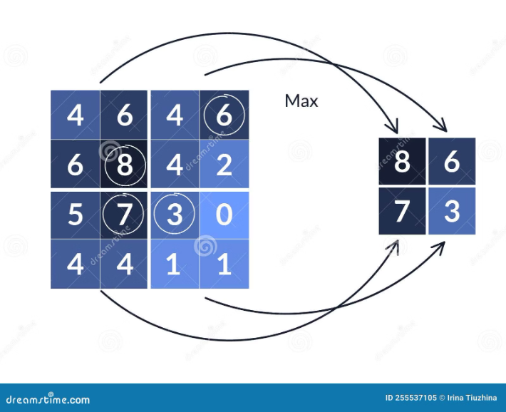
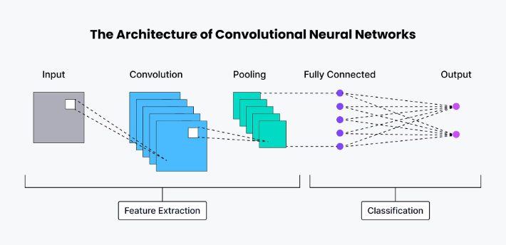

CNN Fundamentals: How They "See" Patterns
Convolutional Neural Networks (CNNs) are specialized for structured data. Originally for images, they are powerful for any data with local, spatial relationships, focusing on identifying patterns in local regions regardless of their exact position. CNNs automatically learn the best features, eliminating manual feature engineering.
The Convolutional Layer
Fully Connected Layers
Uses small matrices called Filters (Kernels) that slide across the input data, performing a dot product to create a Feature Map. This process highlights where the filter's pattern was detected, and weight sharing makes it robust to pattern location.
These layers take the flattened output from the final convolutional/pooling layers. They combine all the high-level features learned by the CNN to make the final classification or prediction, typically feeding into a softmax function.
The Pooling Layer
Reduces the spatial size of feature maps (dimensionality reduction). This makes the network more robust to small shifts in the input pattern and helps reduce overfitting. Max Pooling is a common type.
The full CNN architecture flows from Input Data through CONV, RELU, and POOL layers, then FLATTENED, and finally into the Fully Connected Layer for output classification (e.g., "Normal Traffic," "DDoS Attack").
05

Slide 6



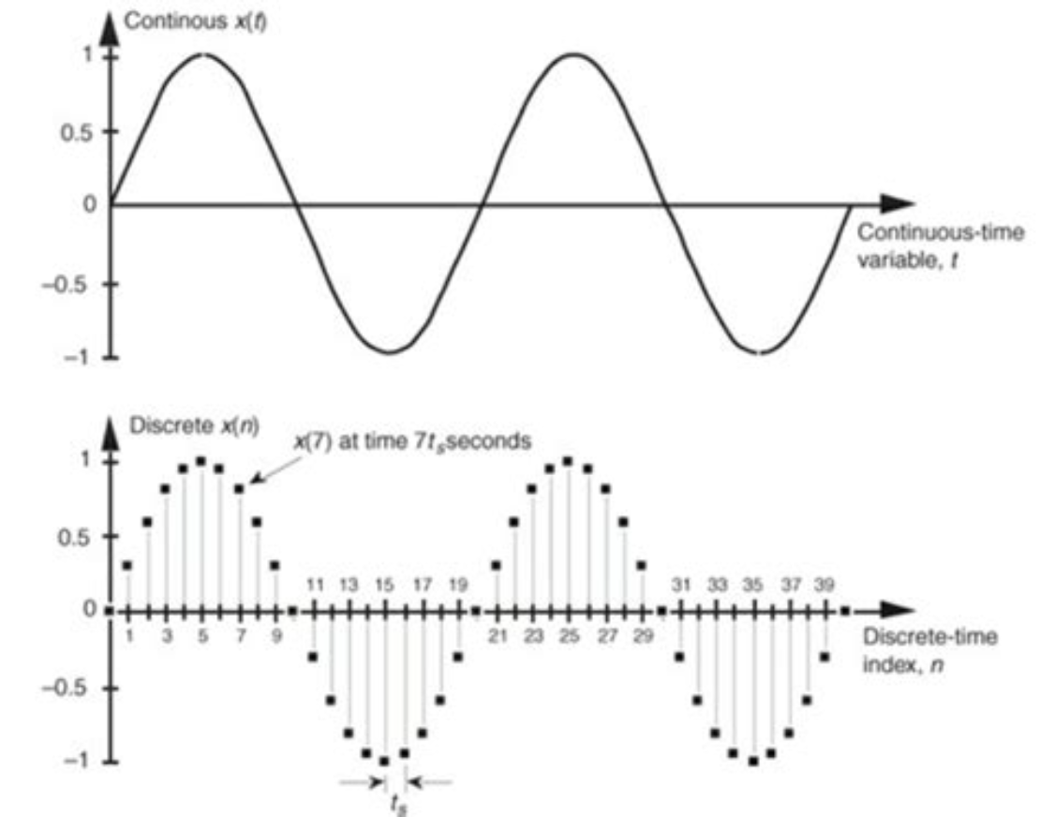
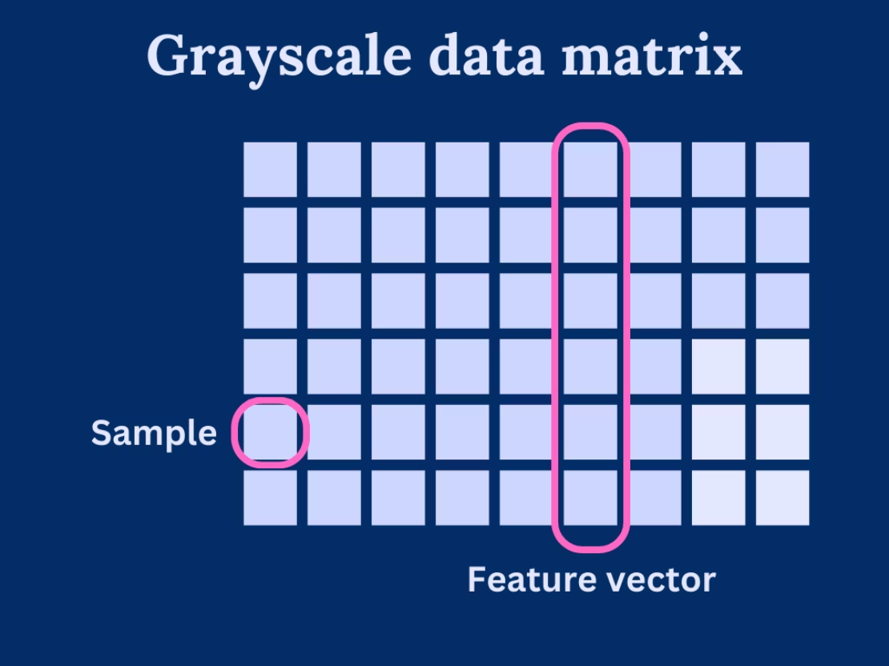
Transforming Network Data for CNNs
The challenge is converting raw, heterogeneous network data (packets, flows) into a structured grid of numbers that a CNN can process.
"Traffic Signal"
"Flow Matrix"
Treats a sequence of network events as a 1D time-series signal. Features include packet size sequence, inter-arrival time, or bandwidth usage over time. The input to the CNN is a vector.
Represents a network activity snapshot as a 2D grid, similar to a grayscale image. Rows represent individual network flows or time windows, and columns represent flow features (e.g., packet count, byte count, duration). The input is a matrix.
Effective data representation is crucial: it allows the CNN to apply its powerful spatial pattern detection capabilities to temporal and statistical network features.
06

Slide 7
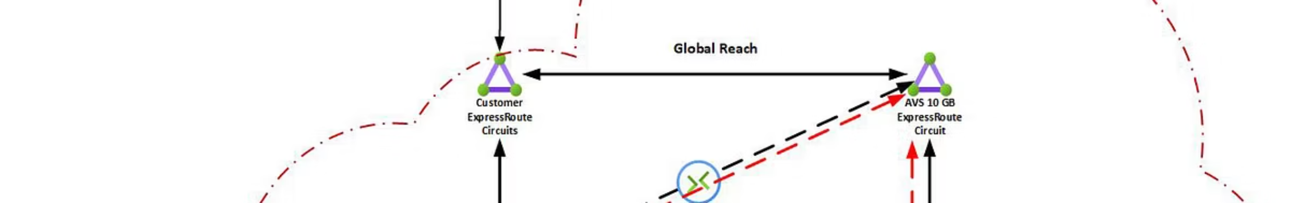
CNNs in Action: Use Cases for Network Monitoring
Traffic Classification
Intrusion Detection Systems (IDS)
Encrypted Traffic Analysis
The goal is to identify the application or service generating the traffic (e.g., video streaming, gaming, P2P). CNNs detect subtle patterns in packet sizes and timings that distinguish applications, even within encrypted tunnels, aiding bandwidth management and QoS.
Since the payload is encrypted, CNNs analyze metadata (packet sizes, inter-arrival times, flow duration) which remains unencrypted. This allows identification of specific encrypted applications (VPN, Tor, Netflix) or detection of anomalies within those flows.
CNNs detect malicious activities like Port scans, DDoS attacks, and botnet C&C traffic. They learn "normal" patterns and flag deviations, enabling signature-less anomaly detection for new attacks and providing early threat warnings.
07

Slide 8





Advantages & Challenges of CNNs in NMS
Data Labeling
Requires large, accurately labeled datasets for supervised learning, which is often time-consuming and expensive to acquire.
Automatic Feature Learning
Eliminates the need for time-consuming and error-prone manual feature engineering.
Computational Resources
Training deep CNNs is computationally intensive, often requiring specialized hardware like GPUs.
Detection of Novel Attacks
Interpretability
Learns generalizable patterns, allowing for signature-less detection of new threats.
The "black box" nature of deep learning makes it difficult to understand the reasoning behind a specific detection decision.
Concept Drift
Scalability & Robustness
Network traffic patterns constantly evolve, meaning models require frequent retraining to maintain accuracy.
Can effectively process large volumes of high-dimensional network data and is robust to noise or small pattern variations.
08

Slide 9

Key Takeaways & Discussion
Adaptive Solution
Data is Key
Traditional NMS struggles with modern threats; CNNs offer a powerful, adaptive solution by automatically learning patterns.
Effective data representation (1D signals, 2D matrices) is crucial for successful implementation.
Core Applications
Future Vitality
CNNs excel in traffic classification, intrusion detection, and encrypted traffic analysis.
Despite challenges in data and resources, CNNs are a vital tool for the future of network security and monitoring.
Questions & Discussion
Thank You for your attention. We are now open for questions.
09

Slide 10
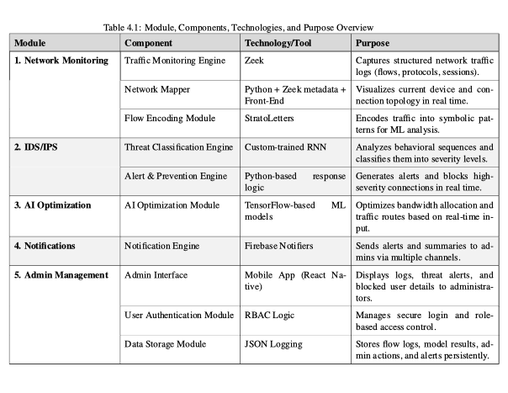
AI-Driven Network Monitoring and Security System (VIGILANTE)
Table
VIGILANTE is an AI-powered network monitoring and cybersecurity framework developed to enhance large institutional infrastructures such as GIKI’s network.
It integrates GRU-based neural networks, symbolic flow encoding, and Zeek-powered traffic monitoring for real-time anomaly detection and intelligent traffic optimization.
Built on a hybrid microservices and event-driven architecture, it ensures modularity, scalability, and responsiveness in managing complex network environments.
10

Slide 11
Relevance to our Project
Aspect | VIGILANTE | Our AI-Based Network Monitoring System
Core Objective | Real-time AI-driven network monitoring, intrusion prevention, and performance optimization | Intelligent monitoring and anomaly detection for secure and optimized networks
Architecture | Hybrid microservices and event-driven design ensuring modularity and scalability | Modular and distributed design for scalable, efficient monitoring
AI Models Used | GRU-based RNN for threat classification, clustering & reinforcement learning for optimization | CNN/DNN models for anomaly detection and real-time traffic pattern analysis
Traffic Monitoring Tool | Passive monitoring with Zeek and symbolic flow encoding | Real-time packet capture and flow-based monitoring
Optimization Strategy | Adaptive performance tuning using AI optimization module | Machine learning–based bandwidth and latency optimization
Alerting & Visualization | Mobile dashboard with live alerts, topology view, and remote control | Centralized web interface with intelligent alert system and visual analytics
Results Achieved | 97.3% detection accuracy, 12% bandwidth gain, 18% latency reduction | Targeting similar or improved detection accuracy and performance enhancement
Future Scope | Integration of SDN, advanced deep learning models, and external threat intelligence | Incorporating hybrid ML models, cloud scalability, and extended automation features
11

Slide 12
Thank You
12

