Slide 1
아두이노(Arduino) WiFi

Slide 2
아두이노와 파이어베이스 연결
https://github.com/firebase/firebase-arduino/tree/master/examples/FirebaseDemo_ESP8266
Download FirebaseArduino library
Start Arduino
Click Sketch > Include Library > Add .ZIP Library...
Choose firebase-arduino-master.zip downloaded

Slide 3
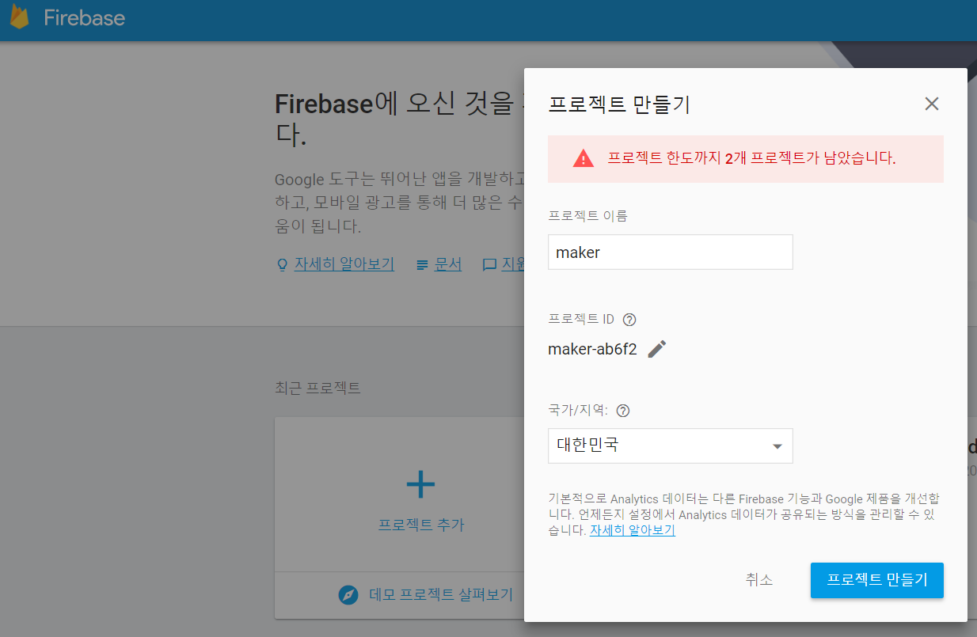
파이어베이스
https://console.firebase.google.com/

Slide 4
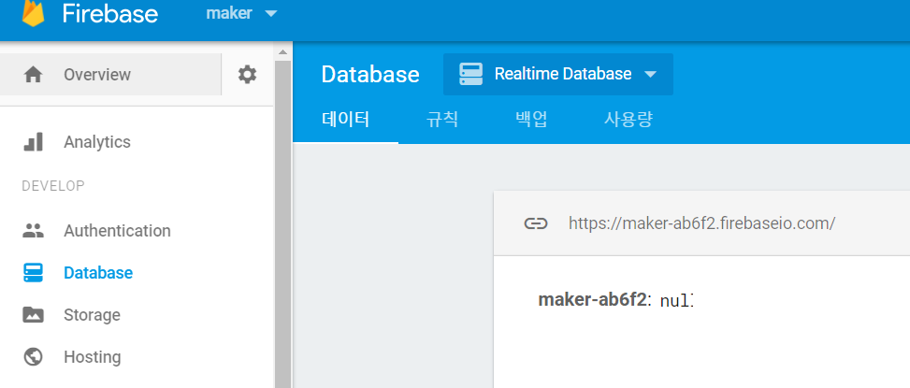
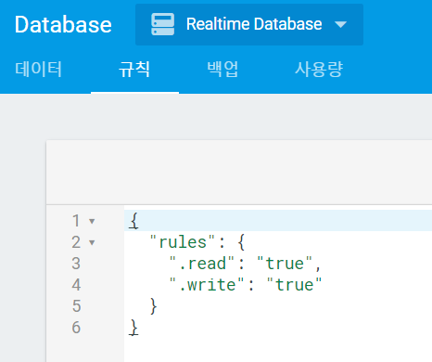
파이어베이스
Database

Slide 5
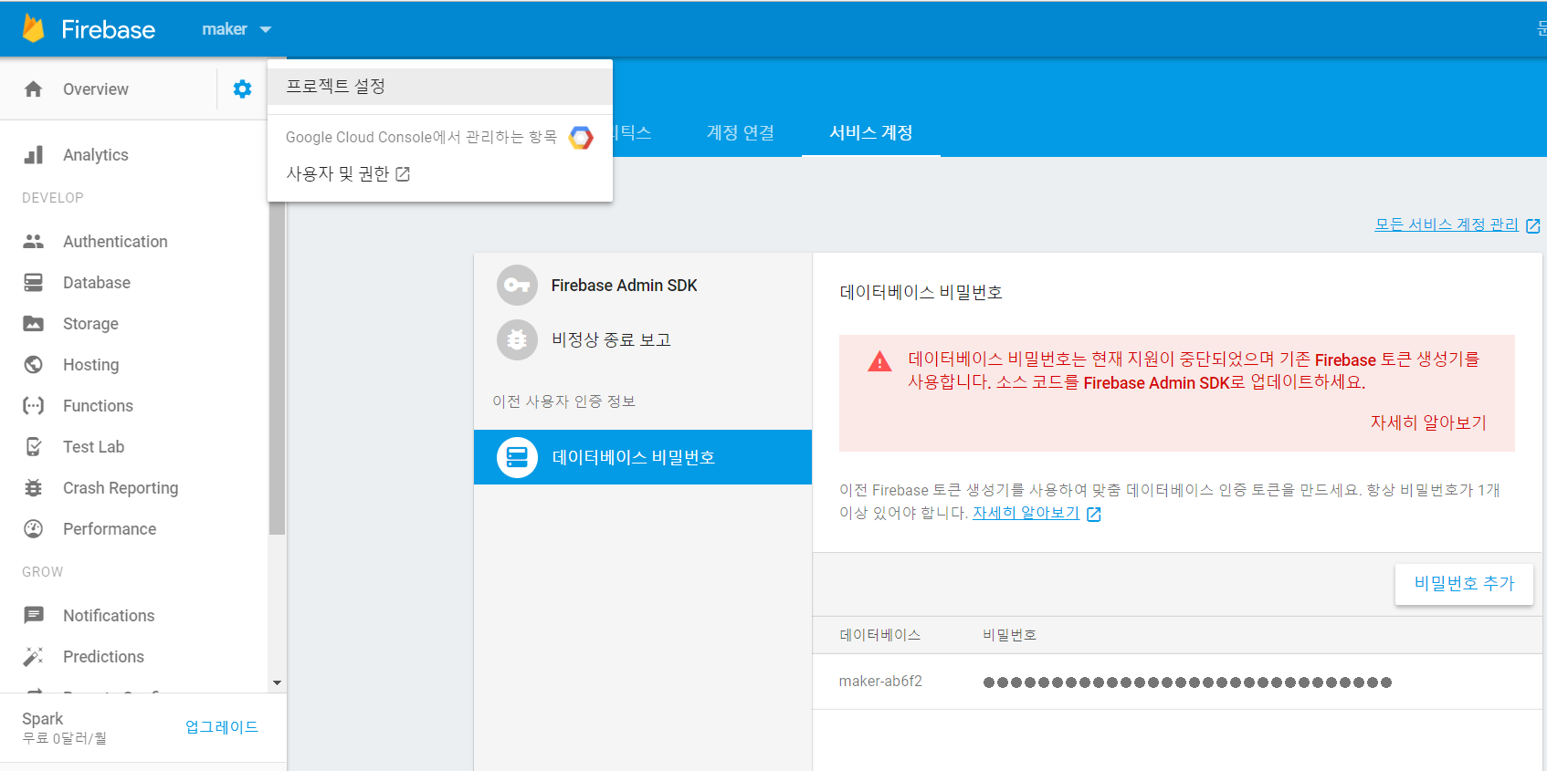
파이어베이스

Slide 6
ESP8266 WiFi 설정 및 firebase 설정
#include <ESP8266WiFi.h>
#include <FirebaseArduino.h>
// Set these to run example.
#define FIREBASE_HOST ＂본인파이어베이스"
#define FIREBASE_AUTH ＂본인파이어베이스비번"
#define WIFI_SSID "본인wifi"
#define WIFI_PASSWORD " 본인wifi 비번"
int n = 0;
void loop() {
// set value
n = Firebase.getInt("num") + 1 ;
Serial.println(n);
Firebase.setInt("num", n);
// handle error
if (Firebase.failed()) {
Serial.print("setting /number failed:");
Serial.println(Firebase.error());
return;
}
delay(1000);
}
void setup() {
Serial.begin(9600);
// connect to wifi.
WiFi.begin(WIFI_SSID, WIFI_PASSWORD);
Serial.print("connecting");
while (WiFi.status() != WL_CONNECTED) {
Serial.print(".");
delay(500);
}
Serial.println();
Serial.print("connected: ");
Serial.println(WiFi.localIP());
Firebase.begin(FIREBASE_HOST,FIREBASE_AUTH);
}

Slide 7
LED 불켜기
#include <ESP8266WiFi.h>
#include <FirebaseArduino.h>
// Set these to run example.
#define FIREBASE_HOST "maker-ab6f2.firebaseio.com"
#define FIREBASE_AUTH "lQCOnHGm1tcU4Ay14I4X5x5bl2ToG9X0r6CVtuix"
#define WIFI_SSID "silla2g"
#define WIFI_PASSWORD "min12345"
int led = 13 ;
void setup() {
Serial.begin(9600);
pinMode(13, OUTPUT);
// connect to wifi.
WiFi.begin(WIFI_SSID, WIFI_PASSWORD);
Serial.print("connecting");
while (WiFi.status() != WL_CONNECTED) {
Serial.print(".");
delay(500);
}
Serial.println();
Serial.print("connected: ");
Serial.println(WiFi.localIP());
Firebase.begin(FIREBASE_HOST,FIREBASE_AUTH);
}
int n = 0;
void loop() {
// set value
String n = Firebase.getString("led") ; Serial.println(n);
// handle error
if (Firebase.failed()) {
Serial.print("read /led failed:");
Serial.println(Firebase.error());
return;
}
if ( n == “0” ) {
digitalWrite(led, LOW);
}
else {
digitalWrite(led, HIGH);
}
delay(1000);
}

