Slide 1
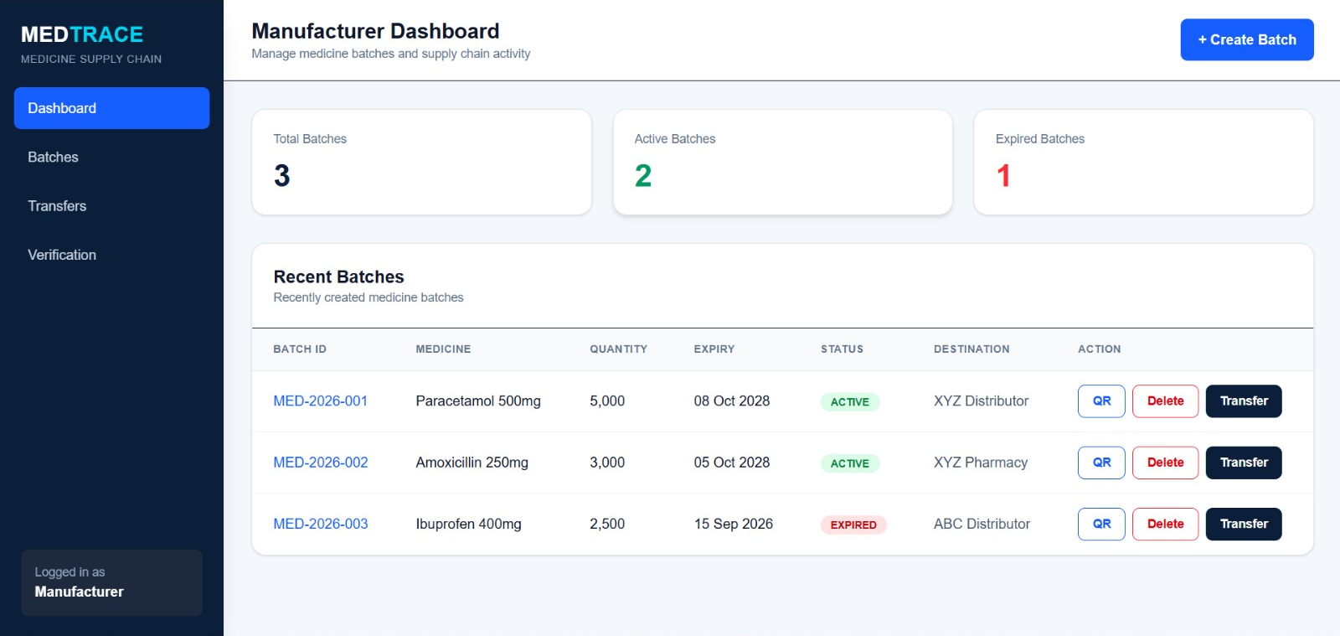
MEDTRACE
BLOCKCHAIN | CB-03
Blockchain-powered medicine supply chain tracker
Problem statement CB-03: Anti-counterfeit drug supply-chain tracker
Hackathon project | Team of 4
Notes:
Introduce MedTrace: a blockchain-based tracker that lets anyone check whether a medicine batch is genuine. Domain: Blockchain. Problem statement: CB-03.

Slide 2



Fake medicines slip through unchecked
Counterfeit drugs
Expired & recalled
No way to verify
Fake medicines enter the chain between manufacturer, distributor and pharmacy.
Expired or recalled medicines can stay on shelves unnoticed.
Patients and pharmacists cannot easily check if a strip is genuine.
Our goal: make every batch traceable and every pack verifiable by anyone.
Notes:
The problem from CB-03: counterfeit and expired medicines enter the supply chain, and patients and pharmacists have no simple way to check a strip.

Slide 3





A traceable journey for every batch
01 Register
02 Transfer
03 Stock
04 Verify
Manufacturer logs the batch and its expiry on the blockchain.
Each hand-off to a distributor or pharmacy is recorded.
Pharmacy receives the batch with its full history attached.
Anyone scans the pack's QR to see if it is genuine.
Every hand-off is recorded, so a batch's full journey can be traced and verified.
Notes:
Walk through the four stages: register, transfer, stock, verify.

Slide 4



How MedTrace works
Web interface
TypeScript & JavaScript dashboards
Why blockchain?
Tamper-proof records
Once a hand-off is on-chain, it cannot be quietly edited.
Backend
REST API and blockchain integration
Shared transparency
Manufacturer, distributor and pharmacy see one truth.
Blockchain
Solidity contract on Ethereum Sepolia
Role-based trust
Only the right role can create or transfer a batch.
QR verification
Scan and check any batch
Notes:
Four building blocks: web interface, backend, blockchain smart contracts, QR verification. Blockchain gives tamper-proof, shared, role-controlled records.

Slide 5




Tech stack
Blockchain
Backend
Frontend
Delivery
Solidity smart contract
Hardhat tests
Ethereum Sepolia
Node.js REST API
TypeScript & JavaScript
Blockchain integration
TypeScript & JavaScript
Role-based dashboards
QR scan and verify
Deployed on Vercel
GitHub version control
Live public demo
Notes:
Smart contract written in Solidity and tested with Hardhat, deployed to Ethereum Sepolia. Backend and frontend use TypeScript and JavaScript. Hosted on Vercel.

Slide 6
Manufacturer dashboard
Batch overview
Total, active and expired batches at a glance.
One-click actions
Create a QR, transfer or delete from each row.
Clear status
Active and expired batches are flagged instantly.
Live demo: manufacturer view with three sample batches
Notes:
Show the manufacturer dashboard: batch counts, recent batches with status, and QR / Delete / Transfer actions. Create Batch button at top right.

Slide 7
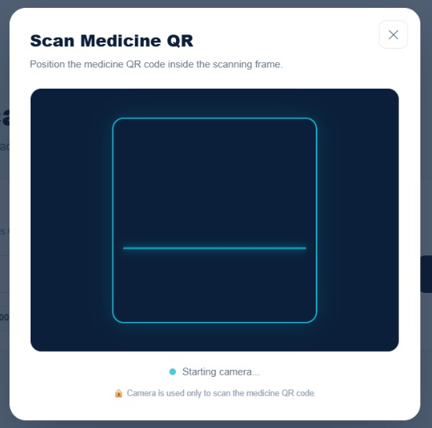



Scan. Verify. Trust.
Scan the pack's QR
Point the camera at the code inside the scanning frame.
Or enter the batch ID
A manual check when a code is damaged or unreadable.
See the full journey
Know if a batch is genuine and where it has been.
Notes:
Demo the verification page: scan the QR with the camera or type the batch ID. The camera is only used to read the medicine QR code.

Slide 8
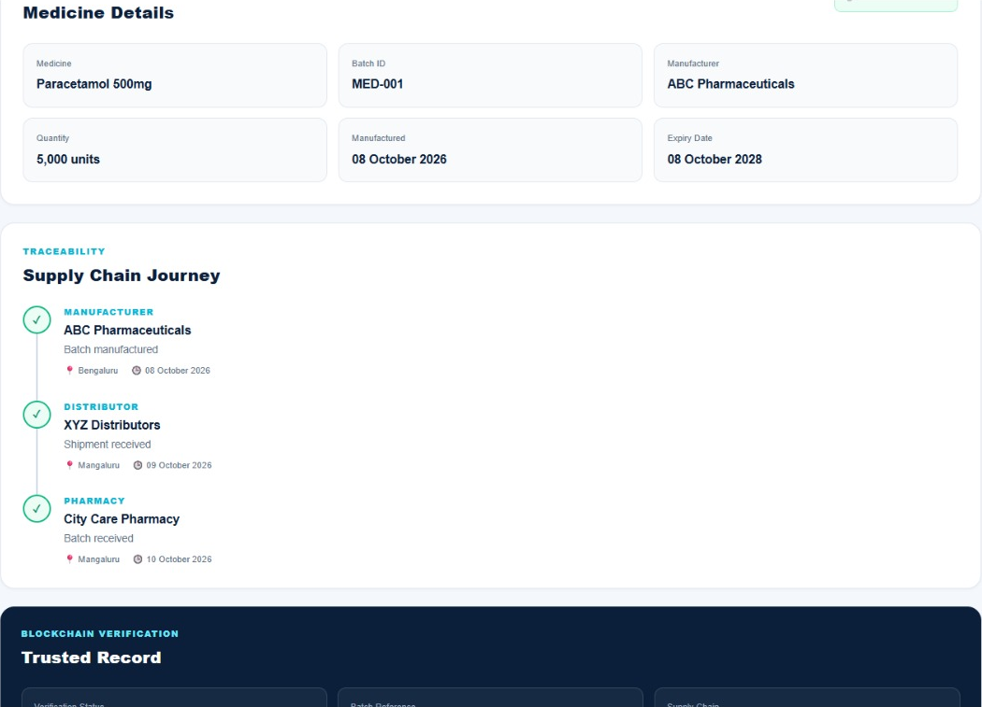




Verification result: the full journey
Four possible verdicts
Authentic
Registered and in date
Expired
Past its expiry date
Recalled
Flagged as recalled
Unregistered
No record on the blockchain
Notes:
After a scan, MedTrace shows the medicine details, the supply chain journey from manufacturer to distributor to pharmacy, and the blockchain verification record.

Slide 9



Key features
Batch registration
Smart contracts
Role-based access
Medicine, quantity and expiry logged per batch.
Transfers follow rules enforced on-chain.
Manufacturer, distributor and pharmacy roles.
QR for every batch
Expiry & recalls
Clear verdicts
Generate and scan codes in seconds.
Expired or recalled batches are flagged.
Authentic, expired, recalled or unregistered.
Notes:
Summarise the core features. Each maps back to the CB-03 objective.

Slide 10
Our team of four
MEMBER 1
MEMBER 2
MEMBER 3
MEMBER 4
Backend
Blockchain & Integration
Frontend
QR Verification & UI/UX
APIs and data logic behind batches and transfers.
Smart contracts, wired into the app.
Dashboards and pages for every role.
The QR scan flow and the look and feel.
Notes:
Introduce each teammate by name and their contribution.

Slide 11




Where MedTrace goes next
Mobile scanning app
Quick checks for pharmacists and patients on their phones.
Cold-chain tracking
Add storage and transport conditions to batch history.
Regulator dashboard
A live view of flagged and expired batches for authorities.
Production network
Move from the Sepolia testnet to a live production network.
Notes:
Future scope: mobile scanning, cold-chain data, regulator view, production network.

Slide 12
MEDTRACE
Trust every strip.
Thank you
Live demo: med-trace-mv1w2iu8m-pradyumnavbhat-ops-projects.vercel.app
Notes:
Close with the live demo link and open for questions.

