Slide 1
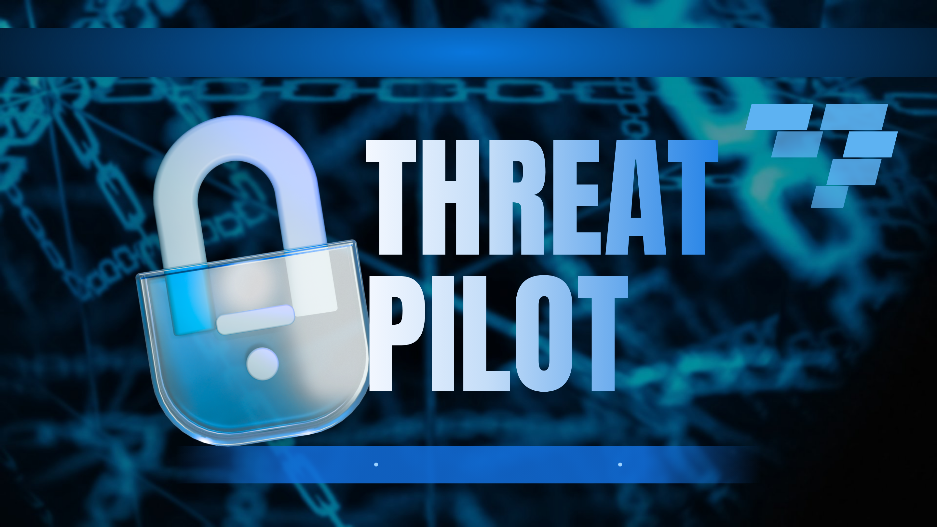
Home
Problem
Solution
Architecture
Impact
Agentic SBOM Risk Auditor
CB-02 · Cyber Security + Blockchain
Hackatopia 2K26
Notes:
Threat Pilot, an agentic SBOM risk auditor for problem statement CB-02. One line: scanners flag every CVE; we prove which ones your code can reach, rank them by real risk, and open a verified pull request after a human approves.

Slide 2
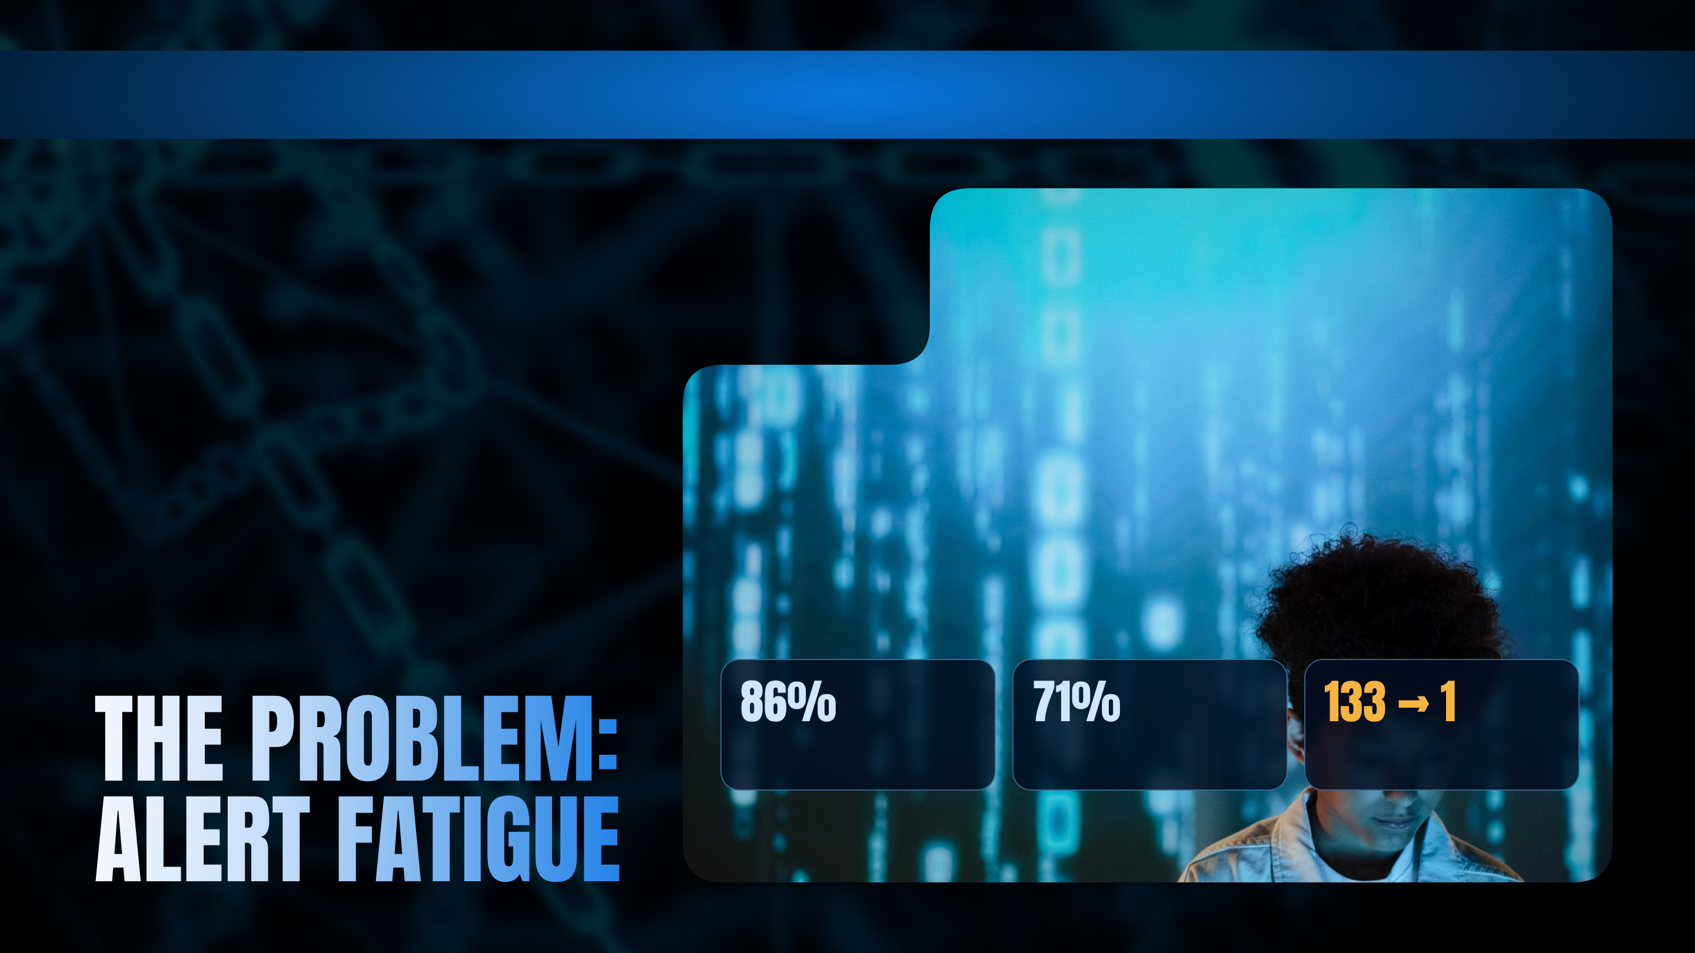
Home
Problem
Solution
Architecture
Impact
CB-02 · Automated SBOM Risk Auditor
A typical Python service pulls in 50–200 open-source packages, most of them transitive. Scanners report every known CVE in every one of them, whether or not the app ever runs the affected code.
Who is affected
Developers buried in alerts, security engineers with no evidence, and leads who cannot ship a fix safely.
Why it matters
Teams triage by CVSS severity alone. Nobody fixes 133 alerts, so nobody fixes any, and the one reachable bug ships.
of commercial codebases contain vulnerable open source
of dependencies are transitive, invisible in requirements.txt
scanner alerts on a 59-package repo vs. actually reachable
Source: Black Duck OSSRA 2025; Threat Pilot live run
Notes:
Open with the number. "This is a small Python project. Fifty-nine packages. A normal dependency scanner gives one hundred and thirty-three security alerts. Nobody fixes 133 alerts, so nobody fixes any. That is the real vulnerability." Industry data: 86% of commercial codebases contain vulnerable open source, and 71% of dependencies are transitive (Black Duck OSSRA 2025).

Slide 3
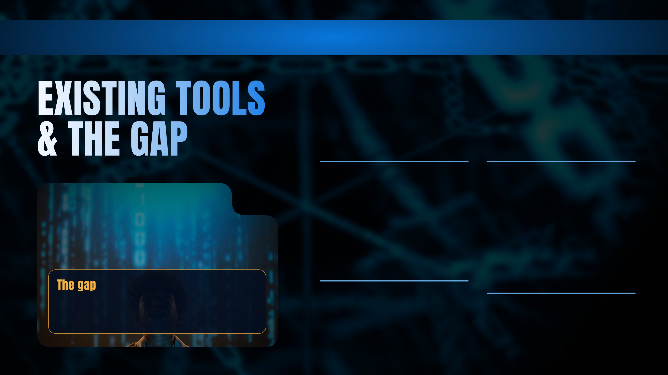
Home
Problem
Solution
Architecture
Impact
Dependabot & pip-audit
Snyk & commercial SCA
List every package with a known CVE and bump versions. They never ask whether your code calls the vulnerable function: all 133 alerts on our test repo.
Reachability exists for some languages as a paid, closed feature. The reasoning is hidden; there is no call chain you can check yourself.
Triage by CVSS score
Fixing by hand
Teams sort by severity. A 9.8 in a package that is never imported outranks a 7.5 that runs on user input.
Engineers pick versions, check conflicts and write PRs manually. Blind auto-bumps can break the build or leave the CVE open.
No tool proves which CVEs your code actually reaches, shows the evidence, and ships a verified fix behind human approval.
Notes:
"The scanner is not wrong. It is answering the wrong question. It tells you the vulnerable code is on your disk. It does not tell you whether your program ever runs it." Dependabot and pip-audit list every CVE; Snyk has reachability only as a paid, closed feature; CVSS triage ignores whether code runs.

Slide 4
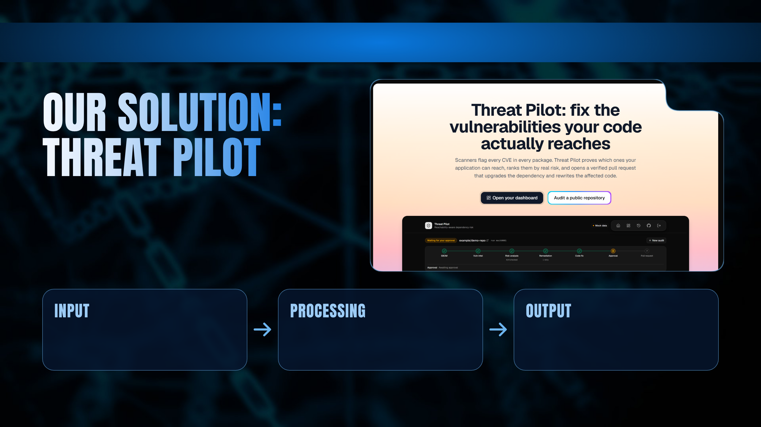
Home
Problem
Solution
Architecture
Impact
Threat Pilot proves which vulnerabilities your application can actually reach, ranks them by real risk, and opens a verified pull request that upgrades the dependency and rewrites the affected code, only after a human approves.
A public GitHub repository
7 LangGraph agents
Evidence + a pull request
Sign in with GitHub, pick a repo or paste a URL. Threat Pilot reads its requirements.txt.
SBOM → live CVE data → reachability proof → risk score → verified fix → human gate.
Findings ranked by real risk with file:line evidence, and a verified PR opened after approval.
Notes:
Input: a GitHub repository. Processing: seven LangGraph agents build the SBOM, pull live CVE data, prove reachability, score risk and verify a fix. Output: ranked findings with file and line evidence, and a pull request opened only after approval.

Slide 5
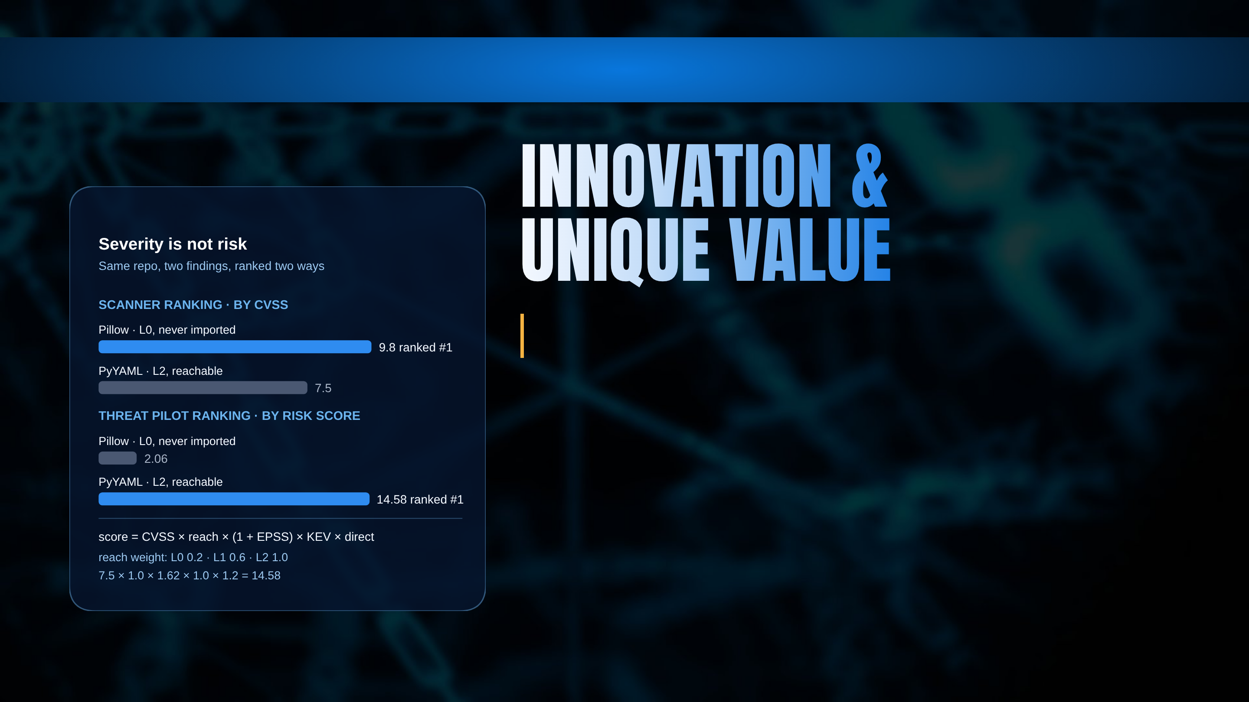
Home
Problem
Solution
Architecture
Impact
USP: the open, explainable auditor that turns hundreds of CVE alerts into one evidence-backed, verified, human-approved pull request.
What is genuinely new
Why teams choose it
Reachability proof L0, L1 or L2 for every CVE, with file, line and the call chain into the library.
vs Dependabot / pip-audit 133 alerts become 1 reachable finding.
vs Snyk open, free data sources, and the evidence is shown, not hidden.
A fix that works smallest safe upgrade plus rewritten functions, checked by a critic loop.
Trustworthy AI the LLM never produces facts; every output is checked in code, and it runs with no model at all.
Human-gated nothing touches GitHub until someone approves.
Notes:
Severity is not risk. PyYAML at CVSS 7.5 is called by our code (L2) and scores 14.58. Pillow at CVSS 9.8 is never imported (L0) and scores 2.06. The reversal is the product, and every factor can be recomputed by hand.

Slide 6
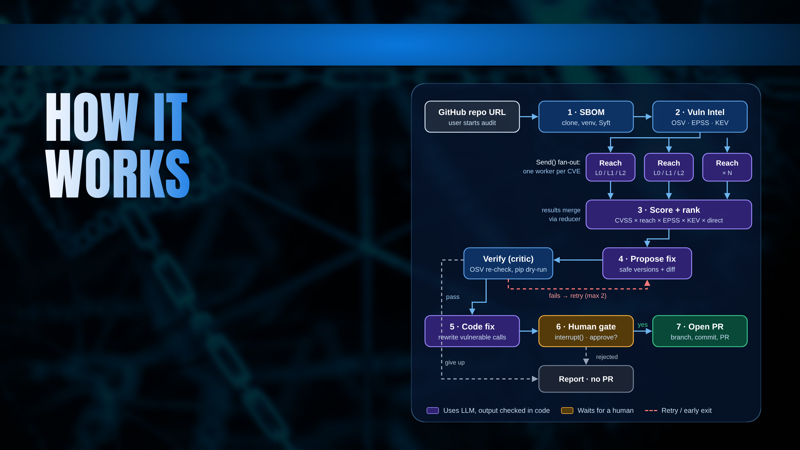
Home
Problem
Solution
Architecture
Impact
User journey
Decision points
Sign in with GitHub and pick a repository.
Verifier fix still vulnerable or won't resolve? Retry with a new version, max 2, then report.
Watch each agent run live over SSE.
Read ranked findings with file:line evidence.
Nothing to change no reachable fix needed: end with a report.
Review upgrades, rewritten code and PR text.
Human gate rejected: run ends, GitHub is never touched.
Approve, and the pull request opens.
Notes:
Walk the pipeline. Reachability workers run in parallel through Send(). The verifier can reject a fix and send it back, at most twice. The graph pauses at the human gate with interrupt() and survives a restart. Three ways to end without a PR: give up, nothing to change, rejected.

Slide 7
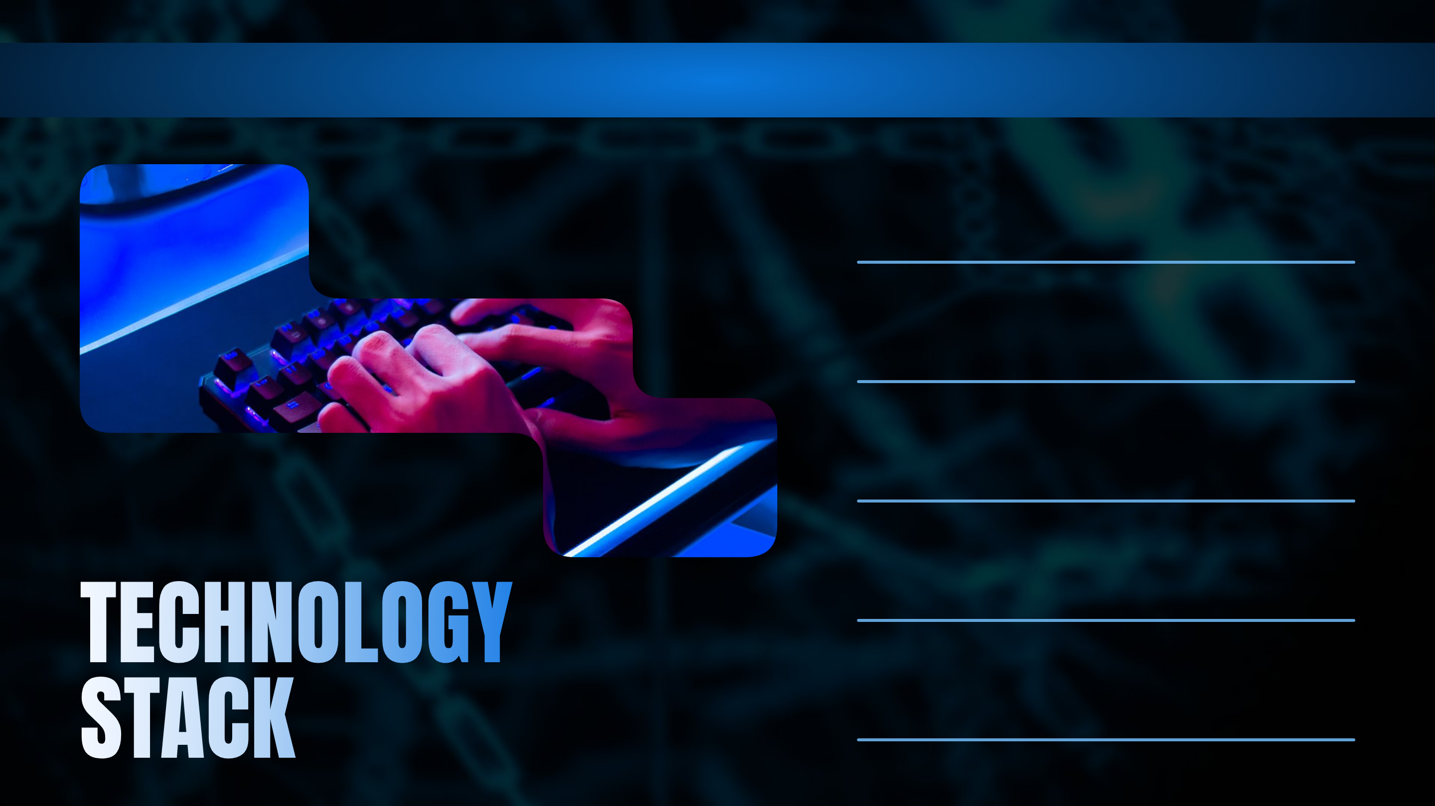
Home
Problem
Solution
Architecture
Impact
Frontend · React 18, TypeScript, Vite, Tailwind v4, shadcn/ui
Typed contract mirrors backend schemas; instant reloads for a 24-hour build.
Backend · Python 3.12, FastAPI, Server-Sent Events
Async and Pydantic-typed. Python's own ast parses the code being audited; pip resolves fixes.
AI / agents · LangGraph 1.2, Gemini 3.5 Flash, Ollama
Send() fan-out, cycles and interrupt() built in. CrewAI/AutoGen chat; we need an auditable graph.
Database · Neon Postgres, SQLite fallback
Serverless, with a first-party LangGraph checkpointer, so paused audits survive restarts.
APIs · Syft, OSV.dev, EPSS, CISA KEV, GitHub
Free, no-key, live vulnerability data with fixed-version ranges; LangSmith traces every agent.
Notes:
Justify choices. LangGraph gives fan-out, cycles and durable pause as built-ins; CrewAI and AutoGen are conversation-driven. FastAPI plus SSE for a one-way progress stream. Neon Postgres because LangGraph ships a Postgres checkpointer. OSV, EPSS and KEV are free and need no key.

Slide 8
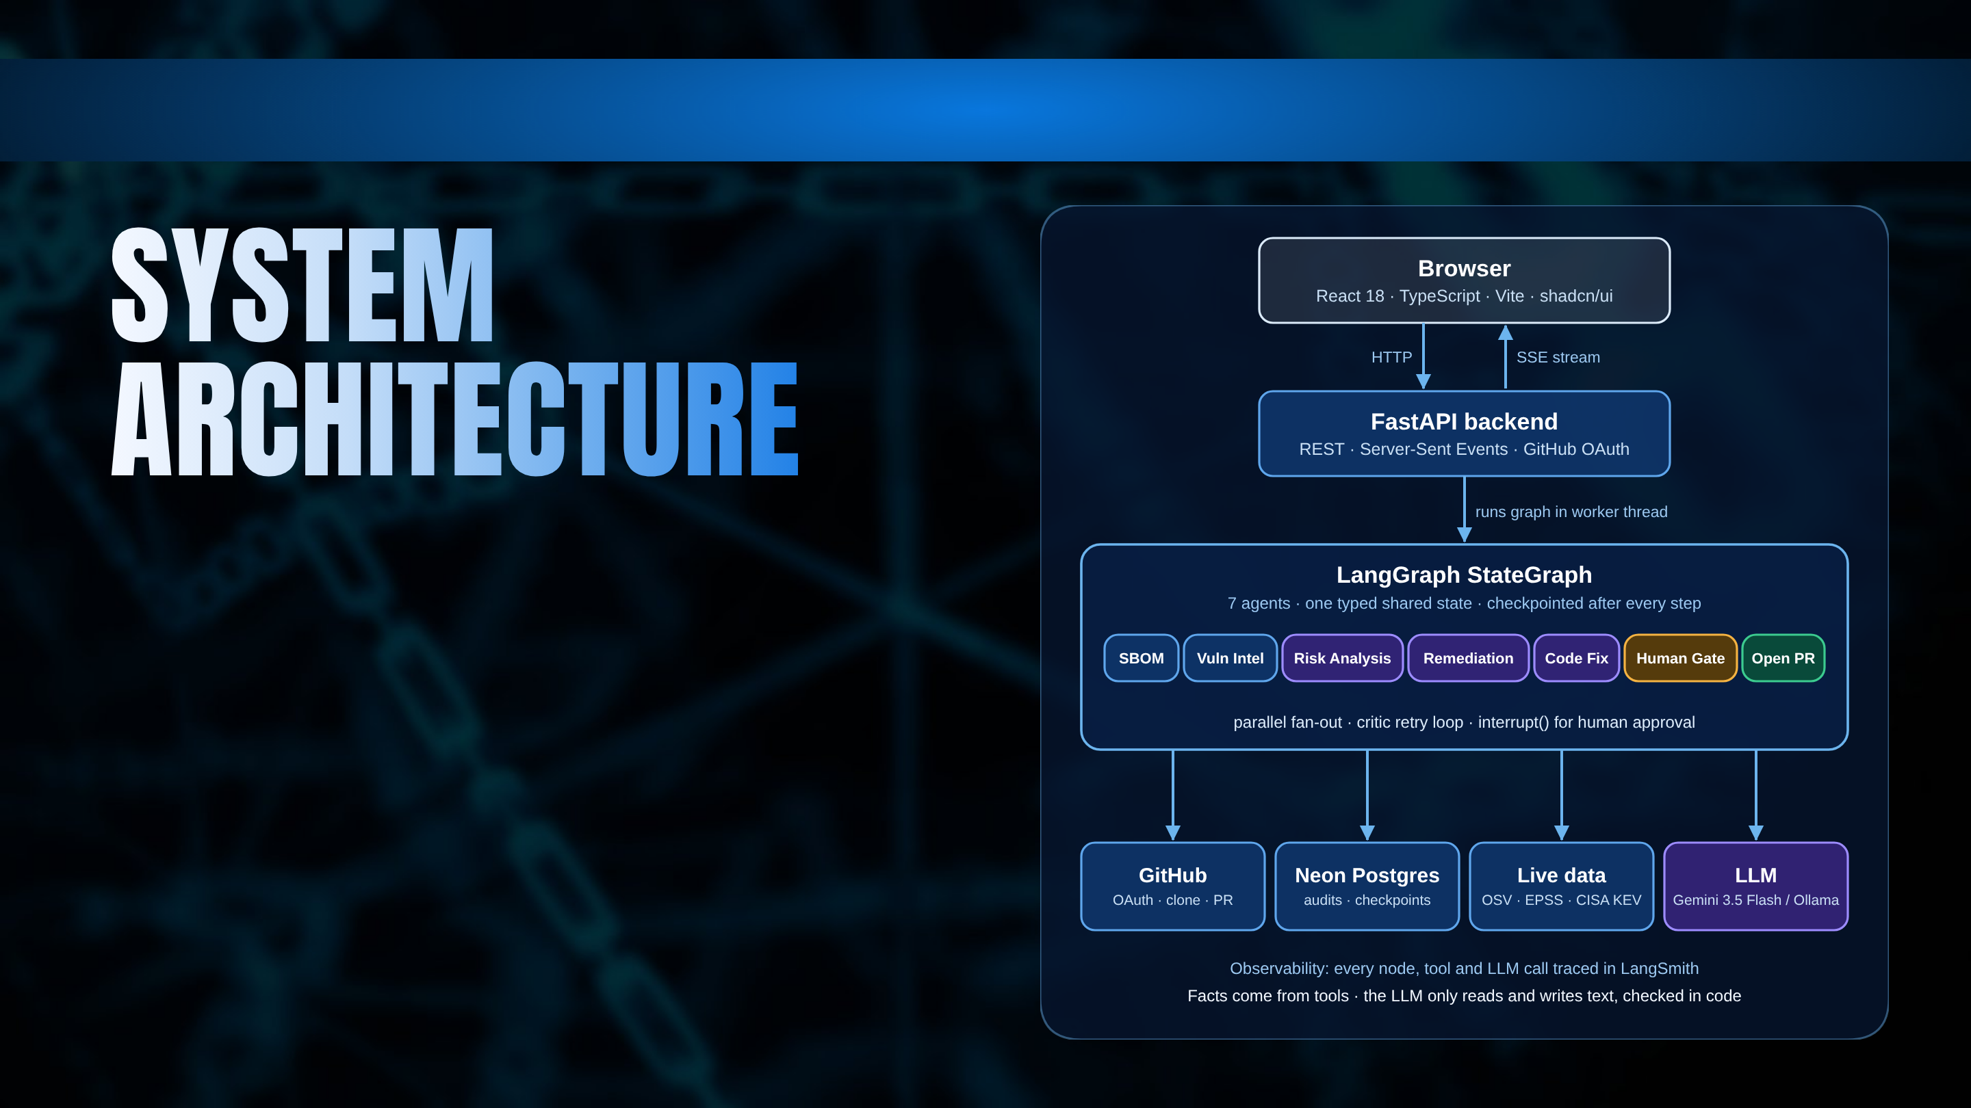
Home
Problem
Solution
Architecture
Impact
How components talk
Trust & safety by design
The browser starts an audit over HTTP and follows it over one SSE stream. FastAPI runs the LangGraph pipeline in a worker thread; agents never call each other, they only read and write shared state. Postgres stores audits, cache and graph checkpoints.
Open PR is the only writer to GitHub, behind the human gate.
No automatic major-version bumps.
GitHub token stays server-side, encrypted at rest.
Each repo installs in its own isolated virtualenv.
Notes:
Facts come from deterministic tools. The LLM only reads and writes text, in four places, and every output is checked in code with a fallback that works with no model. Open PR is the only node that writes to GitHub, and it sits behind the human gate.

Slide 9
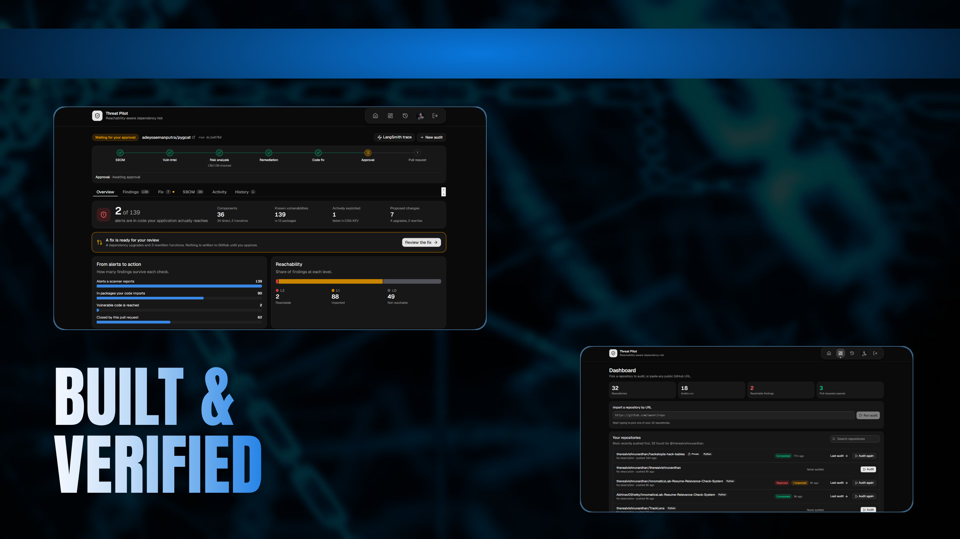
Home
Problem
Solution
Architecture
Impact
Prototype status
24-hour build strategy
Working end to end on real public repos.
0–2h freeze state schema, stub all agents.
55 backend tests pass with no network.
2–10h real data, AST scanner, SSE UI.
10–16h critic loop, interrupt/resume, integrate.
Verified live against OSV, EPSS and CISA KEV.
16–24h polish, warm cache, rehearse.
Real pull requests opened through GitHub.
Challenges → mitigation
LLM invents names → validated against package source.
Venue network fails → DB cache and OFFLINE mode.
Bad fix → verifier loop, dry-run resolve.
Restart mid-approval → Postgres checkpoints.
Notes:
Prototype status: working end to end, 55 backend tests pass with no network, verified live against OSV, EPSS and KEV, real PRs opened. Be honest about limits: Python and requirements.txt only; reachability is static analysis, evidence not proof.

Slide 10

Home
Problem
Solution
Architecture
Impact
GitHub Action
Blockchain trust layer
Run the graph on every pull request and comment the risk change it introduces.
Sign each SBOM and audit result and anchor the hash on-chain, so anyone can verify what was audited and when.
Safer verification
More ecosystems
Sandboxed installs in a container or microVM, and the project's own tests run against the fix.
npm and Java through three adapters each: installer, tree-sitter parser, OSV ecosystem name.
Scale out
Smarter AI triage
Job queue and workers on the checkpointed graph; organisations, roles and rate limits.
LLM-assisted exploitability notes for L2 findings, still checked against evidence.
Notes:
Next: a GitHub Action that comments the risk change on every PR, sandboxed installs and running project tests against the fix, npm and Java via adapters, and for the blockchain track, signing each SBOM and anchoring its hash on-chain.

Slide 11
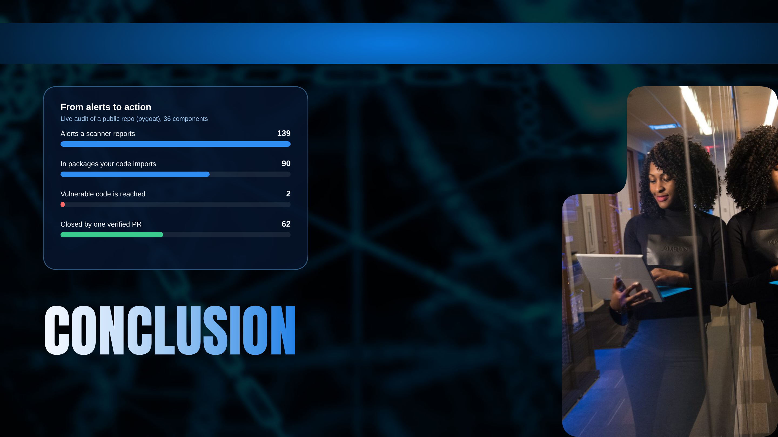
Home
Problem
Solution
Architecture
Impact
Key takeaway
Scanners tell you the vulnerable code is on your disk. Threat Pilot tells you whether your program runs it, and hands you the fix.
Three strongest benefits
Focus 139 alerts become 2 that need action today.
Trust file:line evidence, a verified fix and a human gate.
Speed the pull request is drafted, checked and ready.
Vision
Every dependency alert arrives with proof and a reviewed fix: supply-chain security teams actually act on.
Notes:
Close: "It is Python-only today, and reachability is static analysis, so it is evidence, not proof. But it turns one hundred and thirty-nine alerts into two decisions, with the reasoning attached. Thank you."

Slide 12
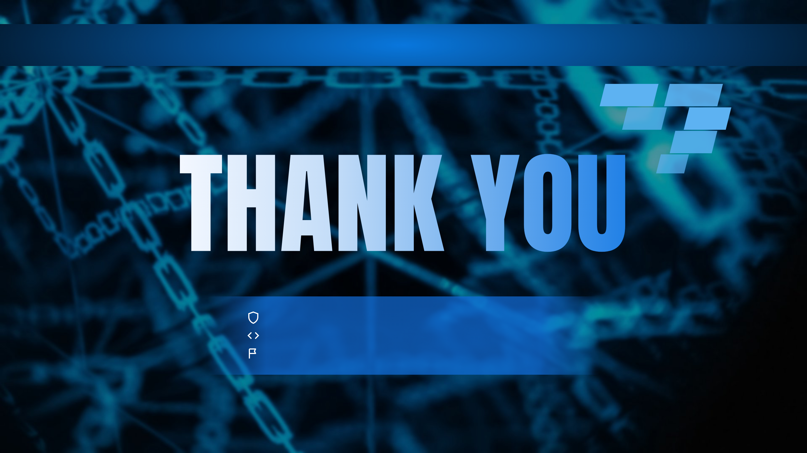
Home
Problem
Solution
Architecture
Impact
Threat Pilot · Agentic SBOM Risk Auditor
github.com/therealvishnuvardhan
Hackatopia 2K26 · CB-02 · Questions welcome
Notes:
Thank the judges and invite questions. Keep the LangSmith trace open for "how do the agents actually run".

