Slide 1

Sammati
HACKATOPIA 2K26
Sammati Wallet
QuickLoan is asking to use your data
Credit check
PAN, income band | 30 days
The verifiable consent layer for India’s data economy
Marketing offers
Optional | not pre-ticked
UPI made payments simple and trustworthy. Sammati does that for consent.
ALLOWED credit_check
PROBLEM STATEMENT Verifiable, enforceable consent under India’s DPDP Act
BLOCKED marketing 451
Citizen Wallet
Gateway SDK
Consent Ledger
Auditor
Signed with your device key
Team ACE
Notes:
15 seconds. Introduce Sammati: the verifiable consent layer for India's data economy. "UPI made payments simple and trustworthy. Sammati does that for consent." Mention the three personas we built for: Asha the citizen, Ravi the compliance lead, Meera the regulator auditor. Four pieces: citizen wallet, gateway SDK, consent ledger, regulator auditor.

Slide 2



Consent in India is an “I agree” nobody controls
01 | PROBLEM UNDERSTANDING
Asha Citizen, 29
₹250 Cr
maximum penalty per instance for failing to safeguard personal data
Said yes to dozens of apps. She cannot see who holds her data, and withdrawing rarely stops anything.
Ravi Compliance lead, QuickLoan
76 Cr+
internet users in India (MeitY figure, 2023). Every one of them is asked for consent.
Must show notice was given and consent obtained, but consent sits in the company’s own database.
Meera Regulator auditor
May 2027
end of the phased DPDP compliance window (13 May 2027)
Has to trust the audited company’s own logs. No independent way to catch an edited record.
Sources: DPDP Act 2023, Schedule (penalties); MeitY user figure as reported by Water & Shark (Nov 2023); DPDP Rules notified 13 Nov 2025.
Notes:
The problem: consent today is one giant "I agree" nobody controls. Citizens cannot see who holds their data, withdrawal rarely stops downstream data flows, and regulators have to trust the audited company's own logs. The law has changed: DPDP Act 2023 puts consent at the centre, with penalties up to Rs 250 crore per instance for failing to safeguard personal data. The law is here, the infrastructure is not.

Slide 3



Existing approaches leave one gap open
02 | EXISTING SOLUTIONS AND THE GAP
Cookie banners and “I agree” boxes
THE GAP
Falls short: One bundled click, stored on the company’s own server. No choice per purpose and no proof the user can check.
Consent that is:
1
Signed by the user, not clicked on a server
Consent records in company databases
Falls short: The audited party holds the evidence and can edit it. A withdrawal rarely reaches downstream processors.
2
Enforced at request time, not just logged
Self-reported logs and audits
3
Verifiable without trusting the company
Falls short: Regulators must trust logs produced by the company they audit. A quietly edited record stays invisible.
Sammati fills all three.
Notes:
What exists today: cookie banners and checkbox consent recorded on the company's own server; consent records in company databases that the company can edit; and audits that rely on the audited company's own logs. The gap: no one provides consent that is user-signed, enforced at request time, and verifiable without trusting the company.

Slide 4




Consent that is signed, enforced and provable
03 | PROPOSED SOLUTION
INPUT
PROCESSING
OUTPUT
Scan, choose, sign
Verify, enforce, decide
Allow, block, prove
Citizen scans a company QR, picks each purpose separately in English, Hindi or Kannada, and signs with a key that never leaves the phone.
Signed consent is stored on the ledger. The gateway checks it on every request. Sensitive data is decided on as ciphertext.
ALLOWED or BLOCKED (451) in real time. Withdrawals cascade to processors. Anchored proof for the regulator.
THE FOUR PIECES
Citizen Wallet
Gateway SDK
Consent Ledger
Regulator Auditor
Flutter
TypeScript middleware
Solidity on Polygon Amoy
React
One place to see and control every purpose. Withdraw in two taps.
requireConsent() on any endpoint. Blocks unauthorised use in real time.
User-signed, tamper-evident consent state and anchored access logs.
Recomputes hash chains against anchors and names the edited record.
Notes:
Input to processing to output. Citizen scans and signs, one toggle per purpose, nothing pre-ticked. The ledger stores signed consent; the gateway checks it on every request; the Processor decides on ciphertext. Output: allowed or blocked in real time, cascade on withdrawal, anchored proof for the regulator. We built four pieces: wallet, gateway, ledger, auditor.

Slide 5



What is genuinely new
04 | INNOVATION AND UNIQUE VALUE PROPOSITION
Enforcement, not just a log
Proof of every access
Withdraw in the wallet and the company’s very next request is blocked, not merely recorded.
Each data use is hash-chained and anchored on chain. Citizens can verify it and the regulator can catch edited logs.
User-signed, shared truth
Use without reading
The company cannot forge a “yes” or deny a “no”. Neither side owns the record.
The company gets a decision from data it never sees. Withdraw and the data is erased, not just locked.
OUR USP
UPI made payments simple and trustworthy. Sammati does that for consent.
Notes:
Four differentiators. 1) Enforcement, not just a log: withdraw and the very next request is blocked. 2) Proof of access: every access is hash-chained and anchored. 3) User-signed shared truth: the company cannot forge a yes or deny a no. 4) Use without reading: decisions from encrypted data; withdraw and the data is erased. Why choose Sammati: it works like UPI did for payments, one wallet, instant, revocable and verifiable.

Slide 6


One journey, five steps, every step provable
05 | HOW THE SOLUTION WORKS
1
2
3
4
5
Scan and choose
Sign
Enforce
Withdraw
Audit
Citizen scans the company QR and reads an itemised notice. One toggle per purpose, nothing pre-ticked.
The wallet signs an EIP‑712 message with the device key. A relayer pays gas, so the user never does.
requireConsent() checks the ledger on every call, then writes a hash-chained access log.
Two taps. The next request is blocked, the sealed copy erased, processors notified and acknowledged.
The auditor recomputes hash chains and Merkle roots against on-chain anchors and flags the exact record.
Valid consent on the ledger?
YES | ALLOWED: data flows, access is logged
Either way, the decision becomes a log entry, batched into a Merkle tree and anchored on chain.
NO | BLOCKED (HTTP 451): reason code, refusal logged
Withdrawal to block: under 1.5 s target on a local chain.
Notes:
Walk the journey: user scans, signs, the gateway enforces, the user withdraws, the auditor verifies. Decision point at every request: valid consent on the ledger means ALLOWED, otherwise BLOCKED with HTTP 451 and a reason code. Either way an access-log entry is created, hash-chained, batched into a Merkle tree and anchored on chain. In the live demo: not one big "I agree", each purpose is its own choice; withdraw takes two taps and the very next request is blocked.

Slide 7





A stack chosen for trust and speed
06 | TECHNOLOGY STACK
Frontend
Backend
Blockchain
Flutter wallet (Dart) | React web apps (Vite)
Node.js + TypeScript | Express gateway SDK | SQLite | WebSocket
Solidity 0.8 | Hardhat | OpenZeppelin | Polygon Amoy
Secure storage and biometric lock on the phone; one codebase.
One language end to end; middleware drops into any company backend.
Shared state no single company owns. Hashes only, gasless for users.
Security and crypto
AI / ML and decisions
Cloud and APIs
EIP‑712 signing | X25519 + AES‑256‑GCM | hash chains and Merkle roots
Deterministic loan-scoring rules with reason codes. No black-box model.
Target: Render and Vercel | GitHub Actions | public RPC for Amoy
Standard primitives; Dart and Node pass the same test vectors.
Every decision is explainable and auditable by design.
Runs fully offline on a local chain; Amoy is proof, not a dependency.
Notes:
Be ready to justify each choice. Flutter for secure storage and biometric signing on the phone. Node and TypeScript end to end so the gateway is a drop-in middleware. Solidity on Polygon Amoy for shared state no company owns; only hashes on chain and the user never pays gas. Crypto: EIP-712 for signatures, X25519 + HKDF + AES-256-GCM for envelopes. There is no ML black box: the decision engine is deterministic with reason codes. Honest note: deployment targets Render and Vercel; the demo runs on a local chain with Amoy as public proof.

Slide 8
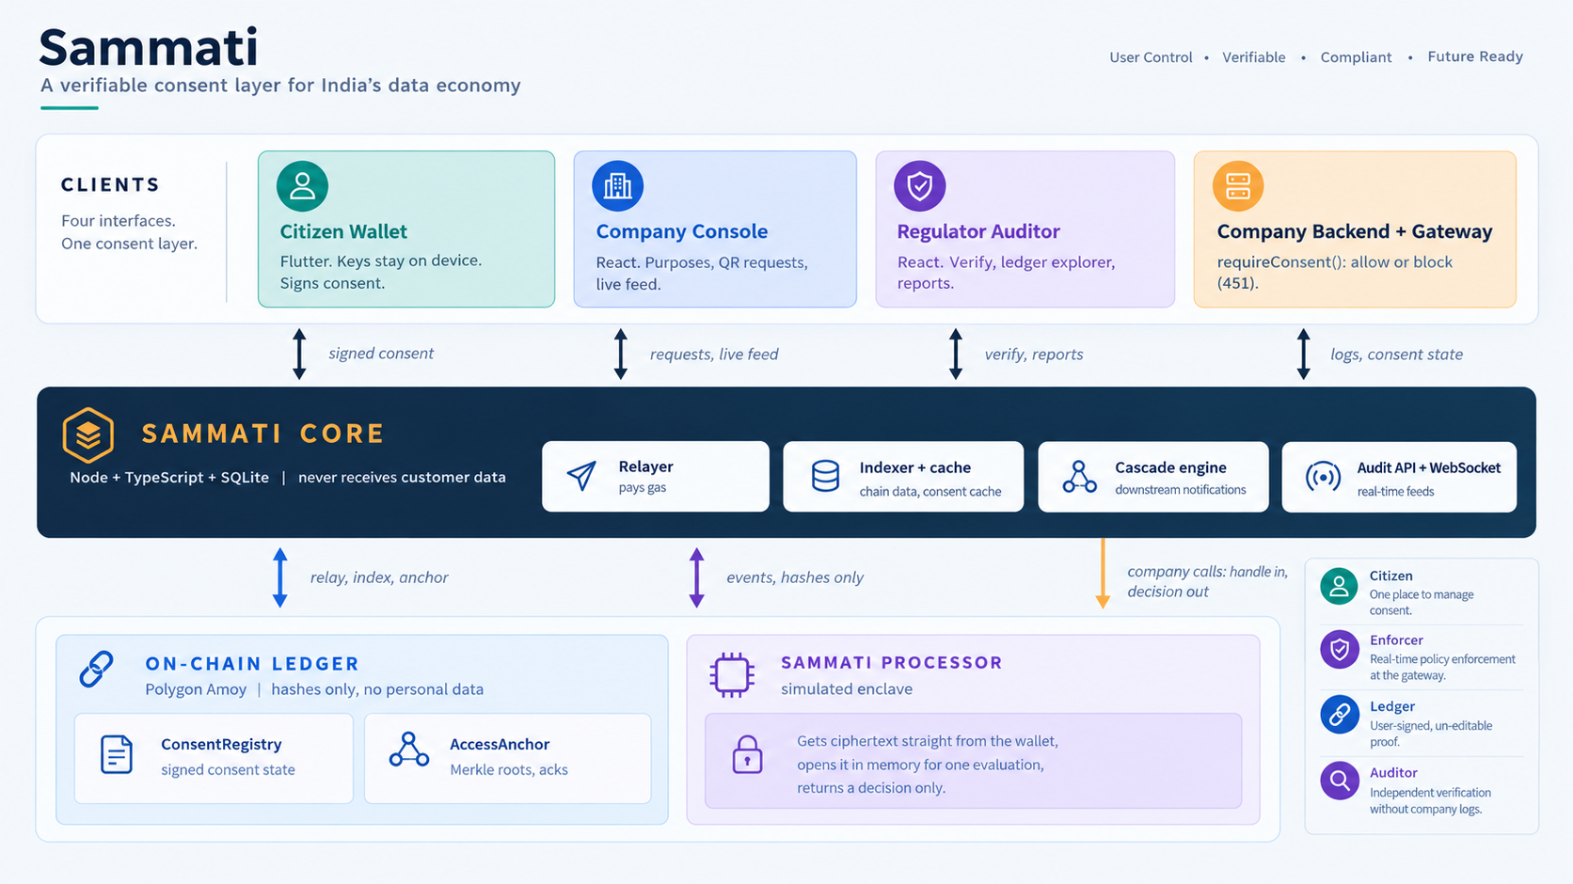
Architecture at a glance
07 | SYSTEM ARCHITECTURE
CLIENTS
Citizen Wallet
Company Console
Regulator Auditor
Company Backend + Gateway
Flutter. Keys stay on device. Signs consent.
React. Purposes, QR requests, live feed.
React. Verify, ledger explorer, reports.
requireConsent(): allow or block (451).
signed consent
requests, live feed
verify, reports
logs, consent state
SAMMATI CORE Node + TypeScript + SQLite | never receives customer data
Relayer (pays gas)
Indexer + cache
Cascade engine
Log anchoring
Audit API + WebSocket
relay, index, anchor
events, hashes only
company calls:
handle in, decision out
ON-CHAIN LEDGER Polygon Amoy | hashes only, no personal data
SAMMATI PROCESSOR simulated enclave
ConsentRegistry: signed consent state
AccessAnchor: Merkle roots, acks
Gets ciphertext straight from the wallet, opens it in memory for one evaluation, returns a decision only.
Notes:
Read the diagram top to bottom. Clients: citizen wallet, company console, regulator auditor, and the company backend with our gateway SDK. Sammati Core relays signed messages (the user never pays gas), indexes the chain, caches consent, runs the cascade and anchors logs. Core never receives customer data. The ledger holds consent state and Merkle roots, hashes only. The Processor is a separate service: the wallet sends it ciphertext directly, it opens one envelope in memory, and the company gets a decision only. Honest limit: the Processor is a simulated enclave in this build; production uses a hardware enclave with remote attestation.

Slide 9



It is built, it runs, and we say what is simulated
08 | TECHNICAL FEASIBILITY AND IMPLEMENTATION
Prototype status
24-hour build strategy
Challenges and mitigation
Golden path working: grant, allow, withdraw, block, tamper alert
Same contracts live on Polygon Amoy testnet
Runs fully offline on a local chain
Automated e2e suite searches every log, event and database for leaked data
Spike EIP‑712 signing in Dart in the first 2 hours
Golden path first: grant, enforce, withdraw
Then differentiators: tamper detection, cascade, Processor
Polish, rehearse, record a fallback demo
Dart signing: early spike and shared test vectors with Node
Venue Wi-Fi: local chain, phone hotspot, recorded fallback
Company bypasses the gateway: audit flags unlogged or invalid access
Scope creep: cut lines agreed up front
Disclosed shortcuts: Core holds company and processor keys, and the Processor is a simulated enclave. Production: companies hold their own keys and the Processor runs in a hardware TEE with remote attestation. All demo data is fictional.
Notes:
Can it actually be built? Yes: it is built. The golden path runs end to end, the same contracts are live on Polygon Amoy, and an automated end-to-end test searches every log, event, response and database file for the known test PAN and finds nothing. We were honest about the shortcuts: company and processor keys are held by Core for the demo, and the Processor is a simulated enclave. All data is fictional. Challenges: Dart EIP-712 signing (spiked early with shared test vectors), venue Wi-Fi (local chain and a recorded fallback).

Slide 10
Built to scale like India’s payment rails
REAL-WORLD IMPACT AND SCALABILITY
₹0
for citizens. Companies pay per verified check, and a relayer covers gas.
Aligned with the DPDP principles. Not certified.
10 Implemented
1 tx
per batch. Thousands of access logs anchor as a single Merkle root.
12 Partial
6 Out of scope
3 roles
served: citizens get control, companies get drop-in compliance, regulators get independent proof.
28 obligations mapped. Every legal point stays marked VERIFY until checked against the official text. Honest gaps: breach flow, children’s data, correction, nomination.
Notes:
Real-world impact: modelled on the Account Aggregator pattern. Citizens are free; companies pay per verified check. Access logs are batched into one Merkle root, so thousands of events cost one transaction; in production this runs on a consortium or L2 chain. On legality we are deliberately careful: we say aligned with the principles of the DPDP Act, not compliant. 28 obligations are mapped: 10 implemented, 12 partial, 6 out of scope, and every legal point is marked VERIFY until checked. Gaps are on the slide on purpose.

Slide 11
From hackathon prototype to national consent layer
09 | FUTURE SCOPE
Harden
Scale
Expand
Close the disclosed gaps
Production deployment
Long-term vision
Processor in a hardware enclave (AWS Nitro or Intel SGX) with remote attestation
Companies hold their own keys
Account recovery: social or Aadhaar-linked
Breach notice, children’s data, correction and nomination flows
Permissioned or L2 chain run by a consortium of consent managers
Gateway as a sidecar or API-gateway plugin
More Indian languages beyond English, Hindi and Kannada
Push alerts when the app is closed
Zero-knowledge proofs that consent exists, without revealing purposes
Legal review and registration as a consent manager
Lending, health, food and commerce on one consent wallet
Purpose templates for lenders, hospitals and retailers
Today: working prototype with public testnet proof. Next: hardware-backed trust. Then: a national consent network.
Notes:
Future scope in three horizons. Harden: put the Processor in a hardware enclave with remote attestation, companies hold their own keys, account recovery, breach notification, children's data, correction and nomination. Scale: a consortium or L2 chain, the gateway as a sidecar or API-gateway plugin, more languages. Expand: zero-knowledge consent proofs, legal review and registration as a consent manager, and more sectors on one consent wallet.

Slide 12
Consent you can prove, withdraw and verify
10 | CONCLUSION KEY TAKEAWAY
Enforced
Provable
Private
Withdraw in two taps and the company’s next request is blocked.
User-signed consent and anchored logs let anyone catch an edited record.
Decisions from encrypted data. Nothing personal goes on chain.
UPI made payments simple and trustworthy. Sammati does that for consent.
Final vision: the neutral consent layer between every citizen and every institution in India’s data economy.
Thank you | Team ACE
Notes:
One takeaway: consent you can prove, withdraw and verify. Three benefits: enforced (withdraw blocks the next request), provable (user-signed, anchored logs catch edited records), private (decisions from encrypted data, nothing personal on chain). Vision: the neutral consent layer India's data economy needs. Thank you, we are ready for questions. For Q&A, use the cheat sheet in presentation.md.

