Slide 1


CURRENT REAL-WORLD SITUATION
CS-02 · VERIFY BEFORE SUBMISSION
Trust breaks at the model boundary.
LLM Firewall
Against Prompt Injection
When assistants access documents, tools, and sensitive information, attackers can steer behavior through the prompt path—causing unsafe output, unintended tool use, data exposure, or actions taken with model permissions.
Why it matters
A compromised context can turn a helpful assistant into an uninspected route to private data, business systems, and downstream decisions.
Verified evidence
Workex
OWASP GenAI Security Project · LLM01:2025 Prompt Injection says prompt injection can alter model behavior or output, can be direct or indirect, and that RAG and fine-tuning do not fully mitigate the vulnerability.
What is the problem?
LLMs can be manipulated by direct injection from a user or indirect injection hidden in documents, webpages, or retrieved content.
Supporting data point
Verified: OWASP identifies prompt injection as an active LLM security risk. Numeric statistic: validate before submission; no verified figure is available in current sources.
Who is affected?
People and organizations connecting an LLM to documents, tools, workflows, credentials, or sensitive information.
TEAM 404ERRORFOUND-
MASSEEHA AND PRATHAM SEETHARAM
WORKEX · HACKATOPIA 2026
Notes:
Frame CS-02 as a security-boundary problem: direct user instructions and indirect instructions hidden in retrieved content can change model behavior. Emphasize who is exposed when assistants connect to documents, tools, credentials, and sensitive information. Cite OWASP GenAI Security Project, LLM01:2025 Prompt Injection for the verified evidence; do not present an unverified prevalence statistic.
1

Slide 2
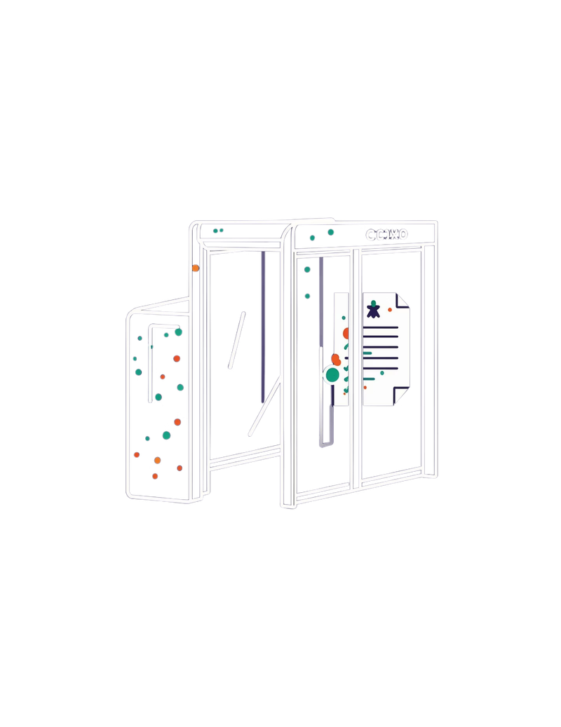


THE GAP
AI safety controls are spread across the stack.
When prompts, retrieval, model safeguards and monitoring live in different places, decisions become difficult to inspect, test and govern consistently.
OWASP · LLM01:2025
OWASP lists Prompt Injection as LLM01:2025 and notes that RAG and fine-tuning do not fully mitigate the vulnerability.
VISIBLE CHECKPOINT NEEDED
Notes:
Existing controls matter, but they are distributed. The practical gap is one visible checkpoint before the model call and one place to check the generated output.
2

Slide 3
PROPOSED SOLUTION
Workex places policy between the prompt and the model.
INPUT
SCAN
DECIDE
BLOCK
verdict only
User prompt
Security engine
Policy gate
OUTPUT CHECK
MODEL CALL · IF PERMITTED
RESULT
Scan generated response
User response
Gemini API
ALLOW · SANITIZE · BLOCK
Notes:
Explain the sequence: scan the prompt, apply policy, call Gemini only if permitted, then scan the output. A blocked prompt ends at the policy decision and never reaches Gemini.
3

Slide 4
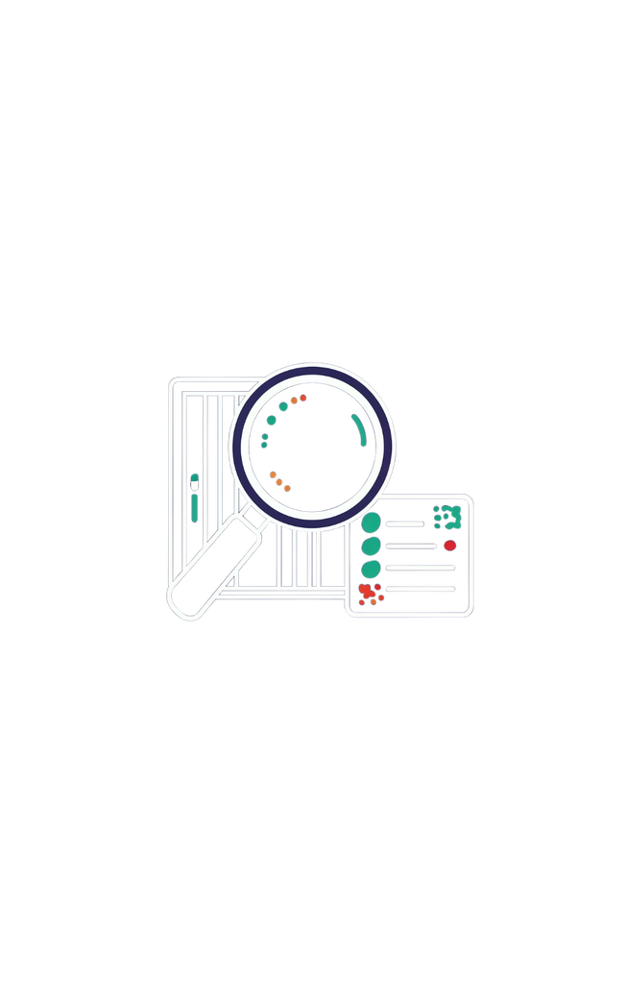
INNOVATION · USP
Make AI security
inspectable.
Workex combines input screening, configurable policies, explainable risk signals and generated-output checking around the model call.
It is a lightweight gateway for teams that need a clear place to inspect, test and govern decisions.
EXPLAINABLE BY DESIGN
Notes:
The innovation is inspectability, not a claim of perfect detection. Workex makes the security decision visible at the point where the application team can test and govern it.
4

Slide 5
END-TO-END WORKFLOW
Every prompt follows a visible route.
User → Scanner / Batch Scan (input) → security processing and policy → Gemini API only when permitted → output check → response or withheld result → action.
1
2
3
4
5
6
Input
Scan
Policy
Gemini API
Output
Result
User prompt
Security signals
Decision
If permitted
Response check
Return / withhold
ALLOW
Proceed to Gemini.
SANITIZE
Transform, then continue.
BLOCK
Stop before the model call.
PROTOTYPE SURFACES
EVIDENCE & VALIDATION
Overview · Scanner · Batch Scan · Threats · History · Policies
Verified: direct /scan testing blocked a system-prompt extraction attempt (risk score 55).
Still under testing: reliable block-before-model-call enforcement, protected-configuration detection, and stable frontend-to-backend availability.
Notes:
Use the route to explain the user journey. The three outcomes are policy decisions, not model guesses. The critical control is that BLOCK terminates the route before Gemini. Distinguish the verified /scan result from the behavior still under testing.
5

Slide 6
FRONTEND
BACKEND
TECHNOLOGY STACK
React · Vite · TypeScript
Python · FastAPI
A small, typed boundary around the model.
Lightweight API boundary where policy and credentials stay server-side.
Typed interface for fast iteration across Overview, Scanner, Batch Scan, Threats, History and Policies.
The prototype keeps responsibilities explicit: interface, API boundary, model integration and transparent detection logic.
AI / ML
DETECTION
Gemini API
Rules + heuristics
Called only after the security decision permits the request.
Transparent prototype behavior, designed to be tested and improved.
Database: no database is claimed because it is not confirmed. Deployment is also not confirmed.
Notes:
Keep the stack explanation grounded. These choices support a fast, inspectable prototype without claiming a database, cloud deployment or trained model that has not been confirmed.
6

Slide 7





SYSTEM ARCHITECTURE
Security decisions and credentials stay on the backend.
React UI
FastAPI
Security engine
Policy gate
Gemini API
React / Vite / TypeScript
Backend request boundary
Signals and risk checks
Allow / sanitize / block
Allowed calls only
Response path
The backend checks generated output, then returns the response to the frontend.
Blocked branch
A blocked prompt receives a security verdict; no Gemini request is made.
Notes:
Point out the trust boundary. The frontend presents the workflow, but the backend owns policy decisions and API credentials. A blocked prompt must stop before Gemini.
7

Slide 8
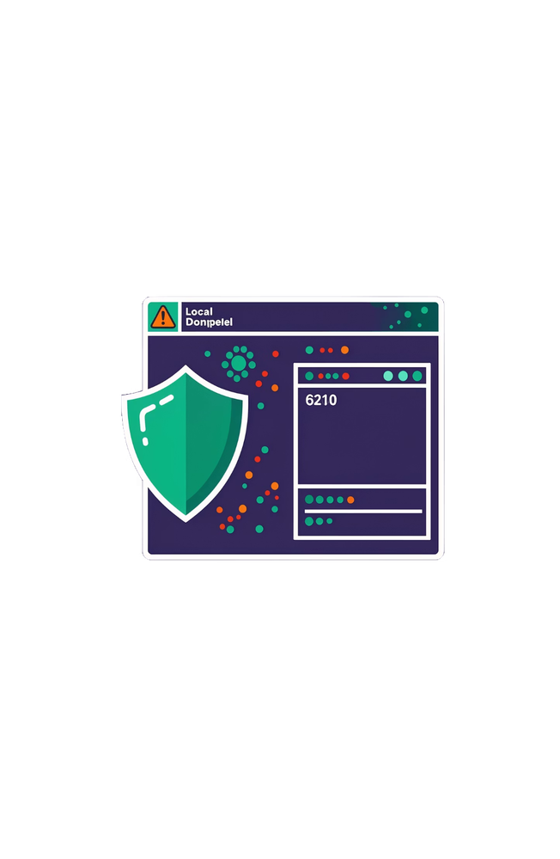

FEASIBILITY · IMPLEMENTATION
The build path is concrete, with known risks.
Verified
Local app runs. Direct /scan testing blocked a system-prompt extraction attempt with risk score 55.
Known gaps
One system-configuration request was incorrectly allowed. Frontend also showed a security-engine-unavailable HTTP 503 issue.
Milestones: API contract → rules → Gemini integration → scanner views → output checks → attack and benign-prompt tests → demo stabilization.
DEMO URL / VIDEO · RESERVE IF AVAILABLE
LOCAL PROTOTYPE · UNDER TESTING
Notes:
Separate verified behavior from intended behavior. The prototype has a demonstrated block, but it also has a false negative and an availability issue that must be addressed before a reliable live demo.
8

Slide 9
1
Measure detection
FUTURE SCOPE
Build a broader labelled dataset and track false positives and false negatives.
Improve coverage through labelled evaluation.
2
Strengthen coverage
Test indirect prompt injection and protected-configuration access cases.
These are future enhancements, not completed features.
3
Expand intelligence
Evaluate context-aware classifiers and additional model providers.
4
Harden deployment
Add audit trails, monitoring, language and document coverage, and reliable end-to-end block-before-call verification.
Notes:
Frame the roadmap as disciplined evaluation. Better security comes from measuring errors, expanding test coverage and hardening the end-to-end boundary, not from claiming that one rule set solves prompt injection.
9

Slide 10

CONCLUSION
Inspect the route
before trust.
Workex adds an inspectable security layer around AI applications.
Input screening
Policy decisions
Output checking
Help teams govern model interactions without claiming perfect detection or guaranteed security.
THANK YOU
Notes:
Close on the practical contribution: Workex creates a visible security layer around AI interactions. The vision is governance with honest limits, not a promise of perfect detection.
10

