Slide 1

NASA SPACE APPS 2023
By:
ROHIT M
KARTHIK S
SAMARTH BC
LIFE ON EXOPLANETS
Introduction
Star system
Planetary features
Calculations
Conclusion
References
AKASH TRIO MK 1

Slide 2
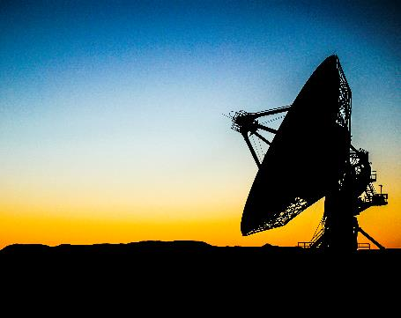
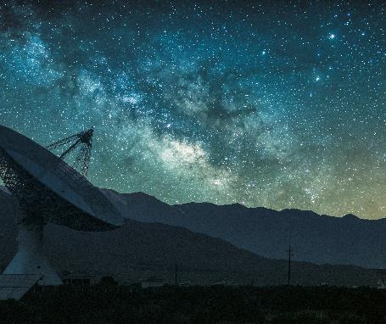
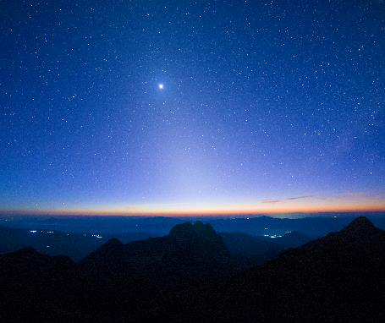
INTRODUCTION
With the great opportunity provided by the NASA organization and JGI we Akash Trio MK 1 would love to showcase our dedicated work on Life on exoplanets.
We have worked and tried to create the best possible imaginative, scientific and creative model of an exoplanet and life forms that may thrive in the chosen conditions.

Slide 3
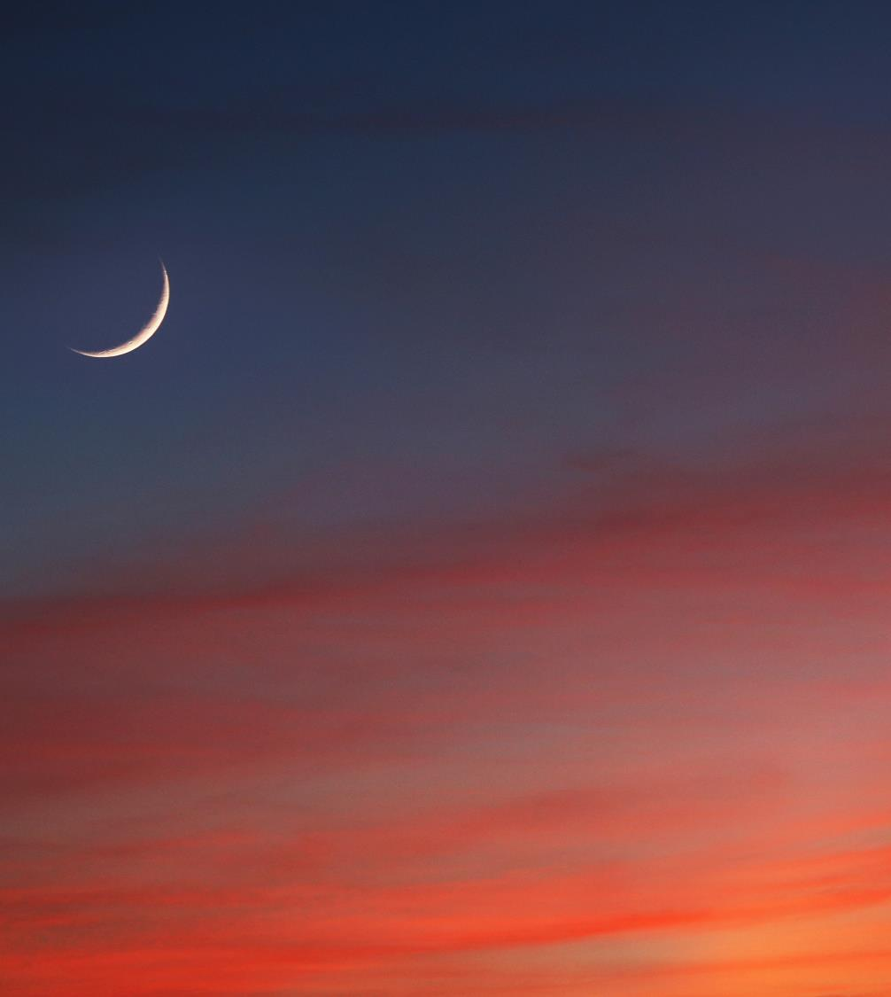
STAR SYSTEM
We have chosen our planet to orbit a double star system. A system that contains two stars rotating about their center of mass.
We chose our stars to be unique and rare and hence we chose stars to be an O and an A type.
We calculated the exact temperature, mass, radius and other factors which has the best ability of sustaining life.
We have listed below all the scientific details of our double star system.
.
STAR 1
O type star
M = 15.6 solar mass
R = 7.5 solar radii
T = 33,500K
Luminosity level V
STAR 2
A type star
M = 2 solar mass
R = 2 solar radii
T = 7690K
Luminosity level IV
Distance between the stars = 25 solar radii
Habitable zone: 0.38au to 0.7au
Net Luminosity = 80,154 watt

Slide 4

PLANETARY FEATURES
The life on the planet is majorly influenced by the planet’s cosmic features
We have found the best possible values the planet can have for the
organisms to exist, evolve and thrive
Our planet exists in the habitable zone of the star system and revolves
In a purely circular orbit (i.e eccentricity = 0)
All the calculated values are listed below:
M = 0.75 e+24 kg (1/8 of earth)
R = 3160km
Z = 60 (Zenith angle gives the angle between radiation vector and axis)
Ks = 20kw/m² (Energy received per unit area)
g = 10m/s
Density = Same as earth
The angle and angular velocity is set in such a way it receives the
exact amount of energy from the star to sustain life.
The link to our 3D model is here :- https://akmi.vercel.app/

Slide 5
Calculations
ALL THE FORMULAS USED FOR PRECISE CALCULATIONS ARE LISTED BELOW
COM = M1R1 + M2R2
M1 + M2
Ks = S Cos(Z) [Energy per unit area]
Cos(Z) = Sin(X)Sin(Y) + Cos(X)Cos(Y)Cos(H)
E = Ks x Area of cross section (Planet)
Ks: Energy per unit area
Z: Zenith angle [Angle between radiation and axis]
X: Latitude angle
Y: Solar declination
H: Hour angle
g = GM
R²
Distance (HZ, star) = [Luminosity(star) / Luminosity (Sun)]0.5
luminosity = brightness x 12.57 x (distance)²

Slide 6
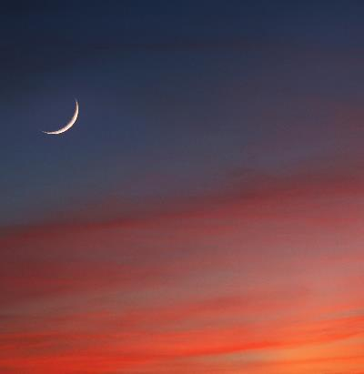
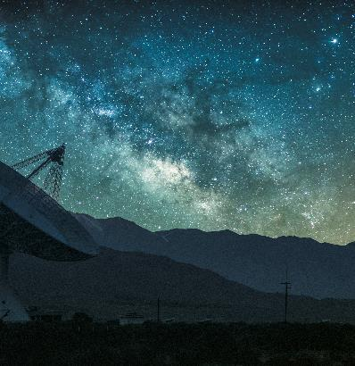
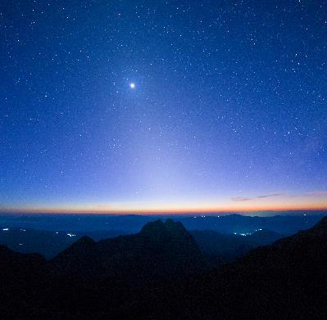
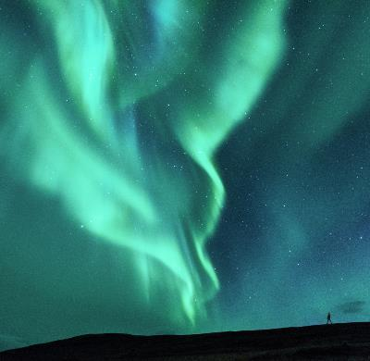
CONCLUSION
We conclude by saying that with the conditions presented by us there can thrive life forms in the presented planet.
With all the details and calculations we have done, we have also showcased our project with the help of blender and unreal engine to give a enhanced and clear view about life on our planet.
We have made the scaling precise and accurate to make it as realistic as possible while being scientifically accurate.
We heartfully thank NASA organization as well as JGI for providing this beautiful opportunity for us to share our views and ideas to the world.

Slide 7
REFERENCES
https://www.spaceappschallenge.org/2023/challenges/habitable-exoplanets-creating-worlds-beyond-our-own/?tab=resources
https://exoplanets.nasa.gov/discovery/exoplanet-catalog/
https://www.omnicalculator.com/physics/luminosity
https://www.sciencedirect.com/topics/earth-and-planetary-sciences/zenith-angle
https://www.britannica.com/science/O-type-star
https://en.wikipedia.org/wiki/A-type_main-sequence_star
https://www.omnicalculator.com/physics/orbital-period
Wolfram|Alpha: Computational Intelligence (wolframalpha.com)

