Slide 1
The Informetrics of Cybernetics
(or When Nerds Meet Cool Kids)
Paul Wong · School of Cybernetics, ANU
With Claude Sonnet 4.6 (Anthropic) · Work in Progress
March 2026

Slide 2
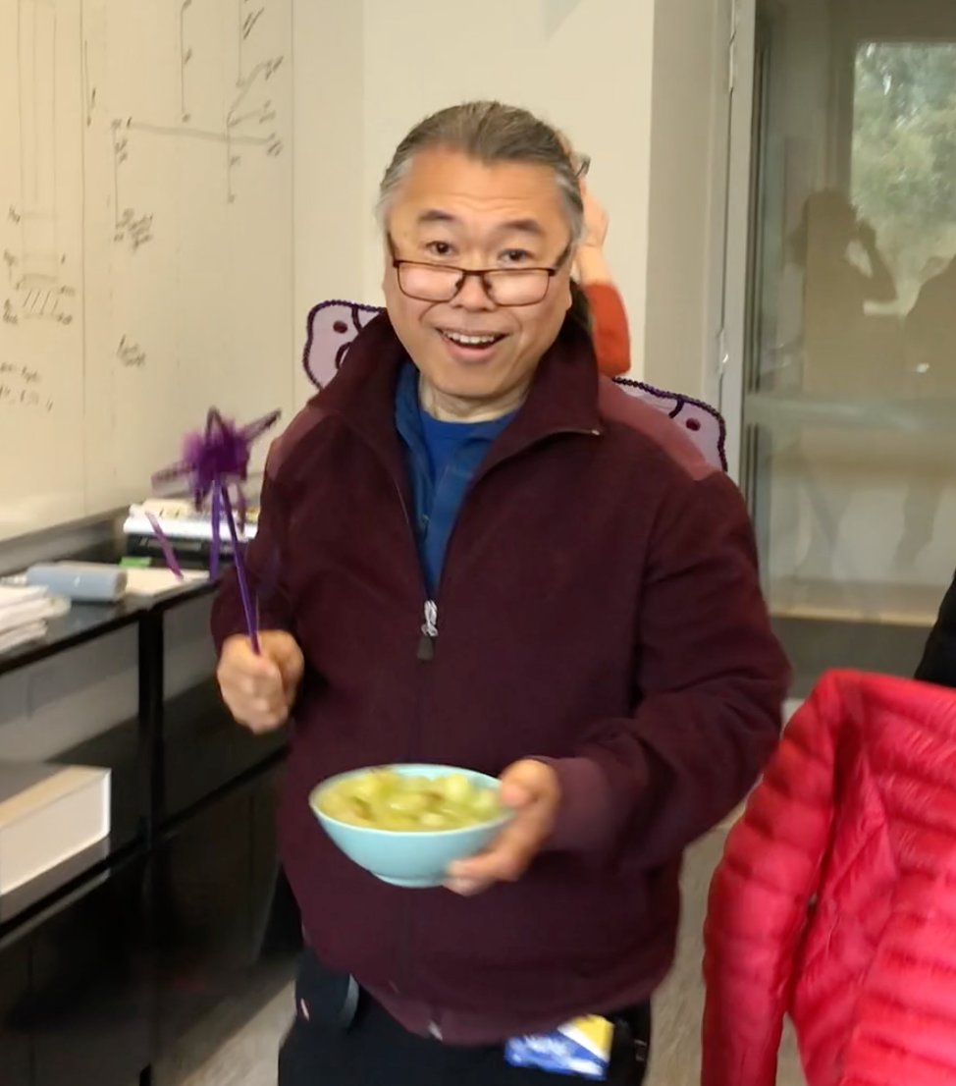
About the Speaker
Paul Wong
"disobedient · impolite · hyperactive
talkative · inattentive"
aka Wong Man · aka School Fairy
— Elementary school report card (wears this as a badge of honour)
· Deviant logician (with pride)
· PhD: Automated Reasoning, ANU
· Public service → DSTO → ANU
Today's Talk
· Senior Lecturer, School of Cybernetics
· Consultant: Chief Scientist, DFAT, Qatar Foundation
1. What is Informetrics?
· Playback Theatre practitioner
2. CyberneticsNLP — the pipeline & findings
3. CyberneticsAR — the extension
· Experimental / improvised musician
4. AI–Human teaming as a research agenda

Slide 3
What is Informetrics?
Informetrics is the statistical and quantitative analysis of information-theoretic phenomena applied to social processes, knowledge systems, and scholarly activities. It treats information itself as a measurable object of study.
Bibliometrics
Scientometrics
Computational Informetrics
The scholarly practice of attribution through bibliographies — citation analysis, reference patterns, h-index, journal impact
Quantitative study of scientific practice — output, collaboration networks, institutional productivity, field growth
NLP, topic modelling, network analysis, machine learning — extracting structure from large text corpora at scale
Who cites whom? How do ideas propagate?
How does science evolve as a social enterprise?
What does 700 cybernetics books look like as a map?

Slide 4
The Cybernetic Bookshelf
675+
7,349
70+
OCR
Books
Chapters
Years
1954–2025
Text source
(Calibre)
1940s–60s Foundational works — Wiener, Ashby, Beer, Shannon, McCulloch & Pitts
1960s–70s Second-order cybernetics — von Foerster, Maturana, Varela, Bateson
1950s–90s* General Systems Theory (Bertalanffy 1950s+), management cybernetics, biosemiotics
1990s–now Complexity, enactivism, digital humanities, ANU School of Cybernetics
* GST dates from the 1950s; corpus coverage of that period may be incomplete. Findings are provisional — the collection is not exhaustive.

Slide 5
What Are We Trying to Find Out?
1
What are the major intellectual ideas within cybernetics?
Topics
2
How has the field evolved since the 1950s — who and what has driven change?
Temporal
3
Which concepts and persons are most central across the literature?
Network
4
How do key terms migrate between subdisciplines over time?
Velocity
5
What does AI-human teaming look like in practice for research?
Meta

Slide 6
1
The Collaboration
Human + AI co-authorship — what it looks like in practice

Slide 7
Who Did What? (CRediT Taxonomy)
Role | Paul Wong | Claude Sonnet 4.6
Conceptualisation | ✦ Lead | —
Domain expertise (cybernetics) | ✦ Lead | —
Software (26 pipeline scripts) | ◆ Supporting | ✦ Lead
Formal analysis | — | ✦ Lead
Visualisation | — | ✦ Lead
Data curation (corpus assembly) | ✦ Lead | ◆ Supporting
Documentation (1,600+ lines) | ◆ Supporting | ✦ Lead
Supervision & Project admin | ✦ Lead | —
✦ Lead · ◆ Supporting · — Not involved | Taxonomy proposed by Claude, reviewed and modified by Paul — expected to evolve as the work continues

Slide 8
Building CyberneticsNLP — 5 Sessions
Mar 20
Mar 21
Mar 24
Mar 27
Mar 30
v0.1
v0.2
v0.3
v0.4
v0.5
Steps 1–10
Corpus ingestion,
LDA/NMF topics,
HTML reports
Index grounding,
concept velocity,
TF-IDF,
embedding comparison
Entity network,
entity classifier,
integrity checker,
regression tests
121 NER corrections,
262 name-merge rules,
4 graph layouts,
README rewrite
Talk preparation
(this session):
slide deck, PDF
extracts, AG2 review
26 pipeline scripts · 1,600+ line methodology doc · 900+ line decision log · 15 regression tests

Slide 9
2
The Pipeline
A 15-step reproducible NLP architecture

Slide 10
Pipeline at a Glance
Ingest &
Clean
Topic
Modelling
Summarise
(API)
Index
Extract
Grounding
& Velocity
Entity
Network
Steps 0–2
Ingestion & Cleaning
Streaming CSV parse · state-machine boilerplate removal · Hunspell + regex filtering · 7–16% token removal
Steps 3–4
Topic Modelling
LDA (7 topics, book-level, TF-IDF 3 000 features) · NMF (6 topics, chapter-level) · seed 99, stable across 4 seeds
Step 3b
Abstractive Summaries
Anthropic API · 675 books · ~$25–35 · fully resumable · verbatim similarity checking
Steps 9–12
Index & Grounding
Index term extraction · 262 person-name merge rules · lift scores · concept density scatter · concept velocity
Steps 14–15
Entity Network
3-stage NER: heuristics → spaCy → Wikidata · PMI × reliability edges · 4 node kinds · 4 graph layouts

Slide 11
Topic Modelling — LDA & NMF
Book-Level · LDA · 7 Topics
Chapter-Level · NMF · 6 Topics
Latent Dirichlet Allocation — probabilistic model that treats each document as a mixture of topics, discovering word co-occurrence patterns across the full corpus
Non-negative Matrix Factorisation — parts-based decomposition of a term matrix; tends to produce more focused, distinct topics than LDA
· TF-IDF · 3,000 features · 4+ char tokens
· Input: abstractive summaries (not raw text)
· 7 topics selected via coherence + interpretability
· 6 topics vs 7 (LDA): summaries are shorter & denser; fewer latent dimensions emerge naturally
· Topic names: API-proposed, Paul reviewed — further automation planned
· Runs independently of book-level pipeline
· Tested across 4 random seeds — additional seeds needed to validate stability
· Chapter-level clustering analysed separately
Topic stability across seeds is promising but requires further validation · More automated naming approaches are under development

Slide 12
3
Findings
What the corpus reveals about the cybernetics intellectual landscape

Slide 13
The Intellectual Map — 7 LDA Topics
Topic names: Claude inspected the top-20 words per topic and proposed labels; Paul reviewed and accepted or modified each. This is a provisional naming — more automated approaches are under development.
T1
Human & Social Experience
T5
2nd-Order Cybernetics & Bateson
human · media · technology · social · cybernetic
bateson · communication · living · order · self · reality
T2
Mathematical & Formal Systems
wiener · machine · mathematical · computer · language
T6
Control Theory & Engineering
control · systems · behavior · feedback · model · function
T3
General Systems Theory
systems · cybernetics · social · management · design
T7
Popular & Applied Cybernetics
T4
History & Philosophy
people · world · human · life · make · years · think
science · human · theory · life · knowledge · philosophy

Slide 14
How the Field Has Evolved: 1954–2025
Foundational Era
1940s – 1960s
Second-Order Wave
1960s – 1970s
Control theory, cybernetics, information theory born simultaneously. Wiener, Ashby, Shannon, Beer. The Macy Conferences unite biologists, engineers, and mathematicians.
von Foerster, Maturana & Varela (autopoiesis), Bateson. Cybernetics turns on itself — the observer enters the system. Biology and philosophy intersect.
Dominant: T2 Mathematical · T6 Control Theory
Dominant: T5 2nd-Order · T4 History & Philosophy
Fragmentation & Specialisation
1980s – 1990s
Expansion & Revival
2000s – 2025
Field splits into management cybernetics, biosemiotics, AI, complexity. VSM (Beer), Luhmann's social systems theory. Smaller but denser publishing.
Complexity science, enactivism, digital humanities, ANU School of Cybernetics. Largest publication volume. New voices, interdisciplinary reach.
Dominant: T3 Systems Theory · T6 Control
Dominant: T1 Human & Social · T7 Popular & Applied

Slide 15
Concept Velocity: How Terms Migrate
Anchor Terms
Stable, pervasive — present across all topics and all decades
e.g. feedback · system · control · information · communication
High density, low lift — define the field's shared vocabulary but don't discriminate between traditions
Signal Terms
Highly discriminating — strongly associated with one tradition only
e.g. autopoiesis · schismogenesis · eigenform · requisite variety
High lift within one topic — reveal the unique conceptual DNA of each intellectual tradition
Frontier Terms
Emerging ideas showing movement and migration across topics over time
e.g. resilience · complexity · emergence · embodiment · enactivism
Velocity > 0 across decades — track where the field is expanding and evolving next
Visualised in Chart 7 of the time series report (book_nlp_timeseries.html)

Slide 16
The Entity Relational Network
Persons
Concepts
Organisations
Locations
Wiener · Ashby · Bateson · Beer · von Foerster · Maturana
feedback · autopoiesis · requisite variety · entropy · homeostasis
MIT · Macy Foundation · Tavistock Institute · Bell Labs
Cambridge · Princeton · Palo Alto · New York · London
How Edges & Classification Work
· Edge weight: PMI × reliability — book-level co-occurrence adjusted for entity frequency
· 3-stage NER pipeline: heuristics → spaCy en_core_web_sm → Wikidata REST API (2 req/s, cached permanently)
· 121 post-audit manual overrides — e.g. 'stelarc' → person, 'digital' → concept, 'whole earth catalog' → suppress
· 4 graph layouts selectable in the UI: Force-directed · Radial · Bipartite · Circular
· Node-kind toggles + degree percentile filter (p75/p90/p95/p99) in the interactive report

Slide 17
4
CyberneticsAR
The extension — federated AI agents meet augmented reality

Slide 18
CyberneticsAR — What Is It?
An extension of CyberneticsNLP: a team of federated AI agents — each contributing distinct capabilities — collaborates to produce an Augmented Reality experience grounded in the analytical insights from the NLP pipeline.
Claude
DeepSeek
Gemini
GitHub Copilot
MS 365 Copilot
Anthropic
DeepSeek AI
Google
Microsoft
Microsoft
NLP analysis, reasoning, documentation, code generation
Cross-lingual analysis, multilingual corpus support
Multimodal — integrating text, images, and visual data
Code scaffolding, repository management, PR review
Document workflow, integration with research artefacts
Each agent brings distinct strengths — together they form a federated team for complex research production

Slide 19
AI–Human Teaming — The Meta-Perspective
Two Projects — Different Purposes
Open Questions
CyberneticsNLP
Division of labour
Research — understanding an intellectual field through its literature
When should a human direct vs. delegate? What tasks are AI-inappropriate?
Trust & validation
CyberneticsAR
How do you verify AI-generated code, analysis, or decisions at scale?
Service/product development — building AI-assisted tools for active use
Attribution
Separation is deliberate
If 26 scripts are Claude's code, whose intellectual property is it?
Different goals, different governance, no reverse dependencies between them
Multi-agent dynamics
Both generate meta-data
5 AI agents on one project — how do they coordinate without conflict?
Session logs, CRediT records, overrides — data about AI–human teaming itself
Reproducibility
Can another team reproduce AI-assisted research without the same AI?

Slide 20
5
Reflections
What worked, what surprised us, and what's next

Slide 21
What Worked · What Surprised Us
✓ What Worked Well
! Surprises & Limitations
· Speed: full 15-step pipeline in 4 sessions — ~1 week
· Entity classifier needed 121 manual overrides after automated passes
· Code quality: 15 regression tests, integrity checker, resumable at every step
· OCR line-break hyphens ('feed-\nback') were a significant noise source
· Documentation: methodology, decisions, changelog — all written by Claude
· Topic stability held across 4 random seeds — unexpectedly robust
· Domain adaptation: cybernetics whitelist, 262 name-merge rules, NER audit
· Wikidata API added genuine disambiguation for ambiguous names
· Iterative co-design: Paul shaped questions; Claude coded answers
· 17 API summaries failed verbatim-similarity checks — needed regeneration

Slide 22
What's Next
Immediately
Phase 2 — Analysis
Phase 3 — Publication
→ Data quality: filter entity noise (OCR artefacts, suffix fragments)
→ PhD theses corpus: same pipeline on ~1,300 cybernetics dissertations
→ Paper: Mapping the Cybernetics Intellectual Landscape
→ Seed validation: rerun LDA/NMF across more random seeds
→ Events analysis (conferences, milestones)
→ Targets: Kybernetes · DHQ · Systems Research
→ Regenerate 17 missing summaries
→ Co-citation network from bibliographies
→ Zenodo DOI deposit + GitHub v1.0 release
→ Full spaCy + Wikidata entity pass
→ Temporal entity analysis across decades
→ CyberneticsAR extension continues in parallel

Slide 23
Key Takeaways
1
Cybernetics is an evolving intellectual tradition and practice, with different thematic emphases across time and application domains
2
Concept velocity reveals which ideas are stable anchors and which are migrating to the frontier
3
Human–AI collaboration can produce research-grade software in days, not months — Claude's claim; Paul remains healthily sceptical
4
CyberneticsNLP (research) and CyberneticsAR (product development) are deliberately kept separate: different goals, different governance, no reverse dependencies
5
AI agents still need humans to keep them honest — the AG2 framework makes that explicit through session-driven, human-mediated decisions
github.com/cyberneticbookshelf-stack/cyberneticsNLP · paul.wong@anu.edu.au

