Slide 1
The Informetrics of Cybernetics
(or When Nerds Meet Cool Kids)
Paul Wong · School of Cybernetics, ANU
With Claude Sonnet 4.6 (Anthropic) · Work in Progress
April 2026

Slide 2
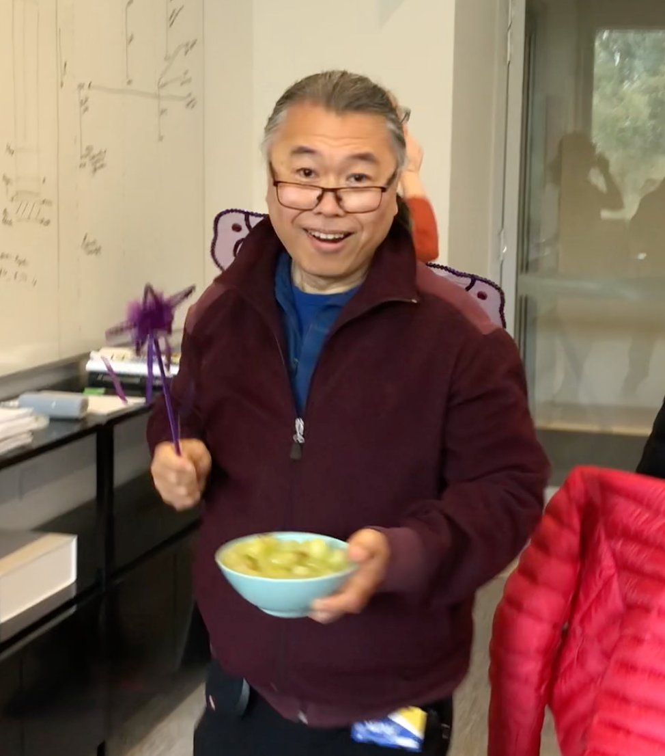
About the Speaker
Paul Wong
"disobedient · impolite · hyperactive
talkative · inattentive"
aka Wong Man · aka School Fairy
— Elementary school report card (wears this as a badge of honour)
· Deviant logician (with pride)
· PhD: Automated Reasoning, ANU
· Public service → DSTO → ANU
Today's Talk
· Senior Lecturer, School of Cybernetics
· Consultant: Chief Scientist, DFAT, Qatar Foundation
1. What is Informetrics?
· Playback Theatre practitioner
2. CyberneticsNLP — the pipeline & findings
3. CyberneticsAR — the extension
· Experimental / improvised musician
4. AI–Human teaming as a research agenda

Slide 3
What is Informetrics?
Informetrics is the statistical and quantitative analysis of information-theoretic phenomena applied to social processes, knowledge systems, and scholarly activities. It treats information itself as a measurable object of study.
Bibliometrics
Scientometrics
Computational Informetrics
The scholarly practice of attribution through bibliographies — citation analysis, reference patterns, h-index, journal impact
Quantitative study of scientific practice — output, collaboration networks, institutional productivity, field growth
NLP, topic modelling, network analysis, machine learning — extracting structure from large text corpora at scale
Who cites whom? How do ideas propagate?
How does science evolve as a social enterprise?
What does 700 cybernetics books look like as a map?

Slide 4
The Cybernetic Bookshelf
695
7,349
70+
OCR
Books
Chapters
Years
1954–2025
Text source
(Calibre)
1940s–60s Foundational works — Wiener, Ashby, Beer, Shannon, McCulloch & Pitts
1960s–70s Second-order cybernetics — von Foerster, Maturana, Varela, Bateson
1950s–90s* General Systems Theory (Bertalanffy 1950s+), management cybernetics, biosemiotics
1990s–now Complexity, enactivism, digital humanities, ANU School of Cybernetics
* GST dates from the 1950s; corpus coverage of that period may be incomplete. Findings are provisional — the collection is not exhaustive.

Slide 5
What Are We Trying to Find Out?
Reading one book vs. reading 695 books over 70 years is not just a difference of scale — it is a difference in epistemic access. The questions below are only askable at corpus scale.
1
What are the major intellectual ideas within cybernetics?
Topics
2
How has the field evolved since the 1950s — who and what has driven change?
Temporal
3
Which concepts and persons are most central across the literature?
Network
4
How do key terms migrate between subdisciplines over time?
Velocity
5
What does AI-human teaming look like in practice for research?
Meta

Slide 6
1
The Collaboration
Human + AI co-authorship — what it looks like in practice

Slide 7
Who Did What? (CRediT Taxonomy)
Role | Paul Wong | Claude Sonnet 4.6
Conceptualisation | ✦ Lead | —
Domain expertise (cybernetics) | ✦ Lead | —
Software (~34 pipeline scripts) | ◆ Supporting | ✦ Lead
Formal analysis | — | ✦ Lead
Visualisation | — | ✦ Lead
Data curation (corpus assembly) | ✦ Lead | ◆ Supporting
Documentation (2,000+ lines) | ◆ Supporting | ✦ Lead
Supervision & Project admin | ✦ Lead | —
✦ Lead · ◆ Supporting · — Not involved | Taxonomy proposed by Claude, reviewed and modified by Paul — expected to evolve as the work continues

Slide 8
Building CyberneticsNLP — 5 Sessions
Mar 20
Mar 21
Mar 24
Apr 8
Apr 14
v0.1
v0.2
v0.3
v0.4.2
v0.4.3
Steps 1–10
Corpus ingestion,
LDA/NMF topics,
HTML reports
Index grounding,
concept velocity,
TF-IDF,
embedding comparison
Entity network,
entity classifier,
integrity checker,
regression tests
Monograph classifier:
197 expert labels,
report quality fixes,
v0.4.2 (8 Apr 2026)
Full-text LDA refactor
pub-type filter:
k-selection sweep,
9-topic canonical run
~34 pipeline scripts · 2,000+ line methodology doc · 1,600+ line decision log · 15 regression tests

Slide 9
2
The Pipeline
A 15-step reproducible NLP architecture

Slide 10
Pipeline at a Glance
Ingest &
Clean
Topic
Modelling
Summarise
(API)
Index
Extract
Grounding
& Velocity
Entity
Network
Steps 0–2
Ingestion & Cleaning
Streaming CSV parse · state-machine boilerplate removal · Hunspell + regex filtering · 7–16% token removal
Steps 3–4
Topic Modelling
LDA (9 topics, book-level, TF-IDF 15,000 features) · 5 seeds, stability validated · NMF (8 topics, chapter-level, not presented)
Step 3b
Abstractive Summaries
Anthropic API · 695 books · ~$25–35 · fully resumable · verbatim similarity checking
Steps 9–12
Index & Grounding
Book back-indexes as controlled vocabulary · 262 person-name merge rules · lift scores · concept density scatter · concept velocity
Steps 14–15
Entity Network
3-stage NER: heuristics → spaCy → Wikidata · PMI × reliability edges · 4 node kinds · 4 graph layouts

Slide 11
Topic Modelling — LDA (Book-Level)
Book-Level · LDA · 9 Topics
Chapter-Level · NMF · Infrastructure Built
Latent Dirichlet Allocation — probabilistic model that treats each document as a mixture of topics, discovering word co-occurrence patterns across the full corpus
Non-negative Matrix Factorisation — chapter-level analysis built and validated (8-topic solution). Not presented in this talk.
· TF-IDF · 15,000 features (full-text) · 4+ char tokens
· Input: abstractive summaries (not raw text)
· k=9 (9 topics) via NPMI coherence + stability
· 8-topic solution available in pipeline outputs
· Topic names: API-proposed, Paul reviewed — further automation planned
· Runs independently — see HTML reports
· 5-seed stability analysis complete — mean stability 0.327, 5/9 topics stable
· Presentation scope: book-level LDA only
5-seed stability complete (mean=0.327) · Topic names provisional pending multi-rater validation

Slide 12
3
Preliminary Findings
What the corpus suggests about the cybernetics intellectual landscape

Slide 13
The Intellectual Map — 9 LDA Topics
9-topic solution — 7 shown above. Also: T8 Cybernetics of Posthumanism · T9 Cultural Applications of Cybernetics (stability 0.622, highest across all k). Names: API-proposed, corrected by Paul via title-sweep. Provisional — run-records validation pending.
T1
History and Biography of Cybernetics
T5
Biological Systems Cybernetics
wiener · lem · heims · kline · waldrop · čapek
homeostasis · nervous · biological · body · energy · system
T2
Formal Foundations of Cybernetics
stress · allostasis · brain · body · regulation · neural
T6
Cybernetics of Psychology
automata · computation · algorithm · mathematical · formal
T3
Cross-Domain Applications of Cybernetics
urban · church · border · governance · policy · social
T7
Extensions of Cybernetics
T4
Cybernetic Management Theory
brier · hui · actor · semiotic · post · techno · network
beer · viable · management · variety · organisation · vsm

Slide 14
How the Field Has Evolved: 1954–2025
Foundational Era
1940s – 1960s
Second-Order Wave
1960s – 1970s
Control theory, cybernetics, information theory born simultaneously. Wiener, Ashby, Shannon, Beer. The Macy Conferences unite biologists, engineers, and mathematicians.
von Foerster, Maturana & Varela (autopoiesis), Bateson. Cybernetics turns on itself — the observer enters the system. Biology and philosophy intersect.
Dominant: T6 Formal Foundations · T4 Cybernetic Management
Dominant: T2 Cybernetics of Psychology · T5 Biological Systems
Fragmentation & Specialisation
1980s – 1990s
Expansion & Revival
2000s – 2025
Field splits into management cybernetics, biosemiotics, AI, complexity. VSM (Beer), Luhmann's social systems theory. Smaller but denser publishing.
Complexity science, enactivism, digital humanities, ANU School of Cybernetics. Largest publication volume. New voices, interdisciplinary reach.
Dominant: T4 Cybernetic Management · T6 Formal Foundations
Dominant: T8 Cybernetics of Posthumanism · T9 Cultural Applications

Slide 15
Concept Velocity: How Terms Migrate
Anchor Terms
Stable, pervasive — present across all topics and all decades
e.g. feedback · system · control · information · communication
High density, low lift — define the field's shared vocabulary but don't discriminate between traditions
Signal Terms
Highly discriminating — strongly associated with one tradition only
e.g. autopoiesis · schismogenesis · eigenform · requisite variety
High lift within one topic — reveal the unique conceptual DNA of each intellectual tradition
Frontier Terms
Emerging ideas showing movement and migration across topics over time
e.g. resilience · complexity · emergence · embodiment · enactivism
Velocity > 0 across decades — track where the field is expanding and evolving next
Terms sourced from book back-indexes — human-curated controlled vocabulary unique to print monographs, independent of LDA word lists · Caveat: index compilation changed across the 70-year span — early indexes hand-compiled (selective, semantically rich); later indexes often computer-assisted (denser, less discriminating) · Velocity visualised in Chart 7 (book_nlp_timeseries.html)

Slide 16
The Entity Relational Network
Persons
Concepts
Organisations
Locations
Wiener · Ashby · Bateson · Beer · von Foerster · Maturana
feedback · autopoiesis · requisite variety · entropy · homeostasis
MIT · Macy Foundation · Tavistock Institute · Bell Labs
Cambridge · Princeton · Palo Alto · New York · London
How Edges & Classification Work
· Edge weight: PMI × reliability — book-level co-occurrence adjusted for entity frequency
· 3-stage NER pipeline: heuristics → spaCy en_core_web_sm → Wikidata REST API (2 req/s, cached permanently)
· 121 post-audit manual overrides — e.g. 'stelarc' → person, 'digital' → concept, 'whole earth catalog' → suppress
· 4 graph layouts selectable in the UI: Force-directed · Radial · Bipartite · Circular
· Node-kind toggles + degree percentile filter (p75/p90/p95/p99) in the interactive report

Slide 17
4
CyberneticsAR
The extension — federated AI agents meet augmented reality

Slide 18
CyberneticsAR — What Is It?
An extension of CyberneticsNLP: a team of federated AI agents — each contributing distinct capabilities — collaborates to produce an Augmented Reality experience grounded in the analytical insights from the NLP pipeline.
Claude
DeepSeek
Gemini
GitHub Copilot
MS 365 Copilot
Anthropic
DeepSeek AI
Google
Microsoft
Microsoft
NLP analysis, reasoning, documentation, code generation
Cross-lingual analysis, multilingual corpus support
Multimodal — integrating text, images, and visual data
Code scaffolding, repository management, PR review
Document workflow, integration with research artefacts
Each agent brings distinct strengths — together they form a federated team for complex research production

Slide 19
AI–Human Teaming — The Meta-Perspective
Two Projects — Different Purposes
Open Questions
CyberneticsNLP
Division of labour
Research — understanding an intellectual field through its literature
When should a human direct vs. delegate? What tasks are AI-inappropriate?
Trust & validation
CyberneticsAR
How do you verify AI-generated code, analysis, or decisions at scale?
Service/product development — building AI-assisted tools for active use
Attribution
Separation is deliberate
If 26 scripts are Claude's code, whose intellectual property is it?
Different goals, different governance, no reverse dependencies between them
Multi-agent dynamics
Both generate meta-data
5 AI agents on one project — how do they coordinate without conflict?
Session logs, CRediT records, overrides — data about AI–human teaming itself
Reproducibility
Can another team reproduce AI-assisted research without the same AI?

Slide 20
5
Reflections
What worked, what surprised us, and what's next

Slide 21
What Worked · What Surprised Us
✓ What Worked Well
! Surprises & Limitations
· Speed: full 15-step pipeline in 4 sessions — ~1 week
· Entity classifier needed 121 manual overrides after automated passes
· Code quality: 15 regression tests, integrity checker, resumable at every step
· OCR line-break hyphens ('feed-\nback') were a significant noise source
· Documentation: methodology, decisions, changelog — all written by Claude
· Topic stability held across 4 random seeds — unexpectedly robust
· Domain adaptation: cybernetics whitelist, 262 name-merge rules, NER audit
· Wikidata API added genuine disambiguation for ambiguous names
· Iterative co-design: Paul shaped questions; Claude coded answers
· 17 API summaries failed verbatim-similarity checks — needed regeneration

Slide 22
What's Next
Immediately
Phase 2 — Analysis
Phase 3 — Publication
→ Data quality: filter entity noise (OCR artefacts, suffix fragments)
→ PhD theses corpus: same pipeline on ~1,300 cybernetics dissertations
→ Paper: Mapping the Cybernetics Intellectual Landscape
→ Document unit decision: proceedings & anthology exclusion policy
→ Events analysis (conferences, milestones)
→ Targets: Kybernetes · DHQ · Systems Research
→ Regenerate 17 missing summaries
→ Co-citation network from bibliographies
→ Zenodo DOI deposit + GitHub v1.0 release
→ Full spaCy + Wikidata entity pass
→ Temporal entity analysis across decades
→ CyberneticsAR extension continues in parallel

Slide 23
Key Takeaways
1
Large-scale corpus analysis affords qualitatively different epistemic access than reading individual books — topic structure, temporal evolution, and network centrality are only visible at corpus scale (695 books, 70 years)
2
Concept velocity reveals which ideas are stable anchors and which are migrating to the frontier
3
Human–AI collaboration can produce research-grade software in days, not months — Claude's claim; Paul remains healthily sceptical
4
CyberneticsNLP (research) and CyberneticsAR (product development) are deliberately kept separate: different goals, different governance, no reverse dependencies
5
AI agents still need humans to keep them honest — the AG2 framework makes that explicit through session-driven, human-mediated decisions
github.com/cyberneticbookshelf-stack/cyberneticsNLP · paul.wong@anu.edu.au

Slide 24
Typoglycemia, Filling-in, Intelligence, and Stupidity
Tymgecyoipla trikcs the brian beacsue we dno't raed erevy lteetr sluenleitqay. Isneatd, our binars use ptteran reoicgtoinn to pcosres fliimaar word sphaes and key letter pootnisis (lilpeaecsy fsirt and last lets)ter. This aolwls us to read qliucky and even usnrdeantd txet wehn the ieonritr leettrs are scamerlbd or cnaiotn tospy.
Notes:
https://v0-typoglycemia-tool.vercel.app/
Typoglycemia tricks the brain because we don't read every letter sequentially. Instead, our brains use pattern recognition to process familiar word shapes and key letter positions (especially first and last letters). This allows us to read quickly and even understand text when the interior letters are scrambled or contain typos.

