Slide 1

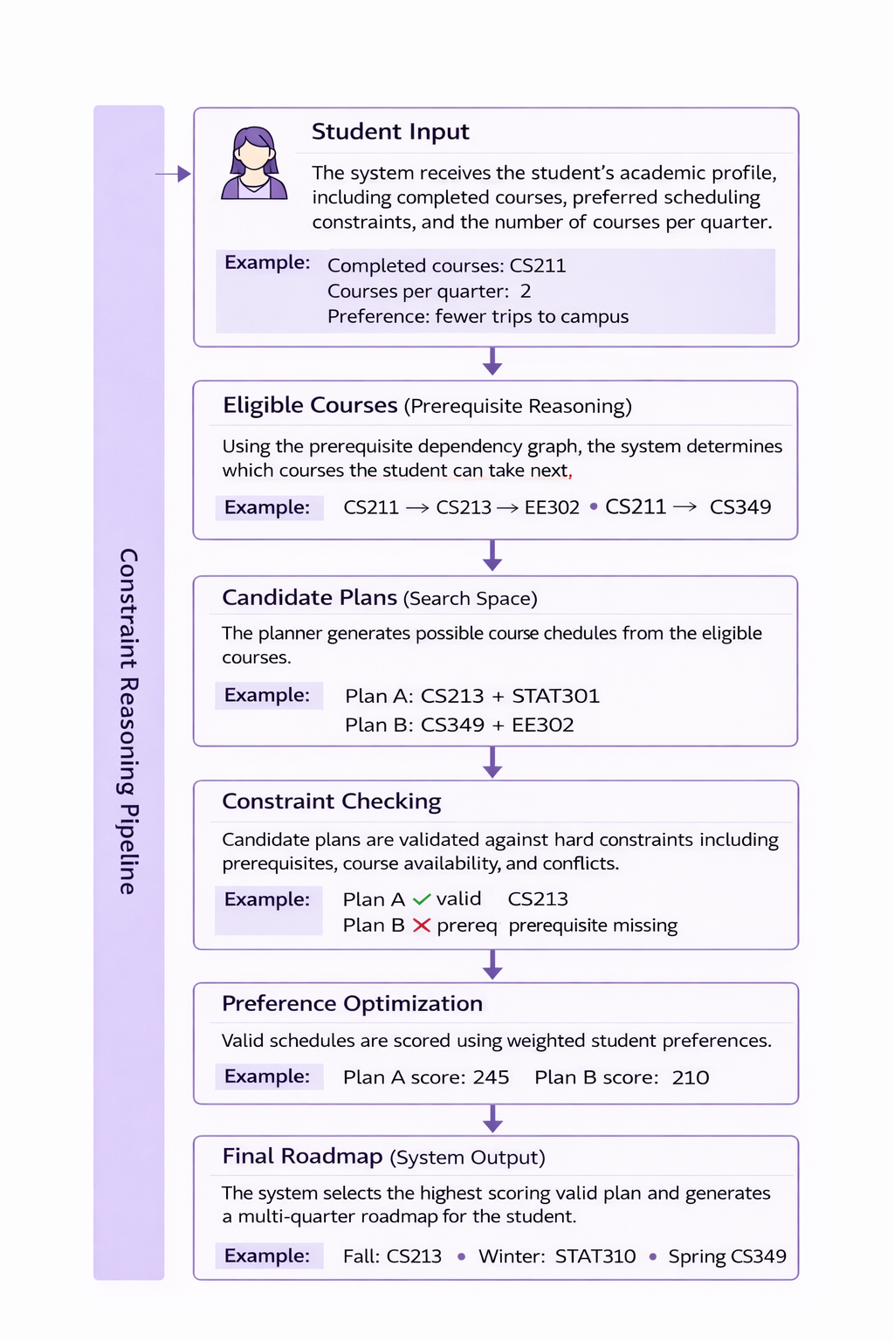
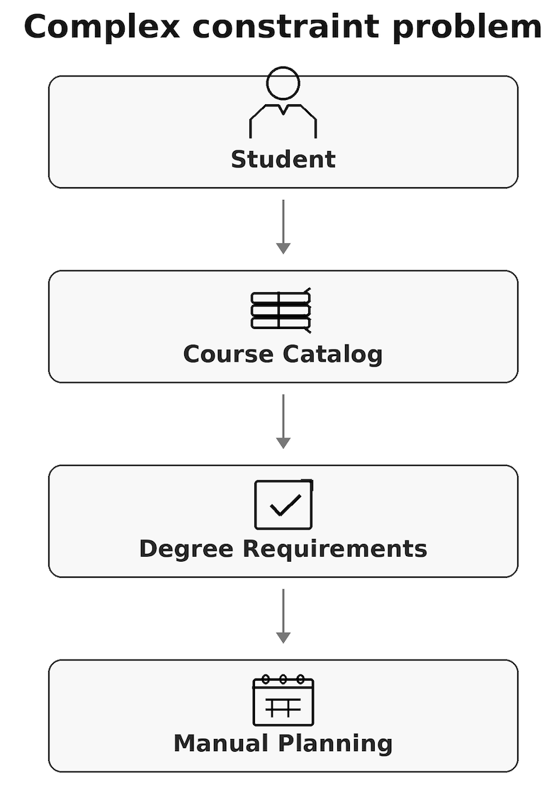
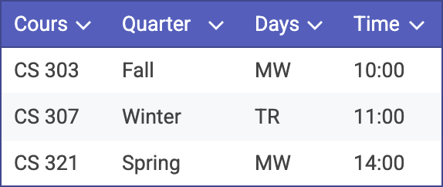
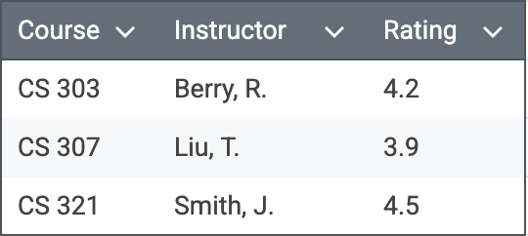
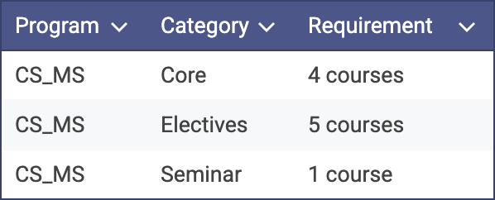
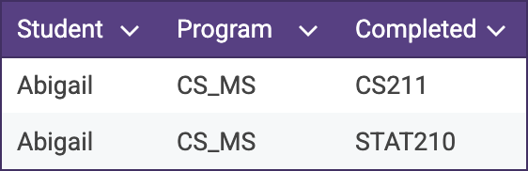
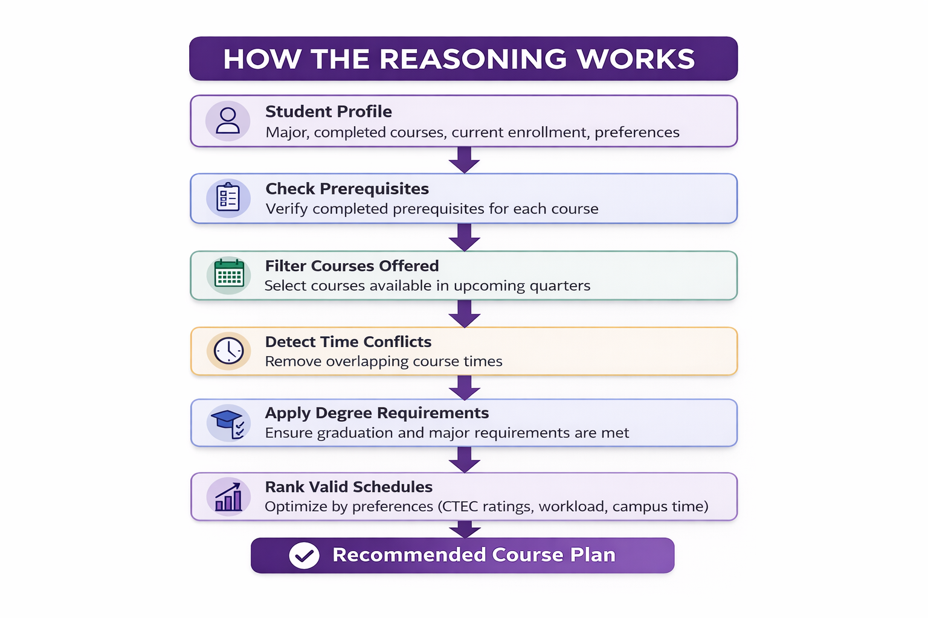
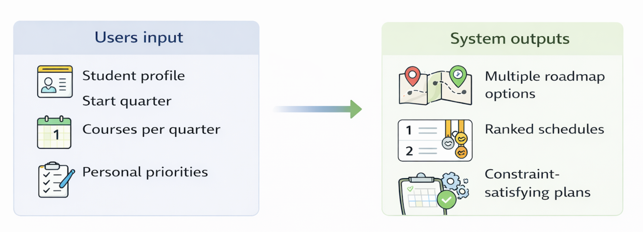
Intelligent Course Scheduling with Structured Constraint Reasoning
Allan Tang · Yitao Hong · Kenneth Lee
Master of Science in Artificial Intelligence
Northwestern University
Problems
Representation
Example: Building a road map
Students must manually plan courses across multiple quarters.
Challenges:
Satisfy prerequisite chains
Meet degree requirements
Avoid time conflicts
Courses offered only certain quarters
Balance workload and preferences
Current tools (degree audits, advising) do not generate optimized schedules. Students must manually test many combinations.
Here we utilize tabular data that is structured across 4 relational tables that encode a Constraint Satisfaction Problem. Each table encodes different types of knowledge, namely the following:
Temporal: Course scheduling offerings, with features such as course prerequisites, times offered, dates offered, and course locations.
Curricular: Minimum degree requirements for graduation.
Evaluative: CTEC evaluations for instructors on specific courses.
Biographical: Student profiles, with status (full-time versus part-time), declared major, courses completed to date, and courses currently registered for in the following quarter.
Why it matters
Temporal
Evaluative
Students want schedules that satisfy constraints and match their goals.
Benefits of automated planning:
Ensure prerequisites are satisfied
Guarantee degree requirements are met
Avoid scheduling conflicts
Optimize student preferences
fewer days on campus
shorter campus time
higher instructor ratings
Curricular
Biographical
Reasoning
System Work Guide
Conclusion
Structured constraint reasoning allows reliable course planning beyond what LLMs can guarantee. The system combines graph reasoning, constraint checking, and preference optimization to generate valid and explainable academic roadmaps.
Acknowledgements
We would like to thank Professor Mohammed A. Alam for his guidance and feedback throughout this project. This work was completed as part of MSAI 371 at Northwestern University.

