Slide 2
Recommendation Report
Session ID: 9abfec21-cd10-4fb6-a65b-1137fe6cc7ef
Generated: 2025-04-25

Slide 3
Fragment: Green With Software

Slide 4
Green With Software: Top 3 Insights
The organization’s IT structure is heavily weighted towards project-based delivery for functional requirements, hindering the development of reusable capabilities and long-term value. A shift towards a product-centric IT operating model, supported by collaborative project management tools and training, is critical for improved efficiency and scalability.
The current IT architecture demonstrates foundational modernization but lacks key elements of a fully modern approach. Prioritizing the adoption of microservices, API-driven integration, and a diversified database strategy (including NoSQL options) alongside continued Agile and CI/CD investment will unlock greater agility and innovation.
Cloud adoption is currently fragmented and lacks strategic direction. Establishing a formal cloud policy, coupled with infrastructure-as-code automation, is essential to move beyond experimentation and realize the benefits of a controlled and scalable hybrid cloud environment.

Slide 5
Green With Software: Roadmap Overview
Summary: This roadmap guides the transition from a project-centric IT organization to a product-focused model, leveraging modern architectures and data-driven insights. It emphasizes integrating agile practices, automating processes, and optimizing operations for improved business outcomes. The plan focuses on building a foundation for continuous innovation and delivering tangible value through improved KPIs.
Total Est: 122 hrs (~15.2 days)
Key Roles: Developers, IT Architects, Data Analysts, Project Managers, Security Professionals, Innovation Leaders, Operations Engineers, Database Administrators

Slide 6
Green With Software: Implementation Plan Details
Overall Goal: Green With Software Implementation Plan
Description:
This roadmap outlines a phased approach to transform the organization's IT capabilities. The Early Steps focus on establishing foundational alignment through collaborative practices and initial cloud experimentation. The Intermediate Steps concentrate on integrating agile methodologies, modernizing the architecture with a mix of database technologies, and automating processes for scalability. Finally, the Advanced Steps prioritize persona-based operations, strengthening critical event support, and aligning projects with measurable business benefits to drive continuous improvement and innovation.
Methodology / Steps:
--- Early Steps ---
1. Introduce collaborative project management tools like Jira or Trello. 2. Implement basic sustainability checkpoints in project development. 3. Provide training on integrated operating models. 4. Experiment with cloud usage for one-off experiments. 5. Develop a cloud policy to guide experimentation. 6. Begin collaborative efforts for basic data management. 7. Explore integrable data sources for improved analytics. 8. Start documenting data processes and insights. 9. Introduce basic agile principles. 10. Encourage team collaboration. 11. Implement visual project management.
--- Intermediate Steps ---
12. Implement a mix of enterprise DB and NoSQL databases for flexibility. 13. Transition towards Agile and continuous integration practices. 14. Introduce virtualization for enhanced resource utilization. 15. Leverage technology advances and automate manual processes. 16. Seek executive sponsorship for innovation initiatives. 17. Allocate innovation to business units with defined strategies. 18. Establish initial processes for innovation, avoiding silos.
--- Advanced Steps ---
19. Shift focus from ticket-based to persona-based operations. 20. Encourage solution adoption and persona-based training. 21. Strengthen critical event support. 22. Target projects at bringing tangible business benefits. 23. Measure success based on positive movement in business-related KPIs. 24. Evaluate the percentage of improvement in productivity from moving to product-centric IT. 25. Implement monitoring tools for proactive issue detection. 26. Refine data processes based on KPI analysis. 27. Establish a feedback loop for continuous improvement.
Roles Involved (Overall): Developers, IT Architects, Data Analysts, Project Managers, Security Professionals, Innovation Leaders, Operations Engineers, Database Administrators
Tools/Platforms (Overall): Jira, Trello, Git, VersionOne, Bitbucket, AWS CLI, Google Sheets, Kanban, OpenProject, MongoDB, Jenkins, Docker, Kubernetes, Red Hat OpenShift, Amazon ECS, Spigit, GitHub, Prometheus, Cherwell, Smartsheet, Odoo
Subtask Estimates (Aggregated):
--- Early Steps ---
Project Management Tooling: 8 hours; Sustainability Checkpoints: 4 hours; Integrated Operating Model Training: 4 hours; Cloud Experimentation: 6 hours; Cloud Policy Development: 4 hours; Data Collaboration: 4 hours; Data Source Exploration: 4 hours; Data Documentation: 4 hours; Agile Introduction: 4 hours; Team Collaboration: 4 hours; Visual Project Management: 4 hours.
--- Intermediate Steps ---
Database Integration: 8 hours; Agile/CI Transition: 6 hours; Virtualization Implementation: 4 hours; Automation Implementation: 6 hours; Executive Sponsorship: 4 hours; Innovation Allocation: 4 hours; Innovation Processes: 4 hours.
--- Advanced Steps ---
Persona-Based Operations: 8 hours; Solution Adoption Training: 4 hours; Critical Event Support: 4 hours; Benefit-Driven Projects: 8 hours; KPI Measurement: 4 hours; Productivity Evaluation: 4 hours; Monitoring Implementation: 6 hours; Data Process Refinement: 4 hours.

Slide 7
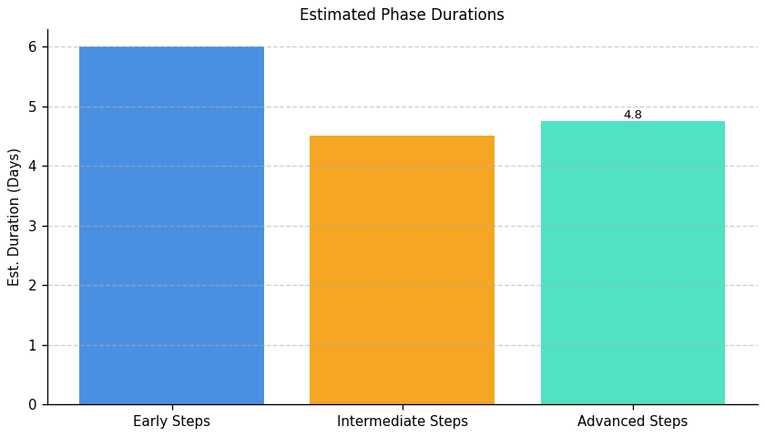
Green With Software: Roadmap Phase Durations

Slide 8
Fragment: Green With Software

Slide 9
Green With Software: Top 3 Insights
The organization demonstrates a critical lack of proactive server infrastructure management, specifically regarding scalability, resource monitoring, and redundancy. This absence creates significant operational risk and limits the ability to respond effectively to changing business demands or unexpected outages.
Security practices are fundamentally deficient, with core protections like intrusion detection, robust access controls, and consistent log auditing missing. This widespread vulnerability exposes the organization to data breaches, compliance failures, and potential financial losses.
Despite recognizing the need to respond to server anomalies with alerts, the organization’s reactive approach is undermined by the absence of foundational monitoring and preventative security measures, suggesting alerts are unlikely to be fully effective in mitigating significant issues.

Slide 10
Green With Software: Roadmap Overview
Summary: This implementation roadmap addresses critical gaps in server infrastructure resilience, security, and scalability. It outlines a phased approach to enhance resource monitoring, implement robust intrusion detection, and ensure ongoing compliance through optimization and governance. The plan aims to proactively mitigate risks and optimize performance for long-term stability.
Total Est: 495 hrs (~61.9 days)
Key Roles: IT Architects, Infrastructure Managers, Scalability Planning Team, IT Leadership, IT Administrators, Infrastructure Team, IT Specialists, Monitoring Team, Monitoring Administrators, Security Analysts, Testing Teams, Business Analysts, Network Administrators, Optimization Experts, Compliance Specialists, Logging System Analysts

Slide 11
Green With Software: Implementation Plan Details
Overall Goal: Fragment B Implementation Plan
Description:
This roadmap initiates with a foundational assessment to establish a baseline understanding of current infrastructure gaps in scalability, resource monitoring, and security. The intermediate phase focuses on implementing initial solutions for these areas, integrating them into the existing environment. Finally, the advanced phase concentrates on optimization, redundancy, logging, and ongoing compliance to ensure a resilient and secure infrastructure.
Methodology / Steps:
--- Early Steps ---
1. Assess the current server infrastructure for scalability gaps, collaborating with IT architects and conducting workload analysis. 2. Evaluate and select a resource monitoring tool for server infrastructure, researching options and aligning with requirements. 3. Conduct a security threat assessment to identify potential risks and vulnerabilities, collaborating with security experts. 4. Analyze current and projected resource demands for server infrastructure, collecting usage data and collaborating with business and IT teams. 5. Conduct a network assessment to identify areas for optimization, using network monitoring tools and analyzing traffic patterns.
--- Intermediate Steps ---
6. Develop a plan for enhancing server infrastructure scalability, identifying solutions and creating a roadmap. 7. Configure and integrate the selected monitoring tool with the server infrastructure, following documentation and testing configurations. 8. Evaluate and select an IDS solution suitable for the infrastructure, researching tools and aligning with the threat assessment. 9. Develop a plan to ensure server resources meet current and future demands, defining resource allocation strategies. 10. Develop an access control policy defining user permissions and restrictions, collaborating with IT security and assessing system requirements. 11. Evaluate and select an appropriate load balancing solution, researching options and aligning with infrastructure requirements.
--- Advanced Steps ---
12. Implement the planned upgrades to enhance scalability, upgrading hardware and implementing scaling solutions. 13. Implement resource monitoring in the production environment and provide training. 14. Implement the selected IDS solution and integrate it into the server infrastructure, configuring parameters and performing integration testing. 15. Implement identified optimizations and monitor the impact on network performance. 16. Integrate the selected logging system into your server infrastructure, configuring log sources and collaborating with IT teams. 17. Implement the selected firewall solution and conduct testing. 18. Implement redundancy measures in the server infrastructure, upgrading hardware and configuring redundant systems.
Roles Involved (Overall): IT Architects, Infrastructure Managers, Scalability Planning Team, IT Leadership, IT Administrators, Infrastructure Team, IT Specialists, Monitoring Team, Monitoring Administrators, Security Analysts, Testing Teams, Business Analysts, Network Administrators, Optimization Experts, Compliance Specialists, Logging System Analysts
Tools/Platforms (Overall): docker, kubernetes, Amazon ECS, Google Kubernetes Engine (GKE), Grafana, Prometheus, Datadog, New Relic, iperf, SolarWinds Network Performance Monitor, Snort, Cisco Firepower, Suricata, Collectd, iptables, Cisco ASA, Palo Alto Networks, HAProxy, Nginx, ELK Stack (Elasticsearch, Logstash, Kibana), Splunk, Keepalived, Veeam Backup & Replication
Subtask Estimates (Aggregated):
--- Early Steps ---
Scalability Analysis - 25h; Collaboration with IT Architects - 20h; Monitoring Tool Research - 20h; Alignment with Requirements - 15h; Threat Assessment - 20h; Risk Analysis - 15h; Demand Analysis - 25h; Collaboration with Business and IT Teams - 20h; Assessment - 20h; Traffic Pattern Analysis - 15h
--- Intermediate Steps ---
Solution Identification - 30h; Roadmap Creation - 25h; Configuration Setup - 30h; Testing - 25h; Research - 25h; Alignment with Threat Assessment - 20h; Capacity Planning - 30h; Collaboration with IT and Business Teams - 25h; Policy Development - 20h; Collaboration with System Administrators - 15h; Load Balancer Research - 20h; Alignment with Requirements - 15h
--- Advanced Steps ---
Hardware Upgrade - 40h; Scaling Solution Implementation - 35h; Rollout - 35h; Training - 30h; Configuration - 30h; Integration Testing - 25h; Implementation - 30h; Performance Monitoring - 25h; Integration - 30h; Collaboration with IT Teams - 25h; Configuration - 30h; Security Testing - 25h; Hardware Upgrade - 40h; Redundancy Configuration - 35h

Slide 12
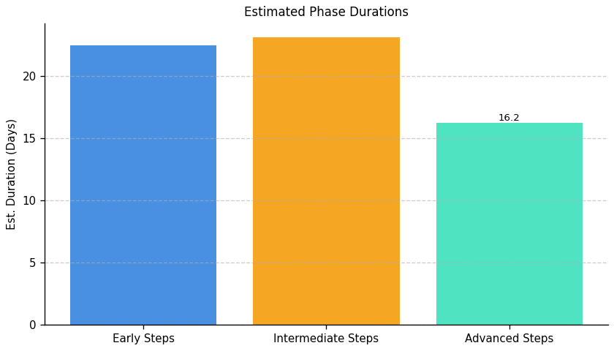
Green With Software: Roadmap Phase Durations

Slide 13
Fragment: Green With Software

Slide 14
Green With Software: Top 3 Insights
A documented disaster recovery plan exists, but its effectiveness is undermined by inconsistent application to data protection practices, creating a critical vulnerability to data loss and extended downtime. Significant investment – exceeding 90 hours – is required to establish and regularly test comprehensive data backup and recovery procedures.
Despite defined data management policies, implementation is lacking, and there is no formal process for retiring outdated IT infrastructure. Addressing this requires over 125 hours of dedicated audit and strategy development to mitigate security risks, reduce complexity, and improve overall IT efficiency.
While foundational resilience planning is present, the organization faces a substantial gap between policy documentation and practical execution across key areas like data protection and infrastructure lifecycle management, indicating a need to prioritize consistent implementation and ongoing validation of established procedures.

Slide 15
Green With Software: Roadmap Overview
Summary: This implementation plan addresses critical gaps in data management, backup, recovery, and infrastructure decommissioning. It focuses on establishing robust data protection strategies, implementing comprehensive backup solutions, and ensuring ongoing governance for long-term sustainability and proactive risk mitigation.
Total Est: 358 hrs (~44.8 days)
Key Roles: Data Owners, IT Operations, IT Security Specialist, Backup Strategist, Documentation Specialist, Testing Coordinator, Infrastructure Specialist, Audit Team, Strategy Development Team, Review Team, System Administrators, Data Stakeholders, IT Specialists, Backup Administrators, IT Administrators

Slide 16
Green With Software: Implementation Plan Details
Overall Goal: Fragment C Implementation Plan
Description:
This roadmap outlines a phased approach to enhance data protection and operational maturity. The Early Steps focus on foundational assessment and policy development. Intermediate Steps involve designing and implementing comprehensive backup and archive strategies. Finally, Advanced Steps establish ongoing governance, infrastructure optimization, and routine review processes to ensure long-term sustainability and proactive risk management.
Methodology / Steps:
--- Early Steps ---
1. Assess the criticality of different data sets to define backup and archive priorities, collaborating with data owners and using criticality metrics. 2. Develop a backup policy outlining the frequency, types, and locations of backups, collaborating with stakeholders and assessing data criticality. 3. Collaborate with IT teams to identify scenarios for backup and recovery testing and develop a test plan. 4. Collaborate with stakeholders to ensure alignment and buy-in for data protection initiatives.
--- Intermediate Steps ---
5. Design a comprehensive strategy for backups and archives based on criticality, collaborating with IT security and operations teams and aligning with business needs. 6. Evaluate and select a backup solution aligned with policy requirements, researching backup tools and aligning with data criticality. 7. Implement the selected backup solution and conduct testing, configuring backup schedules and performing data recovery tests. 8. Align the backup strategy with business needs and security requirements, ensuring compliance with relevant regulations.
--- Advanced Steps ---
9. Conduct a comprehensive audit to identify outdated or underutilized infrastructure components, collaborating with infrastructure teams and using monitoring tools. 10. Develop a strategy outlining the criteria, process, and timeline for decommissioning identified components, gathering input from relevant teams and documenting clear decommissioning guidelines. 11. Establish a routine for reviewing and updating the decommissioning strategy, conducting periodic reviews and considering technological advancements. 12. Ensure documentation and testing of disaster recovery and business continuity protocols, conducting regular drills and updating documentation as needed.
Roles Involved (Overall): Data Owners, IT Operations, IT Security Specialist, Backup Strategist, Documentation Specialist, Testing Coordinator, Infrastructure Specialist, Audit Team, Strategy Development Team, Review Team, System Administrators, Data Stakeholders, IT Specialists, Backup Administrators, IT Administrators
Tools/Platforms (Overall): Bacula, Duplicity, Amanda, Commvault, Veeam Backup & Replication
Subtask Estimates (Aggregated):
--- Early Steps ---
Collaboration and Planning - 15h; Criticality Assessment - 25h; Policy Development - 20h; Collaboration with Stakeholders - 15h; Test Plan Development - 20h; Collaboration with IT Teams - 15h
--- Intermediate Steps ---
Strategy Design - 30h; Alignment with Business Needs - 20h; Research - 25h; Alignment with Policy Requirements - 20h; Configuration - 30h; Data Recovery Testing - 25h
--- Advanced Steps ---
Collaboration and Planning - 20h; Infrastructure Audit - 30h; Team Collaboration - 18h; Document Development - 25h; Periodic Reviews - 22h; Strategy Updates - 20h

Slide 17
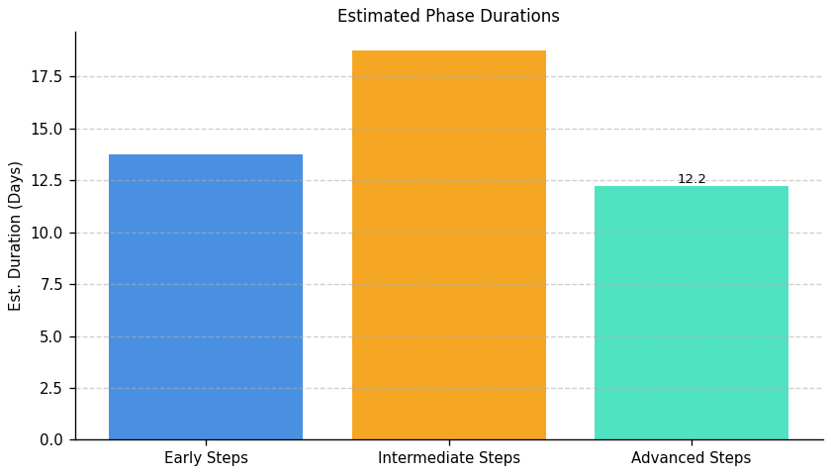
Green With Software: Roadmap Phase Durations

Slide 18
Fragment: Green With Software

Slide 19
Green With Software: Top 3 Insights
The organization demonstrates a strong commitment to proactively identifying and implementing energy efficiency improvements within IT operations through regular audits.
A significant gap exists in developing and retaining specialized internal expertise in carbon literacy; current skills development is ad-hoc and lacks a structured approach to recruitment, formal assessment, or mentorship for employees focused on sustainable IT practices.
While initial steps are being taken to influence employee behavior around IT’s environmental impact, these efforts are fragmented and lack dedicated ownership or a system for tracking progress and measuring effectiveness – hindering the organization’s ability to scale sustainable IT practices across the workforce.

Slide 20
Green With Software: Roadmap Overview
Summary: This roadmap addresses the need to formalize Green IT practices within the organization. It focuses on establishing a baseline environmental impact assessment, implementing resource optimization processes, and developing employee skills in sustainability. The plan aims to embed environmental responsibility into the organization's culture and attract talent with relevant expertise.
Total Est: 258 hrs (~32.2 days)
Key Roles: Environmental Specialist, IT Operations, Process Design Expert, Documentation Specialist, Training Coordinator, Tool Administrators, Sustainability Analysts, HR Specialists, Department Heads, Training Analysts, Program Designers, Program Coordinators, Assessment Designers, Subject Matter Experts, HR Representatives, Mentoring Coordinators, Sustainability Strategists, Communication Specialists, Infrastructure Managers

Slide 21
Green With Software: Implementation Plan Details
Overall Goal: Fragment D Implementation Plan: Green With Software
Description:
This roadmap outlines a phased approach to integrating Green IT principles into the organization. The initial 'Early Steps' phase establishes a foundational understanding of the current environmental impact and begins designing resource optimization processes. The 'Intermediate Steps' phase focuses on implementing these processes, evaluating supporting tools, and developing assessment methods. Finally, the 'Advanced Steps' phase concentrates on building employee skills through training and mentorship, and establishing a plan to attract and retain carbon-literate resources, embedding sustainability into the organization's long-term strategy.
Methodology / Steps:
--- Early Steps ---
1. Conduct an assessment of environmental impact in the current environment, collaborating with environmental specialists and utilizing assessment tools. 2. Design processes to optimize resource usage based on assessment results, collaborating with process design experts and aligning with environmental goals. 3. Define criteria for assessing sustainability-related skills proficiency, collaborating with subject matter experts and aligning with sustainability goals.
--- Intermediate Steps ---
4. Document the established processes and conduct training for relevant teams, utilizing documentation tools and organizing training sessions. 5. Evaluate existing and potential tools for managing sustainability, researching available tools and collaborating with IT teams. 6. Develop assessment tools for assessing proficiency aligned with defined criteria, designing assessments and pilot testing tools.
--- Advanced Steps ---
7. Implement selected tools and provide training to relevant teams, configuring tools and conducting training sessions. 8. Identify specific sustainability-focused skills that need development, conducting skill gap analysis and collaborating with department heads. 9. Define a structured incentive plan for carbon-literate resources, collaborating with HR and designing incentive programs.
Roles Involved (Overall): Environmental Specialist, IT Operations, Process Design Expert, Documentation Specialist, Training Coordinator, Tool Administrators, Sustainability Analysts, HR Specialists, Department Heads, Training Analysts, Program Designers, Program Coordinators, Assessment Designers, Subject Matter Experts, HR Representatives, Mentoring Coordinators, Sustainability Strategists, Communication Specialists, Infrastructure Managers
Tools/Platforms (Overall): Impact assessment tools, Documentation tools, Training platforms
Subtask Estimates (Aggregated):
--- Early Steps ---
Environmental Impact Assessment: Collaboration and Planning - 20h; Impact Assessment - 30h; Process Design for Resource Optimization: Process Design - 25h; Alignment with Goals - 18h; Define Proficiency Criteria: Criteria Definition - 25h; Collaboration with Experts - 15h
--- Intermediate Steps ---
Documentation and Training: Documentation - 22h; Training Sessions - 20h; Sustainability Tools Evaluation: Tool Research - 25h; Collaboration with IT Teams - 15h; Develop Assessment Tools: Tool Development - 30h; Pilot Testing - 20h
--- Advanced Steps ---
Tool Implementation and Training: Tool Implementation - 40h; Training Sessions - 20h; Identify Training Needs: Skill Gap Analysis - 20h; Collaboration with Department Heads - 15h; Define Incentive Structure: Incentive Structure Definition - 25h; Collaboration with HR - 15h

Slide 22
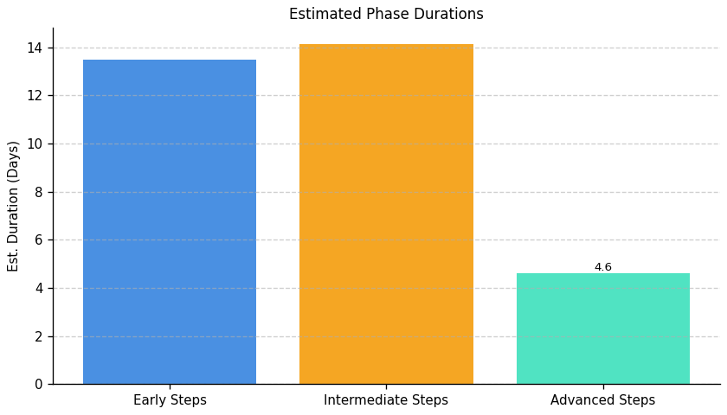
Green With Software: Roadmap Phase Durations

Slide 23
Fragment: Green With Software

Slide 24
Green With Software: Top 3 Insights
The organization has begun initial carbon reduction efforts within data centers, focusing on power management and renewable sourcing, but these represent early-stage actions without a comprehensive strategy.
A significant gap exists in quantifying the organization’s total IT carbon footprint; the inability to measure emissions in standardized units (like CO2e) prevents effective target setting, progress tracking, and informed decision-making regarding reduction initiatives.
Despite measuring carbon intensity (emissions per user), current IT operations show no improvement in this metric year-over-year, indicating that existing efforts are insufficient to drive meaningful reductions and require re-evaluation or expansion.

Slide 25
Green With Software: Roadmap Overview
Summary: This roadmap outlines a phased approach to improving IT carbon efficiency for Green With Software. It begins with establishing a baseline carbon footprint, progresses through renewable energy adoption and power optimization, and culminates in a strategic, data-driven carbon reduction plan. The goal is to achieve measurable reductions in carbon intensity and establish a continuous improvement cycle.
Total Est: 54 hrs (~6.8 days)
Key Roles: IT Operations, Sustainability Team, Data Analytics

Slide 26
Green With Software: Implementation Plan Details
Overall Goal: Green With Software IT Carbon Reduction Implementation Plan
Description:
This roadmap guides Green With Software through a comprehensive journey to reduce its IT carbon footprint. The initial Early Steps focus on establishing a clear understanding of current emissions and defining key metrics. Intermediate Steps build upon this foundation by expanding renewable energy usage and optimizing power consumption. Finally, the Advanced Steps establish a long-term strategy for continuous improvement, leveraging data-driven insights and emerging technologies to minimize environmental impact.
Methodology / Steps:
--- Early Steps ---
1. Define a standardized method for calculating carbon footprint related to IT operations, including scope. 2. Implement a system to track carbon emissions per user as a primary carbon intensity metric. 3. Begin collecting data for the past year to establish a baseline carbon footprint in metric tons of CO2 equivalent. 4. Document the data collection process and reporting frequency.
--- Intermediate Steps ---
5. Evaluate opportunities to increase the proportion of renewable energy used for data centers. 6. Refine power management settings on all devices to maximize energy savings. 7. Investigate and implement server virtualization to consolidate workloads and reduce energy consumption. 8. Monitor the impact of these actions on carbon intensity metrics.
--- Advanced Steps ---
9. Conduct a detailed assessment of server operations to identify areas for carbon reduction. 10. Implement cooling optimization techniques to improve server energy efficiency. 11. Establish key performance indicators (KPIs) for carbon intensity and track progress against targets. 12. Regularly review and update the carbon reduction strategy based on performance data and emerging technologies.
Roles Involved (Overall): IT Operations, Sustainability Team, Data Analytics
Tools/Platforms (Overall): Carbon accounting software, Power management tools, Virtualization platforms, Data analytics platforms, Server monitoring tools
Subtask Estimates (Aggregated):
--- Early Steps ---
Metric Definition - 8h; Tracking System Implementation - 12h; Data Collection - 4h; Documentation - 2h
--- Intermediate Steps ---
Renewable Energy Evaluation - 4h; Power Management Refinement - 6h; Virtualization Implementation - 4h; Monitoring Setup - 2h
--- Advanced Steps ---
Server Assessment - 4h; Cooling Optimization - 4h; KPI Definition - 2h; Strategy Review - 2h

Slide 27
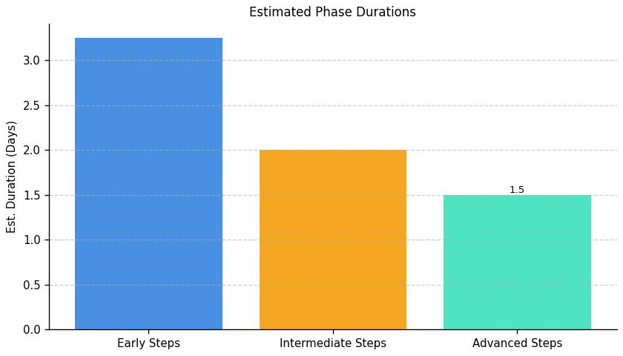
Green With Software: Roadmap Phase Durations

Slide 28
Fragment: Green With Software

Slide 29
Green With Software: Top 3 Insights
The organization demonstrates awareness of IT sustainability principles, particularly regarding environmental impact and recyclability, but consistently fails to translate this awareness into comprehensive, documented policies and procedures.
A significant gap exists between stated priorities for responsible IT asset management and actual practices, specifically concerning e-waste disposal; the absence of a formal policy creates risk for unsustainable end-of-life handling and potential non-compliance.
Current equipment lifecycle management is at an introductory level, requiring substantial development to move beyond basic considerations and implement a truly circular IT asset approach focused on extending lifespan and maximizing resource recovery.

Slide 30
Green With Software: Roadmap Overview
Summary: This roadmap addresses the need for a comprehensive IT environmental sustainability program, starting with foundational e-waste management and progressing to lifecycle optimization and circular IT practices. The organization will establish formal policies, integrate environmental criteria into procurement, and track equipment throughout its lifespan to minimize environmental impact and maximize resource utilization.
Total Est: 50 hrs (~6.2 days)
Key Roles: Procurement, IT Operations, Sustainability Officer

Slide 31
Green With Software: Implementation Plan Details
Overall Goal: Fragment F Implementation Plan: Green With Software
Description:
This roadmap outlines a phased approach to enhance IT environmental sustainability. The initial Early Steps focus on establishing a formal e-waste policy and identifying certified recycling vendors. Intermediate Steps build upon this foundation by integrating environmental considerations into procurement processes and implementing basic asset tracking. Finally, Advanced Steps aim to optimize lifecycle management for circularity, extending equipment lifespan, maximizing reuse, and continuously improving e-waste reduction through KPIs and regular audits.
Methodology / Steps:
--- Early Steps ---
1. Research best practices for e-waste disposal and recycling. 2. Draft a preliminary e-waste policy outlining disposal procedures. 3. Identify and vet certified e-waste recycling vendors. 4. Communicate the draft policy to key stakeholders for feedback and incorporate revisions.
--- Intermediate Steps ---
5. Integrate environmental criteria, such as recyclability and energy efficiency, into IT procurement guidelines. 6. Implement an asset tracking system to monitor equipment lifecycle stages, including acquisition, deployment, maintenance, and disposal. 7. Develop a process for evaluating the environmental impact of potential IT purchases, considering factors like carbon footprint and resource consumption. 8. Train procurement staff on the new environmental criteria and asset tracking procedures.
--- Advanced Steps ---
9. Explore options for extending equipment lifespan through refurbishment, upgrades, and repair programs. 10. Investigate opportunities for equipment reuse within the organization, potentially through internal redeployment or donation programs. 11. Establish key performance indicators (KPIs) to track e-waste reduction progress, such as the percentage of e-waste recycled and the average equipment lifespan. 12. Conduct regular audits of e-waste disposal practices to ensure compliance with the established policy and identify areas for improvement.
Roles Involved (Overall): Procurement, IT Operations, Sustainability Officer
Tools/Platforms (Overall): Document Management System, Vendor Databases, Asset Management Software, Procurement Systems, Reporting Tools
Subtask Estimates (Aggregated):
--- Early Steps ---
Research (8h); Drafting (12h); Vendor Identification (4h); Communication (4h).
--- Intermediate Steps ---
Procurement Integration (6h); Asset Tracking Implementation (4h); Impact Evaluation Process (2h); Training (2h).
--- Advanced Steps ---
Lifespan Extension Research (2h); Reuse Opportunities (2h); KPI Establishment (2h); Auditing (2h).

Slide 32
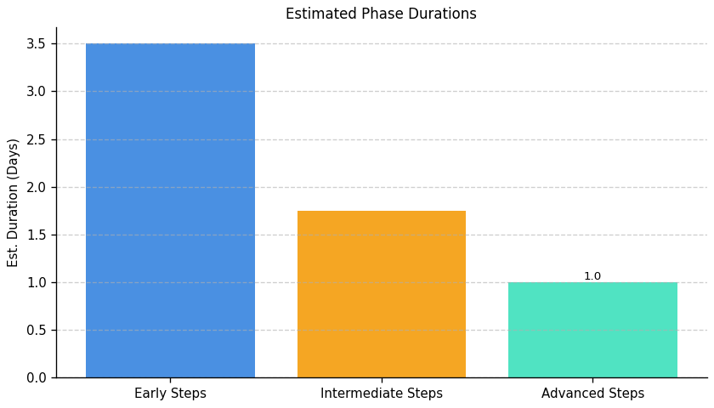
Green With Software: Roadmap Phase Durations

