Slide 2
Recommendation Report
Session ID: 9abfec21-cd10-4fb6-a65b-1137fe6cc7ef
Generated: 2025-04-25

Slide 3
Fragment: A

Slide 4
Fragment A: Top 3 Insights
The organization’s IT structure is heavily weighted towards short-term project delivery, hindering the development of reusable, scalable solutions and creating a need to shift towards a product-centric operating model with standardized collaborative tools.
Modernization efforts in IT architecture have begun with N-Tier implementation and Agile adoption, but are incomplete; a strategic roadmap is required to evolve beyond this basic setup and embrace principles like microservices and API integration to improve system flexibility and reduce technical debt.
Cloud adoption is currently reactive and lacks governance, preventing the realization of significant benefits in scalability and cost efficiency; a defined hybrid cloud strategy, coupled with infrastructure-as-code practices, is essential to unlock the full potential of cloud technologies.

Slide 5
Fragment A: Roadmap Overview
Summary: This organization is transitioning from a project-centric IT model to a product-focused approach, modernizing its architecture, and leveraging cloud technologies. The roadmap focuses on establishing collaborative practices, integrating agile methodologies, and utilizing data-driven insights to improve operational efficiency and foster innovation.
Total Est: 94 hrs (~11.8 days)
Key Roles: Developers, IT Architects, Data Analysts, Project Managers, Security Professionals, Innovation Leaders, Operations Engineers

Slide 6
Fragment A: Implementation Plan Details
Overall Goal: Green With Software Implementation Plan
Description:
This roadmap guides the organization through a phased transition towards a product-centric IT model. The Early Steps focus on foundational alignment and experimentation with cloud technologies. Intermediate Steps involve integrating agile practices and modernizing the IT architecture. Finally, the Advanced Steps emphasize performance optimization, persona-based operations, and realizing business benefits through data-driven insights and improved sustainability.
Methodology / Steps:
--- Early Steps ---
1. Introduce collaborative project management tools like Jira, Trello, or OpenProject. 2. Implement basic sustainability checkpoints in project development. 3. Provide training on integrated operating models. 4. Experiment with cloud usage for one-off projects and develop a cloud policy to guide experimentation. 5. Begin collaborative efforts for basic data management and explore integrable data sources for improved analytics. 6. Start documenting data processes and insights. 7. Introduce basic agile principles and encourage team collaboration. 8. Implement visual project management techniques.
--- Intermediate Steps ---
9. Implement a mix of enterprise databases and NoSQL solutions for increased flexibility. 10. Transition towards Agile and continuous integration practices. 11. Introduce virtualization technologies for enhanced resource utilization.
--- Advanced Steps ---
12. Shift focus from ticket-based to persona-based operations and encourage solution adoption with persona-based training. 13. Strengthen critical event support processes. 14. Target projects to deliver tangible business benefits and measure success based on positive movement in business-related KPIs. 15. Evaluate the percentage of improvement in productivity from moving to product-centric IT.
Roles Involved (Overall): Developers, IT Architects, Data Analysts, Project Managers, Security Professionals, Innovation Leaders, Operations Engineers
Tools/Platforms (Overall): Jira, Trello, Git, VersionOne, Bitbucket, AWS CLI, Google Sheets, Kanban, OpenProject, MongoDB, Jenkins, Docker, Kubernetes, Red Hat OpenShift, Amazon ECS, Prometheus, Cherwell, Smartsheet, Odoo
Subtask Estimates (Aggregated):
--- Early Steps ---
Project Management Tooling: 8h; Sustainability Checkpoints: 4h; Integrated Operating Model Training: 4h; Cloud Experimentation: 6h; Cloud Policy: 2h; Data Collaboration: 4h; Data Integration Exploration: 4h; Data Documentation: 2h; Agile Introduction: 4h; Team Collaboration: 2h; Visual Project Management: 2h
--- Intermediate Steps ---
DB/NoSQL Integration: 6h; Agile/CI Transition: 6h; Virtualization Implementation: 4h
--- Advanced Steps ---
Persona-Based Operations: 6h; Solution Adoption Training: 4h; Critical Event Support: 4h; Benefits Realization Management: 4h; KPI Measurement: 8h; Productivity Evaluation: 8h

Slide 7
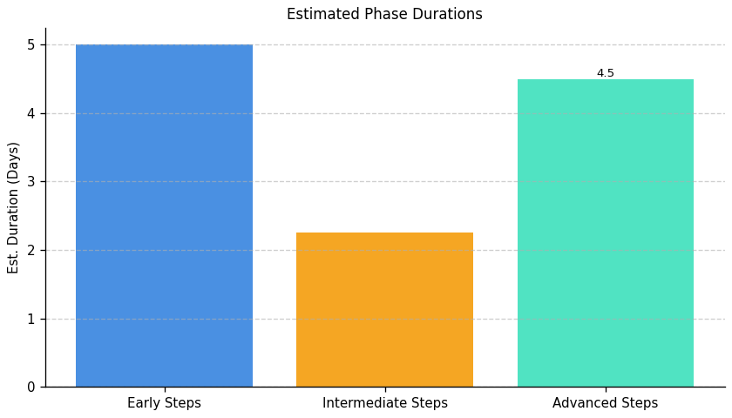
Green With Software: Roadmap Phase Durations

Slide 8
Fragment B

Slide 9
Fragment B: Top 3 Insights
The organization’s server infrastructure lacks core management capabilities, specifically in areas of scalability, resource monitoring, and redundancy, creating a high-risk environment for outages and performance issues. Addressing these foundational gaps is critical before investing in more advanced features.
A critical and pervasive security deficiency exists due to the absence of essential controls like intrusion detection, robust access management, centralized logging, and compliance auditing. This widespread lack of security measures significantly increases vulnerability to breaches and potential non-compliance penalties.
While the organization demonstrates some awareness of the need for monitoring through the implementation of server behavior alerts, this proactive step is largely ineffective without the supporting infrastructure – comprehensive resource monitoring and detailed logging – to provide meaningful context and enable effective response.

Slide 10
Fragment B: Roadmap Overview
Summary: This implementation plan addresses critical infrastructure gaps in scalability, monitoring, security, and redundancy. It outlines a phased approach to enhance server infrastructure, implement robust monitoring and intrusion detection systems, and establish proactive measures for long-term stability and compliance.
Total Est: 495 hrs (~61.9 days)
Key Roles: IT Architects, Infrastructure Managers, Scalability Planning Team, IT Leadership, IT Administrators, Infrastructure Team, IT Specialists, Monitoring Team, Monitoring Administrators, Security Analysts, Testing Teams, Business Analysts, Network Administrators, Optimization Experts, Compliance Specialists, Logging System Analysts, Redundancy Planning Team

Slide 11
Fragment B: Implementation Plan Details
Overall Goal: Fragment B Implementation Plan
Description:
This roadmap initiates with a foundational assessment to identify scalability limitations, resource monitoring deficiencies, security vulnerabilities, and capacity demands. The intermediate phase focuses on implementing solutions to address these gaps, including enhancing scalability, configuring monitoring tools, selecting and integrating intrusion detection systems, and developing redundancy plans. Finally, the advanced phase centers on optimizing implemented solutions, integrating them into the production environment, and establishing ongoing processes for monitoring, compliance, and security to ensure long-term resilience.
Methodology / Steps:
--- Early Steps ---
1. Assess the current server infrastructure for scalability gaps, collaborating with IT architects and conducting workload analysis. 2. Evaluate and select a resource monitoring tool for server infrastructure, researching options and aligning with requirements. 3. Conduct a security threat assessment to identify potential risks and vulnerabilities, collaborating with security experts. 4. Analyze current and projected resource demands for server infrastructure, collecting usage data and collaborating with business and IT teams. 5. Conduct a network assessment to identify areas for optimization, using network monitoring tools and analyzing traffic patterns.
--- Intermediate Steps ---
6. Develop a plan for enhancing server infrastructure scalability, identifying solutions and creating a roadmap. 7. Configure and integrate the selected monitoring tool with the server infrastructure, following documentation and testing configurations. 8. Evaluate and select an IDS solution suitable for the infrastructure, researching tools and aligning with the threat assessment. 9. Develop a redundancy plan to enhance server infrastructure availability, identifying solutions and creating a mitigation plan. 10. Develop a plan outlining optimizations based on network assessment findings, collaborating with network experts and prioritizing improvements.
--- Advanced Steps ---
11. Implement the planned upgrades to enhance scalability, upgrading hardware and implementing scaling solutions. 12. Implement resource monitoring in the production environment and provide training. 13. Implement the selected IDS solution and integrate it into the server infrastructure, configuring parameters and performing integration testing. 14. Implement the planned redundancy measures in the server infrastructure, upgrading hardware and configuring redundant systems. 15. Implement identified network optimizations and monitor the impact, making configuration changes and analyzing performance.
Roles Involved (Overall): IT Architects, Infrastructure Managers, Scalability Planning Team, IT Leadership, IT Administrators, Infrastructure Team, IT Specialists, Monitoring Team, Monitoring Administrators, Security Analysts, Testing Teams, Business Analysts, Network Administrators, Optimization Experts, Compliance Specialists, Logging System Analysts, Redundancy Planning Team
Tools/Platforms (Overall): docker, kubernetes, Amazon ECS, Google Kubernetes Engine (GKE), Grafana, Prometheus, Snort, iperf, Datadog, New Relic, Cisco Firepower, Suricata, Veeam Backup & Replication, HAProxy, Nginx, Citrix ADC, F5 BIG-IP, Collectd, ELK Stack (Elasticsearch, Logstash, Kibana), Splunk, OpenSCAP, Tenable Nessus
Subtask Estimates (Aggregated):
--- Early Steps ---
Scalability Analysis: 25h; Collaboration with IT Architects: 20h; Monitoring Tool Research: 20h; Alignment with Requirements: 15h; Threat Assessment: 20h; Risk Analysis: 15h; Demand Analysis: 25h; Collaboration with Business and IT Teams: 20h; Assessment: 20h; Traffic Pattern Analysis: 15h
--- Intermediate Steps ---
Solution Identification: 60h; Roadmap Creation: 25h; Configuration Setup: 30h; Testing: 25h; Alignment with Threat Assessment: 20h; Solution Identification: 30h; Mitigation Plan Creation: 25h; Plan Development: 25h; Collaboration with Experts: 20h
--- Advanced Steps ---
Hardware Upgrade: 80h; Scaling Solution Implementation: 70h; Rollout: 35h; Training: 30h; Configuration: 30h; Integration Testing: 25h; Redundancy Configuration: 35h; Implementation: 30h; Performance Monitoring: 25h

Slide 12
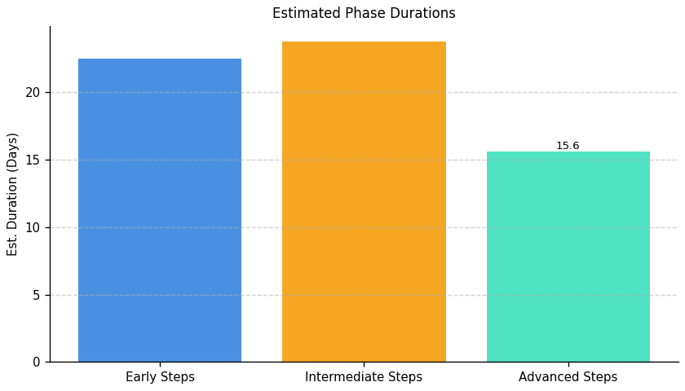
Green With Software: Roadmap Phase Durations

Slide 13
Fragment: C

Slide 14
Fragment C: Top 3 Insights
Disaster recovery planning exists, but its benefits are limited by inconsistent application across all data types and systems. While a foundational plan and testing are present, critical data remains vulnerable due to uneven protection coverage.
Data lifecycle management is significantly underdeveloped, evidenced by defined but unenforced policies and the absence of a comprehensive backup and archive strategy. This creates substantial risk related to data loss, recovery time, and compliance.
Proactive infrastructure management is lacking, specifically regarding the decommissioning of outdated systems. The absence of a formal decommissioning process leads to unnecessary resource consumption, potential security vulnerabilities, and accumulating technical debt.

Slide 15
Fragment C: Roadmap Overview
Summary: This implementation plan addresses critical gaps in data protection and infrastructure management. It focuses on establishing a robust data protection strategy, implementing effective backup and recovery procedures, and developing a clear process for infrastructure decommissioning to mitigate risks and ensure business continuity.
Total Est: 360 hrs (~45.0 days)
Key Roles: Data Owners, IT Operations, IT Security Specialist, Backup Strategist, Documentation Specialist, Testing Coordinator, Infrastructure Specialist, Audit Team, Strategy Development Team, Review Team, System Administrators, Data Stakeholders, IT Specialists, Backup Administrators, IT Administrators

Slide 16
Fragment C: Implementation Plan Details
Overall Goal: Fragment C Implementation Plan
Description:
This roadmap outlines a phased approach to enhance data protection and infrastructure lifecycle management. The initial phase focuses on assessing data criticality and establishing a foundational data protection strategy. The intermediate phase translates this assessment into concrete strategies for backup, recovery, and decommissioning, with a focus on implementation and testing. Finally, the advanced phase emphasizes rigorous testing, comprehensive documentation, and continuous improvement to ensure long-term effectiveness and adaptability.
Methodology / Steps:
--- Early Steps ---
1. Assess the criticality of different data sets to define backup and archive priorities. 2. Collaborate with data owners using criticality metrics and stakeholders to assess data criticality. 3. Develop a backup policy outlining the frequency, types, and locations of backups. 4. Evaluate and select a backup solution aligned with policy requirements and research backup tools.
--- Intermediate Steps ---
5. Design a comprehensive strategy for backups and archives based on criticality, collaborating with IT security and operations teams and aligning with business needs. 6. Implement the selected backup solution and configure backup schedules. 7. Perform data recovery tests and develop a strategy outlining the criteria, process, and timeline for decommissioning identified components. 8. Gather input from relevant teams and document clear decommissioning guidelines.
--- Advanced Steps ---
9. Document the strategy and conduct testing to ensure effectiveness, using documentation tools and organizing testing scenarios. 10. Develop a test plan outlining scenarios for backup and recovery testing and collaborate with IT teams to identify critical scenarios. 11. Conduct regular backup and recovery testing, execute test scenarios, and analyze results. 12. Establish a routine for reviewing and updating the decommissioning strategy and conduct periodic reviews, considering technological advancements.
Roles Involved (Overall): Data Owners, IT Operations, IT Security Specialist, Backup Strategist, Documentation Specialist, Testing Coordinator, Infrastructure Specialist, Audit Team, Strategy Development Team, Review Team, System Administrators, Data Stakeholders, IT Specialists, Backup Administrators, IT Administrators
Tools/Platforms (Overall): Bacula, Duplicity, Commvault, Veeam Backup & Replication, Amanda
Subtask Estimates (Aggregated):
--- Early Steps ---
Collaboration and Planning - 15h; Criticality Assessment - 25h; Policy Development - 20h; Stakeholder Collaboration - 15h; Research - 25h; Policy Alignment - 20h
--- Intermediate Steps ---
Strategy Design - 30h; Business Needs Alignment - 20h; Configuration - 30h; Data Recovery Testing - 25h; Team Collaboration - 18h; Document Development - 25h
--- Advanced Steps ---
Documentation - 18h; Testing Scenarios - 22h; Test Plan Development - 20h; IT Team Collaboration - 15h; Testing Execution - 30h; Results Analysis - 25h; Periodic Reviews - 22h; Strategy Updates - 20h

Slide 17
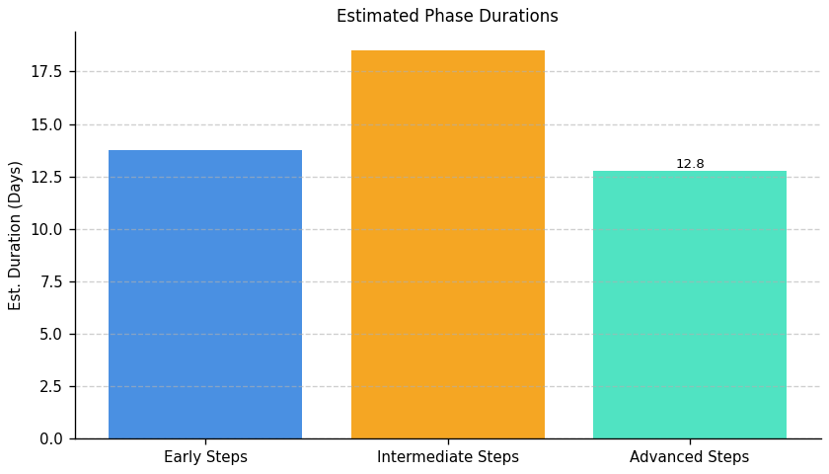
Green With Software: Roadmap Phase Durations

Slide 18
Fragment: D

Slide 19
Fragment D: Top 3 Insights
The organization demonstrates a strong commitment to proactively identifying and implementing energy efficiency improvements within IT operations through regular audits. This provides a solid foundation for reducing environmental impact, but needs to be expanded beyond energy to encompass broader Green IT principles.
A significant gap exists in developing and retaining a workforce with the specialized skills needed to drive a comprehensive Green IT strategy; current sustainability training is limited to awareness-level initiatives and lacks formal assessment, targeted recruitment, or mentorship opportunities for carbon literacy.
While positive behavioral changes are being encouraged regarding IT’s environmental impact, these efforts are currently decentralized and lack dedicated leadership or a system for tracking progress and demonstrating accountability, hindering the organization’s ability to scale sustainable practices effectively.

Slide 20
Fragment D: Roadmap Overview
Summary: This roadmap addresses the need to integrate Green IT principles into the organization's operations. It focuses on assessing environmental impact, implementing resource optimization processes, and developing internal skills to foster a sustainable IT environment. Successful implementation will require executive buy-in and cross-functional collaboration.
Total Est: 383 hrs (~47.9 days)
Key Roles: Environmental Specialist, IT Operations, Process Design Expert, Documentation Specialist, Training Coordinator, IT Specialists, Sustainability Analysts, Tool Administrators, Training Facilitators, Program Designers, HR Specialists, Assessment Administrators, Sustainability Strategists, Communication Specialists, Mentoring Coordinators, Department Heads, Subject Matter Experts

Slide 21
Fragment D: Implementation Plan Details
Overall Goal: Green With Software Implementation Plan
Description:
This roadmap guides the organization through a phased approach to Green IT implementation. The initial Early Steps focus on establishing a baseline understanding of environmental impact and designing resource optimization processes. Intermediate Steps involve implementing these processes, evaluating sustainability tools, and developing assessment methods. Finally, Advanced Steps concentrate on building internal capabilities through training, mentorship, and establishing incentives for carbon-literate resources to embed sustainability into the organization's culture.
Methodology / Steps:
--- Early Steps ---
1. Conduct an assessment of environmental impact in the current environment, collaborating with environmental specialists and utilizing assessment tools. 2. Design processes to optimize resource usage based on assessment results, collaborating with process design experts and aligning with environmental goals. 3. Define criteria for assessing sustainability-related skills proficiency, collaborating with subject matter experts and aligning with sustainability goals.
--- Intermediate Steps ---
4. Document the established processes and conduct training for relevant teams, utilizing documentation tools and organizing training sessions. 5. Evaluate existing and potential tools for managing sustainability, researching available tools and collaborating with IT teams. 6. Develop assessment tools for assessing proficiency aligned with defined criteria, designing assessments and pilot testing tools.
--- Advanced Steps ---
7. Implement selected tools and provide training to relevant teams, configuring tools and conducting training sessions. 8. Identify specific sustainability-focused skills that need development, conducting skill gap analysis and collaborating with department heads. 9. Define a structured incentive plan for carbon-literate resources, collaborating with HR and designing incentive programs.
Roles Involved (Overall): Environmental Specialist, IT Operations, Process Design Expert, Documentation Specialist, Training Coordinator, IT Specialists, Sustainability Analysts, Tool Administrators, Training Facilitators, Program Designers, HR Specialists, Assessment Administrators, Sustainability Strategists, Communication Specialists, Mentoring Coordinators, Department Heads, Subject Matter Experts
Tools/Platforms (Overall): Assessment tools, Documentation tools
Subtask Estimates (Aggregated):
--- Early Steps ---
Collaboration and Planning - 20h; Impact Assessment - 30h; Process Design - 25h; Alignment with Goals - 18h; Criteria Definition - 25h; Collaboration with Experts - 15h.
--- Intermediate Steps ---
Documentation - 22h; Training Sessions - 20h; Tool Research - 25h; Collaboration with IT Teams - 15h; Tool Development - 30h; Pilot Testing - 20h.
--- Advanced Steps ---
Tool Implementation - 40h; Training Sessions - 20h; Skill Gap Analysis - 20h; Collaboration with Department Heads - 15h; Incentive Structure Definition - 25h; Collaboration with HR - 10h.

Slide 22
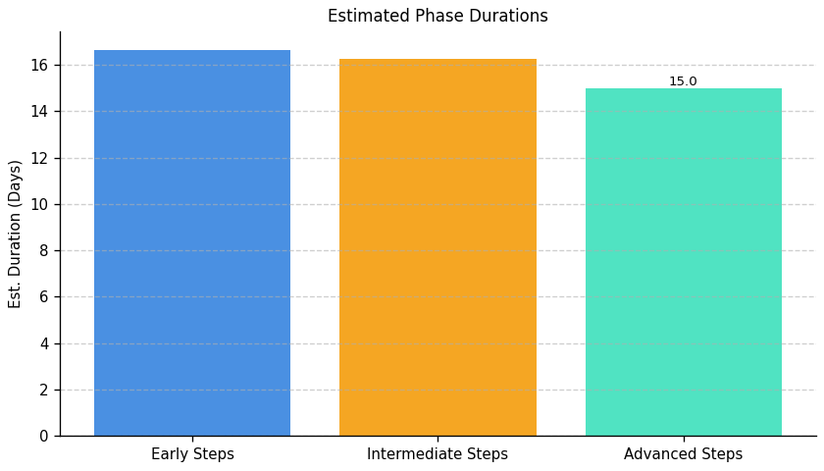
Green With Software: Roadmap Phase Durations

Slide 23
Fragment: E

Slide 24
Fragment E: Top 3 Insights
The organization has begun initial carbon reduction efforts within data centers, focusing on power management and renewable sourcing, but these represent early-stage actions without a comprehensive strategy.
A significant barrier to meaningful progress is the inability to accurately measure the organization’s total IT carbon footprint in standardized units (like metric tons of CO2e), preventing effective target setting and performance tracking.
Despite measuring carbon intensity (emissions per user) for server operations, current initiatives are not demonstrably reducing emissions; performance has stagnated, indicating a need to re-evaluate and enhance existing reduction strategies.

Slide 25
Fragment E: Roadmap Overview
Summary: This roadmap outlines a phased approach to improving IT carbon efficiency. It begins with establishing a baseline measurement of the organization's IT carbon footprint, progresses to refining strategies and expanding renewable energy use, and culminates in continuous optimization and governance to ensure long-term sustainability.
Total Est: 40 hrs (~5.0 days)
Key Roles: IT Operations, Sustainability Team

Slide 26
Fragment E: Implementation Plan Details
Overall Goal: Green With Software Implementation Plan
Description:
This roadmap guides the organization through a three-phase process to reduce its IT carbon footprint. The initial phase focuses on establishing a clear understanding of current emissions and defining key metrics. The intermediate phase builds on this foundation by refining existing strategies, expanding renewable energy usage, and implementing key performance indicators. Finally, the advanced phase emphasizes continuous monitoring, analysis, and optimization, alongside the establishment of a robust governance framework to ensure sustained progress.
Methodology / Steps:
--- Early Steps ---
1. Define a comprehensive methodology for calculating the organization's IT carbon footprint, including scope 3 emissions. 2. Implement a system to track carbon emissions per user as a primary carbon intensity metric. 3. Collect data for the past year to establish a baseline carbon footprint in metric tons of CO2 equivalent. 4. Document the data collection process and ensure data accuracy.
--- Intermediate Steps ---
5. Review and refine the existing strategy to minimize the carbon footprint associated with server operations. 6. Expand the use of renewable energy sources beyond data centers to other IT infrastructure. 7. Implement additional power management settings on a wider range of devices. 8. Establish key performance indicators to monitor the effectiveness of carbon reduction initiatives.
--- Advanced Steps ---
9. Implement continuous monitoring of carbon intensity metrics to identify areas for improvement. 10. Analyze trends in carbon emissions and intensity to understand the impact of implemented initiatives. 11. Explore carbon offsetting options to neutralize remaining emissions. 12. Establish a regular reporting cadence to communicate progress to stakeholders.
Roles Involved (Overall): IT Operations, Sustainability Team
Tools/Platforms (Overall): Carbon accounting software, Data analytics tools, Power management software, Renewable energy procurement platforms, Data visualization tools, Reporting platforms
Subtask Estimates (Aggregated):
--- Early Steps ---
Methodology Definition - 8h; Metric Implementation - 6h; Data Collection - 4h; Documentation - 2h
--- Intermediate Steps ---
Strategy Review - 4h; Renewable Energy Expansion - 4h; Power Management Implementation - 2h; KPI Establishment - 2h
--- Advanced Steps ---
Continuous Monitoring Setup - 4h; Trend Analysis - 2h; Offset Exploration - 2h; Reporting Cadence - 2h

Slide 27
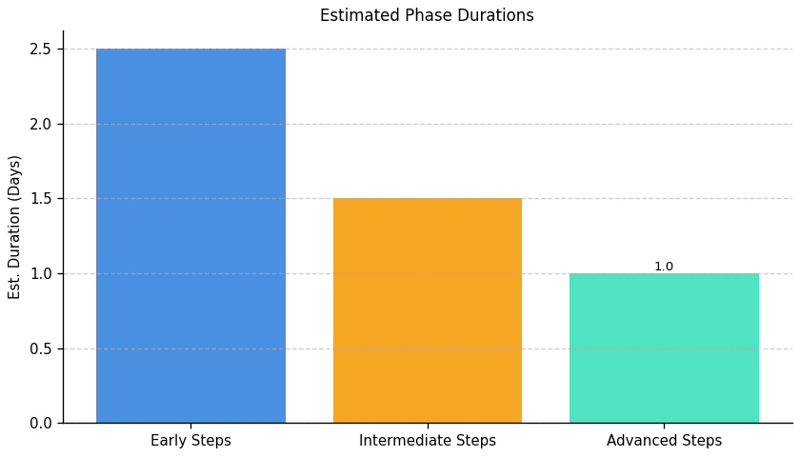
Green With Software: Roadmap Phase Durations

Slide 28
Fragment: F

Slide 29
Fragment F: Top 3 Insights
The organization demonstrates awareness of IT sustainability principles, particularly regarding environmental impact during procurement and the desirability of recyclable equipment.
A significant gap exists between stated intentions regarding IT sustainability and the implementation of comprehensive, lifecycle-focused policies – specifically, a formal e-waste disposal process is missing.
While initial steps toward improved equipment lifecycle management have been taken, consistent application of best practices across all stages (procurement to disposal) remains a key area for development and represents the most substantial opportunity for improvement.

Slide 30
Fragment F: Roadmap Overview
Summary: This roadmap addresses the need for a more formalized and proactive approach to IT equipment lifecycle management and e-waste disposal. It outlines steps to establish a foundational e-waste policy, integrate environmental considerations into procurement, and optimize practices for circularity and continuous improvement. Successful implementation will reduce environmental impact and ensure responsible IT resource management.
Total Est: 50 hrs (~6.2 days)
Key Roles: Procurement, IT Operations, Sustainability Officer

Slide 31
Fragment F: Implementation Plan Details
Overall Goal: Fragment F Implementation Plan: Green With Software
Description:
This roadmap guides the organization through a phased approach to improve its environmental sustainability in IT. The initial Early Steps focus on establishing a formal e-waste policy and identifying appropriate recycling vendors. Intermediate Steps build upon this foundation by integrating environmental criteria into procurement processes and implementing basic asset tracking. Finally, Advanced Steps aim to optimize lifecycle management for circularity, extending equipment lifespan, maximizing reuse, and continuously monitoring and improving e-waste reduction efforts.
Methodology / Steps:
--- Early Steps ---
1. Research best practices for e-waste disposal and recycling. 2. Draft a preliminary e-waste policy outlining disposal procedures. 3. Identify and vet certified e-waste recycling vendors. 4. Communicate the draft policy to key stakeholders for feedback and incorporate revisions.
--- Intermediate Steps ---
5. Integrate environmental criteria, including recyclability and energy efficiency, into IT procurement guidelines. 6. Implement an asset tracking system to monitor equipment lifecycle stages. 7. Develop a process for evaluating the environmental impact of potential IT purchases. 8. Train procurement staff on the new environmental criteria and asset tracking procedures.
--- Advanced Steps ---
9. Explore options for extending equipment lifespan through refurbishment, upgrades, and repair. 10. Investigate opportunities for equipment reuse within the organization or through donation programs. 11. Establish key performance indicators (KPIs) to track e-waste reduction progress and overall sustainability performance. 12. Conduct regular audits of e-waste disposal practices to ensure compliance and identify areas for improvement.
Roles Involved (Overall): Procurement, IT Operations, Sustainability Officer
Tools/Platforms (Overall): Document Management System, Vendor Databases, Asset Management Software, Procurement Systems, Reporting Tools
Subtask Estimates (Aggregated):
--- Early Steps ---
Research - 8h; Drafting - 12h; Vendor Identification - 4h; Communication - 4h
--- Intermediate Steps ---
Procurement Integration - 6h; Asset Tracking Implementation - 4h; Impact Evaluation Process - 2h; Training - 2h
--- Advanced Steps ---
Lifespan Extension Research - 2h; Reuse Investigation - 2h; KPI Development - 2h; Auditing - 2h

Slide 32
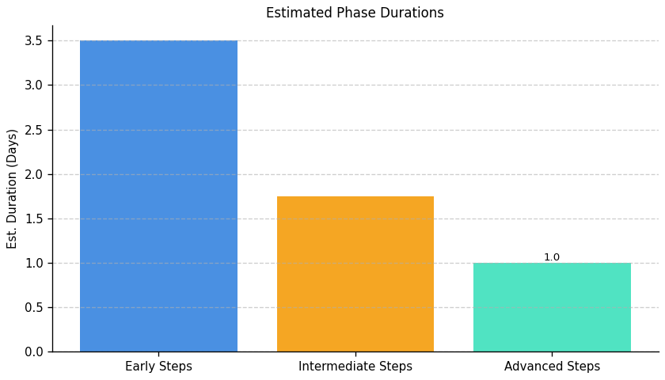
Green With Software: Roadmap Phase Durations

