Slide 1
Recommendation Report
Session ID: df033ae9-84d4-48ba-a577-374955cbe690
Generated: 2025-04-29

Slide 2
Sustainable Digital Transformation: Top 3 Insights
The organization possesses strong technical foundations for digital transformation – leveraging modern IT practices like containerization and APIs – but currently applies these technologies primarily to existing business goals rather than proactively designing for and measuring positive sustainability impacts. This represents a missed opportunity to embed sustainability *into* the core of digital initiatives.
Innovation efforts are currently fragmented and lack consistent executive support, limiting their scalability and ability to drive organization-wide adoption of sustainable practices. Establishing clear, repeatable innovation processes and securing leadership commitment are crucial for fostering a culture of continuous improvement focused on both business value and environmental/social responsibility.
Sustainability initiatives are presently focused on achieving defined business Key Performance Indicators, which risks neglecting broader, less directly quantifiable environmental and social consequences. Integrating specific sustainability metrics alongside traditional business objectives is essential to ensure a holistic and genuinely sustainable digital transformation strategy.

Slide 3
Sustainable Digital Transformation: Roadmap Overview
Overview:
This roadmap outlines a phased approach to achieving sustainable digital transformation. The initial phase focuses on building a modern, agile IT foundation through containerization, API development, and integration with core business functions. The intermediate phase advances the hybrid cloud strategy, leveraging data for operational efficiency and business outcomes through self-service capabilities and AI/ML implementation. Finally, the advanced phase fosters a culture of innovation, refines the 'Operate to Transform' model, and drives process improvements aligned with key business performance indicators.
Total Est: 130 hrs (~16.2 days)
Key Roles: IT Architects, Developers, Business Analysts, Security Professionals, Data Scientists, Innovation Managers, Project Managers, Innovation Managers

Slide 4
Sustainable Digital Transformation: Implementation Plan Details
--- Early Steps ---
1. Embrace containerization for a microservices architecture. 2. Develop matured data lakes for real-time analytics. 3. Implement RESTful APIs with API gateways for seamless communication. 4. Integrate IT as an integral part of business strategy. 5. Introduce and formalize agile frameworks. 6. Implement iterative development processes. 7. Enhance collaboration within development teams.
--- Intermediate Steps ---
1. Create self-service capabilities for infrastructure deployment. 2. Adopt Micro Services, Containers, and Serverless computing. 3. Develop dynamic cloud applications that are auto-scalable and fault-tolerant. 4. Implement AI and ML-enabled algorithms for advanced tasks. 5. Leverage human-like intelligence to enhance decision-making. 6. Center programs on driving specific business outcomes. 7. Measure success based on the achievement of business objectives.
--- Advanced Steps ---
1. Seek executive sponsorship for innovation initiatives. 2. Allocate innovation to business units with defined strategies. 3. Establish initial processes for innovation, avoiding silos. 4. Adopt a KPI-based perspective for operations. 5. Drive process improvement for business outcomes. 6. Evaluate the percentage of projects successfully transitioning to product-centric IT.
Tools/Platforms (Overall):
Kubernetes, Azure DevOps, Docker, Jira, Git-scm, Odoo, AWS Lambda, TensorFlow, IBM Watson, ServiceNow, Grafana, Spigit, GitHub, Salesforce, Security Onion, Cisco Firepower, Palo Alto Networks Prisma Cloud
Subtask Estimates (Aggregated):
--- Early Steps ---
Containerization: 10h; Data Lakes: 15h; APIs: 10h; Business Integration: 5h; Agile Frameworks: 5h; Iterative Development: 5h; Collaboration: 5h
--- Intermediate Steps ---
Self-Service: 5h; Microservices/Containers/Serverless: 10h; Cloud Applications: 5h; AI/ML Implementation: 10h; Human-like Intelligence: 5h; Outcome-Centric Programs: 5h; Business Objective Measurement: 5h
--- Advanced Steps ---
Executive Sponsorship: 5h; Innovation Allocation: 5h; Innovation Processes: 5h; KPI-Based Operations: 5h; Process Improvement: 5h; Project Transition Evaluation: 5h

Slide 5
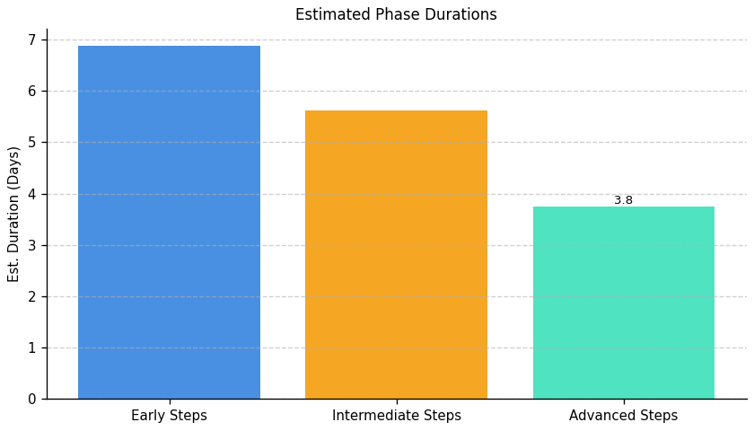
Sustainable Digital Transformation: Roadmap Phase Durations

Slide 6
Server Development and Optimization: Top 3 Insights
The organization demonstrates a critical lack of foundational server management practices, specifically in logging, monitoring, performance analysis, and capacity planning. This absence necessitates a substantial investment – estimated at 90-175 man-hours per area – to establish even basic operational capabilities and proactively address potential issues before they impact service availability.
A significant security risk exists due to the complete absence of core security measures like patching, intrusion detection, access controls, and log auditing. Remediation requires a similarly substantial effort (135-175 hours per area) and represents an immediate priority to mitigate potential data breaches and ensure regulatory compliance.
The organization lacks a defined strategy for selecting and implementing server tools, exhibiting indecision between open-source and commercial options. This ambiguity, coupled with a lack of internal expertise, could lead to inefficient resource allocation and the adoption of suboptimal solutions, hindering effective server management and security improvements.

Slide 7
Server Development and Optimization: Roadmap Overview
Overview:
This roadmap addresses critical gaps in server infrastructure management, security, and high availability. It begins with foundational monitoring and risk assessment, progresses through system integration, strategy development, and tool selection, and culminates in performance optimization, implementation of redundancy measures, and ongoing governance. The plan aims to establish a secure, compliant, and optimized IT environment capable of supporting business growth and ensuring continuous operation.
Total Est: 910 hrs (~113.8 days)
Key Roles: IT Specialists, IT Administrators, Monitoring Teams, Security Analysts, Compliance Specialists, Business Analysts, Development Teams, Infrastructure Managers, Scalability Planning Team, IT Leadership, Network Administrators, Optimization Experts, QA Engineers, Performance Analysts, Alerting System Analysts, Caching Strategists, Logging System Analysts, Load Balancer Administrators, Testing Team, Data Management Specialists, Redundancy Planning Team, Patch Management Experts, System Administrators, Infrastructure Team, IT Security Specialists

Slide 8
Server Development and Optimization: Implementation Plan Details
--- Early Steps ---
1. Evaluate centralized logging systems to choose the most suitable one, researching logging solutions, considering scalability, and compatibility. 2. Evaluate and select a resource monitoring tool for server infrastructure, researching monitoring tools and aligning with infrastructure requirements. 3. Evaluate alerting systems to choose an effective solution, researching alerting tools and considering real-time monitoring capabilities. 4. Conduct a network assessment to identify areas for optimization, using network monitoring tools and analyzing traffic patterns. 5. Assess current server infrastructure for scalability gaps, collaborating with IT architects and conducting workload analysis. 6. Assess the current server infrastructure for high availability, conducting a risk assessment and identifying single points of failure. 7. Develop a patch management policy outlining the frequency and process for updates, collaborating with IT security and assessing software requirements. 8. Conduct a security threat assessment to identify potential risks and vulnerabilities, collaborating with security experts and performing risk analysis. 9. Develop an access control policy defining user permissions and restrictions, collaborating with IT security and assessing system requirements.
--- Intermediate Steps ---
1. Integrate the selected logging system into your server infrastructure, configuring log sources and collaborating with IT teams. 2. Configure and integrate the selected monitoring tool with the server infrastructure, following tool documentation and testing configurations. 3. Configure alerts based on abnormal server behavior or performance issues, defining alert thresholds and collaborating with monitoring teams. 4. Develop a caching strategy based on server workload and application requirements, collaborating with development teams and analyzing application behavior. 5. Develop a process for auditing server logs for security and compliance, defining audit criteria and collaborating with security and compliance teams. 6. Configure the selected load balancer for your server infrastructure, following load balancer documentation and testing configurations. 7. Identify redundancy solutions and create a mitigation plan. 8. Evaluate and implement automated patching tools for efficient updates, researching patch management tools and aligning with policy. 9. Evaluate and select an IDS solution suitable for the infrastructure, researching IDS tools and aligning with the threat assessment. 10. Evaluate and select a firewall solution aligned with access control policies, researching firewall tools and aligning with policy requirements.
--- Advanced Steps ---
1. Implement selected caching mechanisms and conduct testing, configuring caching and performing load testing. 2. Implement the planned upgrades to enhance scalability, upgrading hardware and implementing scaling solutions. 3. Implement resource monitoring in the production environment and provide training, rolling out the solution and training relevant teams. 4. Implement identified optimizations and monitor the impact, making configuration changes and analyzing performance. 5. Implement the selected firewall solution and conduct testing, configuring firewall rules and performing security testing. 6. Implement the selected IDS solution and integrate it into the server infrastructure, configuring IDS parameters and performing integration testing. 7. Upgrade hardware and configure redundant systems. 8. Implement the selected firewall solution and conduct testing, configuring firewall rules and performing security testing. 9. Implement the data retention policy and monitor its effectiveness, configuring data storage and collaborating with IT and monitoring teams. 10. Develop a plan for performance testing of critical server applications, identifying testing scenarios and defining success criteria. 11. Execute performance testing on critical server applications, using testing tools and analyzing results. 12. Develop a policy for retaining historical performance data, defining data retention periods and collaborating with data management teams.
Tools/Platforms (Overall):
ELK Stack (Elasticsearch, Logstash, Kibana), Splunk, Grafana, Prometheus, Dynatrace, InfluxDB, OpsGenie, PagerDuty, iperf, SolarWinds Network Performance Monitor, HAProxy, Nginx, Redis, Varnish, Akamai, Cloudflare, Wazuh, SolarWinds Security Event Manager, Citrix ADC, F5 BIG-IP, docker, kubernetes, Amazon ECS, Google Kubernetes Engine (GKE), Datadog, New Relic, Apache JMeter, LoadRunner, OpenStack, VMware vSphere, Keepalived, Veeam Backup & Replication, OpenVAS, Tenable, Qualys, Snort, Cisco Firepower, Suricata, iptables, Cisco ASA, Palo Alto Networks
Subtask Estimates (Aggregated):
--- Early Steps ---
Evaluation: 35 hours; Research: 30 hours; Monitoring Tool Research: 40 hours; Alignment with Requirements: 30 hours; Assessment: 45 hours; Traffic Pattern Analysis: 30 hours; Scalability Analysis: 50 hours; Collaboration with IT Architects: 40 hours; Risk Assessment: 25 hours; Single Point of Failure Identification: 20 hours; Policy Development: 40 hours; Collaboration with System Administrators: 30 hours; Threat Assessment: 20 hours; Risk Analysis: 15 hours; Policy Development: 20 hours; Collaboration with System Administrators: 15 hours.
--- Intermediate Steps ---
Integration: 60 hours; Collaboration with IT Teams: 50 hours; Configuration Setup: 60 hours; Testing: 50 hours; Review and Analysis: 60 hours; Collaboration with IT and Compliance Teams: 50 hours; Strategy Development: 50 hours; Collaboration with Development Teams: 40 hours; Process Development: 40 hours; Collaboration with Security and Compliance Teams: 30 hours; Solution Identification: 55 hours; Mitigation Plan Creation: 50 hours; Research: 50 hours; Alignment with Policy Requirements: 40 hours; Research: 50 hours; Alignment with Threat Assessment: 40 hours; Research: 50 hours; Alignment with Policy Requirements: 40 hours.
--- Advanced Steps ---
Configuration: 60 hours; Load Testing: 50 hours; Hardware Upgrade: 75 hours; Scaling Solution Implementation: 70 hours; Rollout: 65 hours; Training: 60 hours; Testing Execution: 55 hours; Results Analysis: 40 hours; Policy Development: 35 hours; Collaboration with Data Management Teams: 30 hours; Implementation: 60 hours; Monitoring Effectiveness: 50 hours; Configuration: 60 hours; Security Testing: 50 hours; Configuration: 60 hours; Integration Testing: 50 hours; Hardware Upgrade: 40 hours; Redundancy Configuration: 35 hours

Slide 9
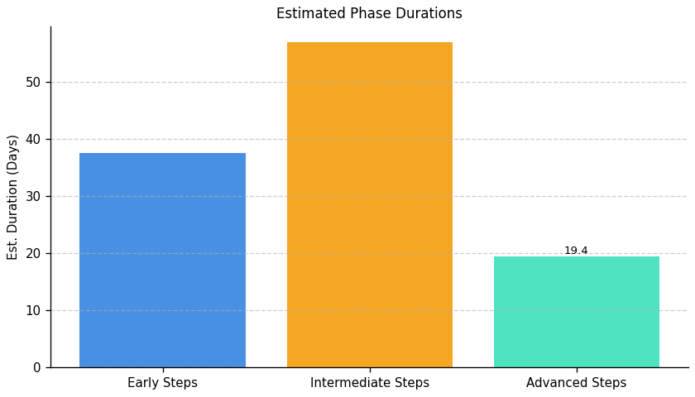
Server Development and Optimization: Roadmap Phase Durations

Slide 10
Operational Integrity and IT Modernization: Top 3 Insights
The organization faces substantial risk due to a complete lack of formal data governance. Specifically, there are no documented policies or procedures for managing data movement, retention, or archiving, creating vulnerabilities to data inconsistencies, compliance violations, and operational inefficiencies.
A critical and immediate weakness is the absence of disaster recovery and business continuity planning. The organization has not implemented or tested any procedures to restore operations following a disruptive event, leaving it highly vulnerable to significant downtime and data loss.
Infrastructure management is reactive and unsustainable. The lack of a defined process for decommissioning outdated systems and regular architecture reviews results in reliance on potentially insecure and inefficient technology, hindering future growth and modernization initiatives.

Slide 11
Operational Integrity and IT Modernization: Roadmap Overview
Overview:
This roadmap addresses critical gaps in data management, IT operations, and disaster recovery to enhance data integrity, business continuity, and compliance. The initial phase focuses on assessing current practices and identifying key areas for improvement. The intermediate phase involves designing standardized protocols and strategies for data movement, decommissioning, and data protection. Finally, the advanced phase concentrates on implementing these protocols, conducting thorough testing, and establishing ongoing governance to ensure sustained operational integrity and adaptability to evolving business needs.
Total Est: 446 hrs (~55.8 days)
Key Roles: Data Engineers, Solution Architects, Documentation Specialist, Communication Coordinator, Infrastructure Specialist, Audit Team, Strategy Development Team, Data Architect, Networking Specialist, Infrastructure Team, Testing Team, System Owners, Protocol Designer, IT Security Specialist, Backup Strategist, DR Specialists, BC Specialists, IT Administrators, Business Analysts, Enterprise Architects, Review Team, Testing Coordinator, Data Owners, IT Operations

Slide 12
Operational Integrity and IT Modernization: Implementation Plan Details
--- Early Steps ---
1. Analyze existing data movement processes to identify gaps and inefficiencies. 2. Conduct a comprehensive audit to identify outdated or underutilized infrastructure components. 3. Assess the criticality of different data sets to define backup and archive priorities. 4. Document current Disaster Recovery (DR) and Business Continuity (BC) protocols. 5. Develop a test plan outlining scenarios for backup and recovery testing. 6. Collaborate with specialists to refine assessment findings.
--- Intermediate Steps ---
1. Align data movement processes within defined architecture boundaries. 2. Develop a strategy outlining the criteria, process, and timeline for decommissioning identified components. 3. Design a comprehensive strategy for backups and archives based on criticality. 4. Design a standardized protocol for data movement based on mapping results. 5. Update DR and BC protocols based on identified improvements. 6. Collaborate with architecture teams to ensure alignment.
--- Advanced Steps ---
1. Document aligned processes and communicate changes to relevant teams. 2. Establish a routine for reviewing and updating the decommissioning strategy. 3. Document the strategy and conduct testing to ensure effectiveness. 4. Implement standardized protocols and conduct thorough testing. 5. Establish a periodic schedule for architecture boundary reviews. 6. Conduct regular backup and recovery testing based on the developed plan. 7. Analyze testing results and refine protocols as needed.
Tools/Platforms (Overall):
Amanda, Bacula, Rubrik, Zerto, Commvault, Veeam Backup & Replication
Subtask Estimates (Aggregated):
--- Early Steps ---
Analysis Collaboration: 18h; Gap Identification: 28h; Collaboration and Planning: 35h; Infrastructure Audit: 30h; Criticality Assessment: 25h; Documentation Review: 20h; Test Plan Development: 20h.
--- Intermediate Steps ---
Collaboration with Architecture: 22h; Process Updates: 20h; Team Collaboration: 18h; Document Development: 25h; Strategy Design: 30h; Alignment with Business Needs: 35h; Protocol Design: 35h; Update Implementation: 25h.
--- Advanced Steps ---
Documentation: 43h; Communication Sessions: 15h; Periodic Reviews: 22h; Strategy Updates: 20h; Testing Scenarios: 22h; Implementation: 30h; Testing and Performance Monitoring: 35h; Schedule Definition: 15h; Results Analysis: 25h.

Slide 13
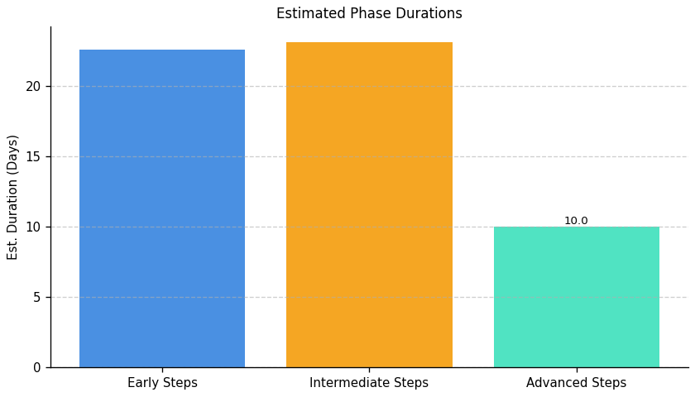
Operational Integrity and IT Modernization: Roadmap Phase Durations

Slide 14
Green IT Strategy and Maturity: Top 3 Insights
The organization fundamentally lacks the ability to measure the impact of its Green IT efforts, consistently failing to quantify reductions in energy consumption, cost savings, or carbon footprint. This absence of data prevents informed decision-making, ROI demonstration, and effective progress tracking towards sustainability objectives.
A comprehensive environmental management framework is entirely absent, with no implemented processes or tools for assessment, optimization, or skills development related to sustainable IT practices. This extends to a complete lack of resource optimization initiatives and dedicated training programs for staff.
Multiple, interconnected barriers – including cost, measurement difficulties, lack of expertise, and insufficient executive support – are preventing Green IT adoption. Addressing this requires a holistic strategy that tackles awareness, skills gaps, budgetary constraints, and organizational buy-in simultaneously, rather than focusing on isolated solutions.

Slide 15
Green IT Strategy and Maturity: Roadmap Overview
Overview:
This roadmap outlines a phased approach to integrate Green IT practices within the organization. The initial Early Steps focus on establishing a baseline understanding of the current environmental impact of IT infrastructure and processes, identifying areas for improvement, and defining sustainability skill requirements. The Intermediate Steps involve designing and implementing resource optimization processes, developing targeted training programs, and raising employee awareness. Finally, the Advanced Steps concentrate on deploying selected tools, delivering training, monitoring the effectiveness of initiatives, and establishing a continuous improvement cycle to ensure long-term sustainability.
Total Est: 405 hrs (~50.6 days)
Key Roles: Environmental Experts, Infrastructure Managers, IT Specialists, Sustainability Analysts, Tool Administrators, Training Coordinators, Process Design Expert, Training Analysts, Training Facilitators, Program Designers, HR Specialists, Assessment Administrators, Communication Specialists, Sustainability Strategists, Department Heads, HR Representatives, Subject Matter Experts, Team Leads, Documentation Specialist, Program Coordinators, HR Analysts

Slide 16
Green IT Strategy and Maturity: Implementation Plan Details
--- Early Steps ---
1. Assess the current environmental impact of infrastructure and processes, collaborating with environmental experts. 2. Evaluate existing and potential tools for managing sustainability, collaborating with IT teams. 3. Conduct an assessment of environmental impact in the current environment, collaborating with environmental specialists and IT Operations. 4. Define proficiency criteria for assessing sustainability-related skills, collaborating with sustainability experts and HR Specialists. 5. Collaborate with experts and plan for implementation.
--- Intermediate Steps ---
1. Design processes to optimize resource usage based on assessment results, collaborating with process design experts. 2. Design training programs for sustainability-focused skills development, collaborating with trainers. 3. Communicate the incentive plan to employees and create awareness, developing communication materials. 4. Develop assessment tools for assessing proficiency aligned with defined criteria and pilot test them. 5. Align processes with organizational goals.
--- Advanced Steps ---
1. Implement selected tools and provide training to relevant teams, configuring tools and conducting training sessions. 2. Document the established processes and conduct training for relevant teams, using documentation tools. 3. Implement the training programs and track participant progress, conducting training sessions. 4. Monitor the effectiveness of incentives and evaluate employee retention, collecting feedback.
Tools/Platforms (Overall):
Impact assessment tools, Documentation tools, Digital platforms
Subtask Estimates (Aggregated):
--- Early Steps ---
Environmental Assessment - 30h; Collaboration with Experts - 20h; Tool Research - 25h; Collaboration with IT Teams - 15h; Collaboration and Planning - 20h; Impact Assessment - 30h; Criteria Definition - 25h; Collaboration with Experts - 15h
--- Intermediate Steps ---
Process Design - 25h; Alignment with Goals - 18h; Program Design - 30h; Collaboration with Trainers - 20h; Communication Development - 30h; Awareness Sessions - 20h; Tool Development - 30h; Pilot Testing - 20h
--- Advanced Steps ---
Tool Implementation - 40h; Training Sessions - 20h; Documentation - 22h; Training Sessions - 20h; Training Sessions - 35h; Progress Tracking - 25h; Monitoring - 35h; Evaluation - 25h

Slide 17
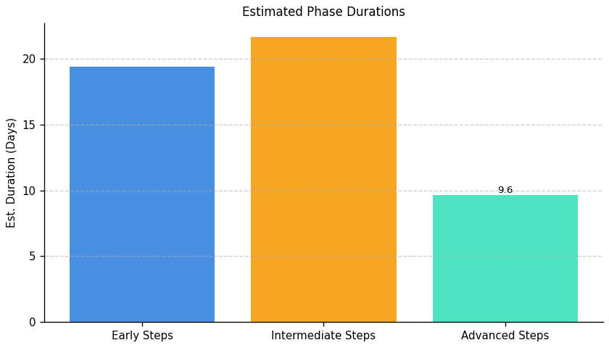
Green IT Strategy and Maturity: Roadmap Phase Durations

Slide 18
IT Carbon Efficiency and Management: Top 3 Insights
The organization does not currently measure its IT carbon footprint – including carbon intensity of operations – preventing baseline establishment, target setting, and progress tracking towards emissions reduction.
A clear strategy for reducing the carbon footprint of server operations is absent, with readily available optimization techniques (like cooling improvements) currently unutilized, indicating a gap between knowledge and practical implementation.
Limited proactive steps have been taken to reduce IT-related carbon emissions, suggesting carbon efficiency is not a prioritized business objective and represents a substantial area for improvement and potential cost savings.

Slide 19
IT Carbon Efficiency and Management: Roadmap Overview
Overview:
This roadmap outlines a phased approach to reducing the IT carbon footprint of the organization. It begins with a foundational assessment of current energy consumption and carbon emissions, followed by the development and implementation of strategies to optimize server operations and cooling systems. While initial data does not support advanced optimization, the roadmap is designed to be iterative, allowing for future expansion as data becomes available and reduction efforts progress.
Total Est: 200 hrs (~25.0 days)
Key Roles: IT Administrators, Environmental Experts, Energy Experts, Data Center Managers, Cooling System Technicians

Slide 20
IT Carbon Efficiency and Management: Implementation Plan Details
--- Early Steps ---
1. Assess the current carbon footprint associated with server operations, collaborating with environmental experts and analyzing energy consumption. 2. Conduct an energy efficiency audit of server data centers, collaborating with energy experts and analyzing cooling systems.
--- Intermediate Steps ---
1. Develop a strategy to minimize the carbon footprint in server operations, implementing energy-efficient practices and utilizing renewable energy. 2. Implement cooling optimization practices based on the audit findings, upgrading cooling systems and monitoring temperature controls.
--- Advanced Steps ---
1. No specific methodology defined based on current data.
Tools/Platforms (Overall):
GreenIT Software, AWS IoT Greengrass, The Green Grid, OpenDCRE, Schneider Electric EcoStruxure
Subtask Estimates (Aggregated):
--- Early Steps ---
Carbon Footprint Assessment: 30 hours; Collaboration with Environmental Experts: 20 hours; Energy Efficiency Audit: 30 hours; Collaboration with Energy Experts: 20 hours.
--- Intermediate Steps ---
Strategy Development: 35 hours; Implementation of Practices: 15 hours; Cooling System Upgrade: 35 hours; Temperature Control Monitoring: 15 hours.
--- Advanced Steps ---
No subtasks defined based on current data.

Slide 21
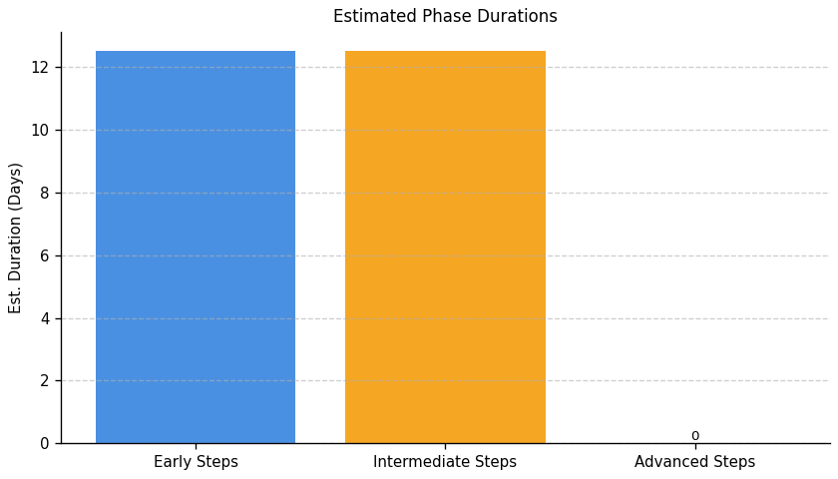
IT Carbon Efficiency and Management: Roadmap Phase Durations

Slide 22
IT Resource Efficiency and E-Waste Management: Top 3 Insights
The organization lacks a defined process for managing IT equipment from acquisition through retirement, resulting in potential cost inefficiencies and hindering sustainability goals.
A formal electronic waste (e-waste) policy is absent, creating compliance risks and preventing the recovery of valuable materials from end-of-life IT assets.
Material efficiency practices are underdeveloped across key areas – procurement, maintenance, and end-of-life management – indicating a need for foundational improvements to optimize resource utilization within the IT lifecycle.

Slide 23
IT Resource Efficiency and E-Waste Management: Roadmap Overview
Overview:
This roadmap outlines a phased approach to improve IT resource efficiency and establish responsible e-waste management practices. The initial phase focuses on policy development and a baseline assessment of current IT assets. The intermediate phase involves implementing the policy, tracking equipment lifecycles, and selecting appropriate recycling partners. Finally, the advanced phase emphasizes continuous improvement through policy refinement, monitoring, lifespan extension strategies, and ongoing evaluation of procurement practices to minimize environmental impact.
Total Est: 60 hrs (~7.5 days)
Key Roles: IT Procurement, IT Operations, Sustainability Officer

Slide 24
IT Resource Efficiency and E-Waste Management: Implementation Plan Details
--- Early Steps ---
1. Research best practices for e-waste disposal and recycling. 2. Draft a responsible disposal/recycling policy. 3. Conduct a basic inventory of current IT equipment (hardware and software). 4. Define initial criteria for environmentally responsible IT procurement.
--- Intermediate Steps ---
1. Communicate the e-waste disposal policy to all relevant personnel. 2. Establish a process for tracking IT equipment from procurement to disposal. 3. Identify and vet potential e-waste recycling partners. 4. Integrate environmental criteria into IT purchasing decisions.
--- Advanced Steps ---
1. Regularly review and update the e-waste disposal policy. 2. Implement a system for monitoring and reporting on e-waste generation. 3. Explore options for extending the lifespan of IT equipment, such as refurbishment and upgrades. 4. Evaluate the effectiveness of the IT procurement criteria and make adjustments as needed.
Tools/Platforms (Overall):
Spreadsheet software (e.g., Excel, Google Sheets), Vendor Management System, Reporting tools, Asset Management Software
Subtask Estimates (Aggregated):
--- Early Steps ---
Research - 8h; Policy Drafting - 8h; Inventory - 4h; Procurement Criteria - 4h.
--- Intermediate Steps ---
Communication - 4h; Tracking Process - 6h; Recycling Partner Vetting - 4h; Procurement Integration - 2h.
--- Advanced Steps ---
Policy Review - 4h; Monitoring System - 4h; Lifespan Extension - 4h; Procurement Evaluation - 8h.

Slide 25
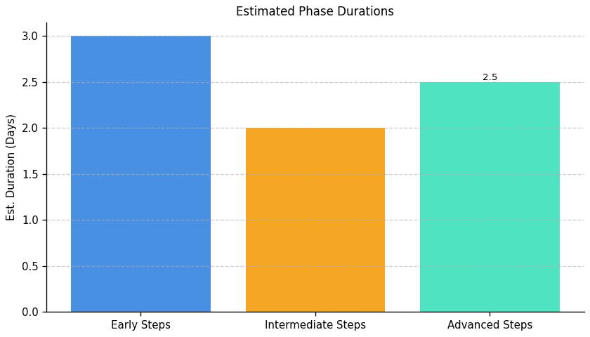
IT Resource Efficiency and E-Waste Management: Roadmap Phase Durations

