Slide 1
Recommendation Report
Session ID: df033ae9-84d4-48ba-a577-374955cbe690
Generated: 2025-04-29

Slide 2
Sustainable Digital Transformation: Top 3 Insights
The organization excels at adopting modern IT practices – containerization, data lakes, and APIs – but currently prioritizes technical implementation over linking these capabilities to concrete, measurable sustainability improvements beyond standard business KPIs. This represents a missed opportunity to leverage existing technology investments for broader environmental and social impact.
Innovation efforts are fragmented and lack consistent executive support, preventing sustainability considerations from being systematically integrated into new product development and business initiatives. Establishing clear innovation processes with leadership backing is crucial to drive sustainability-focused ideation.
While IT is viewed as a core business enabler and a shift towards a product-centric model is underway, the current sustainability strategy remains narrowly focused on business outcomes. A broader perspective encompassing wider environmental and social impacts is needed to align with the principles of sustainable digital transformation.

Slide 3
Sustainable Digital Transformation: Roadmap Overview
Overview:
This roadmap outlines a phased approach to achieving sustainable digital transformation. The initial phase focuses on modernizing IT foundations through containerization, data analytics, and business integration. The intermediate phase emphasizes automation, serverless computing, and aligning programs with key business outcomes. Finally, the advanced phase leverages AI/ML for insights, drives process improvements, and fosters a culture of innovation with executive support to ensure long-term sustainability.
Total Est: 130 hrs (~16.2 days)
Key Roles: IT Architects, Developers, Business Analysts, Security Professionals, Data Scientists, Innovation Managers, Operations Engineers

Slide 4
Sustainable Digital Transformation: Implementation Plan Details
Overall Goal: Sustainable Digital Transformation Implementation Plan
Methodology / Steps:
--- Early Steps ---
1. Embrace containerization for a microservices architecture. 2. Develop matured data lakes for real-time analytics. 3. Implement RESTful APIs with API gateways for seamless communication. 4. Integrate IT as an integral part of business strategy. 5. Introduce iterative development processes and enhance collaboration within development teams. 6. Implement Scrum for an agile framework.
--- Intermediate Steps ---
1. Create self-service capabilities for infrastructure deployment. 2. Adopt Micro Services, Containers, and Serverless computing. 3. Develop dynamic cloud applications that are auto-scalable and fault-tolerant. 4. Center programs on driving specific business outcomes and measure success based on the achievement of business objectives. 5. Allocate innovation to business units with defined strategies.
--- Advanced Steps ---
1. Implement AI and ML-enabled algorithms for advanced tasks. 2. Leverage human-like intelligence to enhance decision-making and continuously evolve cognitive capabilities for ongoing innovation. 3. Adopt a KPI-based perspective for operations and drive process improvement for business outcomes. 4. Seek executive sponsorship for innovation initiatives and establish initial processes for innovation, avoiding silos.
Tools/Platforms (Overall): Kubernetes, Azure DevOps, Docker, Jira, Git-scm, Odoo, AWS Lambda, ServiceNow, Spigit, Taiga, TensorFlow, IBM Watson, Grafana, Salesforce, GitHub
Subtask Estimates (Aggregated):
--- Early Steps ---
Containerization: 10h; Data Lakes: 15h; APIs: 10h; Business Integration: 5h; Agile Implementation: 5h; Collaboration: 5h; Scrum: 5h
--- Intermediate Steps ---
Self-Service: 10h; Serverless: 10h; Dynamic Apps: 5h; Outcome Programs: 5h; KPI Measurement: 5h; Innovation Allocation: 5h
--- Advanced Steps ---
AI/ML Implementation: 10h; Cognitive Evolution: 5h; KPI Operations: 5h; Process Improvement: 5h; Executive Sponsorship: 5h; Innovation Processes: 5h

Slide 5
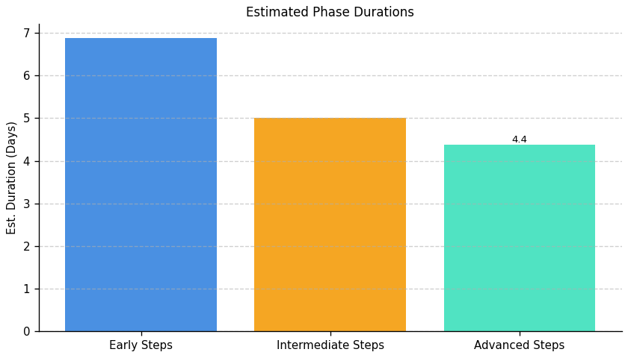
Sustainable Digital Transformation: Roadmap Phase Durations

Slide 6
Server Development and Optimization: Top 3 Insights
The organization demonstrates a critical lack of foundational practices across both server management and security, resulting in a highly vulnerable and reactive infrastructure. Complete absence of implementation in areas like logging, patching, capacity planning, and access controls indicates a systemic gap, exposing the organization to significant risk of outages, data breaches, and compliance failures.
Addressing these gaps will require substantial investment – estimated at over 600 man-hours – to establish even basic capabilities. The detailed recommendations consistently point to a lack of awareness regarding the scope of work needed, suggesting a need for external expertise or targeted training to build internal knowledge and skills.
Organizational silos and a lack of cross-team collaboration are likely hindering progress. Consistent “Not Implemented” responses across multiple critical areas suggest prioritization or resource allocation issues, rather than simply a lack of available tools, and necessitate improved communication and shared ownership between IT, development, security, and business analysis teams.

Slide 7
Server Development and Optimization: Roadmap Overview
Overview:
This roadmap addresses critical gaps in server infrastructure, focusing on monitoring, security, scalability, and performance. The initial phase establishes foundational monitoring and risk assessment, identifying single points of failure and defining security policies. The intermediate phase integrates selected tools for logging, caching, redundancy, and automated patching, aligning them with established policies and threat assessments. Finally, the advanced phase focuses on implementing upgrades, conducting thorough testing, establishing robust governance processes, and ensuring ongoing monitoring and improvement of server infrastructure performance and security.
Total Est: 990 hrs (~123.8 days)
Key Roles: IT Specialists, IT Administrators, Monitoring Teams, Security Analysts, Compliance Specialists, Business Analysts, Development Teams, Infrastructure Managers, Scalability Planning Team, IT Leadership, Network Administrators, Optimization Experts, QA Engineers, Performance Analysts, Data Management Specialists, Alerting System Analysts, Caching Strategists, Logging System Analysts, Load Balancer Administrators, Testing Team, Infrastructure Team, IT Security Specialists, System Administrators, Redundancy Planning Team, Patch Management Experts

Slide 8
Server Development and Optimization: Implementation Plan Details
Overall Goal: Server Development and Optimization Implementation Plan
Methodology / Steps:
--- Early Steps ---
1. Evaluate centralized logging systems to choose the most suitable one and research logging solutions, considering scalability and compatibility. 2. Develop a caching strategy based on server workload and application requirements, collaborating with development teams and analyzing application behavior. 3. Assess the current server infrastructure for scalability gaps, collaborating with IT architects and conducting workload analysis. 4. Conduct a network assessment to identify areas for optimization, using network monitoring tools and analyzing traffic patterns. 5. Develop a plan for performance testing of critical server applications, identifying testing scenarios and defining success criteria. 6. Assess the current server infrastructure for high availability and identify single points of failure. 7. Develop a patch management policy outlining the frequency and process for updates, collaborating with IT security to assess software requirements. 8. Develop an access control policy defining user permissions and restrictions, collaborating with IT security and system administrators to assess system requirements.
--- Intermediate Steps ---
1. Integrate the selected logging system into your server infrastructure and configure log sources, collaborating with IT teams. 2. Evaluate and select caching mechanisms aligned with the developed strategy, researching caching options and performing load testing. 3. Develop a plan for enhancing server infrastructure scalability, identifying scalability solutions and creating a roadmap. 4. Configure the selected load balancer for your server infrastructure, following documentation and testing configurations. 5. Develop a process for auditing server logs for security and compliance, defining audit criteria and collaborating with security and compliance teams. 6. Identify redundancy solutions and create a mitigation plan, researching patch management tools and aligning with the established policy. 7. Evaluate and select a firewall solution aligned with access control policies, researching firewall tools and aligning with policy requirements. 8. Evaluate and select an IDS solution suitable for the infrastructure, researching IDS tools and aligning with the threat assessment.
--- Advanced Steps ---
1. Implement the planned upgrades to enhance scalability and implement load balancing in the production environment, conducting testing and monitoring performance. 2. Regularly review and analyze server logs according to the developed process, conducting audits and collaborating with IT and compliance teams. 3. Implement resource monitoring in the production environment and provide training, rolling out the solution and training relevant teams. 4. Configure alerts based on abnormal server behavior or performance issues, defining alert thresholds and collaborating with monitoring teams. 5. Develop a policy for retaining historical performance data, defining data retention periods and collaborating with data management teams. 6. Upgrade hardware and configure redundant systems, implementing the selected firewall solution and conducting testing. 7. Configure firewall rules and perform security testing, implementing the selected IDS solution and integrating it into the server infrastructure. 8. Configure IDS parameters and perform integration testing.
Tools/Platforms (Overall): ELK Stack (Elasticsearch, Logstash, Kibana), Splunk, Redis, Varnish, Collectd, Datadog, iperf, SolarWinds Network Performance Monitor, Apache JMeter, LoadRunner, docker, kubernetes, Amazon ECS, Google Kubernetes Engine (GKE), HAProxy, Nginx, Citrix ADC, F5 BIG-IP, Wazuh, SolarWinds Security Event Manager, Dynatrace, InfluxDB, AppDynamics, Prometheus Alertmanager, OpsGenie, PagerDuty, Keepalived, Veeam Backup & Replication, OpenVAS, Tenable, Qualys, iptables, Cisco ASA, Palo Alto Networks, Snort, Cisco Firepower, Suricata
Subtask Estimates (Aggregated):
--- Early Steps ---
Evaluation: 20h; Research: 15h; Strategy Development: 25h; Collaboration with Development Teams: 20h; Scalability Analysis: 25h; Collaboration with IT Architects: 20h; Assessment: 20h; Traffic Pattern Analysis: 15h; Plan Development: 25h; Scenario Identification: 20h; Risk Assessment: 25h; Single Point of Failure Identification: 20h; Policy Development: 20h; Collaboration with System Administrators: 30h; Access Control Policy Development: 20h.
--- Intermediate Steps ---
Integration: 30h; Collaboration with IT Teams: 25h; Research: 45h; Alignment with Strategy: 15h; Configuration: 30h; Load Testing: 25h; Solution Identification: 30h; Roadmap Creation: 25h; Configuration Setup: 30h; Testing: 25h; Process Development: 20h; Collaboration with Security and Compliance Teams: 15h; Mitigation Plan Creation: 25h; Alignment with Policy Requirements: 40h; Alignment with Threat Assessment: 20h.
--- Advanced Steps ---
Hardware Upgrade: 40h; Scaling Solution Implementation: 35h; Rollout: 35h; Performance Testing: 30h; Review and Analysis: 30h; Collaboration with IT and Compliance Teams: 25h; Rollout: 35h; Training: 30h; Configuration: 30h; Collaboration with Monitoring Teams: 25h; Policy Development: 20h; Collaboration with Data Management Teams: 15h; Redundancy Configuration: 35h; Security Testing: 50h; Integration Testing: 25h

Slide 9
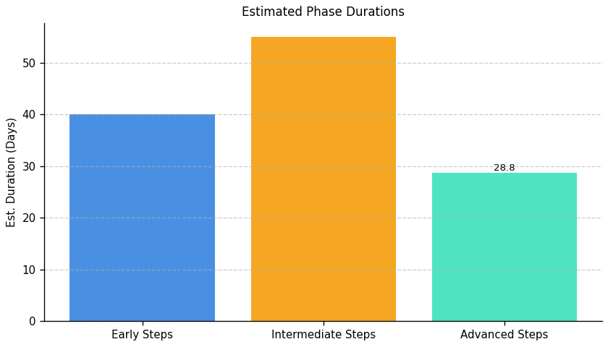
Server Development and Optimization: Roadmap Phase Durations

Slide 10
Operational Integrity and IT Modernization: Top 3 Insights
The organization faces substantial risk due to a complete lack of formal data governance. Missing policies for data movement, retention, and archiving, combined with absent standardized transfer protocols, creates a high probability of data errors, compliance violations, and operational inefficiencies. Immediate development and implementation of these policies is critical.
A critical and costly gap exists in the organization’s ability to recover from disruptions. The complete absence of implemented backup, recovery, and disaster recovery plans – requiring over 250 hours to establish – leaves the organization highly vulnerable to data loss and business interruption. Prioritized investment in these capabilities is essential for business resilience.
The organization’s IT infrastructure is operating without proactive lifecycle management, increasing technical debt and limiting future scalability. The lack of system decommissioning processes and regular architecture reviews indicates reliance on potentially outdated technology and hinders the ability to adapt to changing business requirements. A formal infrastructure lifecycle management program must be established.

Slide 11
Operational Integrity and IT Modernization: Roadmap Overview
Overview:
This roadmap addresses critical gaps in operational integrity and IT modernization, focusing on data management, disaster recovery, and architectural governance. The initial phase establishes a baseline understanding of current processes and infrastructure, identifying areas for improvement in documentation, standardization, and testing. The intermediate phase aligns data movement with architecture, develops decommissioning and disaster recovery strategies, and designs standardized data transfer protocols. Finally, the advanced phase focuses on implementing these strategies, conducting thorough testing, documenting procedures, providing training, and establishing ongoing governance for continuous improvement and adaptation.
Total Est: 422 hrs (~52.8 days)
Key Roles: Data Engineers, Solution Architects, Documentation Specialist, Communication Coordinator, Infrastructure Specialist, Audit Team, Strategy Development Team, Data Architect, Networking Specialist, Infrastructure Team, Testing Team, System Owners, Protocol Designer, Training Coordinator, IT Operations, IT Security Specialist, Backup Strategist, DR Specialists, BC Specialists, Business Analysts, IT Administrators, Analysis Team, Review Team, Enterprise Architects

Slide 12
Operational Integrity and IT Modernization: Implementation Plan Details
Overall Goal: Operational Integrity and IT Modernization Implementation Plan
Methodology / Steps:
--- Early Steps ---
1. Analyze existing data movement processes to identify gaps and inefficiencies. 2. Conduct a comprehensive audit to identify outdated or underutilized infrastructure components. 3. Analyze data movement requirements between infrastructure elements and map these requirements across systems and applications. 4. Assess the criticality of different data sets to define backup and archive priorities. 5. Document current Disaster Recovery (DR) and Business Continuity (BC) protocols and develop a test plan outlining scenarios for backup and recovery testing. 6. Define a periodic schedule for architecture boundary reviews.
--- Intermediate Steps ---
1. Align data movement processes within defined architecture boundaries. 2. Develop a strategy outlining the criteria, process, and timeline for decommissioning identified components. 3. Standardize protocols for efficient data movement across different infrastructure elements, designing a standardized protocol based on mapping results. 4. Design a comprehensive strategy for backups and archives based on criticality. 5. Identify areas of improvement in existing DR and BC protocols and evaluate/select a disaster recovery solution aligned with policy requirements.
--- Advanced Steps ---
1. Implement standardized protocols and conduct thorough testing. 2. Establish a routine for reviewing and updating the decommissioning strategy. 3. Document the aligned processes and communicate changes to relevant teams. 4. Implement the selected DR solution and conduct testing, including regular backup and recovery testing based on the developed plan. 5. Update DR and BC protocols based on identified improvements. 6. Propose updates to architecture boundaries based on the assessment.
Tools/Platforms (Overall): Amanda, Bacula, Rubrik, Zerto, Commvault, Veeam Backup & Replication
Subtask Estimates (Aggregated):
--- Early Steps ---
Analysis Collaboration - 18h; Gap Identification - 28h; Collaboration and Planning - 35h; Infrastructure Audit - 30h; Requirement Analysis - 25h; Collaboration with System Owners - 20h; Data Mapping - 30h; Criticality Assessment - 25h; Documentation Review - 20h; Test Plan Development - 20h; Schedule Definition - 15h; Collaboration with Architecture Teams - 25h. --- Intermediate Steps ---
Collaboration with Architecture - 22h; Process Updates - 20h; Team Collaboration - 18h; Document Development - 25h; Research and Standardization - 20h; Protocol Implementation - 28h; Protocol Design - 35h; Alignment with Business Needs - 35h; Strategy Design - 30h; Thorough Analysis - 30h; Best Practices Review - 25h; Research - 25h; Alignment with Policy Requirements - 20h. --- Advanced Steps ---
Implementation - 30h; Testing and Performance Monitoring - 35h; Periodic Reviews - 22h; Strategy Updates - 20h; Documentation - 22h; Communication Sessions - 18h; Configuration - 30h; Failure Simulation Testing - 25h; Testing Execution - 30h; Results Analysis - 25h; Collaboration with Specialists - 20h; Update Implementation - 25h; Collaboration with Architecture Teams - 25h; Update Proposal - 25h

Slide 13
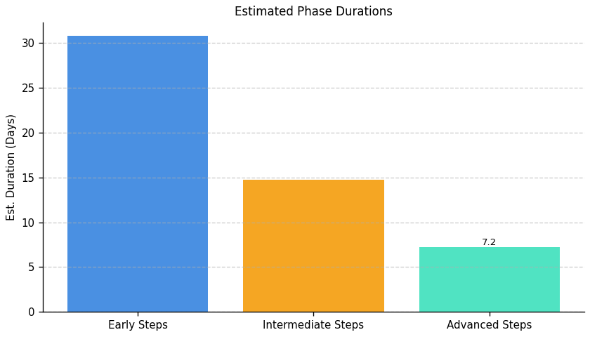
Operational Integrity and IT Modernization: Roadmap Phase Durations

Slide 14
Green IT Strategy and Maturity: Top 3 Insights
The organization fundamentally lacks the ability to measure the impact of its Green IT efforts, consistently failing to quantify reductions in energy consumption, cost savings, or carbon footprint. This absence of data prevents informed decision-making, ROI demonstration, and effective progress tracking towards sustainability objectives.
A comprehensive environmental management framework is entirely absent, with no implemented processes or tools for assessment, optimization, or skills development related to sustainable IT practices. This extends to a complete lack of resource optimization initiatives and dedicated training programs for staff.
Multiple, interconnected barriers – including cost, measurement difficulties, lack of expertise, and insufficient executive support – are preventing Green IT adoption. Addressing this requires a holistic strategy that tackles awareness, skills gaps, budgetary constraints, and organizational resistance simultaneously, rather than focusing on isolated solutions.

Slide 15
Green IT Strategy and Maturity: Roadmap Overview
Overview:
This roadmap outlines a phased approach to integrate Green IT practices within the organization. The initial phase focuses on establishing a baseline understanding of the current environmental impact of IT operations and defining sustainability goals. The intermediate phase centers on designing and implementing processes for resource optimization, integrating sustainability tools, and developing training programs to address skill gaps. Finally, the advanced phase establishes a structured plan for attracting and retaining carbon-literate resources, monitoring incentive effectiveness, and ensuring continuous improvement through ongoing training and assessment.
Total Est: 258 hrs (~32.2 days)
Key Roles: Environmental Experts, Infrastructure Managers, IT Specialists, Sustainability Analysts, Tool Administrators, Training Coordinators, Process Design Expert, Training Analysts, Department Heads, Training Facilitators, Program Designers, HR Specialists, Assessment Administrators, Communication Specialists, Sustainability Strategists, HR Analysts, Team Leads, Subject Matter Experts, Training Instructors, HR Representatives, Sustainability Experts, Assessment Designers

Slide 16
Green IT Strategy and Maturity: Implementation Plan Details
Overall Goal: Green IT Strategy and Maturity Implementation Plan
Methodology / Steps:
--- Early Steps ---
1. Assess the current environmental impact of infrastructure and processes, collaborating with environmental experts. 2. Evaluate existing and potential tools for managing sustainability, researching available options. 3. Conduct an assessment of environmental impact in the current environment, collaborating with environmental specialists. 4. Define proficiency criteria for assessing sustainability-related skills, collaborating with subject matter experts. 5. Identify specific sustainability-focused skills that need development, conducting a skill gap analysis and collaborating with department heads.
--- Intermediate Steps ---
1. Design processes to optimize resource usage based on assessment results, collaborating with process design experts and aligning with sustainability goals. 2. Implement selected tools and provide training to relevant teams, configuring tools and conducting training sessions. 3. Design training programs for sustainability-focused skills development, collaborating with trainers. 4. Communicate the defined skills across teams effectively, conducting workshops and creating communication plans. 5. Develop assessment tools for assessing proficiency aligned with defined criteria, designing assessments and conducting pilot testing.
--- Advanced Steps ---
1. Define a structured incentive plan for carbon-literate resources, collaborating with HR. 2. Implement the training programs and track participant progress, conducting training sessions. 3. Implement the assessment process and analyze results, conducting assessments and analyzing data. 4. Deliver training sessions, either in-person or through digital platforms, facilitating sessions and tracking attendance. 5. Monitor the effectiveness of incentives and evaluate employee retention, collecting feedback and conducting evaluations.
Tools/Platforms (Overall): Impact assessment tools, Sustainability tools, Documentation tools, Training platforms, Assessment platforms
Subtask Estimates (Aggregated):
--- Early Steps ---
Environmental Assessment: 30h; Collaboration with Experts: 40h; Tool Research: 25h; Collaboration with IT Teams: 15h; Criteria Definition: 25h; Skill Gap Analysis: 20h; Collaboration with Department Heads: 15h. --- Intermediate Steps ---
Process Design: 25h; Alignment with Goals: 18h; Tool Implementation: 40h; Training Sessions: 20h; Program Design: 30h; Workshop Conduct: 25h; Communication Planning: 15h; Tool Development: 30h; Pilot Testing: 20h. --- Advanced Steps ---
Incentive Structure Definition: 25h; Collaboration with HR: 15h; Training Sessions: 35h; Progress Tracking: 25h; Assessment Implementation: 35h; Results Analysis: 25h; Training Delivery: 35h; Attendance Tracking: 25h; Monitoring: 35h; Evaluation: 25h

Slide 17
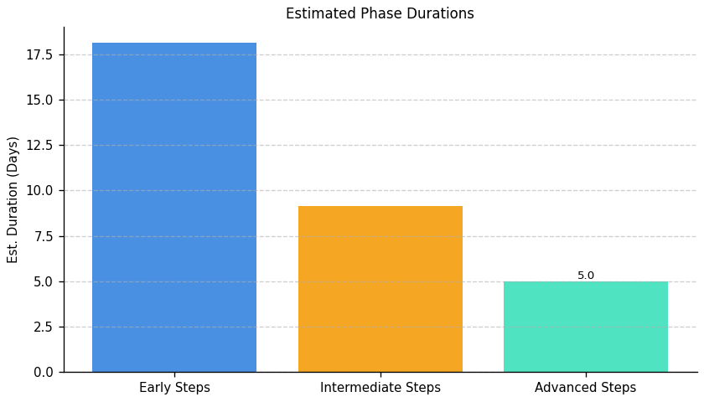
Green IT Strategy and Maturity: Roadmap Phase Durations

Slide 18
IT Carbon Efficiency and Management: Top 3 Insights
The organization does not currently measure its IT carbon footprint – including carbon intensity of operations – preventing baseline establishment, target setting, and progress tracking towards emissions reduction.
A defined strategy for reducing the carbon footprint of server operations is absent, with readily available optimization techniques (like cooling improvements) currently unutilized, indicating a significant implementation gap.
Limited proactive steps have been taken to reduce IT-related carbon emissions, suggesting carbon efficiency is not a prioritized business objective and remains in the initial stages of consideration.

Slide 19
IT Carbon Efficiency and Management: Roadmap Overview
Overview:
This roadmap outlines a phased approach to reducing the carbon footprint of IT operations. It begins with a comprehensive assessment of current energy consumption and carbon intensity, followed by the development and implementation of strategies to optimize server operations and cooling systems. The final phase focuses on continuous monitoring, refinement of strategies, and exploration of carbon offsetting programs to achieve sustained reductions and environmental responsibility.
Total Est: 300 hrs (~37.5 days)
Key Roles: IT Administrators, Environmental Experts, Data Center Managers, Cooling System Technicians, Energy Experts

Slide 20
IT Carbon Efficiency and Management: Implementation Plan Details
Overall Goal: IT Carbon Efficiency and Management Implementation Plan
Methodology / Steps:
--- Early Steps ---
1. Assess the current carbon footprint associated with server operations, collaborating with environmental and energy experts and analyzing energy consumption. 2. Conduct an energy efficiency audit of server data centers, collaborating with energy experts and analyzing cooling systems.
--- Intermediate Steps ---
1. Develop a strategy to minimize the carbon footprint in server operations, implementing energy-efficient practices and utilizing renewable energy. 2. Implement cooling optimization practices based on the audit findings, upgrading cooling systems and monitoring temperature controls.
--- Advanced Steps ---
1. Implement a system for ongoing measurement of carbon intensity in IT operations. 2. Regularly review and refine carbon reduction strategies based on performance data. 3. Explore and implement carbon offsetting programs to neutralize remaining emissions.
Tools/Platforms (Overall): GreenIT Software, AWS IoT Greengrass, The Green Grid, OpenDCRE, Schneider Electric EcoStruxure
Subtask Estimates (Aggregated):
--- Early Steps ---
Carbon Footprint Assessment: 30 hours; Collaboration with Environmental Experts: 20 hours; Energy Efficiency Audit: 30 hours; Collaboration with Energy Experts: 20 hours.
--- Intermediate Steps ---
Strategy Development: 35 hours; Implementation of Practices: 15 hours; Cooling System Upgrade: 35 hours; Temperature Control Monitoring: 15 hours.
--- Advanced Steps ---
System Implementation: 30 hours; Strategy Refinement: 30 hours; Offset Program Exploration: 40 hours.

Slide 21
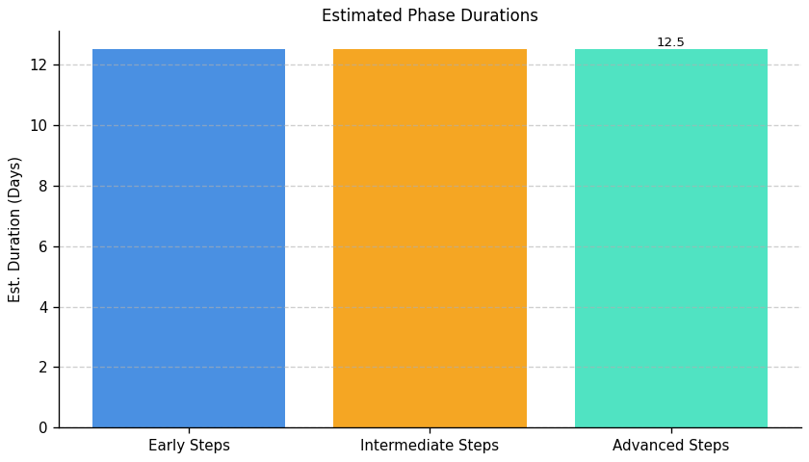
IT Carbon Efficiency and Management: Roadmap Phase Durations

Slide 22
IT Resource Efficiency and E-Waste Management: Top 3 Insights
The organization lacks a defined process for managing IT equipment from acquisition through retirement, resulting in potential cost inefficiencies and hindering resource optimization.
A formal electronic waste (e-waste) policy is absent, creating compliance risks and preventing the recovery of valuable materials through responsible disposal and recycling practices.
Material efficiency is underdeveloped across the IT lifecycle, specifically in procurement and end-of-life management, requiring foundational improvements to minimize waste and maximize resource utilization.

Slide 23
IT Resource Efficiency and E-Waste Management: Roadmap Overview
Overview:
This roadmap outlines a phased approach to improve IT resource efficiency and responsibly manage electronic waste. The initial phase focuses on establishing a baseline understanding of current IT assets and developing a foundational e-waste disposal policy. The intermediate phase operationalizes this policy, integrating sustainability into procurement and developing a basic lifecycle management plan. Finally, the advanced phase focuses on continuous improvement through tracking, evaluation, lifespan extension, and exploration of circular IT practices.
Total Est: 44 hrs (~5.5 days)
Key Roles: IT Procurement, IT Operations, Sustainability Officer

Slide 24
IT Resource Efficiency and E-Waste Management: Implementation Plan Details
Overall Goal: IT Resource Efficiency and E-Waste Management Implementation Plan
Methodology / Steps:
--- Early Steps ---
1. Conduct a comprehensive inventory of all IT equipment (hardware and software). 2. Research best practices for responsible e-waste disposal and recycling. 3. Draft a preliminary e-waste disposal policy outlining basic guidelines. 4. Identify key stakeholders for policy review and approval.
--- Intermediate Steps ---
1. Finalize and formally approve the e-waste disposal policy. 2. Communicate the policy to all relevant employees. 3. Integrate environmental criteria (e.g., energy efficiency, recyclability) into IT procurement guidelines. 4. Develop a basic IT equipment lifecycle management plan outlining procurement, usage, maintenance, and disposal procedures.
--- Advanced Steps ---
1. Implement a system for tracking e-waste generated by the organization. 2. Evaluate the effectiveness of the e-waste disposal policy and identify areas for improvement. 3. Explore options for extending the lifespan of IT equipment through maintenance and upgrades. 4. Investigate opportunities for circular IT practices, such as equipment refurbishment and reuse.
Tools/Platforms (Overall): Spreadsheets, Inventory Management Software, Policy Management Software, Procurement Systems, E-Waste Tracking Software, Lifecycle Management Software
Subtask Estimates (Aggregated):
--- Early Steps ---
Inventory: 8h; Research: 4h; Policy Draft: 4h; Stakeholder ID: 2h
--- Intermediate Steps ---
Policy Finalization: 2h; Communication: 2h; Procurement Integration: 6h; Lifecycle Plan: 4h
--- Advanced Steps ---
Tracking System: 4h; Policy Evaluation: 4h; Lifespan Extension: 2h; Circularity Exploration: 2h

Slide 25
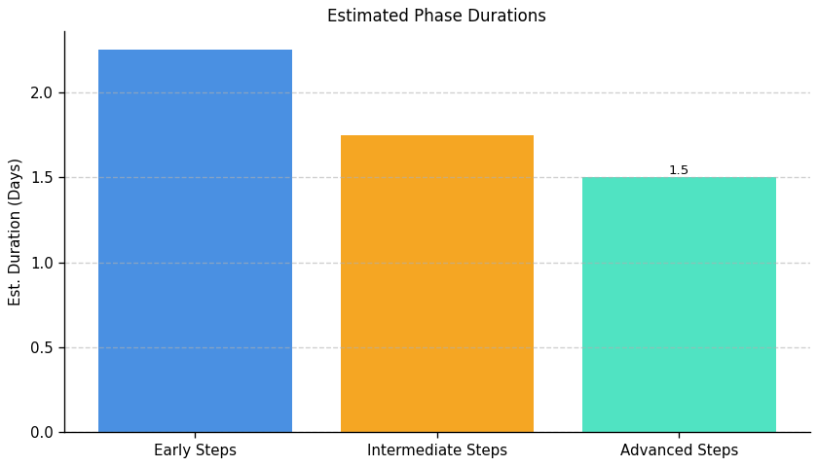
IT Resource Efficiency and E-Waste Management: Roadmap Phase Durations

