Slide 1
Recommendation Report
Session ID: df033ae9-84d4-48ba-a577-374955cbe690
Generated: 2025-04-29

Slide 2
Sustainable Digital Transformation: Top 3 Insights
The organization possesses a strong technical foundation for digital transformation, leveraging modern IT practices like containerization and APIs, but currently prioritizes technology implementation over strategically aligning these capabilities to comprehensive sustainability goals beyond standard business KPIs.
Innovation efforts are currently fragmented and lack consistent executive support, preventing the development of repeatable processes and a widespread culture of continuous improvement necessary for embedding sustainable practices throughout the organization.
While IT is increasingly viewed as central to the business and a shift towards a product-centric model is underway, the organization’s sustainability approach remains narrowly focused on direct business outcomes, missing opportunities to address broader environmental and social impacts inherent in a truly sustainable digital transformation.

Slide 3
Sustainable Digital Transformation: Roadmap Overview
Overview:
This roadmap outlines a phased approach to achieving sustainable digital transformation. The initial phase focuses on building a modern, agile IT foundation through containerization, API development, and integration with core business functions. The intermediate phase advances the operating model with hybrid cloud adoption, enhanced data analytics, and automation. Finally, the advanced phase fosters a culture of innovation and optimizes IT operations for continuous improvement and adaptive governance, driving measurable business outcomes.
Total Est: 115 hrs (~14.4 days)
Key Roles: IT Architects, Developers, Business Analysts, Security Professionals, Data Scientists, Innovation Managers, Project Managers, Innovation Managers

Slide 4
Sustainable Digital Transformation: Implementation Plan Details
--- Early Steps ---
1. Embrace containerization for a microservices architecture. 2. Develop matured data lakes for real-time analytics. 3. Implement RESTful APIs with API gateways for seamless communication. 4. Integrate IT as an integral part of business strategy. 5. Introduce and formalize agile frameworks. 6. Implement iterative development processes. 7. Enhance collaboration within development teams.
--- Intermediate Steps ---
1. Create self-service capabilities for infrastructure deployment. 2. Adopt Micro Services, Containers, and Serverless computing. 3. Develop dynamic cloud applications that are auto-scalable and fault-tolerant. 4. Implement AI and ML-enabled algorithms for advanced tasks. 5. Leverage human-like intelligence to enhance decision-making. 6. Center programs on driving specific business outcomes. 7. Measure success based on the achievement of business objectives.
--- Advanced Steps ---
1. Seek executive sponsorship for innovation initiatives. 2. Allocate innovation to business units with defined strategies. 3. Establish initial processes for innovation, avoiding silos. 4. Adopt a KPI-based perspective for operations. 5. Drive process improvement for business outcomes. 6. Evaluate the percentage of projects successfully transitioning to product-centric IT.
Tools/Platforms (Overall):
Kubernetes, Azure DevOps, Docker, Jira, Git-scm, Odoo, AWS Lambda, TensorFlow, IBM Watson, ServiceNow, Grafana, Spigit, GitHub, Salesforce, Security Onion, Cisco Firepower, Palo Alto Networks Prisma Cloud
Subtask Estimates (Aggregated):
--- Early Steps ---
Containerization: 10h; Data Lakes: 15h; APIs: 10h; Business Integration: 5h; Agile Frameworks: 5h; Iterative Development: 5h; Collaboration: 5h
--- Intermediate Steps ---
Hybrid Cloud: 10h; Serverless: 5h; Data Analytics: 10h; AI/ML: 5h; Outcome Measurement: 5h
--- Advanced Steps ---
Innovation Sponsorship: 5h; Innovation Allocation: 5h; Innovation Processes: 5h; KPI Adoption: 5h; Process Improvement: 5h

Slide 5
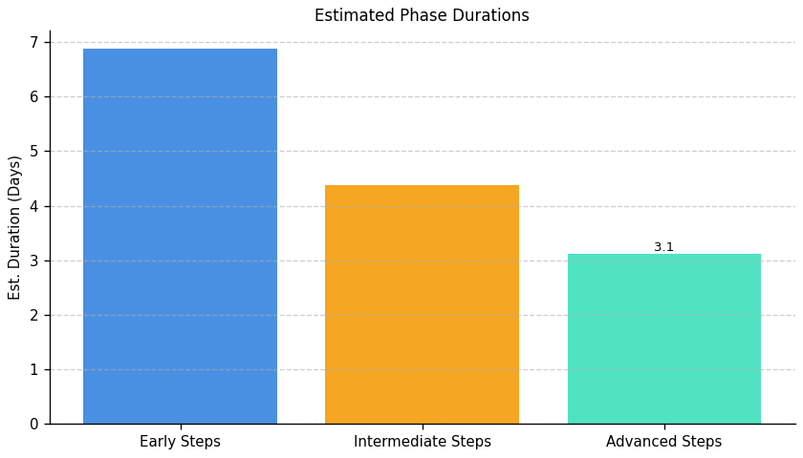
Sustainable Digital Transformation: Roadmap Phase Durations

Slide 6
Server Development and Optimization: Top 3 Insights
The organization demonstrates a complete lack of foundational server management and security practices, including logging, patching, capacity planning, access controls, and redundancy. This absence creates substantial operational risk, potential compliance violations, and vulnerability to outages and data breaches.
Establishing core server infrastructure capabilities—both for management and security—will require a significant investment of approximately 650+ man-hours and necessitate close collaboration between multiple IT teams. This indicates a substantial gap in current IT resources, skillsets, and potentially, cross-departmental workflows.
A critical barrier to improvement isn’t a deliberate choice of tools, but rather a fundamental lack of awareness, implementation, or prioritization of standard server infrastructure solutions (both open-source and commercial). Further investigation is needed to determine why these essential practices haven’t been adopted despite available options.

Slide 7
Server Development and Optimization: Roadmap Overview
Overview:
This roadmap addresses critical gaps in server infrastructure management, security, and high availability. It begins with foundational monitoring and security assessments, progresses through system integration, strategy development, and tool selection, and culminates in performance optimization, implementation of redundancy, and ongoing governance. The plan aims to establish a secure, compliant, and optimized IT environment capable of supporting business growth and minimizing downtime.
Total Est: 910 hrs (~113.8 days)
Key Roles: IT Specialists, IT Administrators, Monitoring Teams, Security Analysts, Compliance Specialists, Business Analysts, Infrastructure Managers, Scalability Planning Team, IT Leadership, Application Developers, Performance Analysts, Network Administrators, Optimization Experts, Testing Team, Logging System Analysts, Alerting System Analysts, Caching Strategists, Data Management Specialists, Infrastructure Team, Redundancy Planning Team, Patch Management Experts, System Administrators, QA Engineers

Slide 8
Server Development and Optimization: Implementation Plan Details
--- Early Steps ---
1. Evaluate centralized logging systems to choose the most suitable one, researching logging solutions, considering scalability, and compatibility. 2. Evaluate and select a resource monitoring tool for server infrastructure, researching monitoring tools and aligning with infrastructure requirements. 3. Evaluate alerting systems to choose an effective solution, researching alerting tools and considering real-time monitoring capabilities. 4. Conduct a network assessment to identify areas for optimization, using network monitoring tools and analyzing traffic patterns. 5. Assess current server infrastructure for scalability gaps, collaborating with IT architects and conducting workload analysis. 6. Assess the current server infrastructure for high availability, conducting a risk assessment and identifying single points of failure. 7. Develop a patch management policy outlining the frequency and process for updates, collaborating with IT security and assessing software requirements. 8. Conduct a security threat assessment to identify potential risks and vulnerabilities, collaborating with security experts and performing risk analysis. 9. Develop an access control policy defining user permissions and restrictions, collaborating with IT security and assessing system requirements.
--- Intermediate Steps ---
1. Integrate the selected logging system into your server infrastructure, configuring log sources and collaborating with IT teams. 2. Configure and integrate the selected monitoring tool with the server infrastructure, following tool documentation and testing configurations. 3. Configure alerts based on abnormal server behavior or performance issues, defining alert thresholds and collaborating with monitoring teams. 4. Develop a caching strategy based on server workload and application requirements, collaborating with development teams and analyzing application behavior. 5. Develop a process for auditing server logs for security and compliance, defining audit criteria and collaborating with security and compliance teams. 6. Configure the selected load balancer for your server infrastructure, following load balancer documentation and testing configurations. 7. Develop a policy for retaining historical performance data, defining data retention periods and collaborating with data management teams. 8. Identify redundancy solutions and create a mitigation plan. 9. Evaluate and implement automated patching tools for efficient updates, researching patch management tools and aligning with policy. 10. Evaluate and select an IDS solution suitable for the infrastructure, researching IDS tools and aligning with the threat assessment. 11. Evaluate and select a firewall solution aligned with access control policies, researching firewall tools and aligning with policy requirements.
--- Advanced Steps ---
1. Implement selected caching mechanisms and conduct testing, configuring caching and performing load testing. 2. Implement the planned upgrades to enhance scalability, upgrading hardware and implementing scaling solutions. 3. Implement resource monitoring in the production environment and provide training, rolling out the solution and training relevant teams. 4. Implement identified optimizations and monitor the impact, making configuration changes and analyzing performance. 5. Develop a plan for performance testing of critical server applications, identifying testing scenarios and defining success criteria. 6. Execute performance testing on critical server applications, using testing tools and analyzing results. 7. Regularly review and analyze server logs according to the developed process, conducting audits and collaborating with IT and compliance teams. 8. Upgrade hardware and configure redundant systems. 9. Implement the selected firewall solution and conduct testing, configuring firewall rules and performing security testing. 10. Implement the selected IDS solution and integrate it into the server infrastructure, configuring IDS parameters and performing integration testing.
Tools/Platforms (Overall):
ELK Stack (Elasticsearch, Logstash, Kibana), Splunk, Grafana, Prometheus, Dynatrace, InfluxDB, OpsGenie, PagerDuty, iperf, SolarWinds Network Performance Monitor, Prometheus Alertmanager, HAProxy, Nginx, Citrix ADC, F5 BIG-IP, Redis, Varnish, Akamai, Cloudflare, Wazuh, SolarWinds Security Event Manager, Keepalived, Veeam Backup & Replication, OpenVAS, Tenable, Qualys, Snort, Cisco Firepower, Suricata, iptables, Cisco ASA, Palo Alto Networks, OpenStack, VMware vSphere, Apache JMeter, LoadRunner
Subtask Estimates (Aggregated):
--- Early Steps ---
Evaluation: 20h; Research: 15h; Monitoring Tool Research: 20h; Alignment with Requirements: 15h; Assessment: 20h; Traffic Pattern Analysis: 15h; Scalability Analysis: 25h; Collaboration with IT Architects: 20h; Risk Assessment: 25h; Single Point of Failure Identification: 20h; Policy Development: 20h; Collaboration with System Administrators: 30h; Threat Assessment: 20h; Risk Analysis: 15h; Policy Development: 20h; Collaboration with System Administrators: 30h.
--- Intermediate Steps ---
Integration: 30h; Collaboration with IT Teams: 25h; Configuration Setup: 30h; Testing: 25h; Configuration: 30h; Collaboration with Monitoring Teams: 25h; Strategy Development: 25h; Collaboration with Development Teams: 20h; Process Development: 20h; Collaboration with Security and Compliance Teams: 15h; Configuration Setup: 30h; Testing: 25h; Policy Development: 20h; Collaboration with Data Management Teams: 15h; Solution Identification: 30h; Mitigation Plan Creation: 25h; Research: 50h; Alignment with Policy Requirements: 40h; Alignment with Threat Assessment: 40h; Alignment with Policy Requirements: 40h.
--- Advanced Steps ---
Configuration: 30h; Load Testing: 25h; Hardware Upgrade: 40h; Scaling Solution Implementation: 35h; Rollout: 35h; Training: 30h; Implementation: 30h; Performance Monitoring: 25h; Plan Development: 25h; Scenario Identification: 20h; Success Criteria Definition: 15h; Testing Execution: 35h; Results Analysis: 20h; Review and Analysis: 30h; Collaboration with IT and Compliance Teams: 25h; Hardware Upgrade: 40h; Redundancy Configuration: 35h; Configuration: 60h; Security Testing: 50h; Integration Testing: 50h

Slide 9
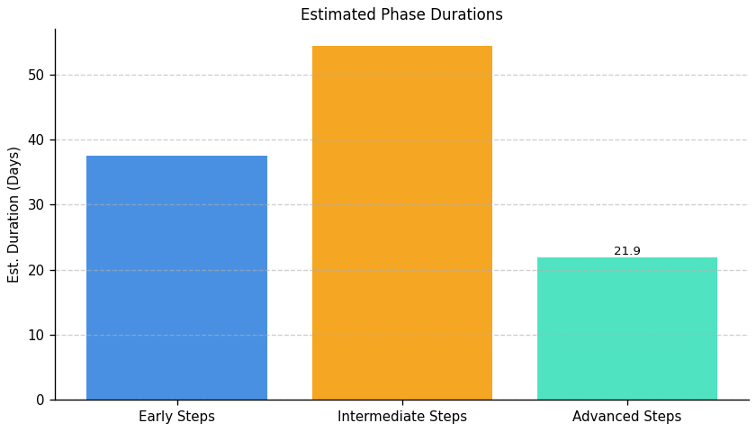
Server Development and Optimization: Roadmap Phase Durations

Slide 10
Operational Integrity and IT Modernization: Top 3 Insights
The organization faces substantial risk due to a complete absence of formal data governance. Specifically, there are no documented policies or procedures for managing data throughout its lifecycle – from creation and movement to retention, archiving, and secure transfer – creating vulnerabilities for data integrity, compliance, and operational efficiency.
A critical weakness exists in organizational resilience. The complete lack of implemented disaster recovery and business continuity plans, including regular backups and testing, leaves the organization highly susceptible to significant data loss and prolonged operational downtime in the event of a disruption.
Proactive IT infrastructure management is severely lacking, hindering future growth and modernization. The absence of asset lifecycle management, including decommissioning processes and regular architecture reviews, indicates a reliance on potentially outdated systems and a reactive approach to infrastructure needs, limiting scalability and increasing technical debt.

Slide 11
Operational Integrity and IT Modernization: Roadmap Overview
Overview:
This roadmap addresses critical gaps in data management, IT operations, and disaster recovery to enhance data integrity, business continuity, and compliance. The initial phase focuses on assessing current processes and identifying vulnerabilities in data movement, infrastructure, and recovery protocols. The intermediate phase centers on aligning data processes with architectural standards, developing robust decommissioning and disaster recovery strategies, and designing standardized data movement protocols. Finally, the advanced phase concentrates on implementing these strategies, conducting thorough testing, documenting procedures, and establishing ongoing governance to ensure continuous improvement and adaptation to evolving business needs.
Total Est: 445 hrs (~55.6 days)
Key Roles: Data Engineers, Solution Architects, Documentation Specialist, Communication Coordinator, Infrastructure Specialist, Audit Team, Strategy Development Team, Data Architect, Networking Specialist, Infrastructure Team, Testing Team, System Owners, Protocol Designer, IT Security Specialist, Backup Strategist, DR Specialists, BC Specialists, IT Administrators, Business Analysts, Enterprise Architects, Testing Teams, DR/BC Specialists, Review Team, Testing Coordinator, IT Specialists, DR Administrators

Slide 12
Operational Integrity and IT Modernization: Implementation Plan Details
--- Early Steps ---
1. Analyze existing data movement processes to identify gaps and inefficiencies. 2. Conduct a comprehensive audit to identify outdated or underutilized infrastructure components. 3. Assess the criticality of different data sets to define backup and archive priorities. 4. Document current Disaster Recovery (DR) and Business Continuity (BC) protocols. 5. Develop a test plan outlining scenarios for backup and recovery testing. 6. Collaborate with data owners and IT operations to refine assessment findings. 7. Collaborate with IT teams to ensure alignment with existing systems.
--- Intermediate Steps ---
1. Align data movement processes within defined architecture boundaries. 2. Develop a strategy outlining the criteria, process, and timeline for decommissioning identified components. 3. Design a comprehensive strategy for backups and archives based on criticality. 4. Design a standardized protocol for data movement based on mapping results. 5. Evaluate and select a disaster recovery solution aligned with policy requirements. 6. Collaborate with architecture teams to ensure alignment. 7. Update processes based on collaboration. 8. Develop documentation for the new strategies.
--- Advanced Steps ---
1. Document the aligned processes and communicate changes to relevant teams. 2. Establish a routine for reviewing and updating the decommissioning strategy. 3. Document the strategy and conduct testing to ensure effectiveness. 4. Implement standardized protocols and conduct thorough testing. 5. Implement the selected DR solution and conduct testing. 6. Define a periodic schedule for architecture boundary reviews. 7. Propose updates to architecture boundaries based on the assessment. 8. Conduct documentation updates. 9. Perform communication sessions with stakeholders. 10. Implement testing scenarios and monitor performance. 11. Configure systems and perform failure simulation testing.
Tools/Platforms (Overall):
Amanda, Bacula, Commvault, Rubrik, Veeam Backup & Replication, Monitoring Tools, Documentation Tools
Subtask Estimates (Aggregated):
--- Early Steps ---
Analysis Collaboration - 18h; Gap Identification - 28h; Collaboration and Planning - 35h; Infrastructure Audit - 30h; Criticality Assessment - 25h; Documentation Review - 20h; Test Plan Development - 20h.
--- Intermediate Steps ---
Collaboration with Architecture - 22h; Process Updates - 20h; Team Collaboration - 18h; Document Development - 25h; Strategy Design - 30h; Alignment with Business Needs - 20h; Research - 25h; Alignment with Policy Requirements - 20h.
--- Advanced Steps ---
Documentation - 43h; Communication Sessions - 15h; Periodic Reviews - 22h; Strategy Updates - 20h; Testing Scenarios - 22h; Implementation - 30h; Testing and Performance Monitoring - 35h; Configuration - 30h; Failure Simulation Testing - 25h; Schedule Definition - 15h; Collaboration with Architecture Teams - 25h; Update Proposal - 25h.

Slide 13
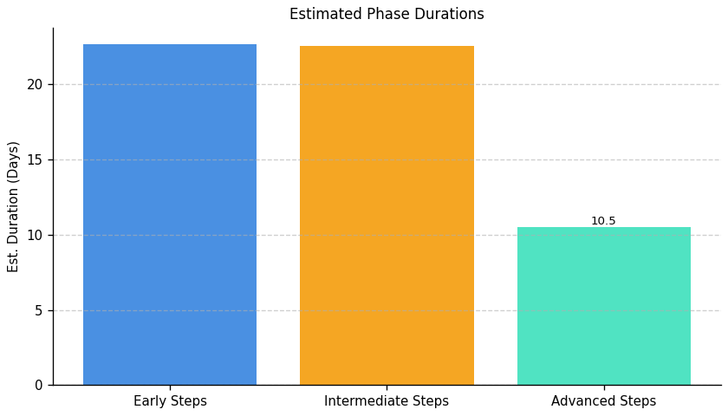
Operational Integrity and IT Modernization: Roadmap Phase Durations

Slide 14
Green IT Strategy and Maturity: Top 3 Insights
The organization fundamentally lacks the ability to measure the impact of its Green IT efforts, consistently failing to quantify reductions in energy consumption, cost savings, or carbon footprint. This absence of data prevents informed decision-making, ROI demonstration, and effective progress tracking towards sustainability objectives.
A comprehensive environmental management system is entirely absent, with no implemented processes or tools for assessment, optimization, or skills development related to sustainable IT practices. This includes a complete lack of resource optimization initiatives, sustainability-focused training, or incentives for environmentally conscious behavior.
Multiple, interconnected barriers – including cost, expertise gaps, lack of executive support, and limited awareness – are preventing Green IT implementation. These challenges indicate a need for a holistic strategy addressing both technical deficiencies and organizational culture to foster broader adoption and overcome resistance.

Slide 15
Green IT Strategy and Maturity: Roadmap Overview
Overview:
This roadmap outlines a phased approach to integrate Green IT practices within the organization. The initial Early Steps focus on establishing a baseline understanding of the current environmental impact of IT operations and initiating planning for sustainability improvements. The Intermediate Steps involve designing and implementing processes for resource optimization, integrating sustainability tools, and developing targeted training programs. Finally, the Advanced Steps concentrate on continuous improvement through ongoing training, monitoring incentive effectiveness, and fostering a long-term culture of sustainability.
Total Est: 628 hrs (~78.5 days)
Key Roles: Environmental Experts, Infrastructure Managers, IT Specialists, Sustainability Analysts, Tool Administrators, Training Coordinators, Process Design Expert, Training Analysts, Training Facilitators, Program Designers, HR Specialists, Assessment Administrators, Communication Specialists, Sustainability Strategists, Department Heads, HR Representatives, Subject Matter Experts, Team Leads, Program Coordinators, HR Analysts, Sustainability Experts

Slide 16
Green IT Strategy and Maturity: Implementation Plan Details
--- Early Steps ---
1. Assess the current environmental impact of infrastructure and processes, collaborating with environmental experts. 2. Evaluate existing and potential tools for managing sustainability, researching available options. 3. Conduct an assessment of environmental impact in the current environment, collaborating with environmental specialists. 4. Define proficiency criteria for assessing sustainability-related skills, collaborating with subject matter experts. 5. Identify specific sustainability-focused skills that need development, conducting a skill gap analysis and collaborating with department heads.
--- Intermediate Steps ---
1. Design processes to optimize resource usage based on assessment results, collaborating with process design experts. 2. Implement selected tools and provide training to relevant teams, configuring tools and conducting training sessions. 3. Design training programs for sustainability-focused skills development, collaborating with trainers. 4. Communicate the defined skills across teams effectively, conducting workshops. 5. Define a structured incentive plan for carbon-literate resources, collaborating with HR. 6. Align process design with overall sustainability goals.
--- Advanced Steps ---
1. Implement the training programs and track participant progress, conducting training sessions. 2. Monitor the effectiveness of incentives and evaluate employee retention, collecting feedback. 3. Establish a mechanism for feedback on skill understanding, setting up feedback sessions and collecting input. 4. Develop training programs to address identified needs, designing curriculum and developing materials. 5. Conduct training sessions, either in-person or through digital platforms, and track attendance.
Tools/Platforms (Overall):
Impact assessment tools, Documentation tools, Training platforms, Digital learning platforms
Subtask Estimates (Aggregated):
--- Early Steps ---
Environmental Assessment - 30h; Collaboration with Experts - 20h; Tool Research - 25h; Collaboration with IT Teams - 15h; Skill Gap Analysis - 20h; Collaboration with Department Heads - 15h
--- Intermediate Steps ---
Process Design - 25h; Alignment with Goals - 18h; Tool Implementation - 40h; Training Sessions - 20h; Program Design - 30h; Collaboration with Trainers - 20h; Workshop Conduct - 25h; Communication Planning - 15h; Incentive Structure Definition - 25h; Collaboration with HR - 15h
--- Advanced Steps ---
Training Sessions - 35h; Progress Tracking - 25h; Monitoring - 35h; Evaluation - 25h; Feedback Session Setup - 20h; Input Collection and Analysis - 15h; Curriculum Design - 30h; Material Development - 20h; Training Delivery - 35h; Attendance Tracking - 25h

Slide 17
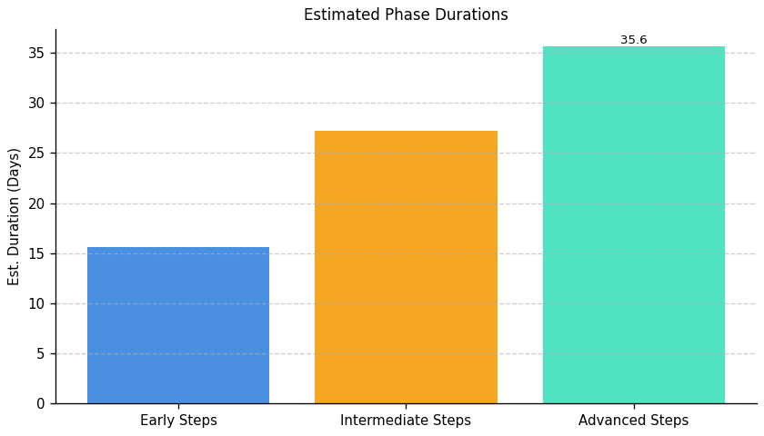
Green IT Strategy and Maturity: Roadmap Phase Durations

Slide 18
IT Carbon Efficiency and Management: Top 3 Insights
The organization does not currently measure its IT carbon footprint – including carbon intensity of operations – preventing baseline establishment, target setting, and progress tracking towards reduction goals.
A defined strategy for reducing the carbon footprint of server operations is absent, with readily available optimization techniques (like cooling improvements) not being utilized, indicating a lack of implementation despite available resources.
IT carbon efficiency is a low organizational priority, evidenced by minimal action taken and a general lack of awareness regarding measurement and strategic reduction initiatives within IT operations.

Slide 19
IT Carbon Efficiency and Management: Roadmap Overview
Overview:
This roadmap outlines a phased approach to reducing the carbon footprint of IT operations. It begins with a comprehensive assessment of current energy consumption and carbon emissions, followed by the development and implementation of strategies to optimize server operations and cooling systems. While initial data does not support advanced optimization, the framework is designed to accommodate future enhancements as data becomes available and reduction efforts progress.
Total Est: 200 hrs (~25.0 days)
Key Roles: IT Administrators, Environmental Experts, Energy Experts, Data Center Managers, Cooling System Technicians

Slide 20
IT Carbon Efficiency and Management: Implementation Plan Details
--- Early Steps ---
1. Assess the current carbon footprint associated with server operations, collaborating with environmental experts and analyzing energy consumption. 2. Conduct an energy efficiency audit of server data centers, collaborating with energy experts and analyzing cooling systems.
--- Intermediate Steps ---
1. Develop a strategy to minimize the carbon footprint in server operations, implementing energy-efficient practices and utilizing renewable energy. 2. Implement cooling optimization practices based on the audit findings, upgrading cooling systems and monitoring temperature controls.
--- Advanced Steps ---
1. No specific methodology defined based on current data.
Tools/Platforms (Overall):
GreenIT Software, AWS IoT Greengrass, The Green Grid, OpenDCRE, Schneider Electric EcoStruxure
Subtask Estimates (Aggregated):
--- Early Steps ---
Carbon Footprint Assessment: 30 hours; Collaboration with Environmental Experts: 20 hours; Energy Efficiency Audit: 30 hours; Collaboration with Energy Experts: 20 hours
--- Intermediate Steps ---
Strategy Development: 35 hours; Implementation of Practices: 15 hours; Cooling System Upgrade: 35 hours; Temperature Control Monitoring: 15 hours
--- Advanced Steps ---
Not applicable based on current data.

Slide 21
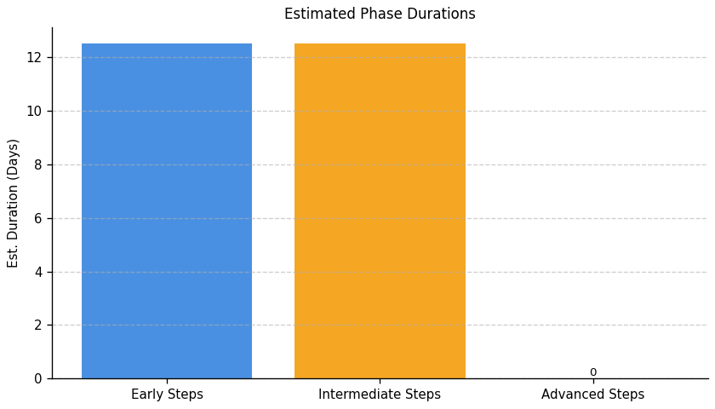
IT Carbon Efficiency and Management: Roadmap Phase Durations

Slide 22
IT Resource Efficiency and E-Waste Management: Top 3 Insights
The organization lacks a defined process for managing IT equipment from acquisition through retirement, leading to potential inefficiencies and increased costs.
A formal electronic waste disposal and recycling policy is absent, creating compliance risks and hindering opportunities to recover value from end-of-life IT assets.
Current IT asset management practices heavily favor a linear consumption model, demonstrating limited adoption of circular economy principles like reuse and refurbishment, and hindering material efficiency improvements.

Slide 23
IT Resource Efficiency and E-Waste Management: Roadmap Overview
Overview:
This roadmap outlines a phased approach to improve IT resource efficiency and establish responsible e-waste management practices. The initial phase focuses on policy development and a baseline assessment of current IT assets. The intermediate phase involves policy implementation, lifecycle tracking, and data collection. Finally, the advanced phase concentrates on optimizing the IT lifecycle, engaging with vendors for sustainable solutions, and establishing key performance indicators to measure progress.
Total Est: 68 hrs (~8.5 days)
Key Roles: IT Procurement, IT Operations, Sustainability Officer

Slide 24
IT Resource Efficiency and E-Waste Management: Implementation Plan Details
--- Early Steps ---
1. Research best practices for e-waste disposal and recycling. 2. Draft a preliminary e-waste disposal policy outlining responsible practices. 3. Conduct a basic inventory of current IT equipment (hardware and software). 4. Define initial criteria for environmentally responsible IT procurement.
--- Intermediate Steps ---
1. Finalize and formally approve the e-waste disposal policy. 2. Communicate the policy to all relevant employees. 3. Implement a tracking system for IT equipment, recording procurement date, assigned user, and disposal date. 4. Begin collecting data on e-waste generated.
--- Advanced Steps ---
1. Evaluate IT procurement processes to prioritize energy-efficient and durable equipment. 2. Explore options for extending the lifespan of IT equipment through maintenance and upgrades. 3. Research and vet certified e-waste recycling vendors. 4. Establish key performance indicators (KPIs) to measure the effectiveness of e-waste management efforts.
Tools/Platforms (Overall):
Spreadsheet software (e.g., Excel, Google Sheets), Internal Communication Platforms, Vendor Management Systems, Data Analytics Tools
Subtask Estimates (Aggregated):
--- Early Steps ---
Research - 8h; Policy Drafting - 12h; Inventory - 8h; Procurement Criteria - 4h.
--- Intermediate Steps ---
Policy Finalization - 4h; Communication - 4h; Tracking System Implementation - 8h; Data Collection Setup - 4h.
--- Advanced Steps ---
Procurement Evaluation - 4h; Lifespan Extension Research - 4h; Vendor Vetting - 4h; KPI Definition - 4h.

Slide 25
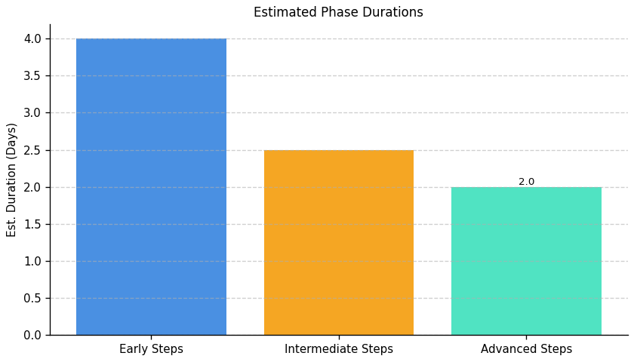
IT Resource Efficiency and E-Waste Management: Roadmap Phase Durations

