Slide 1
Recommendation Report
Session ID: df033ae9-84d4-48ba-a577-374955cbe690
Generated: 2025-04-29

Slide 2
Sustainable Digital Transformation: Top 3 Insights
The organization possesses a strong foundation in modern IT architecture, utilizing microservices, containerization, and APIs. However, a lack of integrated data management beyond existing data lakes and underdeveloped real-time analytics capabilities hinder the full potential of a data marketplace. Prioritizing the development of a comprehensive data strategy, including robust data governance and real-time analytics, is crucial.
The shift towards a product-centric IT structure is a positive step, but requires strengthening agile development practices and integrating sustainability considerations into the development lifecycle. Implementing formalized agile frameworks, enhancing cross-functional collaboration, and embedding sustainability principles will improve the efficiency and effectiveness of IT delivery.
A significant challenge is fostering a culture of innovation. The lack of executive sponsorship and established innovation processes limits the organization's ability to embed innovation effectively. Securing executive buy-in and establishing structured, repeatable innovation processes, including dedicated resources and clear success metrics, are essential for driving sustained growth and transformation.

Slide 3
Sustainable Digital Transformation: Roadmap Overview
Overview:
This roadmap details the evolution of the organization's IT operating model towards a sustainable, product-centric, cloud-native architecture. It emphasizes agile practices, API strategies, and hybrid cloud adoption, while integrating sustainability into the organizational culture. The plan progresses through three phases: foundational agile and microservices implementation, process integration and automation, and finally, AI-driven optimization and governance. Each phase builds upon the previous one, culminating in a highly efficient and sustainable digital ecosystem.
Total Est: 180 hrs (~22.5 days)
Key Roles: Developers, IT Architects, DevOps Engineers, Business Analysts, Sustainability Managers, Data Scientists

Slide 4
Sustainable Digital Transformation: Implementation Plan Details
Overall Goal: Sustainable Digital Transformation Implementation Plan
Methodology / Steps:
--- Early Steps ---
1. Implement iterative development processes and enhance collaboration within development teams. 2. Introduce formalized agile frameworks (e.g., Scrum). 3. Embrace containerization for microservices architecture and develop basic data lakes for real-time analytics. 4. Implement RESTful APIs with API gateways for seamless communication. 5. Integrate IT as an integral part of business strategy and embed sustainability principles in core business functions. 6. Foster a culture of innovation and sustainability.
--- Intermediate Steps ---
1. Create self-service capabilities for infrastructure deployment. 2. Adopt Micro Services, Containers, and Serverless computing. 3. Develop dynamic cloud applications that are auto-scalable and fault-tolerant. 4. Center programs on driving specific business outcomes and measure success based on the achievement of business objectives. 5. Evaluate the percentage of projects successfully transitioning to product-centric IT and allocate innovation to business units with defined strategies. 6. Establish initial processes for innovation, avoiding silos.
--- Advanced Steps ---
1. Implement AI and ML-enabled algorithms for advanced tasks and leverage human-like intelligence to enhance decision-making. 2. Continuously evolve cognitive capabilities for ongoing innovation. 3. Adopt a KPI-based perspective for operations and drive process improvement for business outcomes. 4. Seek executive sponsorship for innovation initiatives.
Tools/Platforms (Overall): Jira, Git, Kubernetes, Docker, Scrum, AWS Lambda, ServiceNow, Taiga, Spigit, TensorFlow, IBM Watson, Grafana, Salesforce
Subtask Estimates (Aggregated):
--- Early Steps --- Various tasks: 10-20 hours each; --- Intermediate Steps --- Various tasks: 15-30 hours each; --- Advanced Steps --- Various tasks: 20-30 hours each

Slide 5
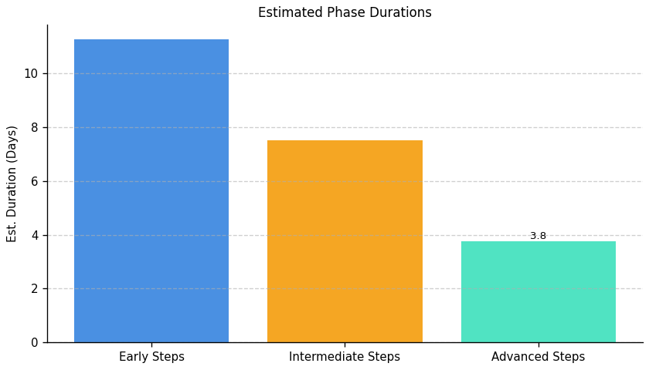
Sustainable Digital Transformation: Roadmap Phase Durations

Slide 6
Server Development and Optimization: Top 3 Insights
The organization's server infrastructure lacks essential monitoring, logging, and security features, creating significant risks of performance bottlenecks, security breaches, and non-compliance. Addressing these deficiencies requires immediate action, including implementing a comprehensive monitoring and alerting system, centralized logging, and robust security measures (firewalls, intrusion detection, regular patching, and access controls). This will necessitate a substantial time investment (estimated at over 700 hours).
The current server infrastructure lacks sufficient redundancy and high availability features, increasing the risk of downtime and service disruptions. Implementing redundancy and high availability requires a dedicated effort (estimated at 175 hours) including risk assessment and solution implementation.
Prioritization and phased implementation of necessary infrastructure improvements are crucial due to the significant time and resource commitment required (over 700 hours total estimated effort across multiple areas). A detailed plan outlining priorities, resource allocation, and implementation timelines is needed to effectively manage this undertaking and mitigate risks.

Slide 7
Server Development and Optimization: Roadmap Overview
Overview:
This roadmap outlines a comprehensive plan to enhance server performance, security, and scalability. The early phase focuses on establishing a baseline for monitoring, resource management, and security assessments, including identifying single points of failure and developing foundational policies. The intermediate phase integrates selected tools, automates processes, implements redundancy plans, and establishes automated patching. The advanced phase implements advanced optimization techniques, such as load balancing and intrusion detection systems, to ensure high availability and robust security. Throughout, rigorous testing and monitoring are crucial.
Total Est: 1030 hrs (~128.8 days)
Key Roles: IT Specialists, Logging System Analysts, IT Administrators, Logging System Integrators, Caching Strategists, Development Teams, IT Architects, Infrastructure Managers, Scalability Planning Team, IT Leadership, Testing Teams, Monitoring Team, Monitoring Administrators, Business Analysts, Network Administrators, Optimization Experts, Security Analysts, Compliance Specialists, Data Management Specialists, QA Engineers, Performance Analysts, Load Balancer Administrators, IT Security Specialists, System Administrators, Patch Management Experts, Redundancy Planning Team

Slide 8
Server Development and Optimization: Implementation Plan Details
Overall Goal: Server Development and Optimization Implementation Plan
Methodology / Steps:
--- Early Steps ---
1. Evaluate centralized logging systems and select a suitable solution; 2. Develop a caching strategy based on server workload and application requirements; 3. Analyze current and projected resource demands for server infrastructure; 4. Assess the current server infrastructure for scalability gaps and identify single points of failure; 5. Evaluate and select a resource monitoring tool for server infrastructure; 6. Evaluate alerting systems to choose an effective solution; 7. Conduct a network assessment to identify areas for optimization; 8. Develop a plan for performance testing of critical server applications; 9. Develop a policy for retaining historical performance data; 10. Assess the current server infrastructure for high availability; 11. Conduct a security threat assessment to identify potential risks and vulnerabilities; 12. Develop an access control policy defining user permissions and restrictions.
--- Intermediate Steps ---
1. Integrate the selected logging system into your server infrastructure; 2. Evaluate and select caching mechanisms aligned with the developed strategy; 3. Develop a plan to ensure server resources meet current and future demands; 4. Develop a plan for enhancing server infrastructure scalability; 5. Configure and integrate the selected monitoring tool with the server infrastructure; 6. Configure alerts based on abnormal server behavior or performance issues; 7. Develop a plan outlining optimizations based on assessment findings; 8. Execute performance testing on critical server applications; 9. Develop a redundancy plan to enhance server infrastructure availability; 10. Evaluate and implement automated patching tools for efficient updates.
--- Advanced Steps ---
1. Implement the planned upgrades to enhance scalability; 2. Implement load balancing in the production environment and conduct testing; 3. Implement the data retention policy and monitor its effectiveness; 4. Regularly review and analyze server logs according to the developed process; 5. Implement identified optimizations and monitor the impact; 6. Implement the planned redundancy measures in the server infrastructure; 7. Evaluate and select an IDS solution suitable for the infrastructure; 8. Implement the selected firewall solution and conduct testing.
Tools/Platforms (Overall): ELK Stack, Splunk, Redis, Varnish, Akamai, Cloudflare, Collectd, Datadog, docker, kubernetes, Amazon ECS, Google Kubernetes Engine, Grafana, Prometheus, Prometheus Alertmanager, OpsGenie, PagerDuty, iperf, SolarWinds Network Performance Monitor, Apache JMeter, LoadRunner, Dynatrace, InfluxDB, AppDynamics, Keepalived, Veeam Backup & Replication, OpenVAS, Tenable, Qualys, Snort, Cisco Firepower, Suricata, iptables, Cisco ASA, Palo Alto Networks, HAProxy, Nginx, Citrix ADC, F5 BIG-IP, Wazuh, SolarWinds Security Event Manager
Subtask Estimates (Aggregated):
--- Early Steps --- Evaluation: 40 hours; Research: 30 hours; Strategy Development: 50 hours; Collaboration with Development Teams: 40 hours; Demand Analysis: 50 hours; Collaboration with Business and IT Teams: 40 hours; Scalability Analysis: 50 hours; Collaboration with IT Architects: 40 hours; Monitoring Tool Research: 40 hours; Alignment with Requirements: 30 hours; Evaluation: 40 hours; Research: 30 hours; Assessment: 40 hours; Traffic Pattern Analysis: 30 hours; Plan Development: 50 hours; Scenario Identification: 40 hours; Success Criteria Definition: 30 hours; Policy Development: 40 hours; Collaboration with Data Management Teams: 30 hours; Risk Assessment: 25 hours; Single Point of Failure Identification: 20 hours; Threat Assessment: 20 hours; Risk Analysis: 15 hours; Policy Development: 20 hours; Collaboration with System Administrators: 15 hours; --- Intermediate Steps --- Integration: 60 hours; Collaboration with IT Teams: 50 hours; Research: 40 hours; Alignment with Strategy: 30 hours; Capacity Planning: 60 hours; Collaboration with IT and Business Teams: 50 hours; Solution Identification: 60 hours; Roadmap Creation: 50 hours; Configuration Setup: 60 hours; Testing: 50 hours; Configuration: 60 hours; Collaboration with Monitoring Teams: 50 hours; Plan Development: 50 hours; Collaboration with Experts: 40 hours; Testing Execution: 70 hours; Results Analysis: 40 hours; Solution Identification: 30 hours; Mitigation Plan Creation: 25 hours; Research: 25 hours; Alignment with Policy Requirements: 20 hours; --- Advanced Steps --- Hardware Upgrade: 80 hours; Scaling Solution Implementation: 70 hours; Rollout: 70 hours; Performance Testing: 60 hours; Implementation: 60 hours; Monitoring Effectiveness: 50 hours; Review and Analysis: 60 hours; Collaboration with IT and Compliance Teams: 50 hours; Implementation: 60 hours; Performance Monitoring: 50 hours; Hardware Upgrade: 40 hours; Redundancy Configuration: 35 hours; Research: 25 hours; Alignment with Threat Assessment: 20 hours; Configuration: 30 hours; Security Testing: 25 hours

Slide 9
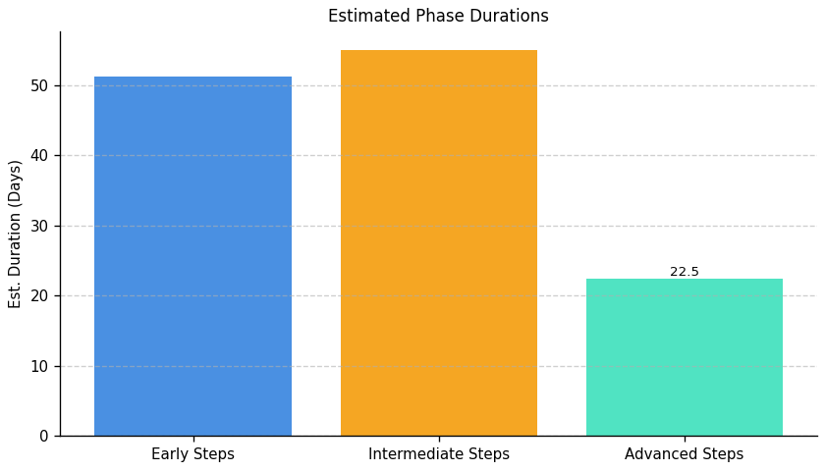
Server Development and Optimization: Roadmap Phase Durations

Slide 10
Operational Integrity and IT Modernization: Top 3 Insights
The organization lacks a robust data management framework, resulting in significant risks to business continuity, data integrity, and regulatory compliance. This includes critical gaps in data movement documentation, decommissioning strategies for outdated infrastructure, standardized data movement protocols, and a comprehensive backup and archive strategy. Implementing these missing processes and associated documentation will require substantial cross-functional collaboration and resource allocation (hundreds of man-hours across multiple projects).
Establishing and implementing comprehensive data retention and archiving policies is crucial to mitigate identified risks and improve operational maturity. The current absence of these policies poses a substantial threat to data integrity and regulatory compliance.
Addressing these deficiencies necessitates a multi-phased approach involving data engineers, architects, infrastructure specialists, IT security, and business analysts to develop and implement a complete data management strategy. This includes defining clear roles and responsibilities, establishing standardized procedures, and allocating sufficient resources for successful implementation and ongoing maintenance.

Slide 11
Operational Integrity and IT Modernization: Roadmap Overview
Overview:
This roadmap enhances operational integrity and modernizes IT infrastructure by addressing critical gaps in data management, infrastructure decommissioning, and disaster recovery. It begins by analyzing existing processes, identifying outdated infrastructure, and assessing data criticality. The intermediate phase focuses on process alignment, automation, and developing comprehensive backup and archive strategies. The advanced phase implements standardized protocols, establishes governance, and ensures robust resilience through comprehensive documentation, testing, and the implementation of a data management policy and disaster recovery solution.
Total Est: 625 hrs (~78.1 days)
Key Roles: Data Engineers, Solution Architects, Data Owners, IT Operations, Infrastructure Specialist, Audit Team, Strategy Development Team, Review Team, Documentation Specialist, Communication Coordinator, Data Architect, Networking Specialist, Infrastructure Team, Testing Team, System Owners, Protocol Designer, Training Coordinator, IT Security Specialist, Backup Strategist, DR Specialists, BC Specialists, Analysis Team, IT Specialists, DR Administrators, Testing Teams, Enterprise Architects, Business Analysts, Disaster Recovery Coordinators

Slide 12
Operational Integrity and IT Modernization: Implementation Plan Details
Overall Goal: Operational Integrity and IT Modernization Implementation Plan
Methodology / Steps:
--- Early Steps ---
1. Analyze existing data movement processes to identify gaps and inefficiencies; conduct a comprehensive audit to identify outdated or underutilized infrastructure components. 2. Assess criticality of different data sets to define backup and archive priorities; document the current Disaster Recovery (DR) and Business Continuity (BC) protocols. 3. Map data movement requirements across various systems and applications; define a periodic schedule for architecture boundary reviews.
--- Intermediate Steps ---
1. Align data movement processes within defined architecture boundaries; develop a strategy outlining the criteria, process, and timeline for decommissioning identified components. 2. Design a comprehensive strategy for backups and archives based on criticality; identify areas of improvement in existing DR and BC protocols. 3. Design a standardized protocol for data movement based on mapping results; assess evolving business needs and their alignment with existing architecture.
--- Advanced Steps ---
1. Document the aligned processes and communicate changes to relevant teams; establish a routine for reviewing and updating the decommissioning strategy. 2. Document the strategy and conduct testing to ensure effectiveness; update DR and BC protocols based on identified improvements. 3. Implement standardized protocols and conduct thorough testing; document the standardized protocol and conduct training for relevant teams. 4. Propose updates to architecture boundaries based on the assessment; develop a disaster recovery policy defining steps and responsibilities during failures. 5. Evaluate and select a disaster recovery solution aligned with policy requirements; implement the selected DR solution and conduct testing. 6. Develop a test plan outlining scenarios for backup and recovery testing; conduct regular backup and recovery testing based on the developed plan.
Tools/Platforms (Overall): Amanda, Rubrik, Zerto, Bacula, Commvault, Veeam Backup & Replication
Subtask Estimates (Aggregated):
--- Early Steps --- Analysis Collaboration: 18 hours; Gap Identification: 28 hours; Collaboration and Planning: 20 hours; Infrastructure Audit: 30 hours; Collaboration and Planning: 15 hours; Criticality Assessment: 25 hours; Documentation Review: 20 hours; Collaboration with Specialists: 15 hours; Collaboration with System Owners: 20 hours; Data Mapping: 30 hours; Schedule Definition: 15 hours; Collaboration with Architecture Teams: 25 hours --- Intermediate Steps --- Collaboration with Architecture: 22 hours; Process Updates: 20 hours; Team Collaboration: 18 hours; Document Development: 25 hours; Strategy Design: 30 hours; Alignment with Business Needs: 20 hours; Thorough Analysis: 30 hours; Best Practices Review: 25 hours; Protocol Design: 35 hours; Alignment with Business Needs: 15 hours; Interviews and Data Collection: 30 hours; Alignment Analysis: 20 hours --- Advanced Steps --- Documentation: 25 hours; Communication Sessions: 15 hours; Periodic Reviews: 22 hours; Strategy Updates: 20 hours; Documentation: 18 hours; Testing Scenarios: 22 hours; Collaboration with Specialists: 20 hours; Update Implementation: 25 hours; Implementation: 30 hours; Testing and Performance Monitoring: 35 hours; Documentation: 22 hours; Training Sessions: 18 hours; Collaboration with Architecture Teams: 25 hours; Update Proposal: 25 hours; Policy Development: 20 hours; Collaboration with IT Teams: 15 hours; Research: 25 hours; Alignment with Policy Requirements: 20 hours; Configuration: 30 hours; Failure Simulation Testing: 25 hours; Test Plan Development: 20 hours; Collaboration with IT Teams: 15 hours; Testing Execution: 30 hours; Results Analysis: 25 hours

Slide 13
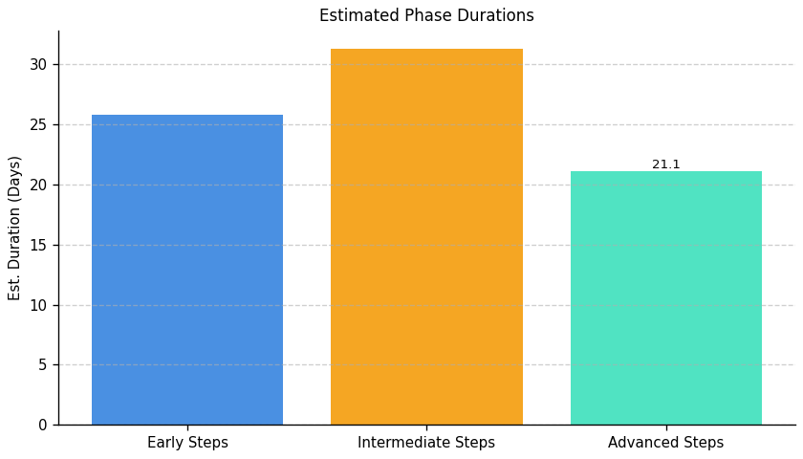
Operational Integrity and IT Modernization: Roadmap Phase Durations

Slide 14
Green IT Strategy and Maturity: Top 3 Insights
The organization lacks a formal framework for managing the environmental impact of its IT operations, including processes, tools, and skilled personnel. This deficiency hinders effective measurement of Green IT initiatives and prevents demonstration of return on investment.
Significant organizational barriers, such as budget limitations, lack of executive sponsorship, and resistance to change, impede the adoption and scaling of Green IT practices. Overcoming these hurdles is crucial for progress.
The absence of robust data collection and analysis regarding energy consumption and cost savings within IT prevents accurate assessment of current environmental impact and informed decision-making for future Green IT investments.

Slide 15
Green IT Strategy and Maturity: Roadmap Overview
Overview:
This roadmap outlines the implementation of a Green IT strategy, progressing from assessing the current environmental impact of IT operations and evaluating suitable tools, to designing resource optimization processes and developing training programs, and finally, implementing chosen tools, delivering training, and establishing incentive programs to foster a carbon-literate workforce and improve environmental performance.
Total Est: 621 hrs (~77.6 days)
Key Roles: Environmental Experts, Infrastructure Managers, IT Specialists, Sustainability Analysts, Tool Administrators, Training Coordinators, Environmental Specialist, IT Operations, Process Design Expert, Documentation Specialist, Training Coordinator, Training Analysts, Department Heads, Training Facilitators, Program Designers, Program Coordinators, Sustainability Experts, Team Leads, Communication Specialists, HR Specialists, Assessment Designers, Subject Matter Experts, Assessment Administrators, Training Instructors, HR Representatives, HR Analysts, Sustainability Strategists

Slide 16
Green IT Strategy and Maturity: Implementation Plan Details
Overall Goal: Green IT Strategy and Maturity Implementation Plan
Methodology / Steps:
--- Early Steps ---
1. Assess the current environmental impact of infrastructure and processes. 2. Evaluate existing and potential tools for managing sustainability. 3. Conduct an assessment of environmental impact in the current environment and identify specific sustainability-focused skills that need development.
--- Intermediate Steps ---
1. Design processes to optimize resource usage based on assessment results. 2. Design training programs for sustainability-focused skills development. 3. Define the skills required for sustainability initiatives and document them.
--- Advanced Steps ---
1. Implement selected tools and provide training to relevant teams. 2. Implement the training programs and track participant progress. 3. Communicate the defined skills across teams effectively and establish a mechanism for feedback on skill understanding. 4. Define a structured incentive plan for carbon-literate resources, communicate the plan to employees, and create awareness. 5. Monitor the effectiveness of incentives and evaluate employee retention. 6. Conduct training sessions, either in-person or through digital platforms.
Tools/Platforms (Overall): Impact assessment tools, Documentation tools, Training platforms
Subtask Estimates (Aggregated):
--- Early Steps --- Environmental Assessment: 30 hours; Collaboration with Experts: 20 hours; Tool Research: 25 hours; Collaboration with IT Teams: 15 hours; Collaboration and Planning: 20 hours; Impact Assessment: 30 hours; Skill Gap Analysis: 20 hours; Collaboration with Department Heads: 15 hours; --- Intermediate Steps --- Process Design: 25 hours; Alignment with Goals: 18 hours; Program Design: 30 hours; Collaboration with Trainers: 20 hours; Skill Definition: 20 hours; Collaboration with Experts: 15 hours; --- Advanced Steps --- Tool Implementation: 40 hours; Training Sessions: 55 hours; Progress Tracking: 25 hours; Workshop Conduct: 25 hours; Communication Planning: 15 hours; Feedback Session Setup: 20 hours; Input Collection and Analysis: 15 hours; Incentive Structure Definition: 25 hours; Collaboration with HR: 15 hours; Communication Development: 30 hours; Awareness Sessions: 20 hours; Monitoring: 35 hours; Evaluation: 25 hours; Training Delivery: 35 hours; Attendance Tracking: 25 hours

Slide 17
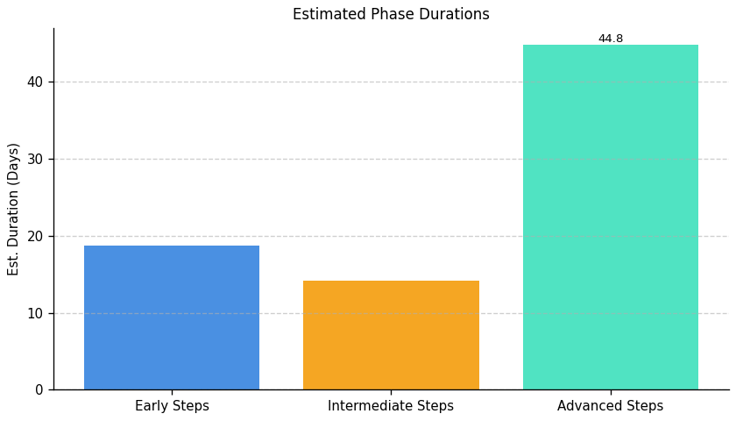
Green IT Strategy and Maturity: Roadmap Phase Durations

Slide 18
IT Carbon Efficiency and Management: Top 3 Insights
The organization lacks a comprehensive strategy for measuring and reducing its IT carbon footprint. This includes the absence of carbon intensity tracking for IT operations, a calculated IT-related carbon footprint, and any initiatives focused on server energy efficiency or data center cooling optimization.
The organization acknowledges its shortcomings in addressing its IT-related environmental impact and explicitly requests external guidance and support to develop and implement effective carbon reduction strategies.
Implementation of carbon reduction strategies requires significant external support, indicating a need for substantial investment in expertise and resources to achieve meaningful progress in this area.

Slide 19
IT Carbon Efficiency and Management: Roadmap Overview
Overview:
This roadmap details the implementation of an IT carbon efficiency and management program. It begins with establishing a baseline carbon footprint for IT operations, identifying key areas for improvement, and initiating collaboration with environmental experts. Next, a reduction strategy is developed and implemented, including energy-efficient practices and renewable energy utilization, along with an energy efficiency audit of data centers, focusing on cooling systems. Finally, the plan culminates in cooling optimization based on audit findings and the establishment of ongoing monitoring to ensure sustained carbon reduction.
Total Est: 200 hrs (~25.0 days)
Key Roles: Environmental Experts, IT Administrators, Data Center Managers, Cooling System Technicians, Energy Experts

Slide 20
IT Carbon Efficiency and Management: Implementation Plan Details
Overall Goal: IT Carbon Efficiency and Management Implementation Plan
Methodology / Steps:
--- Early Steps ---
1. Assess the current carbon footprint associated with server operations by analyzing energy consumption. 2. Collaborate with environmental experts to define appropriate measurement methodologies and metrics for carbon intensity.
--- Intermediate Steps ---
1. Develop a strategy to minimize the carbon footprint in server operations by implementing energy-efficient practices and utilizing renewable energy. 2. Conduct an energy efficiency audit to assess the energy efficiency of server data centers, analyzing cooling systems.
--- Advanced Steps ---
1. Implement cooling optimization practices based on audit findings by upgrading cooling systems and monitoring temperature controls. 2. Establish ongoing monitoring and reporting mechanisms to track carbon intensity and the effectiveness of implemented strategies.
Tools/Platforms (Overall): GreenIT Software, AWS IoT Greengrass, The Green Grid, OpenDCRE, Schneider Electric EcoStruxure
Subtask Estimates (Aggregated):
--- Early Steps --- Carbon Footprint Assessment - 30h; Collaboration with Environmental Experts - 20h; --- Intermediate Steps --- Strategy Development - 35h; Implementation of Practices - 15h; Energy Efficiency Audit - 30h; Collaboration with Energy Experts - 20h; --- Advanced Steps --- Cooling System Upgrade - 35h; Temperature Control Monitoring - 15h

Slide 21
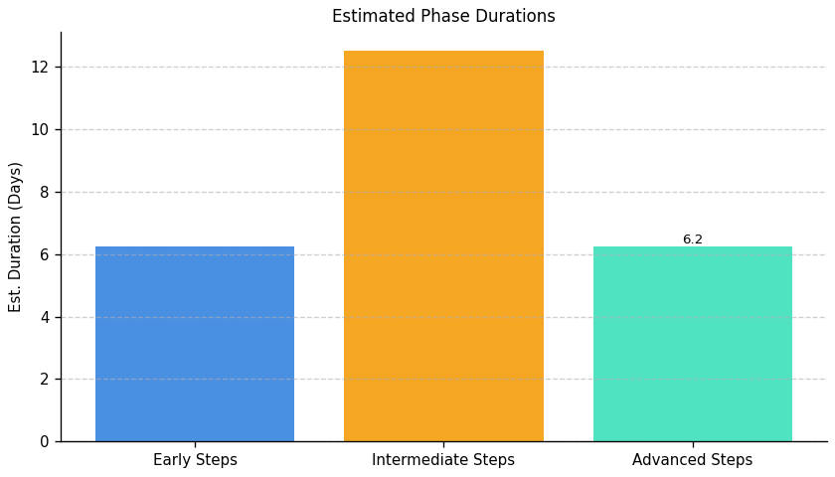
IT Carbon Efficiency and Management: Roadmap Phase Durations

Slide 22
IT Resource Efficiency and E-Waste Management: Top 3 Insights
The organization lacks a formal policy and procedures for the responsible disposal and recycling of electronic waste (e-waste), creating significant environmental risk.
The organization's IT equipment lifecycle management is deficient, impacting sustainability and potentially incurring unnecessary costs through inefficient procurement, maintenance, and disposal practices.
Implementing a comprehensive e-waste management policy coupled with improved IT equipment lifecycle management practices is crucial to enhance environmental sustainability and operational efficiency.

Slide 23
IT Resource Efficiency and E-Waste Management: Roadmap Overview
Overview:
This roadmap outlines the implementation of a comprehensive IT resource efficiency and e-waste management program. It begins with establishing a foundational e-waste disposal policy and progresses through implementing equipment lifecycle management processes, culminating in optimizing resource efficiency and establishing robust reporting mechanisms to track progress and identify areas for improvement. The plan addresses the organization's current lack of a formal e-waste disposal policy and poor equipment lifecycle management practices.
Total Est: 70 hrs (~8.8 days)
Key Roles: IT Manager, Sustainability Officer, Procurement Manager, IT Staff

Slide 24
IT Resource Efficiency and E-Waste Management: Implementation Plan Details
Overall Goal: IT Resource Efficiency and E-Waste Management Implementation Plan
Methodology / Steps:
--- Early Steps ---
1. Research best practices for e-waste management and recycling in the relevant jurisdiction. 2. Draft a basic policy outlining procedures for collecting, sorting, and disposing of e-waste. 3. Identify and contract with a certified e-waste recycler.
--- Intermediate Steps ---
1. Develop a simple inventory system to track IT equipment. 2. Establish basic procedures for equipment maintenance and repair. 3. Integrate the e-waste policy into existing IT procurement and disposal processes.
--- Advanced Steps ---
1. Implement a more robust asset management system to track equipment usage and lifecycle costs. 2. Develop key performance indicators (KPIs) to measure progress towards sustainability goals. 3. Establish regular reporting to monitor progress and identify areas for improvement.
Tools/Platforms (Overall): None
Subtask Estimates (Aggregated):
--- Early Steps --- Research: 8 hours; Policy Drafting: 12 hours; Recycler Selection: 10 hours; --- Intermediate Steps --- Inventory System: 10 hours; Maintenance Procedures: 5 hours; Policy Integration: 5 hours; --- Advanced Steps --- Asset Management System: 10 hours; KPI Development: 5 hours; Reporting Mechanisms: 5 hours

Slide 25
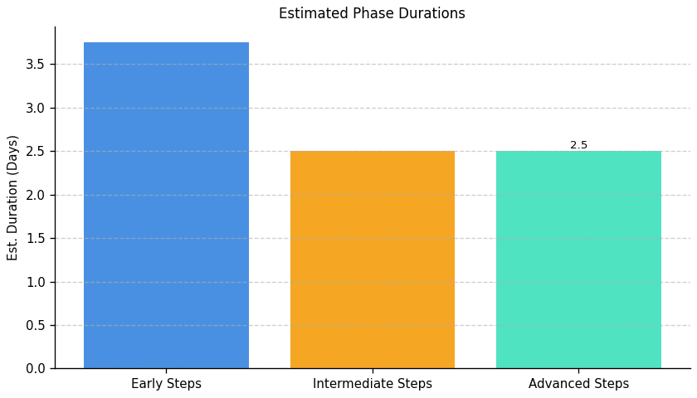
IT Resource Efficiency and E-Waste Management: Roadmap Phase Durations

