Slide 1
Recommendation Report
Session ID: df033ae9-84d4-48ba-a577-374955cbe690
Generated: 2025-04-29

Slide 2
Sustainable Digital Transformation: Top 3 Insights
The organization excels at adopting modern IT practices – containerization, data lakes, and APIs – but currently prioritizes technical implementation over demonstrating how these technologies directly contribute to measurable sustainability improvements beyond standard business KPIs. This creates a risk of ‘tech for tech’s sake’ rather than impactful, sustainable digital transformation.
Sustainability initiatives are largely reactive and focused on achieving existing business goals, neglecting proactive consideration of broader environmental and social impacts. A shift is needed to integrate sustainability as a core value driving innovation and strategic decision-making, not simply a reporting metric.
Innovation efforts are fragmented and lack consistent executive support, preventing sustainability-focused ideas from scaling and becoming embedded within the organization’s core strategy. Establishing clear innovation processes with leadership sponsorship is crucial to fostering a culture where sustainable solutions are actively developed and implemented.

Slide 3
Sustainable Digital Transformation: Roadmap Overview
Overview:
This roadmap outlines a phased approach to achieving sustainable digital transformation. The initial phase focuses on foundational modernization, integrating IT with business functions, and adopting agile practices. The intermediate phase emphasizes process integration, automation, and aligning programs with key business outcomes. Finally, the advanced phase leverages AI/ML-driven insights, continuous process improvement, and executive sponsorship to foster a culture of innovation and maximize sustainability benefits.
Total Est: 190 hrs (~23.8 days)
Key Roles: IT Architects, Developers, Business Analysts, Security Professionals, Innovation Managers, Data Scientists

Slide 4
Sustainable Digital Transformation: Implementation Plan Details
Overall Goal: Sustainable Digital Transformation Implementation Plan
Methodology / Steps:
--- Early Steps ---
1. Embrace containerization for a microservices architecture. 2. Develop matured data lakes for real-time analytics. 3. Implement RESTful APIs with API gateways for seamless communication. 4. Integrate IT as an integral part of business strategy. 5. Introduce iterative development processes and enhance collaboration within development teams. 6. Implement Scrum for an agile framework.
--- Intermediate Steps ---
1. Create self-service capabilities for infrastructure deployment. 2. Adopt Micro Services, Containers, and Serverless computing. 3. Develop dynamic cloud applications that are auto-scalable and fault-tolerant. 4. Center programs on driving specific business outcomes and measure success based on the achievement of business objectives. 5. Allocate innovation to business units with defined strategies.
--- Advanced Steps ---
1. Implement AI and ML-enabled algorithms for advanced tasks. 2. Leverage human-like intelligence to enhance decision-making and continuously evolve cognitive capabilities for ongoing innovation. 3. Adopt a KPI-based perspective for operations and drive process improvement for business outcomes. 4. Seek executive sponsorship for innovation initiatives and establish initial processes for innovation, avoiding silos.
Tools/Platforms (Overall): Kubernetes, Azure DevOps, Docker, Jira, Git-scm, Odoo, AWS Lambda, ServiceNow, Spigit, Grafana, TensorFlow, IBM Watson, Salesforce, GitHub
Subtask Estimates (Aggregated):
--- Early Steps ---
Containerization: 10h; Data Lakes: 15h; APIs: 10h; Business Integration: 5h; Agile Implementation: 5h; Collaboration: 5h; Scrum: 5h; --- Intermediate Steps ---
Self-Service: 10h; Serverless: 10h; Dynamic Apps: 5h; Outcome Programs: 5h; KPI Measurement: 5h; Innovation Allocation: 5h; --- Advanced Steps ---
AI/ML Implementation: 10h; Cognitive Enhancement: 5h; Continuous Evolution: 5h; KPI Operations: 5h; Process Improvement: 5h; Executive Sponsorship: 5h; Innovation Processes: 30h

Slide 5
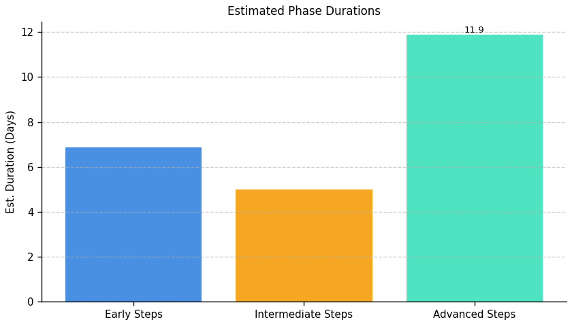
Sustainable Digital Transformation: Roadmap Phase Durations

Slide 6
Server Development and Optimization: Top 3 Insights
The organization demonstrates a critical lack of foundational server management practices, including logging, monitoring, performance analysis, and capacity planning, indicating a fully reactive operational model. Addressing this requires an estimated 265-350+ man-hours to establish core capabilities and prevent future downtime and resource inefficiencies.
Server security and resilience are currently non-existent, with no implementation of essential controls like patching, firewalls, intrusion detection, redundancy, or access controls. This poses a high risk of outages, data breaches, and non-compliance, demanding immediate attention and an estimated 590+ man-hours for initial remediation.
A significant barrier to improvement appears to be a lack of internal expertise rather than simply a lack of tooling. The organization would benefit from external support or targeted training to build the necessary skills for ongoing server optimization, security implementation, and proactive management.

Slide 7
Server Development and Optimization: Roadmap Overview
Overview:
This roadmap addresses critical gaps in server infrastructure, focusing on monitoring, security, redundancy, and performance. The initial phase establishes foundational monitoring and risk assessment, identifying single points of failure and developing essential security policies. The intermediate phase integrates selected tools for logging, caching, load balancing, and automated patching, aligning them with established policies. Finally, the advanced phase focuses on performance optimization, capacity planning, and implementing redundancy solutions, ensuring high availability, data protection, and scalability to support business growth.
Total Est: 860 hrs (~107.5 days)
Key Roles: IT Specialists, IT Administrators, Monitoring Teams, Security Analysts, Compliance Specialists, Business Analysts, Infrastructure Managers, Scalability Planning Team, IT Leadership, Application Developers, Performance Analysts, Network Administrators, Optimization Experts, Testing Team, Logging System Analysts, Alerting System Analysts, Caching Strategists, Infrastructure Team, Data Management Specialists, Redundancy Planning Team, Patch Management Experts, System Administrators, IT Security Specialists

Slide 8
Server Development and Optimization: Implementation Plan Details
Overall Goal: Server Development and Optimization Implementation Plan
Methodology / Steps:
--- Early Steps ---
1. Evaluate centralized logging systems to choose the most suitable one, researching solutions and considering scalability and compatibility. 2. Evaluate and select a resource monitoring tool for server infrastructure, aligning it with infrastructure requirements. 3. Evaluate alerting systems to choose an effective solution, considering real-time monitoring capabilities. 4. Conduct a network assessment to identify areas for optimization, analyzing traffic patterns. 5. Assess current server infrastructure for scalability gaps, collaborating with IT architects and conducting workload analysis. 6. Assess the current server infrastructure for high availability and identify single points of failure. 7. Develop a patch management policy outlining the frequency and process for updates, collaborating with system administrators. 8. Conduct a security threat assessment to identify potential risks and vulnerabilities, performing risk analysis. 9. Develop an access control policy defining user permissions and restrictions, collaborating with system administrators.
--- Intermediate Steps ---
1. Integrate the selected logging system into your server infrastructure, configuring log sources and collaborating with IT teams. 2. Configure and integrate the selected monitoring tool with the server infrastructure, following tool documentation and testing configurations. 3. Configure alerts based on abnormal server behavior or performance issues, defining alert thresholds and collaborating with monitoring teams. 4. Configure the selected load balancer for your server infrastructure, following load balancer documentation and testing configurations. 5. Develop a caching strategy based on server workload and application requirements, collaborating with development teams and analyzing application behavior. 6. Develop a process for auditing server logs for security and compliance, defining audit criteria and collaborating with security and compliance teams. 7. Identify redundancy solutions and create a mitigation plan. 8. Evaluate and implement automated patching tools for efficient updates, aligning with policy requirements. 9. Evaluate and select an IDS solution suitable for the infrastructure, aligning with the threat assessment. 10. Evaluate and select a firewall solution aligned with access control policies.
--- Advanced Steps ---
1. Implement selected caching mechanisms and conduct testing, configuring caching and performing load testing. 2. Implement the planned upgrades to enhance scalability, upgrading hardware and implementing scaling solutions. 3. Implement resource monitoring in the production environment and provide training, rolling out the solution and training relevant teams. 4. Execute performance testing on critical server applications, using testing tools and analyzing results. 5. Develop a roadmap for scaling server infrastructure based on growth assessments, defining milestones and collaborating with IT and business teams. 6. Implement identified optimizations and monitor the impact, making configuration changes and analyzing performance. 7. Upgrade hardware and configure redundant systems. 8. Configure firewall rules and perform security testing. 9. Implement the selected IDS solution and integrate it into the server infrastructure, performing integration testing. 10. Implement the selected firewall solution and conduct testing.
Tools/Platforms (Overall): ELK Stack (Elasticsearch, Logstash, Kibana), Splunk, Grafana, Prometheus, Dynatrace, InfluxDB, OpsGenie, PagerDuty, HAProxy, Nginx, Citrix ADC, F5 BIG-IP, Redis, Varnish, Akamai, Cloudflare, Keepalived, OpenVAS, Veeam Backup & Replication, iptables, Tenable, Qualys, Snort, Cisco Firepower, Suricata, Cisco ASA, Palo Alto Networks, docker, kubernetes, Amazon ECS, Google Kubernetes Engine (GKE), OpenStack, VMware vSphere, Apache JMeter, LoadRunner, Datadog, New Relic, Collectd
Subtask Estimates (Aggregated):
--- Early Steps ---
Evaluation: 40h; Research: 30h; Monitoring Tool Research: 40h; Alignment with Requirements: 30h; Assessment: 40h; Traffic Pattern Analysis: 30h; Scalability Analysis: 50h; Collaboration with IT Architects: 40h; Risk Assessment: 25h; Single Point of Failure Identification: 20h; Policy Development: 40h; Collaboration with System Administrators: 30h; Threat Assessment: 40h; Risk Analysis: 30h; Policy Development: 40h; Collaboration with System Administrators: 30h
--- Intermediate Steps ---
Integration: 60h; Collaboration with IT Teams: 50h; Configuration Setup: 60h; Testing: 50h; Configuration: 60h; Collaboration with Monitoring Teams: 50h; Configuration Setup: 60h; Testing: 50h; Strategy Development: 50h; Collaboration with Development Teams: 40h; Process Development: 40h; Collaboration with Security and Compliance Teams: 30h; Solution Identification: 30h; Mitigation Plan Creation: 25h; Research: 50h; Alignment with Policy Requirements: 40h; Research: 50h; Alignment with Threat Assessment: 40h; Research: 50h; Alignment with Policy Requirements: 40h
--- Advanced Steps ---
Configuration: 60h; Load Testing: 50h; Hardware Upgrade: 80h; Scaling Solution Implementation: 70h; Rollout: 70h; Training: 60h; Testing Execution: 70h; Results Analysis: 40h; Roadmap Development: 60h; Collaboration with IT and Business Teams: 50h; Implementation: 60h; Performance Monitoring: 50h; Hardware Upgrade: 40h; Redundancy Configuration: 35h; Configuration: 60h; Security Testing: 50h; Configuration: 60h; Integration Testing: 50h; Configuration: 60h; Security Testing: 50h

Slide 9
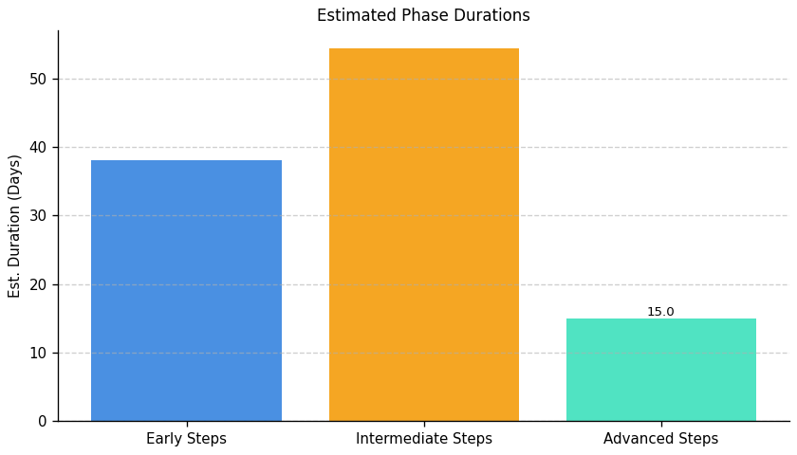
Server Development and Optimization: Roadmap Phase Durations

Slide 10
Operational Integrity and IT Modernization: Top 3 Insights
The organization faces substantial risk due to a complete lack of formal data governance. Missing policies for data movement, retention, and archiving, combined with absent standardized transfer protocols, creates vulnerabilities to data inconsistencies, compliance failures, and operational inefficiencies. Immediate action is needed to define and implement these foundational data management practices.
A critical and unaddressed weakness exists in organizational resilience. The absence of implemented backup/recovery strategies, disaster recovery plans, and associated testing leaves the organization highly susceptible to data loss and business disruption, requiring a significant investment – estimated at over 250 man-hours – to establish even minimal protection measures.
The organization’s IT infrastructure is operating without proactive lifecycle management, increasing technical debt and limiting future scalability. The lack of system decommissioning processes and regular architecture reviews indicates a reliance on potentially outdated technology and hinders the ability to adapt to changing business requirements.

Slide 11
Operational Integrity and IT Modernization: Roadmap Overview
Overview:
This roadmap addresses critical gaps in data management, IT operations, and disaster recovery to enhance data integrity, business continuity, and compliance. The initial phase focuses on assessing the current state and prioritizing areas for improvement. The intermediate phase centers on standardizing processes and aligning them with architectural boundaries. Finally, the advanced phase implements these strategies, conducts thorough testing, and establishes ongoing governance to ensure sustained resilience and alignment with evolving business needs.
Total Est: 417 hrs (~52.1 days)
Key Roles: Data Engineers, Solution Architects, Documentation Specialist, Communication Coordinator, Infrastructure Specialist, Audit Team, Strategy Development Team, Data Architect, Networking Specialist, Infrastructure Team, Testing Team, System Owners, Protocol Designer, Training Coordinator, IT Operations, IT Security Specialist, Backup Strategist, DR Specialists, BC Specialists, Business Analysts, IT Administrators, Analysis Team, Review Team, Enterprise Architects, Testing Coordinator

Slide 12
Operational Integrity and IT Modernization: Implementation Plan Details
Overall Goal: Operational Integrity and IT Modernization Implementation Plan
Methodology / Steps:
--- Early Steps ---
1. Analyze existing data movement processes to identify gaps and inefficiencies. 2. Conduct a comprehensive audit to identify outdated or underutilized infrastructure components. 3. Assess the criticality of different data sets to define backup and archive priorities. 4. Document current Disaster Recovery (DR) and Business Continuity (BC) protocols. 5. Develop a test plan outlining scenarios for backup and recovery testing. 6. Define a periodic schedule for architecture boundary reviews. 7. Collaborate with specialists to refine assessment findings.
--- Intermediate Steps ---
1. Align data movement processes within defined architecture boundaries. 2. Develop a decommissioning strategy outlining criteria, process, and timeline. 3. Standardize protocols for efficient data movement across infrastructure elements. 4. Design a comprehensive strategy for backups and archives based on criticality. 5. Assess evolving business needs and their alignment with existing architecture. 6. Conduct interviews and data collection to support process updates.
--- Advanced Steps ---
1. Document aligned processes and communicate changes to relevant teams. 2. Establish a routine for reviewing and updating the decommissioning strategy. 3. Implement standardized protocols and conduct thorough testing. 4. Document the standardized protocol and conduct training for relevant teams. 5. Document the strategy and conduct testing to ensure effectiveness. 6. Propose updates to architecture boundaries based on the assessment. 7. Update DR and BC protocols based on identified improvements.
Tools/Platforms (Overall): Amanda, Bacula, Rubrik, Zerto, Commvault, Veeam Backup & Replication
Subtask Estimates (Aggregated):
--- Early Steps --- Analysis Collaboration - 18h; Gap Identification - 28h; Collaboration and Planning - 35h; Infrastructure Audit - 30h; Criticality Assessment - 25h; Documentation Review - 20h; Test Plan Development - 20h; Schedule Definition - 15h; Collaboration with Architecture Teams - 25h. --- Intermediate Steps --- Collaboration with Architecture - 22h; Process Updates - 20h; Team Collaboration - 18h; Document Development - 25h; Research and Standardization - 20h; Protocol Implementation - 28h; Strategy Design - 30h; Alignment with Business Needs - 20h; Interviews and Data Collection - 30h; Alignment Analysis - 20h. --- Advanced Steps --- Documentation - 65h; Communication Sessions - 15h; Periodic Reviews - 22h; Strategy Updates - 20h; Implementation - 30h; Testing and Performance Monitoring - 35h; Training Sessions - 18h; Update Proposal - 25h; Update Implementation - 25h; Collaboration with Specialists - 20h.

Slide 13
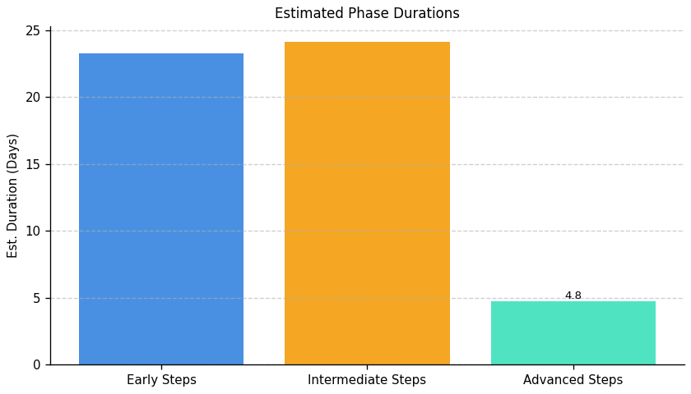
Operational Integrity and IT Modernization: Roadmap Phase Durations

Slide 14
Green IT Strategy and Maturity: Top 3 Insights
The organization fundamentally lacks the ability to measure the impact of its Green IT efforts, consistently failing to quantify reductions in energy consumption, cost savings, or carbon footprint. This absence of data prevents informed decision-making, ROI demonstration, and effective progress tracking towards sustainability objectives.
A comprehensive environmental management system is entirely absent, with no implemented processes or tools for assessment, optimization, or skills development related to sustainable IT practices. This extends to a complete lack of resource optimization initiatives and dedicated training programs for staff.
Multiple, interconnected barriers – including cost, expertise gaps, lack of executive support, and limited awareness – are preventing Green IT implementation. These challenges indicate a need for a holistic strategy addressing both technical deficiencies and organizational culture to foster sustainable IT adoption.

Slide 15
Green IT Strategy and Maturity: Roadmap Overview
Overview:
This roadmap outlines a phased approach to integrate Green IT practices within the organization. The initial Early Steps focus on establishing a baseline understanding of the current environmental impact of IT operations and defining sustainability goals. The Intermediate Steps involve designing and implementing processes for resource optimization, integrating sustainability tools, and developing targeted training programs. Finally, the Advanced Steps concentrate on continuous improvement through ongoing monitoring, assessment, and training, alongside a plan to attract and retain personnel with carbon literacy.
Total Est: 626 hrs (~78.2 days)
Key Roles: Environmental Experts, Infrastructure Managers, IT Specialists, Sustainability Analysts, Tool Administrators, Training Coordinators, Process Design Expert, Training Analysts, Department Heads, Training Facilitators, Program Designers, HR Specialists, Assessment Administrators, Communication Specialists, Sustainability Strategists, HR Analysts, Documentation Specialist, Training Instructors, HR Representatives, Sustainability Experts

Slide 16
Green IT Strategy and Maturity: Implementation Plan Details
Overall Goal: Green IT Strategy and Maturity Implementation Plan
Methodology / Steps:
--- Early Steps ---
1. Assess the current environmental impact of infrastructure and processes, collaborating with environmental experts and using impact assessment tools. 2. Evaluate existing and potential tools for managing sustainability, researching available options and collaborating with IT teams. 3. Conduct an assessment of environmental impact in the current environment, collaborating with environmental specialists. 4. Define proficiency criteria for assessing sustainability-related skills, collaborating with subject matter experts. 5. Identify specific sustainability-focused skills that need development, conducting skill gap analysis and collaborating with department heads. 6. Define a structured incentive plan for carbon-literate resources, collaborating with HR.
--- Intermediate Steps ---
1. Design processes to optimize resource usage based on assessment results, collaborating with process design experts and aligning with environmental goals. 2. Implement selected tools and provide training to relevant teams, configuring tools and conducting training sessions. 3. Design training programs for sustainability-focused skills development, collaborating with trainers and defining program content. 4. Communicate the defined skills across teams effectively, conducting workshops and using communication channels. 5. Develop training programs to address identified needs, designing curriculum and sourcing/developing training materials.
--- Advanced Steps ---
1. Document the established processes and conduct training for relevant teams, using documentation tools and organizing training sessions. 2. Implement the training programs and track participant progress, conducting training sessions and monitoring participant engagement. 3. Establish a mechanism for feedback on skill understanding, setting up feedback sessions and collecting input. 4. Monitor the effectiveness of incentives and evaluate employee retention, collecting feedback and analyzing retention data. 5. Implement the assessment process and analyze results, conducting assessments, gathering feedback, and analyzing performance. 6. Deliver training sessions, either in-person or through digital platforms, facilitating sessions and tracking attendance and participation.
Tools/Platforms (Overall): Impact assessment tools, Sustainability tools, Documentation tools, Training platforms, Assessment tools
Subtask Estimates (Aggregated):
--- Early Steps ---
Environmental Assessment - 30h; Collaboration with Experts - 20h; Tool Research - 25h; Collaboration with IT Teams - 15h; Collaboration and Planning - 20h; Impact Assessment - 30h; Criteria Definition - 25h; Collaboration with Experts - 15h; Skill Gap Analysis - 20h; Collaboration with Department Heads - 15h; Incentive Structure Definition - 25h; Collaboration with HR - 15h; --- Intermediate Steps ---
Process Design - 25h; Alignment with Goals - 18h; Tool Implementation - 40h; Training Sessions - 20h; Program Design - 30h; Collaboration with Trainers - 20h; Workshop Conduct - 25h; Communication Planning - 15h; Curriculum Design - 30h; Material Development - 20h; --- Advanced Steps ---
Documentation - 22h; Training Sessions - 20h; Training Sessions - 35h; Progress Tracking - 25h; Feedback Session Setup - 20h; Input Collection and Analysis - 15h; Monitoring - 35h; Evaluation - 25h; Assessment Implementation - 35h; Results Analysis - 25h; Training Delivery - 35h; Attendance Tracking - 25h

Slide 17
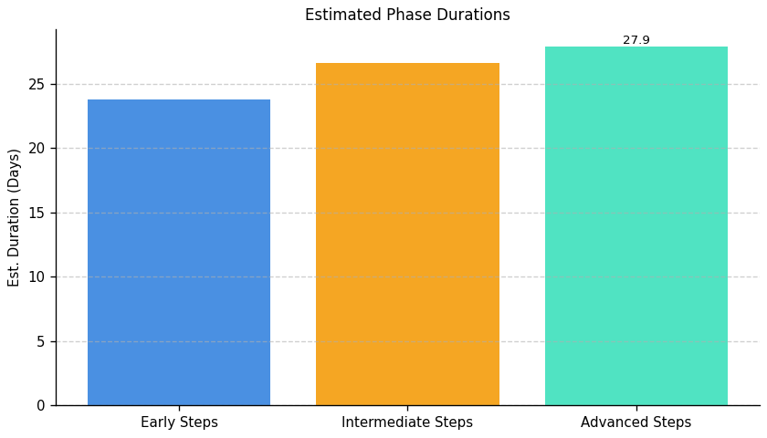
Green IT Strategy and Maturity: Roadmap Phase Durations

Slide 18
IT Carbon Efficiency and Management: Top 3 Insights
The organization does not currently measure its IT carbon footprint – including carbon intensity of operations – preventing baseline establishment, target setting, and progress tracking towards emissions reduction.
A clear strategy for reducing the carbon footprint of server operations is absent, with readily available optimization techniques (like cooling improvements) currently unutilized, indicating a gap between knowledge and practical implementation.
Limited proactive steps have been taken to reduce IT-related carbon emissions, suggesting carbon efficiency is not a prioritized business objective and represents a substantial area for improvement and potential cost savings.

Slide 19
IT Carbon Efficiency and Management: Roadmap Overview
Overview:
This roadmap outlines a phased approach to reducing the carbon footprint of IT operations. It begins with a comprehensive assessment of current energy consumption and carbon intensity, followed by the development and implementation of strategies to optimize server operations and cooling systems. The final phase focuses on continuous monitoring, refinement of reduction strategies, and exploration of carbon offsetting programs to achieve ongoing improvements in IT sustainability.
Total Est: 300 hrs (~37.5 days)
Key Roles: IT Administrators, Environmental Experts, Data Center Managers, Cooling System Technicians, Energy Experts

Slide 20
IT Carbon Efficiency and Management: Implementation Plan Details
Overall Goal: IT Carbon Efficiency and Management Implementation Plan
Methodology / Steps:
--- Early Steps ---
1. Assess the current carbon footprint associated with server operations, collaborating with environmental and energy experts and analyzing energy consumption. 2. Conduct an energy efficiency audit of server data centers, collaborating with energy experts and analyzing cooling systems.
--- Intermediate Steps ---
1. Develop a strategy to minimize the carbon footprint in server operations, implementing energy-efficient practices and utilizing renewable energy. 2. Implement cooling optimization practices based on the audit findings, upgrading cooling systems and monitoring temperature controls.
--- Advanced Steps ---
1. Implement a system for ongoing measurement of carbon intensity in IT operations. 2. Regularly review and refine carbon reduction strategies based on performance data. 3. Explore and implement carbon offsetting programs to neutralize remaining emissions.
Tools/Platforms (Overall): GreenIT Software, AWS IoT Greengrass, The Green Grid, OpenDCRE, Schneider Electric EcoStruxure
Subtask Estimates (Aggregated):
--- Early Steps ---
Carbon Footprint Assessment: 30h; Collaboration with Environmental Experts: 20h; Energy Efficiency Audit: 30h; Collaboration with Energy Experts: 20h
--- Intermediate Steps ---
Strategy Development: 35h; Implementation of Practices: 15h; Cooling System Upgrade: 35h; Temperature Control Monitoring: 15h
--- Advanced Steps ---
System Implementation: 30h; Strategy Refinement: 30h; Offset Program Exploration: 40h

Slide 21
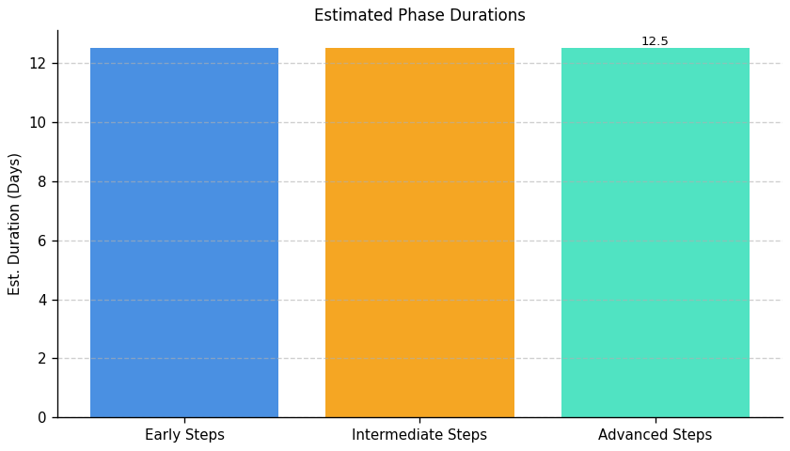
IT Carbon Efficiency and Management: Roadmap Phase Durations

Slide 22
IT Resource Efficiency and E-Waste Management: Top 3 Insights
The organization lacks a defined process for managing IT equipment from acquisition through retirement, resulting in potential cost inefficiencies and hindering sustainability goals.
A formal electronic waste (e-waste) policy is absent, creating compliance risks and preventing the recovery of valuable materials from end-of-life IT assets.
Material efficiency practices are underdeveloped across key areas – procurement, maintenance, and end-of-life management – indicating a need for foundational improvements to optimize resource utilization within the IT lifecycle.

Slide 23
IT Resource Efficiency and E-Waste Management: Roadmap Overview
Overview:
This roadmap outlines a phased approach to improve IT resource efficiency and responsibly manage electronic waste. The initial phase focuses on establishing a baseline understanding of current IT assets and developing a foundational e-waste disposal policy. The intermediate phase operationalizes this policy, integrating sustainability into procurement and developing a basic lifecycle management plan. Finally, the advanced phase focuses on continuous improvement through tracking, evaluation, lifespan extension, and exploration of circular IT practices.
Total Est: 44 hrs (~5.5 days)
Key Roles: IT Procurement, IT Operations, Sustainability Officer

Slide 24
IT Resource Efficiency and E-Waste Management: Implementation Plan Details
Overall Goal: IT Resource Efficiency and E-Waste Management Implementation Plan
Methodology / Steps:
--- Early Steps ---
1. Conduct a comprehensive inventory of all IT equipment (hardware and software). 2. Research best practices for responsible e-waste disposal and recycling. 3. Draft a preliminary e-waste disposal policy outlining basic guidelines. 4. Identify key stakeholders for policy review and approval.
--- Intermediate Steps ---
1. Finalize and formally approve the e-waste disposal policy. 2. Communicate the policy to all relevant employees. 3. Integrate environmental criteria (e.g., energy efficiency, recyclability) into IT procurement guidelines. 4. Develop a basic IT equipment lifecycle management plan outlining procurement, usage, maintenance, and disposal procedures.
--- Advanced Steps ---
1. Implement a system for tracking e-waste generated by the organization. 2. Evaluate the effectiveness of the e-waste disposal policy and identify areas for improvement. 3. Explore options for extending the lifespan of IT equipment through maintenance and upgrades. 4. Investigate opportunities for circular IT practices, such as equipment refurbishment and reuse.
Tools/Platforms (Overall): Spreadsheets, Inventory Management Software, Policy Management Software, Procurement Systems, E-waste Tracking Software, Lifecycle Management Software
Subtask Estimates (Aggregated):
--- Early Steps ---
Inventory: 8h; Research: 4h; Policy Draft: 4h; Stakeholder ID: 2h
--- Intermediate Steps ---
Policy Finalization: 2h; Communication: 2h; Procurement Integration: 6h; Lifecycle Plan: 4h
--- Advanced Steps ---
Tracking System: 4h; Policy Evaluation: 4h; Lifespan Extension: 2h; Circularity Exploration: 2h

Slide 25
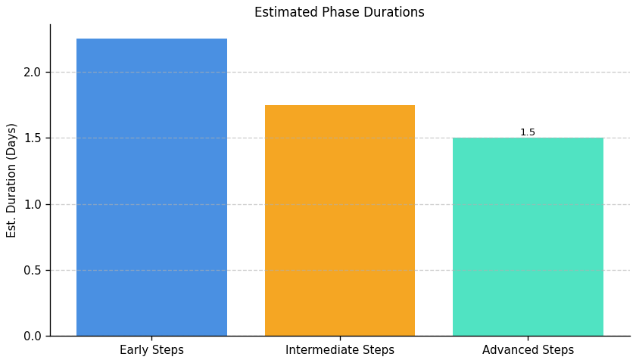
IT Resource Efficiency and E-Waste Management: Roadmap Phase Durations

