Slide 2
Recommendation Report
Session ID: 1e195af3-b327-483a-ab8f-8c5f3940705c
Generated: 2025-04-22

Slide 3
Fragment: Green With Software

Slide 4
Green With Software: Top 3 Insights
The organization is currently at a Level 2 maturity across most key areas assessed – Next-Gen IT, Purposeful Hybrid Cloud, Agile IT, and Product-Centric IT – indicating a foundational stage of transformation but lacking fully established practices and standardization. They are actively experimenting and implementing basic elements of modern IT principles, but haven’t yet reached a point of seamless integration or strategic alignment.
While data-driven decision-making is described as ‘Predictive’ (Level 3), and innovation is ‘Coordinated’ (Level 3), the sustainability approach is ‘Execution Oriented’ (Level 1), suggesting a significant disconnect between technological advancement and embedding sustainability into core organizational values and governance. This indicates a need to elevate sustainability beyond simply meeting program deliverables to a more holistic and strategically integrated approach.

Slide 5
Green With Software: Top 3 Insights (cont.)
The organization’s reliance on project-driven IT, coupled with an ‘Execution Oriented’ sustainability approach, suggests a risk of siloed initiatives and limited realization of broader sustainability outcomes. The recommendations consistently point towards implementing formalized frameworks (Agile, cloud policy), collaborative tools, and increased executive sponsorship to move beyond experimentation and towards a more integrated and impactful operating model.

Slide 6
Green With Software: Roadmap Overview
Summary: The organization currently exhibits a mixed maturity level across key areas of IT modernization and sustainability. While data-driven decision-making is advanced, the IT structure remains largely project-driven, and hybrid cloud adoption is still in an experimental phase. Agile practices are evolving, and API development is in the early stages of discovery. Overall, there's a need to shift towards a more product-centric, agile, and sustainable IT operating model.
Total Est: 235 hrs (~29.4 days)
Roles: IT Architect, DevOps Engineer, Data Scientist, Project Manager, Security Engineer, Innovation Manager, Business Analyst, Sustainability Officer

Slide 7
Green With Software: Early Steps
Goal: Foundational Alignment & Experimentation
Desc: This phase focuses on establishing a baseline understanding of current capabilities and initiating small-scale experiments to explore modern IT principles and sustainability practices. The goal is to lay the groundwork for future modernization efforts.
How: 1. Introduce collaborative project management tools. 2. Implement basic sustainability checkpoints in project development. 3. Provide training on integrated operating models. 4. Experiment with cloud usage for one-off experiments. 5. Develop a cloud policy to guide experimentation. 6. Leverage technology advances and automate manual processes. 7. Implement a mix of enterprise DB and NoSQL for flexibility. 8. Begin the transition towards Agile and continuous integration. 9. Introduce virtualization for enhanced resource utilization.
Who: IT Architect, Project Manager, DevOps Engineer
Tools: MongoDB, Jenkins, AWS CLI, CloudFormation, GanttProject, Microsoft Project, Jira, Git-scm

Slide 8
Green With Software: Early Steps (cont.)
Subtasks: Project Management Tool Implementation – 15h; Sustainability Checkpoint Definition – 10h; Cloud Policy Development – 20h; Virtualization Setup – 15h; Agile Training – 10h
Duration: 70 hrs (~8.8 days)

Slide 9
Green With Software: Intermediate Steps
Goal: Implementation & Integration
Desc: This phase centers on implementing key modernization initiatives, integrating cloud resources, and formalizing agile practices. The focus is on building a more scalable, agile, and sustainable IT infrastructure.
How: 1. Implement iterative development processes. 2. Enhance collaboration within development teams. 3. Introduce formalized agile frameworks. 4. Identify and document owned assets for controlled access. 5. Experiment with controlled exposure for market understanding. 6. Develop a common methodology for API management. 7. Increase executive sponsorship for innovation. 8. Embed innovation in the overall business strategy. 9. Set KPIs for each department/manager involved in innovation.
Who: DevOps Engineer, Data Scientist, IT Architect, Innovation Manager, Business Analyst
Tools: Scrum, Jira, Swagger, MuleSoft, Miro, Brightidea, Docker, Kubernetes, Red Hat OpenShift, Amazon ECS

Slide 10
Green With Software: Intermediate Steps (cont.)
Subtasks: Agile Framework Implementation – 25h; API Documentation – 20h; Innovation KPI Definition – 15h; Containerization Setup – 20h; Cloud Integration – 20h
Duration: 100 hrs (~12.5 days)

Slide 11
Green With Software: Advanced Steps
Goal: Optimization, Governance & Sustainability
Desc: This phase focuses on optimizing the implemented solutions, establishing robust governance frameworks, and embedding sustainability into the organization's DNA. The goal is to achieve a mature and sustainable IT operating model.
How: 1. KPI Setup – 15h; Performance Tuning - 20h; 2. Establish data governance policies. 3. Implement automated monitoring and alerting. 4. Integrate sustainability metrics into performance dashboards. 5. Foster a culture of continuous improvement and innovation. 6. Refine cloud strategy for optimal cost and performance.
Who: Security Engineer, Data Scientist, Sustainability Officer, IT Architect
Tools: Snort, Security Onion, Cisco Firepower, Palo Alto Networks Prisma Cloud, IdeaStream, Spigit, InnovationCloud, Ideanote, OpenProject, GreenProject, EcoWebDesk, Enablon

Slide 12
Green With Software: Advanced Steps (cont.)
Subtasks: Security Tool Integration – 20h; Data Governance Policy Implementation – 15h; Sustainability Metric Integration – 10h; Performance Monitoring Setup – 20h; Cloud Cost Optimization – 10h
Duration: 65 hrs (~8.1 days)

Slide 13
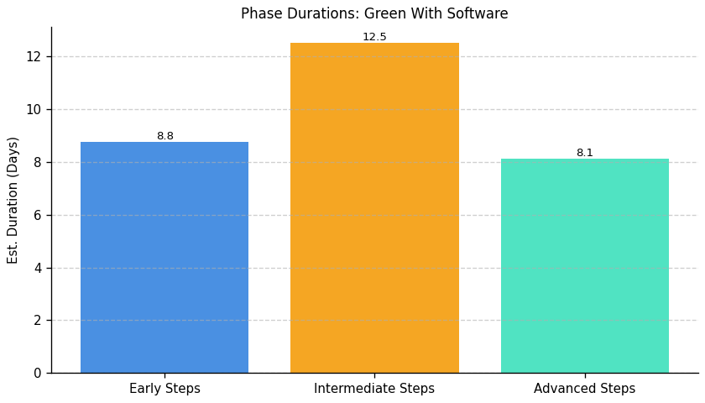
Green With Software: Roadmap Duration Overview

Slide 14
Fragment: Green With Software

Slide 15
Green With Software: Top 3 Insights
The organization demonstrates a strong foundation in proactive infrastructure management, having implemented scalability planning, redundancy/high availability, load balancing, and compliance measures. This suggests a mature approach to building a resilient and adaptable server infrastructure capable of handling growth and meeting regulatory requirements.
A significant gap exists in proactive monitoring and alerting. While resource usage is monitored and logs are audited, the lack of implemented alerts for abnormal server behavior represents a critical vulnerability. This hinders the ability to respond swiftly to performance issues or potential security incidents, potentially leading to downtime or breaches. The provided tools and detailed implementation steps highlight the feasibility of addressing this gap.

Slide 16
Green With Software: Top 3 Insights (cont.)
Network performance and server patching are currently not implemented, indicating areas of potential risk and inefficiency. Optimizing the network for data transfer and low latency, alongside a regular patching schedule, are essential for maintaining a secure, performant, and compliant environment. The substantial estimated man-hours for these tasks suggest they may be perceived as complex or resource-intensive, potentially explaining the current lack of implementation.

Slide 17
Green With Software: Roadmap Overview
Summary: The organization demonstrates a strong foundation in server scalability, redundancy, capacity planning, and security measures like access controls, firewalls, and intrusion detection. However, gaps exist in proactive monitoring, alerting, and network optimization. Addressing these gaps will enhance the resilience, observability, and overall efficiency of the IT infrastructure.
Total Est: 450 hrs (~56.2 days)
Roles: IT Specialist, IT Administrator, Network Administrator, Monitoring Teams, Security Specialist, Logging System Analyst, Patch Management Expert, Optimization Expert, Testing Teams

Slide 18
Green With Software: Early Steps
Goal: Initial Assessment & Planning
Desc: This phase focuses on evaluating and planning for improved server and network monitoring, alerting, and network assessment. It lays the groundwork for implementing proactive measures to identify and address performance issues and security threats.
How: Step 1: Alerting System Evaluation: Evaluate alerting systems to choose an effective solution. Research alerting tools, consider real-time monitoring capabilities. Step 1: Network Assessment: Conduct a network assessment to identify areas for optimization. Use network monitoring tools, analyze traffic patterns. Step 1: Centralized Logging System Evaluation: Evaluate centralized logging systems to choose the most suitable one. Research logging solutions, consider scalability, and compatibility. Step 1: Patch Management Policy: Develop a patch management policy outlining the frequency and process for updates. Collaborate with IT security, assess software requirements.
Who: IT Specialist, Logging System Analyst, Network Administrator, IT Security Specialist

Slide 19
Green With Software: Early Steps (cont.)
Tools: Prometheus Alertmanager, OpsGenie, PagerDuty, iperf, SolarWinds Network Performance Monitor, ELK Stack, Splunk
Subtasks: Alerting System Evaluation – 35h; Network Assessment – 35h; Centralized Logging System Evaluation – 35h; Patch Management Policy – 35h
Duration: 140 hrs (~17.5 days)

Slide 20
Green With Software: Intermediate Steps
Goal: Practice Implementation & Configuration
Desc: This phase involves implementing the planned monitoring, alerting, and network optimization solutions. It focuses on configuring alerts, integrating logging systems, and developing a network optimization plan.
How: Step 2: Alert Configuration: Configure alerts based on abnormal server behavior or performance issues. Define alert thresholds, collaborate with monitoring teams. Step 2: Optimization Plan Development: Develop a plan outlining optimizations based on assessment findings. Collaborate with network experts, prioritize improvements. Step 2: System Integration: Integrate the selected logging system into your server infrastructure. Configure log sources, collaborate with IT teams. Step 2: Automated Patching Tools: Evaluate and implement automated patching tools for efficient updates. Research patch management tools, align with policy.

Slide 21
Green With Software: Intermediate Steps (cont.)
Who: IT Administrator, Monitoring Teams, Network Administrator, Optimization Expert, Logging System Integrator, IT Specialist, Patch Management Expert
Tools: Prometheus Alertmanager, OpsGenie, PagerDuty, iperf, SolarWinds Network Performance Monitor, ELK Stack, Splunk
Subtasks: Alert Configuration – 55h; Optimization Plan Development – 45h; System Integration – 55h; Automated Patching Tools – 45h
Duration: 200 hrs (~25.0 days)

Slide 22
Green With Software: Advanced Steps
Goal: Optimization, Monitoring & Governance
Desc: This phase focuses on ongoing monitoring, performance tuning, and ensuring long-term compliance and security. It involves implementing identified optimizations, conducting security testing, and establishing a process for regular configuration reviews.
How: Step 3: Network Optimization: Implement identified optimizations and monitor the impact. Make configuration changes, analyze performance. Step 3: Implementation and Testing: Implement the selected firewall solution and conduct testing. Configure firewall rules, perform security testing.
Who: Network Administrator, Monitoring Teams, IT Administrator, Testing Teams
Tools: iperf, SolarWinds Network Performance Monitor
Subtasks: Network Optimization – 55h; Implementation and Testing – 55h

Slide 23
Green With Software: Advanced Steps (cont.)
Duration: 110 hrs (~13.8 days)

Slide 24
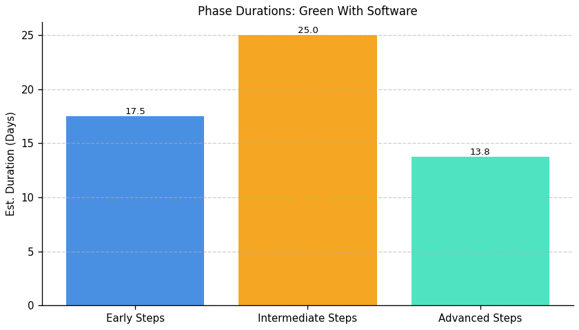
Green With Software: Roadmap Duration Overview

Slide 25
Fragment: Green With Software

Slide 26
Green With Software: Top 3 Insights
The organization demonstrates a foundational level of resilience with implemented disaster recovery and business continuity protocols, a regular backup schedule for critical server data, and a comprehensive backup and archive strategy. However, the implementation of these plans isn’t consistently validated, as backup and recovery procedures, and disaster recovery testing specifically, are not implemented.
A significant gap exists in data management practices, specifically around data movement. Multiple questions indicate “Not Implemented” responses regarding standardized protocols for data movement both within infrastructure and across systems/applications, alongside a lack of documented and aligned data movement processes. This suggests a potential risk of data silos, compliance issues, and inefficiencies.

Slide 27
Green With Software: Top 3 Insights (cont.)
While a data management, retention, and archiving *policy* exists, it is not actively implemented. This indicates a disconnect between defined strategy and operational execution, potentially leading to data governance challenges, increased storage costs, and difficulties in meeting regulatory requirements. The detailed recommendation contexts provided for data movement and decommissioning highlight substantial effort (estimated 40-65 man-hours per area) required to address these gaps.

Slide 28
Green With Software: Roadmap Overview
Summary: The organization demonstrates a good foundation in disaster recovery and backup procedures, with existing policies and schedules in place. However, significant gaps exist in data movement processes, lacking standardized protocols and comprehensive documentation. Decommissioning strategies are also currently not implemented, posing potential risks to infrastructure efficiency and compliance. Addressing these gaps is crucial for enhancing IT resilience, scalability, and modernization.
Total Est: 546 hrs (~68.2 days)
Roles: Data Engineer, Solution Architect, Documentation Specialist, Communication Coordinator, Infrastructure Specialist, Audit Team, Strategy Development Team, Data Architect, Networking Specialist, Infrastructure Team, Testing Team, System Owners, Protocol Designer, Training Coordinator, IT Administrators

Slide 29
Green With Software: Early Steps
Goal: Initial Assessment & Planning
Desc: This phase focuses on analyzing current data movement processes, identifying outdated infrastructure, and developing initial plans for improvement. It lays the groundwork for establishing standardized protocols and decommissioning strategies.
How: 1. Current Data Movement Analysis: Analyze existing data movement processes to identify gaps and inefficiencies. Collaborate with data engineers and architects, use analysis tools. (Data Engineers, Solution Architects - 46 hours)
2. Infrastructure Audit for Decommissioning: Conduct a comprehensive audit to identify outdated or underutilized infrastructure components. Collaborate with infrastructure teams, use monitoring tools, and assess usage patterns. (Infrastructure Specialist, Audit Team - 50 hours)
3. Data Movement Requirement Analysis: Analyze data movement requirements between infrastructure elements. Collaborate with data architects, and assess data flow and communication needs. (Data Architect, Infrastructure Specialist - 40 hours)

Slide 30
Green With Software: Early Steps (cont.)
4. Test Plan Development: Develop a test plan outlining scenarios for backup and recovery testing. Collaborate with IT teams, identify critical scenarios. (Testing Teams, IT Administrators - 35 hours)
Who: Data Engineer, Solution Architect, Infrastructure Specialist, Audit Team, Data Architect, Testing Teams, IT Administrators
Tools: Monitoring Tools, Data Mapping Tools, Documentation Tools
Subtasks: Data Movement Analysis – 46h; Infrastructure Audit – 50h; Data Movement Requirements – 40h; Test Plan Development – 35h
Duration: 171 hrs (~21.4 days)

Slide 31
Green With Software: Intermediate Steps
Goal: Practice Implementation & Configuration
Desc: This phase centers on implementing standardized protocols for data movement, developing decommissioning strategies, and establishing alignment between data movement processes and architecture boundaries. It builds upon the initial assessment to create tangible improvements.
How: 1. Architecture Boundary Alignment: Align data movement processes within defined architecture boundaries. Collaborate with architecture teams, update processes accordingly. (Solution Architects, Data Engineers - 42 hours)
2. Decommissioning Strategy Development: Develop a strategy outlining the criteria, process, and timeline for decommissioning identified components. Gather input from relevant teams, and document clear decommissioning guidelines. (Infrastructure Specialist, Strategy Development Team - 43 hours)

Slide 32
Green With Software: Intermediate Steps (cont.)
3. Protocol Standardization: Standardize protocols for efficient data movement across different infrastructure elements. Consider industry standards, and collaborate with network specialists. (Data Architect, Networking Specialist - 48 hours)
4. Backup and Recovery Testing: Conduct regular backup and recovery testing based on the developed plan. Execute test scenarios, analyze results. (Testing Teams, IT Administrators - 55 hours)
Who: Solution Architect, Data Engineer, Infrastructure Specialist, Strategy Development Team, Data Architect, Networking Specialist, Testing Teams, IT Administrators
Tools: Industry Standard Protocols, Configuration Management Tools, Testing Frameworks
Subtasks: Architecture Alignment – 42h; Decommissioning Strategy – 43h; Protocol Standardization – 48h; Backup/Recovery Testing – 55h
Duration: 188 hrs (~23.5 days)

Slide 33
Green With Software: Advanced Steps
Goal: Optimization, Monitoring & Governance
Desc: This phase focuses on refining implemented processes, establishing ongoing monitoring, and ensuring long-term governance of data movement and infrastructure decommissioning. It aims to create a sustainable and adaptable IT environment.
How: 1. Documentation and Communication: Document the aligned processes and communicate changes to relevant teams. Use documentation tools, conduct communication sessions. (Documentation Specialist, Communication Coordinator - 40 hours)
2. Regular Updates and Reviews: Establish a routine for reviewing and updating the decommissioning strategy. Conduct periodic reviews, consider technological advancements and changing business needs. (Infrastructure Specialist, Review Team - 42 hours)
3. Implementation and Testing: Implement standardized protocols and conduct thorough testing. Collaborate with infrastructure and testing teams, monitor data movement efficiency. (Data Architect, Infrastructure Team, Testing Team - 65 hours)

Slide 34
Green With Software: Advanced Steps (cont.)
4. Documentation and Training: Document the standardized protocol and conduct training for relevant teams. Use documentation tools, organize training sessions. (Documentation Specialist, Training Coordinator - 40 hours)
Who: Documentation Specialist, Communication Coordinator, Infrastructure Specialist, Review Team, Data Architect, Infrastructure Team, Testing Team, Training Coordinator
Tools: Documentation Platforms, Training Tools, Monitoring Dashboards
Subtasks: Documentation & Communication – 40h; Decommissioning Review – 42h; Protocol Implementation & Testing – 65h; Protocol Documentation & Training – 40h
Duration: 187 hrs (~23.4 days)

Slide 35
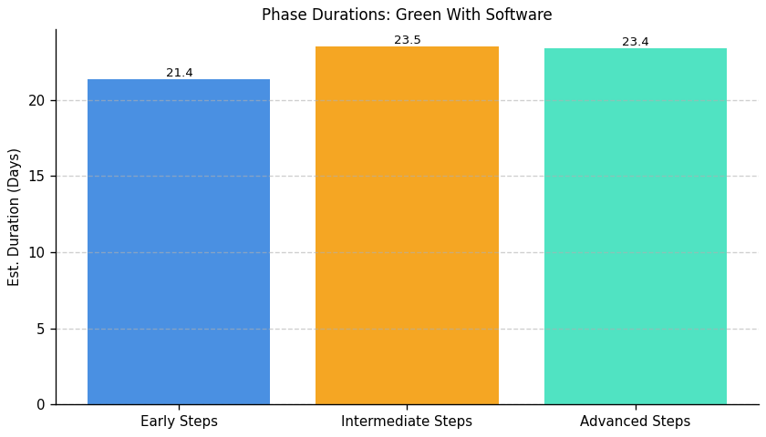
Green With Software: Roadmap Duration Overview

Slide 36
Fragment: Green With Software

Slide 37
Green With Software: Top 3 Insights
The organization demonstrates a strong technical foundation for Green IT with highly automated infrastructure capable of dynamically adjusting to demand, and performs energy efficiency audits daily. This suggests a proactive approach to optimizing IT resource utilization and a commitment to continuous monitoring.
Despite the technical capabilities, the organization lacks formalized processes and tools for managing environmental impact and sustainability practices. Multiple questions (86, 81, 92, 94, 93) indicate “Not Implemented” responses, highlighting a significant gap between technical efficiency and broader sustainability governance and operationalization. This suggests a need to move beyond simply reducing energy consumption within IT to actively managing and mitigating the wider environmental footprint.

Slide 38
Green With Software: Top 3 Insights (cont.)
While skills are acknowledged and assessed (Q91, Q89 reports “Implemented”), there’s a consistent lack of investment in developing sustainability-focused skills through training, mentorship, or incentives (Q92, Q94, Q93 all report “Not Implemented”). Coupled with an inability to quantify the impact of Green IT initiatives (questions 16, 6, 11, 12 all answered “don’t know”), this indicates a challenge in translating technical efforts into measurable sustainability outcomes and a potential skills gap hindering comprehensive impact assessment and reporting.

Slide 39
Green With Software: Roadmap Overview
Summary: The organization demonstrates strong automation for IT infrastructure scaling based on demand, with daily energy efficiency audits. However, formal processes for environmental management, sustainability tools, and skills development are largely unimplemented. There's a lack of clarity around impact measurement and carbon footprint reduction, despite existing skills assessment processes.
Total Est: 575 hrs (~71.9 days)
Roles: Environmental Specialist, IT Operations, Process Design Expert, Documentation Specialist, Training Coordinator, Training Analyst, Department Head, HR Specialist, Sustainability Strategist, Communication Specialist, HR Analyst, Sustainability Analyst, IT Specialist, Tool Administrator, Training Facilitator, Program Designer, Mentoring Coordinator, Subject Matter Expert, Infrastructure Managers

Slide 40
Green With Software: Early Steps
Goal: Foundation & Assessment
Desc: This phase focuses on establishing a baseline understanding of the organization's environmental impact and identifying key areas for improvement in Green IT practices. It involves assessing current infrastructure, processes, and skills to inform future initiatives.
How: 1. Environmental Impact Assessment: Assess the current environmental impact of infrastructure and processes. Collaborate with environmental experts, use impact assessment tools. (Environmental Experts, Infrastructure Managers - 50 hours)
2. Environmental Impact Assessment: Conduct an assessment of environmental impact in the current environment. Collaborate with environmental specialists, use assessment tools. (Environmental Specialist, IT Operations - 50 hours)
3. Identify Training Needs: Identify specific sustainability-focused skills that need development. Conduct skill gap analysis, collaborate with department heads. (Training Analysts, Department Heads - 35 hours)

Slide 41
Green With Software: Early Steps (cont.)
4. Identify Mentoring Needs: Identify areas where mentorship can facilitate sustainability-related skills development. Conduct needs assessment, collaborate with department heads. (Mentoring Coordinators, Department Heads - 35 hours)
Who: Environmental Specialist, IT Operations, Infrastructure Managers, Training Analysts, Department Head, Mentoring Coordinators
Tools: Environmental Impact Assessment Tools
Subtasks: Environmental Impact Assessment (Infrastructure): 50h; Environmental Impact Assessment (IT): 50h; Training Needs Identification: 35h; Mentoring Needs Identification: 35h
Duration: 170 hrs (~21.2 days)

Slide 42
Green With Software: Intermediate Steps
Goal: Implementation & Tooling
Desc: This phase centers on implementing foundational sustainability tools and processes, focusing on resource optimization and establishing a framework for managing environmental impacts. It builds upon the assessment phase by translating findings into actionable steps.
How: 1. Sustainability Tools Evaluation: Evaluate existing and potential tools for managing sustainability. Research available tools, collaborate with IT teams. (IT Specialists, Sustainability Analysts - 40 hours)
2. Process Design for Resource Optimization: Design processes to optimize resource usage based on assessment results. Collaborate with process design experts, align with environmental goals. (Process Design Expert, Environmental Specialist - 43 hours)
3. Design Training Programs: Design training programs for sustainability-focused skills development. Collaborate with trainers, define program content. (Training Facilitators, Program Designers - 50 hours)

Slide 43
Green With Software: Intermediate Steps (cont.)
4. Recruit Mentors: Identify and recruit mentors with expertise in sustainability. Create mentorship criteria, reach out to potential mentors. (HR Specialists, Mentoring Coordinators - 50 hours)
Who: IT Specialists, Sustainability Analysts, Process Design Expert, Environmental Specialist, Training Facilitators, Program Designers, HR Specialists, Mentoring Coordinators
Tools: Sustainability Management Tools, Process Design Software, Learning Management Systems
Subtasks: Tool Evaluation: 40h; Process Design: 43h; Training Program Design: 50h; Mentor Recruitment: 50h
Duration: 183 hrs (~22.9 days)

Slide 44
Green With Software: Advanced Steps
Goal: Optimization & Governance
Desc: This phase focuses on operationalizing sustainability initiatives, establishing ongoing monitoring and reporting mechanisms, and fostering a culture of continuous improvement. It aims to embed Green IT practices into the organization's long-term strategy.
How: 1. Tool Implementation and Training: Implement selected tools and provide training to relevant teams. Configure tools, conduct training sessions. (Tool Administrators, Training Coordinators - 60 hours)
2. Documentation and Training: Document the established processes and conduct training for relevant teams. Use documentation tools, organize training sessions. (Documentation Specialist, Training Coordinator - 42 hours)
3. Program Implementation: Implement the training programs and track participant progress. Conduct training sessions, monitor participant engagement. (Training Facilitators, Program Coordinators - 60 hours)
4. Implement Mentorship Programs: Implement mentorship programs, match mentors with mentees. Facilitate introductions, monitor progress. (Mentoring Coordinators, HR Representatives - 60 hours)

Slide 45
Green With Software: Advanced Steps (cont.)
Who: Tool Administrators, Training Coordinators, Documentation Specialist, Training Facilitators, Program Coordinators, Mentoring Coordinators, HR Representatives
Tools: Monitoring & Reporting Dashboards, Documentation Platforms, Collaboration Tools
Subtasks: Tool Implementation & Training: 60h; Process Documentation & Training: 42h; Training Program Implementation: 60h; Mentorship Program Implementation: 60h
Duration: 222 hrs (~27.8 days)

Slide 46
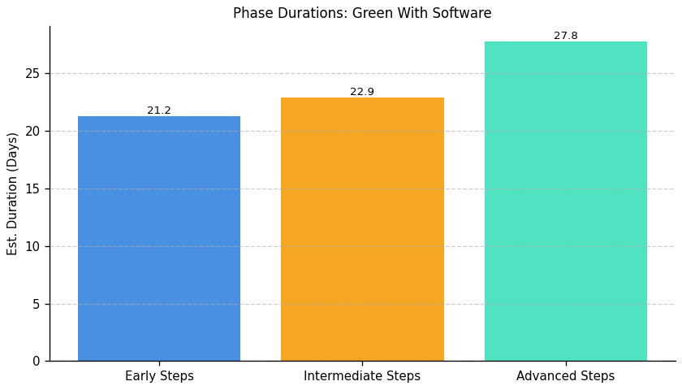
Green With Software: Roadmap Duration Overview

Slide 47
Fragment: Green With Software

Slide 48
Green With Software: Top 3 Insights
The organization is taking some positive steps towards reducing IT-related carbon emissions, specifically leveraging renewable energy sources for data centers. This indicates an awareness of sustainability and a willingness to invest in greener solutions, representing a foundational element of a mature carbon efficiency program.
The organization lacks a clear understanding of its overall IT carbon footprint, as evidenced by the “don’t know” response to the question regarding annual metric tons of CO2 equivalent. This absence of baseline measurement significantly hinders the ability to track progress, set reduction targets, and demonstrate the impact of sustainability initiatives.
While the organization measures carbon intensity, it does so using a relatively high-level metric ("Carbon emissions per user"). This suggests a limited scope of measurement and potentially overlooks opportunities for more granular analysis at the infrastructure or application level, which could reveal more targeted efficiency improvements.

Slide 49
Green With Software: Roadmap Overview
Summary: The organization has begun to address the carbon impact of its IT operations by utilizing renewable energy sources and measuring carbon intensity per user. However, a significant gap exists in understanding the overall carbon footprint, as it is currently unknown. This indicates a need for comprehensive measurement and a more strategic approach to carbon reduction.
Total Est: 150 hrs (~18.8 days)
Roles: IT Specialist, Sustainability Manager, Data Analyst, Infrastructure Engineer, Project Manager

Slide 50
Green With Software: Early Steps
Goal: Initial Assessment & Measurement
Desc: This phase focuses on establishing a baseline understanding of the organization's IT carbon footprint and defining key metrics for ongoing monitoring. It involves calculating the current carbon footprint, identifying major emission sources, and selecting appropriate measurement tools.
How: 1. **Carbon Footprint Calculation:** Engage a Data Analyst to calculate the organization's IT carbon footprint using industry-standard methodologies (e.g., Greenhouse Gas Protocol). 2. **Data Source Identification:** Identify all relevant data sources for IT energy consumption (e.g., server power usage, network equipment, data center cooling). 3. **Tool Selection:** Evaluate and select a carbon accounting tool to automate data collection and reporting. 4. **Metric Definition:** Define key performance indicators (KPIs) for carbon intensity, such as CO2 emissions per user, per transaction, or per unit of compute.
Who: Data Analyst, IT Specialist, Sustainability Manager, Project Manager

Slide 51
Green With Software: Early Steps (cont.)
Tools: Carbon Accounting Software (e.g., Watershed, Persefoni), Energy Monitoring Tools, Spreadsheet Software
Subtasks: Carbon Footprint Calculation – 30h; Data Source Identification – 15h; Tool Selection – 10h; Metric Definition – 5h
Duration: 60 hrs (~7.5 days)

Slide 52
Green With Software: Intermediate Steps
Goal: Implementation & Optimization
Desc: This phase centers on implementing strategies to reduce the carbon footprint based on the initial assessment. It includes optimizing infrastructure, improving energy efficiency, and expanding the use of renewable energy sources.
How: 1. **Infrastructure Optimization:** Implement virtualization and containerization to consolidate servers and reduce energy consumption. 2. **Cooling Optimization:** Optimize data center cooling systems to improve energy efficiency. 3. **Renewable Energy Expansion:** Explore options for increasing the use of renewable energy sources, such as Power Purchase Agreements (PPAs) or on-site solar generation. 4. **Workload Scheduling:** Implement workload scheduling to shift compute-intensive tasks to times when renewable energy is more readily available.
Who: Infrastructure Engineer, IT Specialist, Sustainability Manager, Data Analyst

Slide 53
Green With Software: Intermediate Steps (cont.)
Tools: Virtualization Platforms (e.g., VMware, Hyper-V), Containerization Platforms (e.g., Docker, Kubernetes), Data Center Infrastructure Management (DCIM) Tools
Subtasks: Infrastructure Optimization – 25h; Cooling Optimization – 15h; Renewable Energy Expansion – 10h; Workload Scheduling – 5h
Duration: 55 hrs (~6.9 days)

Slide 54
Green With Software: Advanced Steps
Goal: Monitoring, Governance & Continuous Improvement
Desc: This phase focuses on establishing a robust monitoring and governance framework to ensure ongoing carbon reduction efforts. It involves tracking KPIs, reporting on progress, and continuously identifying opportunities for improvement.
How: 1. **KPI Monitoring:** Implement a dashboard to track key carbon performance indicators (KPIs) in real-time. 2. **Reporting & Communication:** Develop regular reports on carbon footprint and reduction progress for stakeholders. 3. **Policy Development:** Establish a sustainability policy that outlines the organization's commitment to carbon reduction. 4. **Continuous Improvement:** Regularly review and update carbon reduction strategies based on performance data and emerging technologies.
Who: Sustainability Manager, IT Specialist, Data Analyst, Project Manager
Tools: Carbon Accounting Software, Data Visualization Tools (e.g., Tableau, Power BI), Reporting Platforms

Slide 55
Green With Software: Advanced Steps (cont.)
Subtasks: KPI Monitoring Setup – 15h; Reporting & Communication – 10h; Policy Development – 5h; Continuous Improvement Planning – 5h
Duration: 35 hrs (~4.4 days)

Slide 56
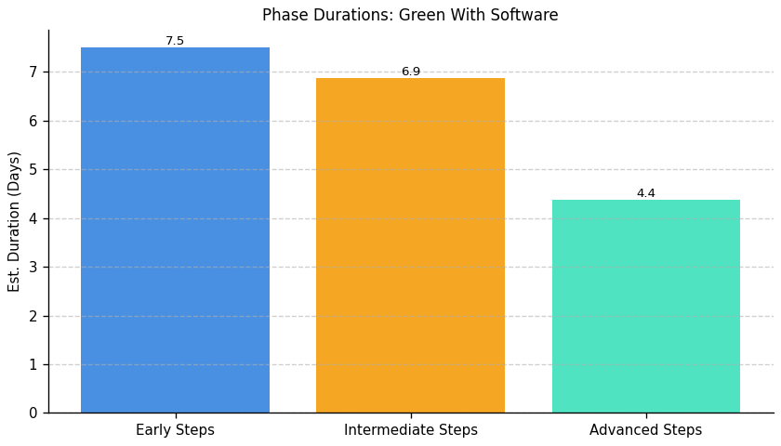
Green With Software: Roadmap Duration Overview

Slide 57
Fragment: Green With Software

Slide 58
Green With Software: Top 3 Insights
The organization acknowledges the importance of responsible e-waste disposal with a formal policy in place, indicating a foundational commitment to environmental responsibility in this specific area.
Despite having a disposal policy, the “Fair” rating for overall equipment lifecycle management suggests significant room for improvement across the entire process – from procurement through maintenance and ultimately to disposal – implying the policy may not be fully integrated or consistently applied.
While environmental impact is considered “Somewhat important” during procurement, it isn’t a high priority, indicating a potential disconnect between stated policy and actual purchasing behavior, and a missed opportunity to proactively reduce environmental impact throughout the lifecycle.

Slide 59
Green With Software: Roadmap Overview
Summary: The organization currently has a policy for responsible e-waste disposal, indicating a foundational level of environmental awareness. However, equipment lifecycle management is rated as 'Fair', and environmental considerations are only 'Somewhat important' in procurement, suggesting opportunities for improvement in proactive sustainability practices across the entire IT asset lifecycle. This roadmap focuses on strengthening lifecycle management and integrating environmental factors more deeply into procurement decisions.
Total Est: 140 hrs (~17.5 days)
Roles: IT Manager, Procurement Specialist, Sustainability Officer, IT Asset Manager

Slide 60
Green With Software: Early Steps
Goal: Foundation & Assessment
Desc: Establish a baseline understanding of current IT asset lifecycle practices and identify gaps in environmental considerations. This phase focuses on detailed assessment and initial planning to improve equipment lifecycle management.
How: 1. Conduct a comprehensive audit of current IT asset inventory, including age, condition, and disposal methods. 2. Review existing procurement policies to identify opportunities for incorporating environmental criteria. 3. Develop a detailed lifecycle management plan outlining procedures for procurement, usage, maintenance, and disposal. 4. Identify key stakeholders and establish communication channels.
Who: IT Manager, IT Asset Manager, Sustainability Officer
Tools: Asset Discovery Tools, Spreadsheet Software, Policy Documentation Tools
Subtasks: Inventory Audit – 20h; Policy Review – 10h; Lifecycle Plan Development – 15h; Stakeholder Alignment – 5h

Slide 61
Green With Software: Early Steps (cont.)
Duration: 50 hrs (~6.2 days)

Slide 62
Green With Software: Intermediate Steps
Goal: Implementation & Integration
Desc: Implement the lifecycle management plan and integrate environmental criteria into the procurement process. This phase focuses on actively improving procurement practices and ensuring responsible disposal methods are consistently applied.
How: 1. Update procurement policies to prioritize IT equipment with high recyclability and low environmental impact. 2. Establish a scoring system for evaluating vendors based on their sustainability practices. 3. Implement a tracking system for IT assets to monitor their lifecycle stage and disposal methods. 4. Train procurement staff on environmental criteria and responsible sourcing. 5. Pilot a program for extending the lifespan of existing equipment through maintenance and upgrades.
Who: Procurement Specialist, IT Manager, Sustainability Officer, IT Asset Manager
Tools: Procurement Software, Asset Tracking Software, Vendor Management Systems, Training Platforms

Slide 63
Green With Software: Intermediate Steps (cont.)
Subtasks: Policy Updates – 15h; Vendor Scoring System – 10h; Asset Tracking Implementation – 20h; Procurement Training – 5h; Pilot Program – 10h
Duration: 60 hrs (~7.5 days)

Slide 64
Green With Software: Advanced Steps
Goal: Optimization & Governance
Desc: Continuously monitor and optimize the IT asset lifecycle management program, ensuring ongoing alignment with sustainability goals. This phase focuses on establishing key performance indicators (KPIs) and refining processes for long-term improvement.
How: 1. Establish KPIs to measure the effectiveness of the lifecycle management program (e.g., e-waste reduction, recycling rates, energy efficiency). 2. Regularly monitor and analyze KPIs to identify areas for improvement. 3. Conduct periodic audits of IT asset disposal practices to ensure compliance with policies. 4. Explore opportunities for circular economy initiatives, such as equipment refurbishment and reuse. 5. Develop a formal governance structure for overseeing the lifecycle management program.
Who: Sustainability Officer, IT Manager, IT Asset Manager
Tools: Data Analytics Tools, Reporting Dashboards, Audit Tools, Governance Platforms

Slide 65
Green With Software: Advanced Steps (cont.)
Subtasks: KPI Definition – 10h; KPI Monitoring & Analysis – 10h; Audit Process – 5h; Circular Economy Exploration – 5h; Governance Structure – 10h
Duration: 30 hrs (~3.8 days)

Slide 66
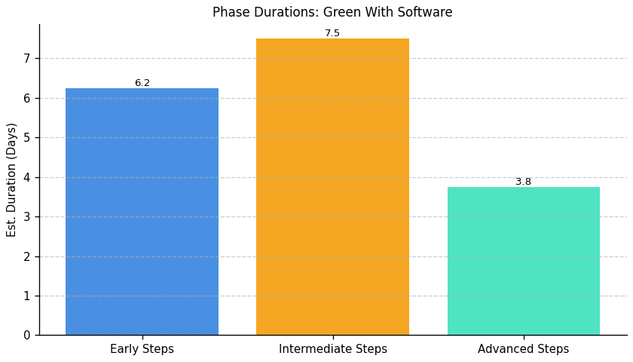
Green With Software: Roadmap Duration Overview

