Slide 2
Recommendation Report
Session ID: df033ae9-84d4-48ba-a577-374955cbe690
Generated: 2025-04-27

Slide 3
Fragment: Green With Software

Slide 4
Green With Software: Top 3 Insights
The organization possesses a strong technical foundation for agility, with modern IT practices like containerization and real-time analytics already in place, but lacks formalized processes and tooling – specifically around microservices orchestration and DevOps – to maximize their value and accelerate delivery.
Innovation efforts are currently fragmented and lack consistent leadership support, preventing the establishment of repeatable, scalable innovation processes across the business; securing executive sponsorship and implementing a collaborative platform for idea management and development is critical.
While the organization recognizes the importance of sustainability, it’s treated as a separate outcome rather than integrated into core business operations and project management; proactively embedding sustainability principles into strategic planning and utilizing tools to track and measure impact will be essential for long-term success.

Slide 5
Green With Software: Roadmap Overview
Summary: This roadmap outlines the steps to build a sustainable IT operating model, integrating IT strategy with business objectives and leveraging modern technologies. It focuses on transitioning to a hybrid cloud environment, enhancing data capabilities, and fostering a culture of innovation to drive sustainable outcomes. The plan addresses foundational modernization, data-driven decision-making, and continuous improvement through governance.
Total Est: 165 hrs (~20.6 days)
Key Roles: IT Architects, Developers, Business Strategists, Security Professionals, Data Scientists, Innovation Managers, Operations Engineers, Executive Sponsors

Slide 6
Green With Software: Implementation Plan Details
Overall Goal: Fragment A Implementation Plan: Green With Software
Description:
This roadmap guides the organization through a phased approach to achieve a sustainable IT operating model. The Early Steps focus on foundational modernization and integration, establishing a modern, agile IT structure aligned with business functions. Intermediate Steps build upon this foundation by enabling a purposeful hybrid cloud environment and enhancing data capabilities for informed decision-making. Finally, the Advanced Steps establish a culture of innovation and embed sustainability principles into the organization's DNA, ensuring continuous improvement and alignment with business goals.
Methodology / Steps:
--- Early Steps ---
1. Embrace containerization for a microservices architecture. 2. Develop matured data lakes for real-time analytics. 3. Implement RESTful APIs with API gateways for seamless communication. 4. Integrate IT as an integral part of business strategy. 5. Introduce iterative development processes and enhance collaboration within development teams. 6. Implement Scrum for an agile framework.
--- Intermediate Steps ---
7. Create self-service capabilities for infrastructure deployment. 8. Adopt Micro Services, Containers, and Serverless computing. 9. Develop dynamic cloud applications that are auto-scalable and fault-tolerant. 10. Implement AI and ML-enabled algorithms for advanced tasks and leverage human-like intelligence to enhance decision-making. 11. Center programs on driving specific business outcomes and measure success based on the achievement of business objectives.
--- Advanced Steps ---
12. Seek executive sponsorship for innovation initiatives. 13. Allocate innovation to business units with defined strategies. 14. Establish initial processes for innovation, avoiding silos. 15. Adopt a KPI-based perspective for operations and drive process improvement for business outcomes. 16. Continuously evolve cognitive capabilities for ongoing innovation.
Roles Involved (Overall): IT Architects, Developers, Business Strategists, Security Professionals, Data Scientists, Innovation Managers, Operations Engineers, Executive Sponsors
Tools/Platforms (Overall): Kubernetes, Azure DevOps, Docker, Jira, Git-scm, Odoo, AWS Lambda, TensorFlow, IBM Watson, Grafana, ServiceNow, Spigit, GitHub, Salesforce
Subtask Estimates (Aggregated):
--- Early Steps ---
Containerization - 20h; Data Lakes - 15h; API Gateways - 10h; Business Integration - 10h; Iterative Development - 10h; Collaboration - 5h; Scrum Implementation - 5h
--- Intermediate Steps ---
Self-Service Cloud - 10h; Microservices/Serverless - 10h; Dynamic Applications - 5h; AI/ML Implementation - 10h; Outcome Measurement - 5h
--- Advanced Steps ---
Executive Sponsorship - 5h; Innovation Allocation - 5h; Process Establishment - 5h; KPI Adoption - 5h; Innovation Program Setup - 20h

Slide 7
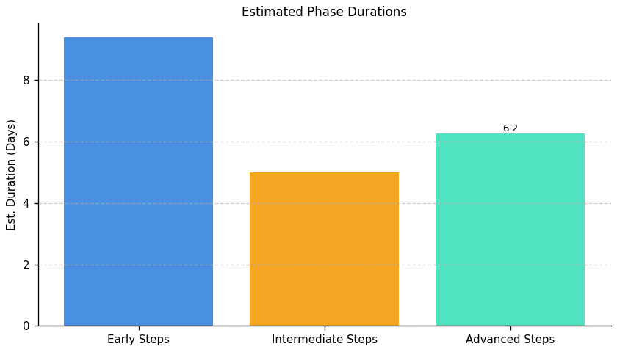
Green With Software: Roadmap Phase Durations

Slide 8
Fragment: Green With Software

Slide 9
Green With Software: Top 3 Insights
The organization lacks fundamental server and network management practices, creating significant operational risk. Specifically, there’s no evidence of centralized logging, performance monitoring, capacity planning, or caching – leading to likely performance issues, increased downtime, and hindering proactive problem resolution.
A critical security gap exists in server infrastructure protection. Core security controls like intrusion detection, firewall configuration, operating system patching, and log auditing are not implemented, exposing the organization to substantial threats and potential compliance violations.
High availability and redundancy are absent, creating a single point of failure within the server environment. Addressing this requires a significant investment of 135-175 man-hours per area (redundancy, patching, intrusion detection, access control) and represents a major risk to business continuity.

Slide 10
Green With Software: Roadmap Overview
Summary: This implementation plan addresses critical gaps in server infrastructure management, resilience, and security. It focuses on establishing foundational monitoring, automating patching, implementing redundancy, and enhancing security controls to improve availability, data integrity, and compliance posture.
Total Est: 860 hrs (~107.5 days)
Key Roles: IT Specialists, IT Administrators, Monitoring Teams, Security Analysts, Compliance Specialists, Business Analysts, Development Teams, Infrastructure Managers, Scalability Planning Team, IT Leadership, Testing Teams, Network Administrators, Optimization Experts, Alerting System Analysts, Data Management Specialists, Caching Strategists, Logging System Analysts, QA Engineers, Performance Analysts, Load Balancer Administrators, Redundancy Planning Team, Patch Management Experts

Slide 11
Green With Software: Implementation Plan Details
Overall Goal: Fragment B Implementation Plan
Description:
This roadmap outlines a phased approach to enhance server infrastructure management and security. The Early Steps focus on foundational risk assessment and planning, establishing a baseline for monitoring and security policies. Intermediate Steps involve the evaluation and implementation of solutions for redundancy, patching, intrusion detection, and access control. Finally, Advanced Steps concentrate on integrating these solutions, conducting thorough testing, and establishing ongoing governance processes to ensure long-term resilience and security.
Methodology / Steps:
--- Early Steps ---
1. Assess the current server infrastructure for high availability and identify single points of failure. 2. Develop a patch management policy outlining the frequency and process for updates. 3. Conduct a security threat assessment to identify potential risks and vulnerabilities. 4. Develop an access control policy defining user permissions and restrictions. 5. Evaluate centralized logging systems to choose the most suitable one. 6. Research logging solutions, consider scalability, and compatibility. 7. Evaluate and select a resource monitoring tool for server infrastructure. 8. Research monitoring tools, align with infrastructure requirements. 9. Evaluate alerting systems to choose an effective solution. 10. Research alerting tools, consider real-time monitoring capabilities.
--- Intermediate Steps ---
11. Integrate the selected logging system into your server infrastructure and configure log sources, collaborating with IT teams. 12. Configure and integrate the selected monitoring tool with the server infrastructure, following tool documentation and testing configurations. 13. Configure alerts based on abnormal server behavior or performance issues, defining alert thresholds and collaborating with monitoring teams. 14. Identify redundancy solutions and create a mitigation plan. 15. Evaluate and implement automated patching tools for efficient updates. 16. Evaluate and select an IDS solution suitable for the infrastructure. 17. Evaluate and select a firewall solution aligned with access control policies. 18. Configure the selected load balancer for your server infrastructure, following load balancer documentation and testing configurations. 19. Develop a policy for retaining historical performance data, defining data retention periods and collaborating with data management teams.
--- Advanced Steps ---
20. Upgrade hardware and configure redundant systems. 21. Implement the selected firewall solution and conduct security testing. 22. Implement the selected IDS solution and integrate it into the server infrastructure. 23. Configure firewall rules and perform security testing. 24. Develop a caching strategy based on server workload and application requirements, collaborating with development teams and analyzing application behavior. 25. Implement selected caching mechanisms and conduct testing, configuring caching and performing load testing. 26. Assess the current server infrastructure for scalability gaps, collaborating with IT architects and conducting workload analysis. 27. Develop a plan for enhancing server infrastructure scalability, identifying scalability solutions and creating a roadmap. 28. Implement the planned upgrades to enhance scalability, upgrading hardware and implementing scaling solutions. 29. Develop a plan for performance testing of critical server applications, identifying testing scenarios and defining success criteria. 30. Execute performance testing on critical server applications, using testing tools and analyzing results. 31. Develop a process for auditing server logs for security and compliance, defining audit criteria and collaborating with security and compliance teams. 32. Regularly review and analyze server logs according to the developed process, conducting audits and collaborating with IT and compliance teams.
Roles Involved (Overall): IT Specialists, IT Administrators, Monitoring Teams, Security Analysts, Compliance Specialists, Business Analysts, Development Teams, Infrastructure Managers, Scalability Planning Team, IT Leadership, Testing Teams, Network Administrators, Optimization Experts, Alerting System Analysts, Data Management Specialists, Caching Strategists, Logging System Analysts, QA Engineers, Performance Analysts, Load Balancer Administrators, Redundancy Planning Team, Patch Management Experts
Tools/Platforms (Overall): ELK Stack (Elasticsearch, Logstash, Kibana), Splunk, Grafana, Prometheus, Dynatrace, InfluxDB, Prometheus Alertmanager, OpsGenie, PagerDuty, HAProxy, Nginx, Citrix ADC, F5 BIG-IP, Redis, Varnish, Akamai, Cloudflare, docker, kubernetes, Amazon ECS, Google Kubernetes Engine (GKE), Apache JMeter, LoadRunner, Wazuh, SolarWinds Security Event Manager, Keepalived, OpenVAS, Tenable, Qualys, Snort, Cisco Firepower, Suricata, iptables, Cisco ASA, Palo Alto Networks, Veeam Backup & Replication
Subtask Estimates (Aggregated):
--- Early Steps ---
Risk Assessment: 25h; Single Point of Failure Identification: 20h; Policy Development: 20h; Collaboration with System Administrators: 15h; Logging System Evaluation: 20h; Logging Solution Research: 15h; Resource Monitoring Tool Evaluation: 20h; Infrastructure Alignment: 15h; Alerting System Evaluation: 20h; Alerting Tool Research: 15h
--- Intermediate Steps ---
Logging System Integration: 30h; IT Team Collaboration: 25h; Monitoring Tool Configuration: 30h; Testing: 25h; Alert Configuration: 30h; Monitoring Team Collaboration: 25h; Load Balancer Configuration: 30h; Testing: 25h; Data Retention Policy Development: 20h; Data Management Team Collaboration: 15h; Redundancy Solution Identification: 30h; Mitigation Plan Creation: 25h; Patching Tool Research: 25h; Policy Alignment: 20h; IDS Solution Research: 25h; Threat Assessment Alignment: 20h; Firewall Solution Research: 25h; Policy Alignment: 20h
--- Advanced Steps ---
Hardware Upgrade: 40h; Redundancy Configuration: 35h; Firewall Configuration: 30h; Security Testing: 25h; IDS Configuration: 30h; Integration Testing: 25h; Firewall Rule Configuration: 30h; Security Testing: 25h; Caching Strategy Development: 25h; Development Team Collaboration: 20h; Caching Implementation: 30h; Load Testing: 25h; Scalability Analysis: 25h; IT Architect Collaboration: 20h; Scalability Solution Identification: 30h; Roadmap Creation: 25h; Hardware Implementation: 35h; Scaling Solution Implementation: 35h; Performance Testing Plan Development: 25h; Scenario Identification: 20h; Success Criteria Definition: 15h; Testing Execution: 35h; Results Analysis: 20h; Audit Process Development: 20h; Security/Compliance Collaboration: 15h; Log Review and Analysis: 30h; IT/Compliance Collaboration: 25h

Slide 12
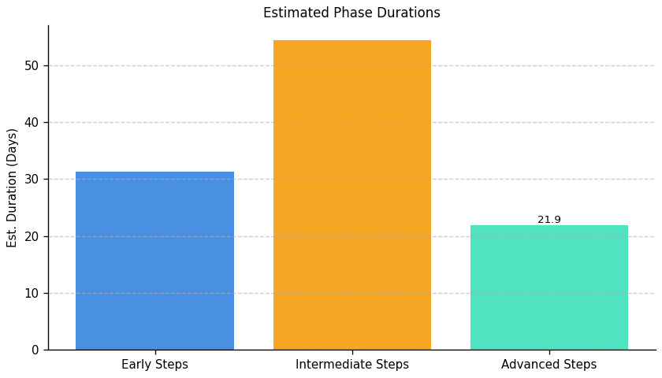
Green With Software: Roadmap Phase Durations

Slide 13
Fragment: Green With Software

Slide 14
Green With Software: Top 3 Insights
The organization demonstrates a critical lack of foundational IT operational maturity, with no implemented policies or strategies for core areas including data management, disaster recovery, and infrastructure governance. This absence necessitates a comprehensive, proactive overhaul of IT management practices.
Addressing the identified gaps will require a significant investment – estimated at 40-65 hours per implementation step – highlighting the substantial effort needed to establish even basic IT hygiene and achieve a minimally acceptable level of operational resilience. This represents a considerable resource commitment.
A key impediment to improvement is a demonstrable skills and/or resource gap in specialized IT roles such as Data Engineers, Architects, and IT Specialists. Filling these roles, or providing targeted training, is essential to successfully implement necessary policies and procedures.

Slide 15
Green With Software: Roadmap Overview
Summary: This organization faces critical risks due to gaps in IT operational processes, including data movement, disaster recovery, and architectural governance. Implementing a robust, documented, and tested framework for these areas is essential for business continuity, compliance, and minimizing potential disruptions. This roadmap outlines a phased approach to address these deficiencies and establish a resilient IT environment.
Total Est: 803 hrs (~100.4 days)
Key Roles: Data Engineers, Solution Architects, Documentation Specialist, Communication Coordinator, Infrastructure Specialist, Audit Team, Strategy Development Team, Data Architect, Networking Specialist, Infrastructure Team, Testing Team, System Owners, Protocol Designer, IT Operations, IT Security Specialist, Backup Strategist, DR Specialists, BC Specialists, Business Analysts, Enterprise Architects, DR/BC Specialists, IT Administrators, Testing Coordinator, Review Team, DR Administrators, IT Specialists

Slide 16
Green With Software: Implementation Plan Details
Overall Goal: Fragment C Implementation Plan
Description:
This roadmap addresses critical gaps in IT operational processes through a phased approach. The Early Steps focus on assessing the current state and identifying deficiencies in data movement, infrastructure, and disaster recovery. Intermediate Steps involve aligning processes with architecture, developing decommissioning and disaster recovery strategies, and designing standardized protocols. Finally, Advanced Steps concentrate on implementing these protocols, conducting thorough testing, establishing ongoing governance, and proposing architecture updates to ensure continuous improvement and resilience.
Methodology / Steps:
--- Early Steps ---
1. Analyze existing data movement processes to identify gaps and inefficiencies. 2. Conduct a comprehensive audit to identify outdated or underutilized infrastructure components. 3. Analyze data movement requirements between infrastructure elements. 4. Assess criticality of different data sets to define backup and archive priorities. 5. Document current Disaster Recovery (DR) and Business Continuity (BC) protocols. 6. Develop a test plan outlining scenarios for backup and recovery testing. 7. Define a periodic schedule for architecture boundary reviews.
--- Intermediate Steps ---
8. Align data movement processes within defined architecture boundaries. 9. Develop a strategy outlining the criteria, process, and timeline for decommissioning identified components. 10. Standardize protocols for efficient data movement across different infrastructure elements. 11. Design a comprehensive strategy for backups and archives based on criticality. 12. Identify areas of improvement in existing DR and BC protocols. 13. Evaluate and select a disaster recovery solution aligned with policy requirements. 14. Assess evolving business needs and their alignment with existing architecture.
--- Advanced Steps ---
15. Document the aligned processes and communicate changes to relevant teams. 16. Establish a routine for reviewing and updating the decommissioning strategy. 17. Implement standardized protocols and conduct thorough testing. 18. Document the strategy and conduct testing to ensure effectiveness. 19. Update DR and BC protocols based on identified improvements. 20. Implement the selected DR solution and conduct testing. 21. Propose updates to architecture boundaries based on the assessment.
Roles Involved (Overall): Data Engineers, Solution Architects, Documentation Specialist, Communication Coordinator, Infrastructure Specialist, Audit Team, Strategy Development Team, Data Architect, Networking Specialist, Infrastructure Team, Testing Team, System Owners, Protocol Designer, IT Operations, IT Security Specialist, Backup Strategist, DR Specialists, BC Specialists, Business Analysts, Enterprise Architects, DR/BC Specialists, IT Administrators, Testing Coordinator, Review Team, DR Administrators, IT Specialists
Tools/Platforms (Overall): Amanda, Bacula, Rubrik, Zerto, Commvault, Veeam Backup & Replication
Subtask Estimates (Aggregated):
--- Early Steps ---
Analysis Collaboration: 18h; Gap Identification: 28h; Collaboration and Planning: 35h; Infrastructure Audit: 30h; Requirement Analysis: 25h; Criticality Assessment: 25h; Documentation Review: 20h; Test Plan Development: 20h; Schedule Definition: 15h; Collaboration with Architecture Teams: 25h
--- Intermediate Steps ---
Collaboration with Architecture: 22h; Process Updates: 20h; Team Collaboration: 18h; Document Development: 25h; Research and Standardization: 20h; Protocol Implementation: 28h; Strategy Design: 30h; Alignment with Business Needs: 20h; Thorough Analysis: 30h; Best Practices Review: 25h; Research: 25h; Alignment with Policy Requirements: 20h; Interviews and Data Collection: 30h; Alignment Analysis: 20h
--- Advanced Steps ---
Documentation: 43h; Communication Sessions: 15h; Periodic Reviews: 22h; Strategy Updates: 20h; Implementation: 30h; Testing and Performance Monitoring: 57h; Collaboration with Specialists: 20h; Update Implementation: 25h; Configuration: 30h; Failure Simulation Testing: 25h; Collaboration with Architecture Teams: 25h; Update Proposal: 25h

Slide 17
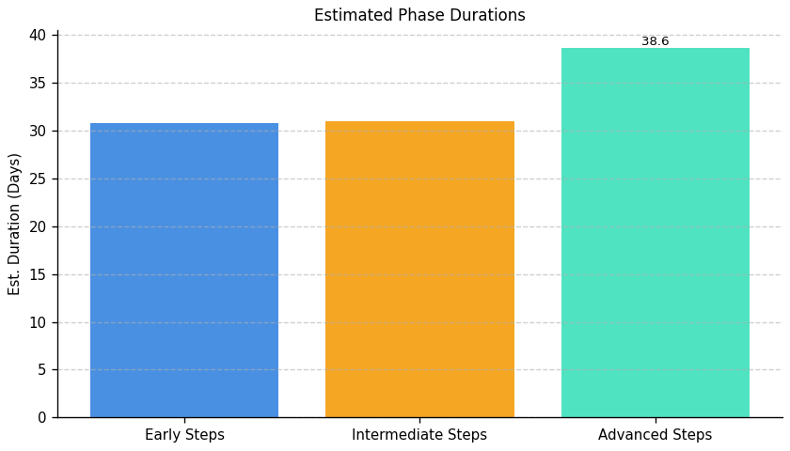
Green With Software: Roadmap Phase Durations

Slide 18
Fragment: Green With Software

Slide 19
Green With Software: Top 3 Insights
The organization fundamentally lacks the ability to measure the impact of its Green IT efforts, consistently failing to quantify benefits like energy savings or carbon reduction. This absence of data prevents informed decision-making, ROI demonstration, and effective progress tracking towards sustainability objectives.
Green IT implementation is in a nascent stage, with no established processes or tools for core areas like environmental management, virtualization sustainability, or relevant skills development. This indicates a complete absence of a structured approach to integrating sustainability into IT operations.
A wide array of interconnected obstacles – encompassing financial constraints, lack of expertise, organizational resistance, and insufficient executive support – are hindering Green IT adoption. Addressing these challenges requires a holistic, strategic plan that tackles both technical implementation and cultural shifts within the organization.

Slide 20
Green With Software: Roadmap Overview
Summary: This organization requires a comprehensive approach to integrate Green IT practices. The roadmap addresses a current lack of environmental impact assessment, process optimization, and skills development, aiming to build a sustainable IT infrastructure and foster a culture of environmental responsibility. Successful implementation will require cross-functional collaboration and investment in appropriate tools and training.
Total Est: 370 hrs (~46.2 days)
Key Roles: Environmental Experts, Infrastructure Managers, IT Specialists, Sustainability Analysts, Tool Administrators, Training Coordinators, Process Design Expert, Training Analysts, Department Heads, Training Facilitators, Program Designers, HR Specialists, Assessment Administrators, Communication Specialists, Sustainability Strategists, HR Analysts, Documentation Specialist

Slide 21
Green With Software: Implementation Plan Details
Overall Goal: Green With Software Implementation Plan
Description:
This roadmap guides the organization through a phased approach to implementing Green IT practices. The initial phase focuses on assessing the current environmental impact of IT operations and planning for sustainability tools. The intermediate phase involves designing optimized processes and implementing selected tools with associated training. Finally, the advanced phase concentrates on developing employee skills and establishing incentive programs to cultivate a sustainable workforce and embed environmental responsibility into the organizational culture.
Methodology / Steps:
--- Early Steps ---
1. Assess the current environmental impact of infrastructure and processes through collaboration with environmental experts and impact assessment tools. 2. Evaluate existing and potential tools for managing sustainability, researching available options and collaborating with IT teams. 3. Conduct a detailed environmental impact assessment in the current environment, collaborating with environmental specialists.
--- Intermediate Steps ---
4. Design processes to optimize resource usage based on assessment results, collaborating with process design experts and aligning with environmental goals. 5. Implement selected tools and provide training to relevant teams, configuring tools and conducting training sessions. 6. Document the established processes and conduct training for relevant teams, using documentation tools and organizing training sessions.
--- Advanced Steps ---
7. Identify specific sustainability-focused skills that need development, conducting skill gap analysis and collaborating with department heads. 8. Design training programs for sustainability-focused skills development, collaborating with trainers and defining program content. 9. Define a structured incentive plan for carbon-literate resources, collaborating with HR and designing incentive programs.
Roles Involved (Overall): Environmental Experts, Infrastructure Managers, IT Specialists, Sustainability Analysts, Tool Administrators, Training Coordinators, Process Design Expert, Training Analysts, Department Heads, Training Facilitators, Program Designers, HR Specialists, Sustainability Strategists, HR Analysts, Documentation Specialist
Tools/Platforms (Overall): Impact assessment tools, Documentation tools
Subtask Estimates (Aggregated):
--- Early Steps ---
Environmental Assessment - 30h; Collaboration with Experts - 20h; Tool Research - 25h; Collaboration with IT Teams - 15h; Collaboration and Planning - 20h; Impact Assessment - 30h
--- Intermediate Steps ---
Process Design - 25h; Alignment with Goals - 18h; Tool Implementation - 40h; Training Sessions - 40h; Documentation - 22h
--- Advanced Steps ---
Skill Gap Analysis - 20h; Collaboration with Department Heads - 15h; Program Design - 30h; Collaboration with Trainers - 20h; Incentive Structure Definition - 25h; Collaboration with HR - 15h

Slide 22
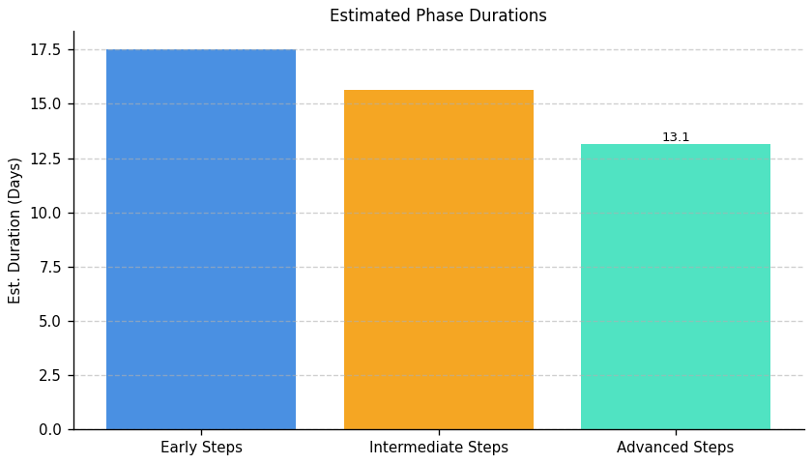
Green With Software: Roadmap Phase Durations

Slide 23
Fragment: Green With Software

Slide 24
Green With Software: Top 3 Insights
The organization currently lacks any established process for measuring IT-related carbon emissions, preventing baseline creation, target setting, and progress tracking. This data gap is a fundamental barrier to reducing environmental impact.
There is a significant disconnect between awareness of IT carbon reduction strategies – such as server cooling optimization – and their practical implementation within the organization. Resources are acknowledged, but not acted upon, indicating an execution challenge.
The organization demonstrates a low level of prioritization regarding the environmental impact of its IT infrastructure, evidenced by a lack of implemented reduction initiatives and a need for foundational education on the importance of IT carbon management.

Slide 25
Green With Software: Roadmap Overview
Summary: This roadmap addresses the need to reduce the carbon footprint of IT operations, focusing on server infrastructure and cooling systems. It outlines a phased approach, starting with assessment and strategy development, progressing to implementation and optimization, and culminating in ongoing monitoring and governance to ensure sustained improvements in energy efficiency and environmental impact.
Total Est: 300 hrs (~37.5 days)
Key Roles: IT Administrators, Environmental Experts, Energy Experts, Data Center Managers, Cooling System Technicians

Slide 26
Green With Software: Implementation Plan Details
Overall Goal: Green With Software Implementation Plan
Description:
This roadmap guides the organization through a comprehensive process of reducing the carbon footprint of its IT infrastructure. The initial phase focuses on establishing a baseline understanding of current energy consumption and carbon emissions. The intermediate phase involves developing and implementing strategies for optimization, including cooling system upgrades and energy-efficient practices. Finally, the advanced phase emphasizes continuous monitoring, refinement of strategies, and the establishment of a governance framework to ensure long-term sustainability and carbon reduction.
Methodology / Steps:
--- Early Steps ---
1. Assess the current carbon footprint associated with server operations, collaborating with environmental experts and analyzing energy consumption. 2. Conduct an audit to assess the energy efficiency of server data centers, collaborating with energy experts and analyzing cooling systems.
--- Intermediate Steps ---
3. Develop a strategy to minimize the carbon footprint in server operations, implementing energy-efficient practices and utilizing renewable energy. 4. Implement cooling optimization practices based on the audit findings, upgrading cooling systems and monitoring temperature controls.
--- Advanced Steps ---
5. Continuously monitor carbon intensity metrics. 6. Refine energy-efficient practices based on performance data. 7. Establish a governance framework for ongoing carbon reduction initiatives.
Roles Involved (Overall): IT Administrators, Environmental Experts, Energy Experts, Data Center Managers, Cooling System Technicians
Tools/Platforms (Overall): GreenIT Software, AWS IoT Greengrass, The Green Grid, OpenDCRE, Schneider Electric EcoStruxure
Subtask Estimates (Aggregated):
--- Early Steps ---
Carbon Footprint Assessment - 30h; Collaboration with Environmental Experts - 20h; Energy Efficiency Audit - 30h; Collaboration with Energy Experts - 20h
--- Intermediate Steps ---
Strategy Development - 35h; Implementation of Practices - 15h; Cooling System Upgrade - 35h; Temperature Control Monitoring - 15h
--- Advanced Steps ---
Monitoring & Analysis - 30h; Strategy Refinement - 30h; Governance Framework - 40h

Slide 27
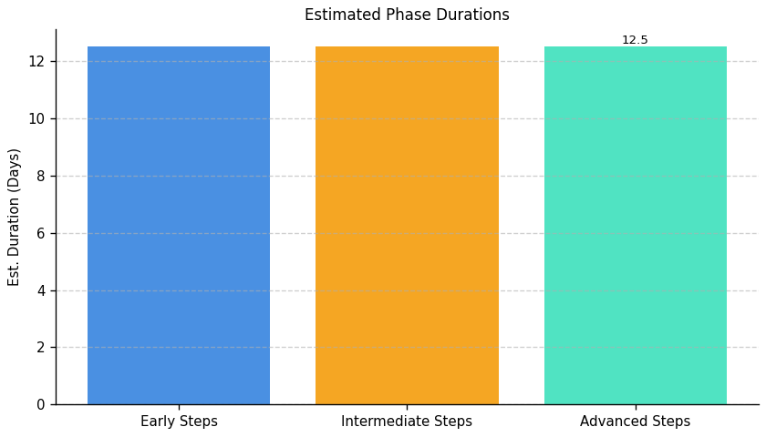
Green With Software: Roadmap Phase Durations

Slide 28
Fragment: Green With Software

Slide 29
Green With Software: Top 3 Insights
The organization lacks a defined, company-wide process for managing IT equipment from purchase through retirement, resulting in inefficiencies and potential financial losses.
A formal electronic waste (e-waste) policy is absent, creating compliance risks and preventing the recovery of valuable materials through responsible recycling or repurposing.
Sustainability is not systematically integrated into IT asset management practices; improvements are needed across procurement, maintenance, and end-of-life handling to reduce environmental impact and improve resource utilization.

Slide 30
Green With Software: Roadmap Overview
Summary: This roadmap addresses the organization's lack of formal IT e-waste policies and lifecycle management. It outlines a phased approach to establish responsible disposal practices, integrate sustainability into procurement, and continuously improve environmental performance within IT operations.
Total Est: 76 hrs (~9.5 days)
Key Roles: IT Procurement, IT Operations, Sustainability Officer

Slide 31
Green With Software: Implementation Plan Details
Overall Goal: Fragment F Implementation Plan: Green With Software
Description:
This roadmap guides the implementation of sustainable IT practices, beginning with establishing a foundational e-waste disposal policy and initial assessment of current IT asset flows. The intermediate phase focuses on implementing the policy, defining a structured equipment lifecycle process, and integrating sustainability into procurement decisions. Finally, the advanced phase optimizes the lifecycle for material efficiency, implements tracking mechanisms, and establishes a system for continuous improvement of sustainability practices.
Methodology / Steps:
--- Early Steps ---
1. Research best practices for e-waste recycling and responsible disposal. 2. Draft a preliminary electronic waste disposal policy outlining basic requirements. 3. Conduct a comprehensive inventory of current IT equipment (hardware and software). 4. Assess current IT procurement processes to identify sustainability gaps. 5. Communicate initial findings to stakeholders.
--- Intermediate Steps ---
6. Finalize and formally approve the electronic waste disposal policy. 7. Communicate the policy to all relevant personnel. 8. Develop a detailed process for IT equipment disposal, including vendor selection, audit procedures, and data sanitization. 9. Integrate environmental criteria into IT purchasing decisions, considering energy efficiency, recyclability, and total cost of ownership. 10. Establish a process for tracking disposed equipment.
--- Advanced Steps ---
11. Implement tracking mechanisms to monitor e-waste generation and recycling rates. 12. Evaluate the effectiveness of the e-waste disposal process and identify areas for improvement. 13. Explore options for extending the lifespan of IT equipment through maintenance, upgrades, and refurbishment. 14. Regularly review and update the e-waste disposal policy and procurement criteria. 15. Investigate opportunities for cloud-based solutions to reduce hardware footprint. 16. Implement a formal asset management system. 17. Develop and deliver training on sustainable IT practices. 18. Conduct regular audits to ensure compliance. 19. Explore partnerships with certified e-waste recyclers. 20. Report on sustainability metrics to stakeholders.
Roles Involved (Overall): IT Procurement, IT Operations, Sustainability Officer
Tools/Platforms (Overall): Spreadsheet software, Research databases, Policy management software, Vendor management systems, Asset management software, Reporting dashboards
Subtask Estimates (Aggregated):
--- Early Steps ---
Research - 8h; Policy Drafting - 8h; Inventory - 4h; Procurement Assessment - 4h.
--- Intermediate Steps ---
Policy Finalization & Approval - 4h; Communication - 2h; Disposal Process Development - 4h; Procurement Integration - 2h.
--- Advanced Steps ---
Tracking Implementation - 4h; Process Evaluation - 2h; Lifespan Extension Research - 2h; Policy Review - 2h; Cloud Solution Investigation - 8h; Asset Management System Implementation - 10h; Training Development & Delivery - 6h; Audits - 2h.

Slide 32
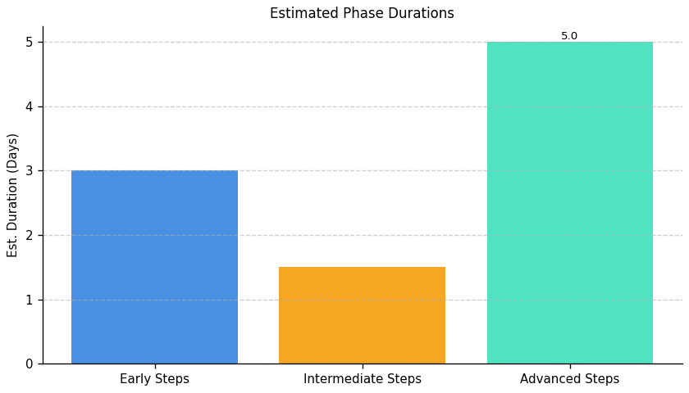
Green With Software: Roadmap Phase Durations

